Slide 1
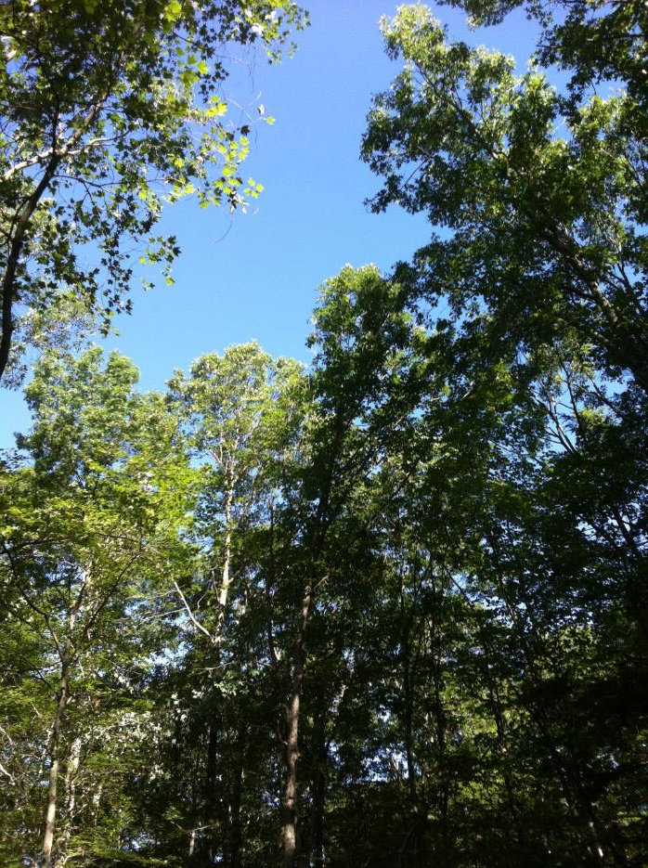
“We all live in the woods.”
Thomas E. Worthley
Associate Extension Professor

Slide 2
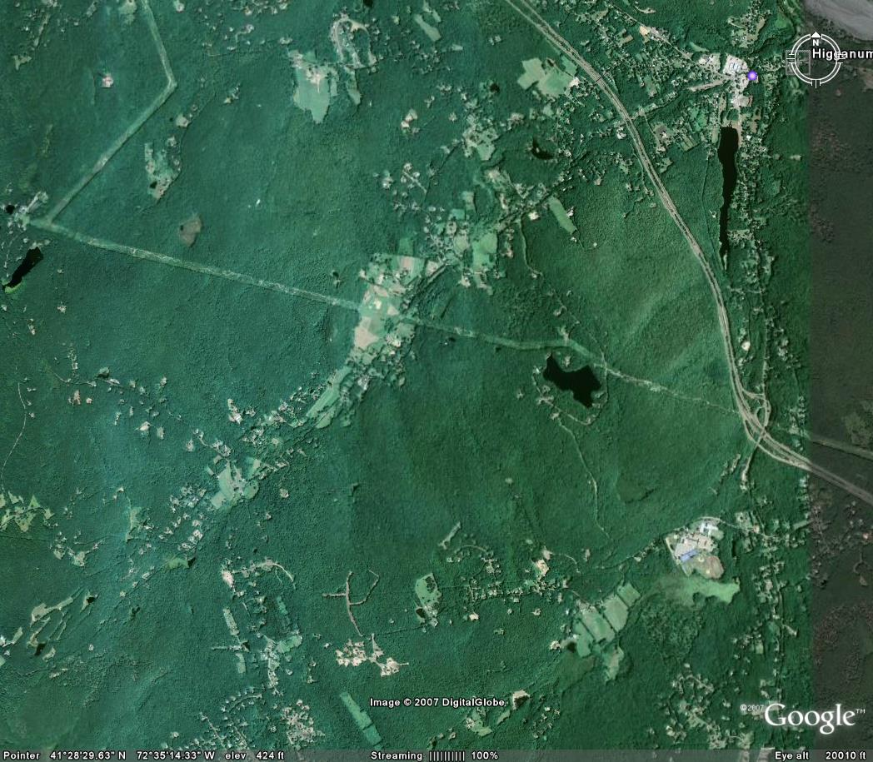
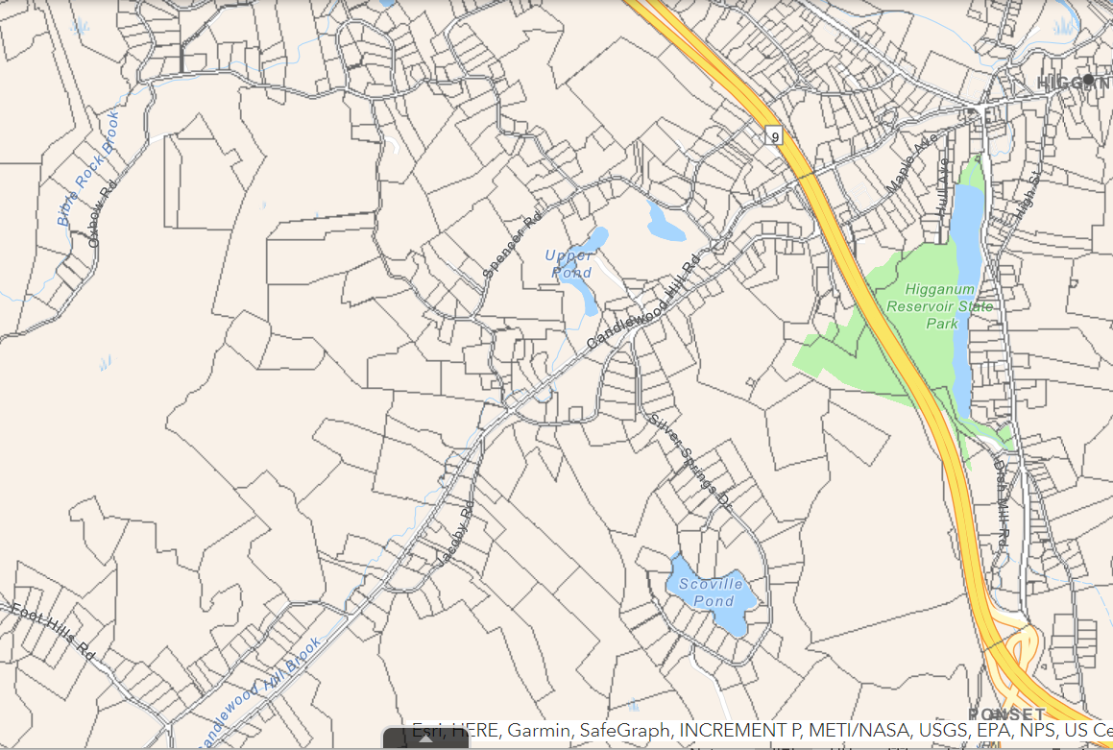
Forest is the natural land cover for our region

Slide 3
75% of the land area of Connecticut is under a tree canopy

Slide 4
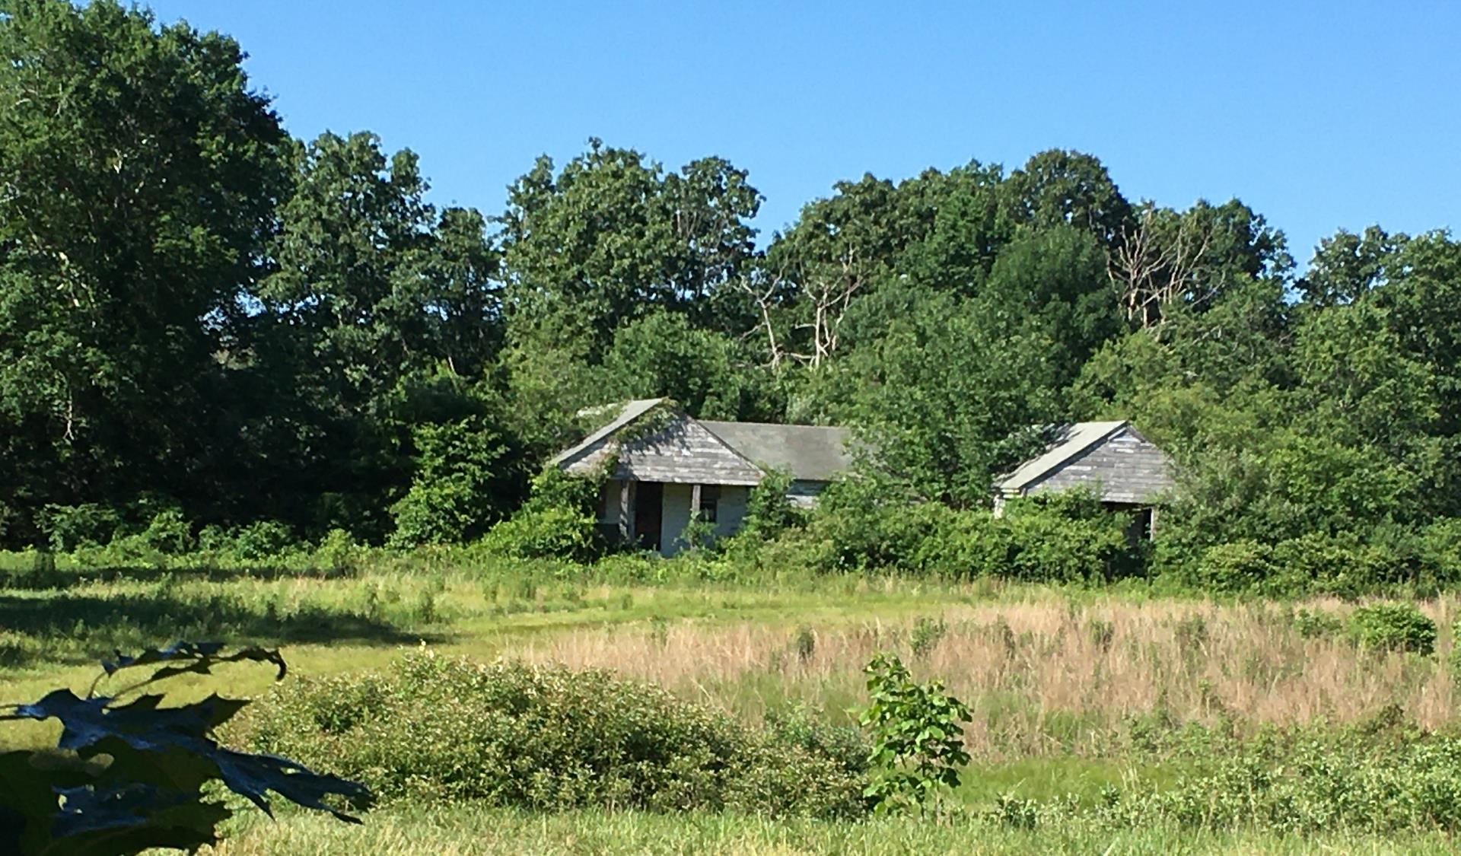
I don’t really worry about the forest. It is patient, resourceful, creative, relentless, powerful, thorough. We can work with that.

Slide 5
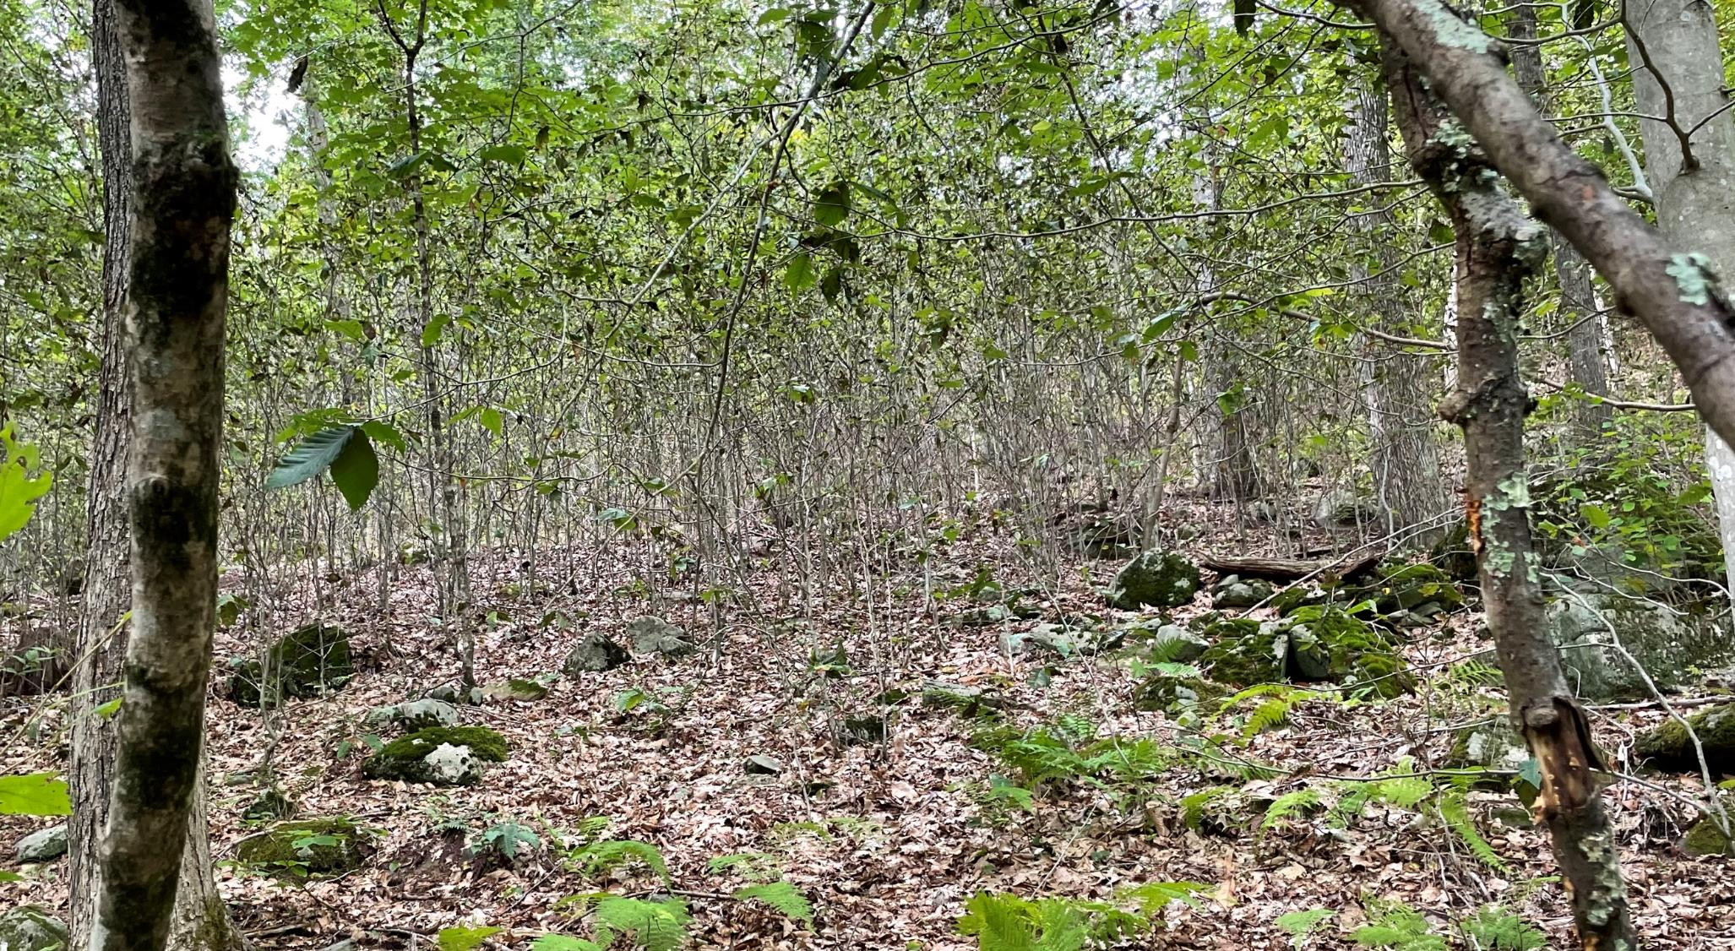

Slide 6
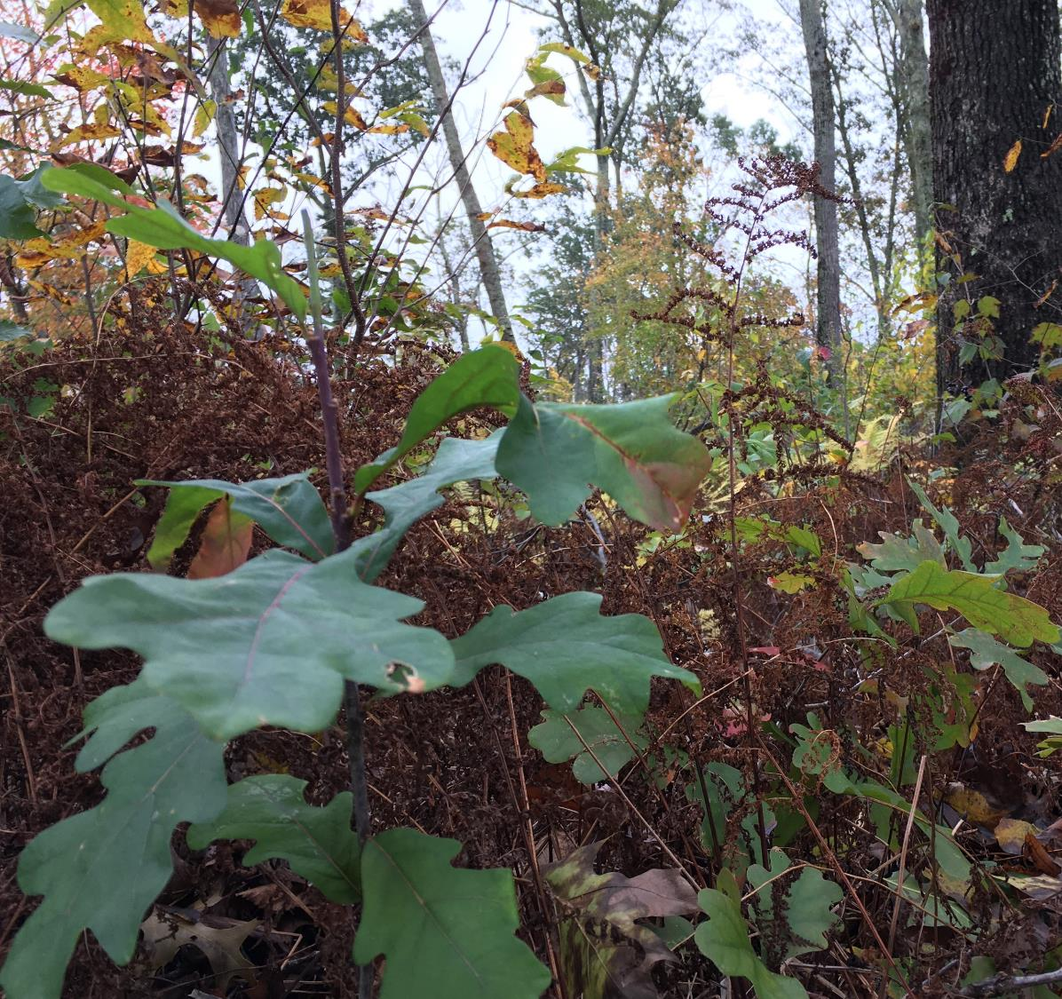
Grow something different?
Focus on growing – envision (and find the words for) the desired conditions 50 years out, 20 years out, 5 years out and what must we do tomorrow?
Communicate from those perspectives.

Slide 7
Everyday Creativity – DeWitt Jones
Key Principles:
A matter of perspective
More than one right answer? Always.
No fear - make mistakes
Learn to break the pattern
See problems as opportunities
Technique and expertise are critical

Slide 8
Everyday Creativity – DeWitt Jones
A matter of perspective

Slide 9
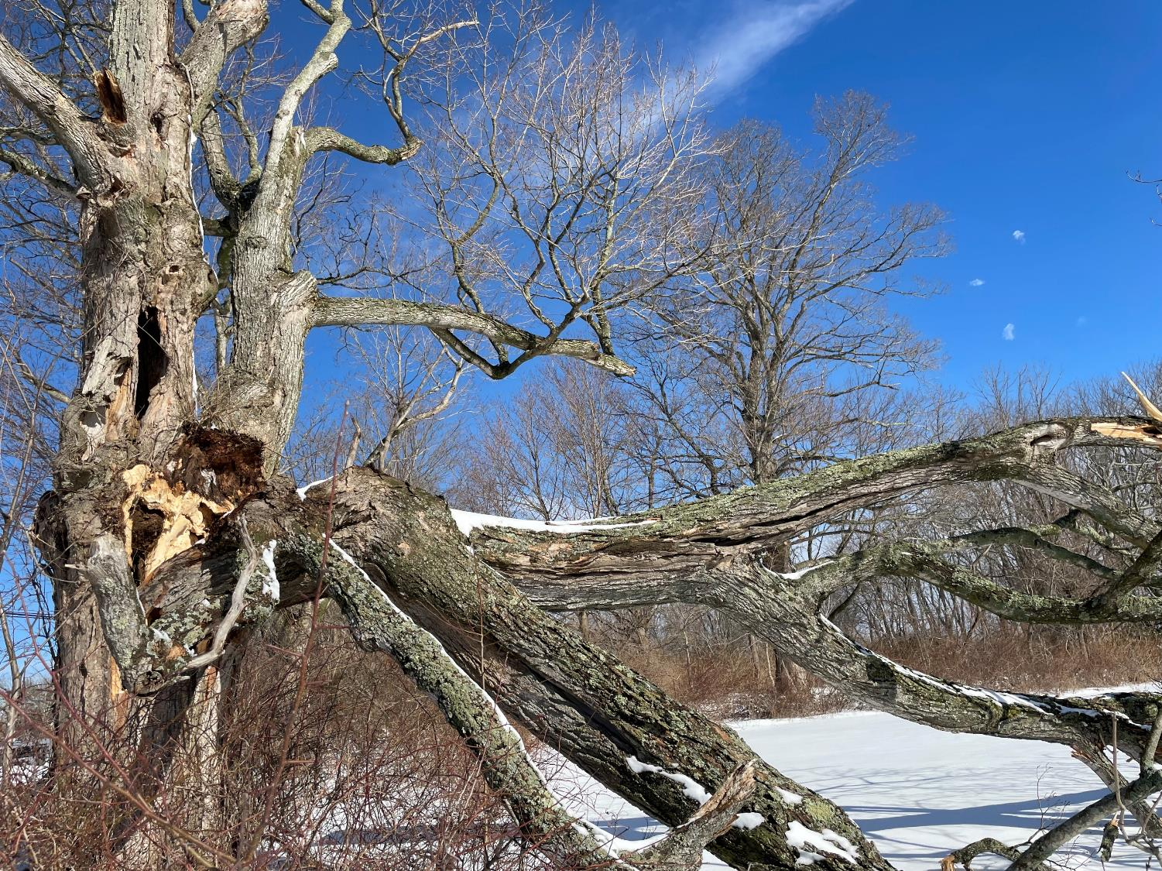
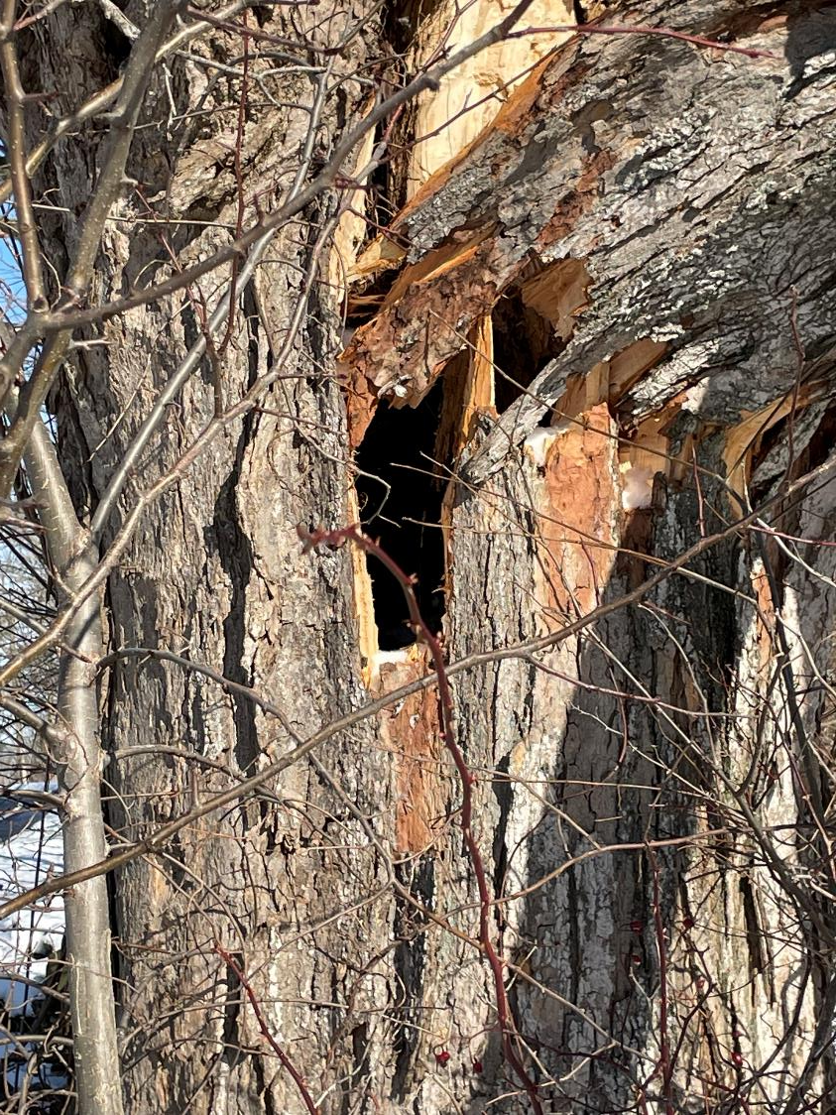

Slide 10
Everyday Creativity – DeWitt Jones
A matter of perspective
More than one right answer? Always.

Slide 12
Everyday Creativity – DeWitt Jones
A matter of perspective
More than one right answer? Always.
No fear - make mistakes
Learn to break the pattern

Slide 13
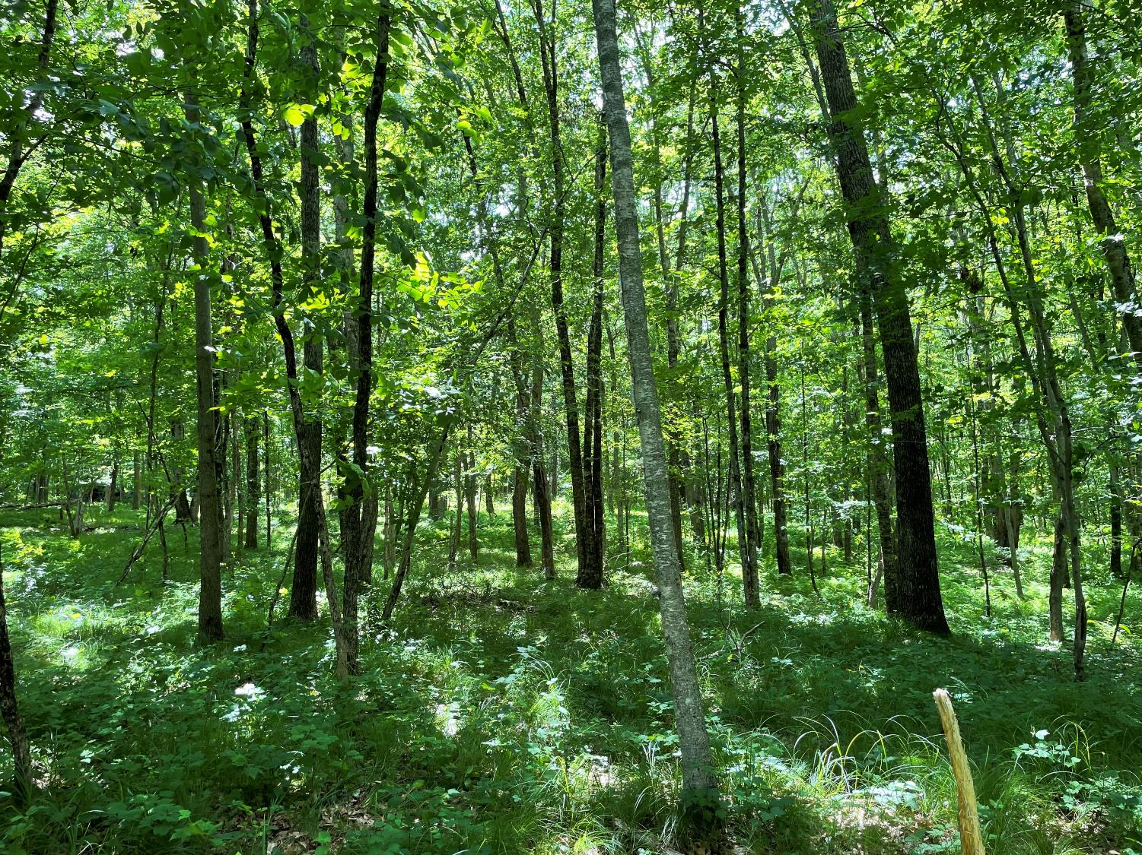
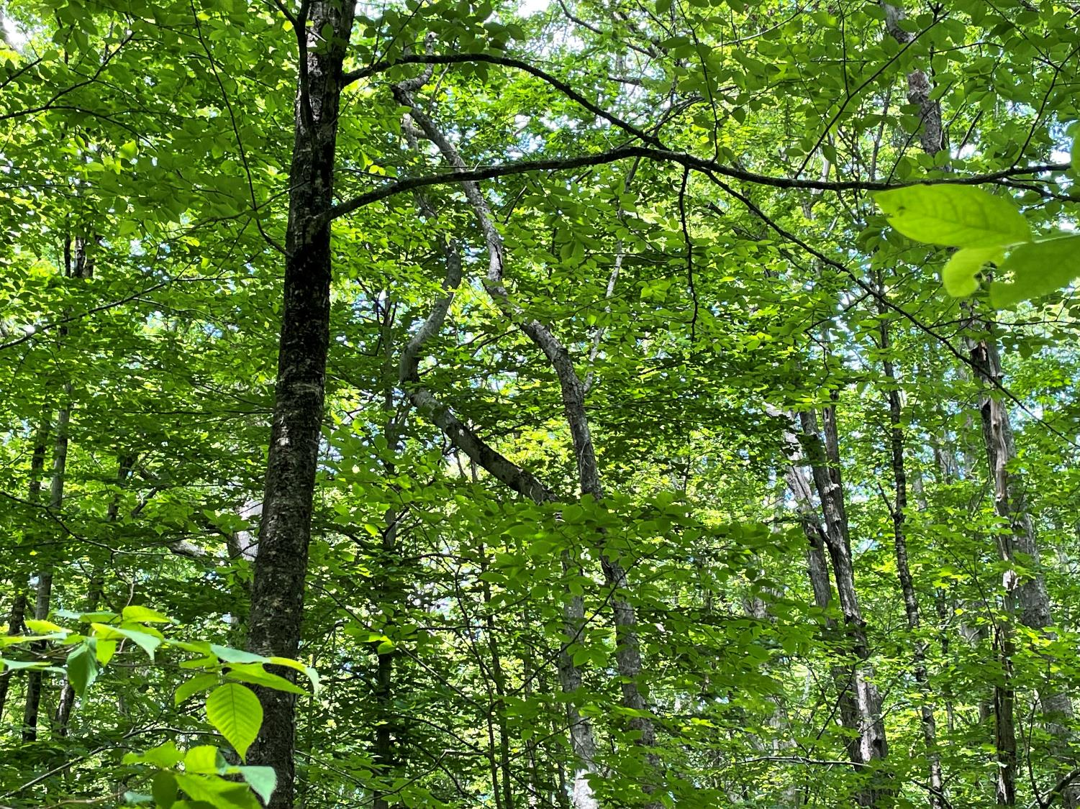
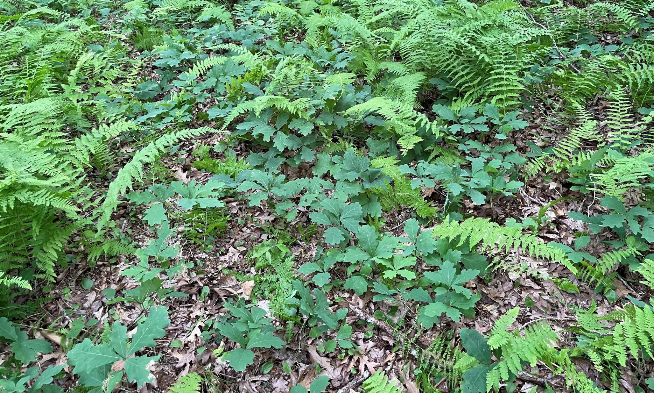

Slide 14
Everyday Creativity – DeWitt Jones
A matter of perspective
More than one right answer? Always.
No fear - make mistakes
Learn to break the pattern
See problems as opportunities

Slide 15
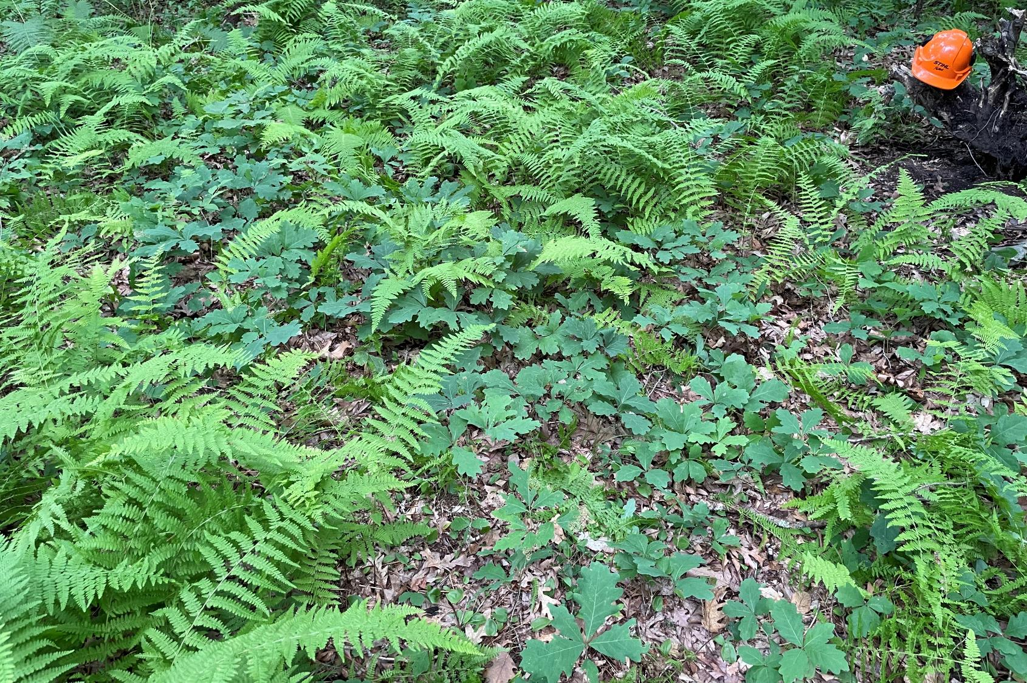

Slide 16
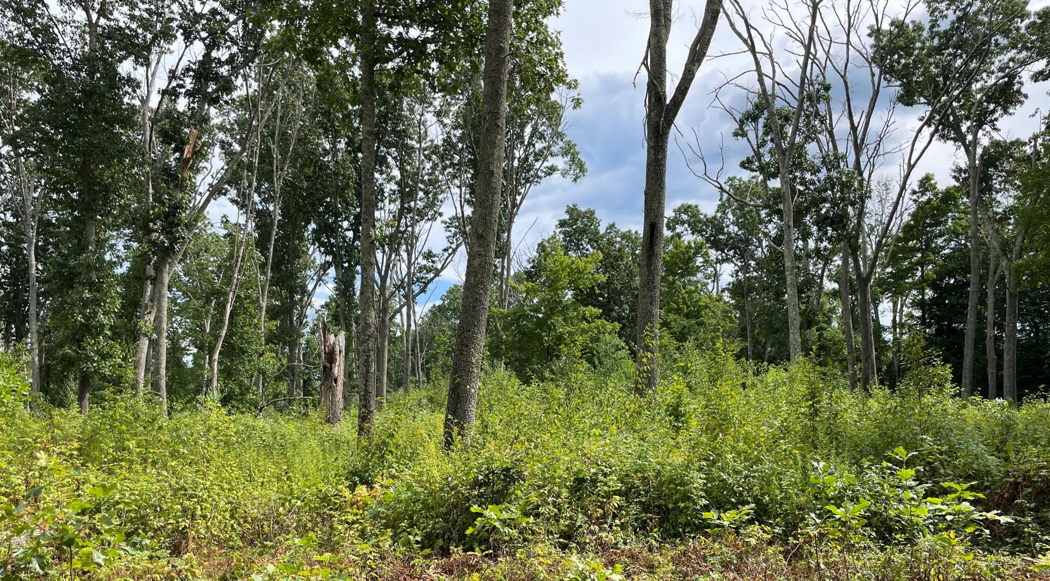

Slide 17
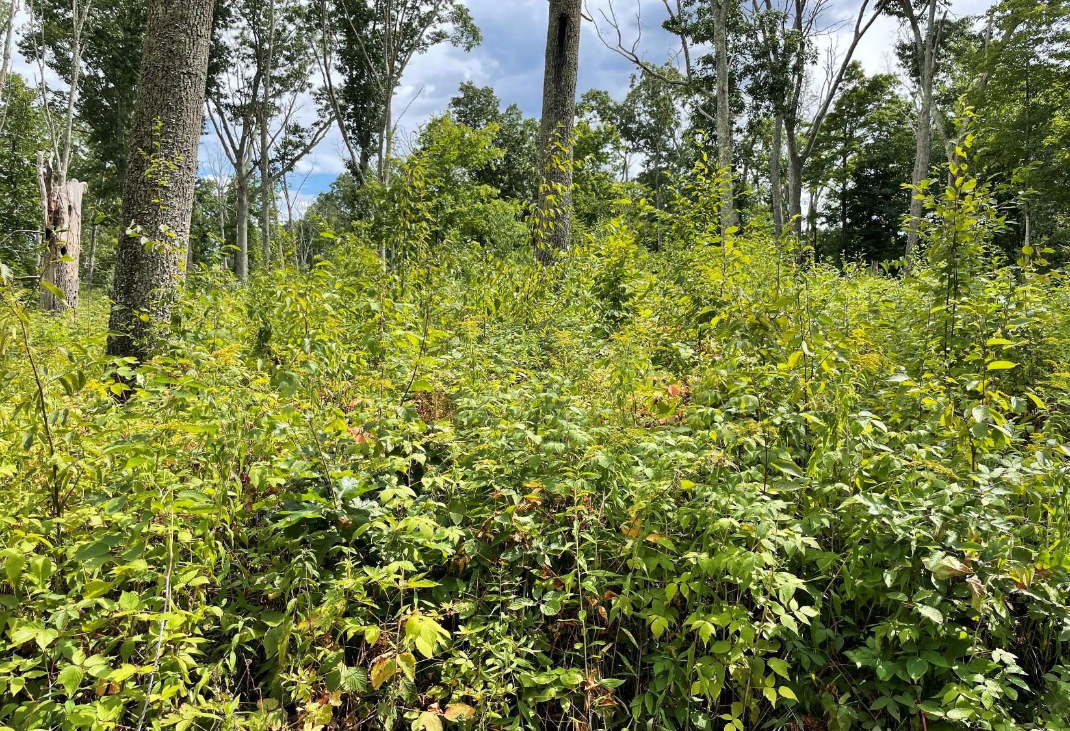
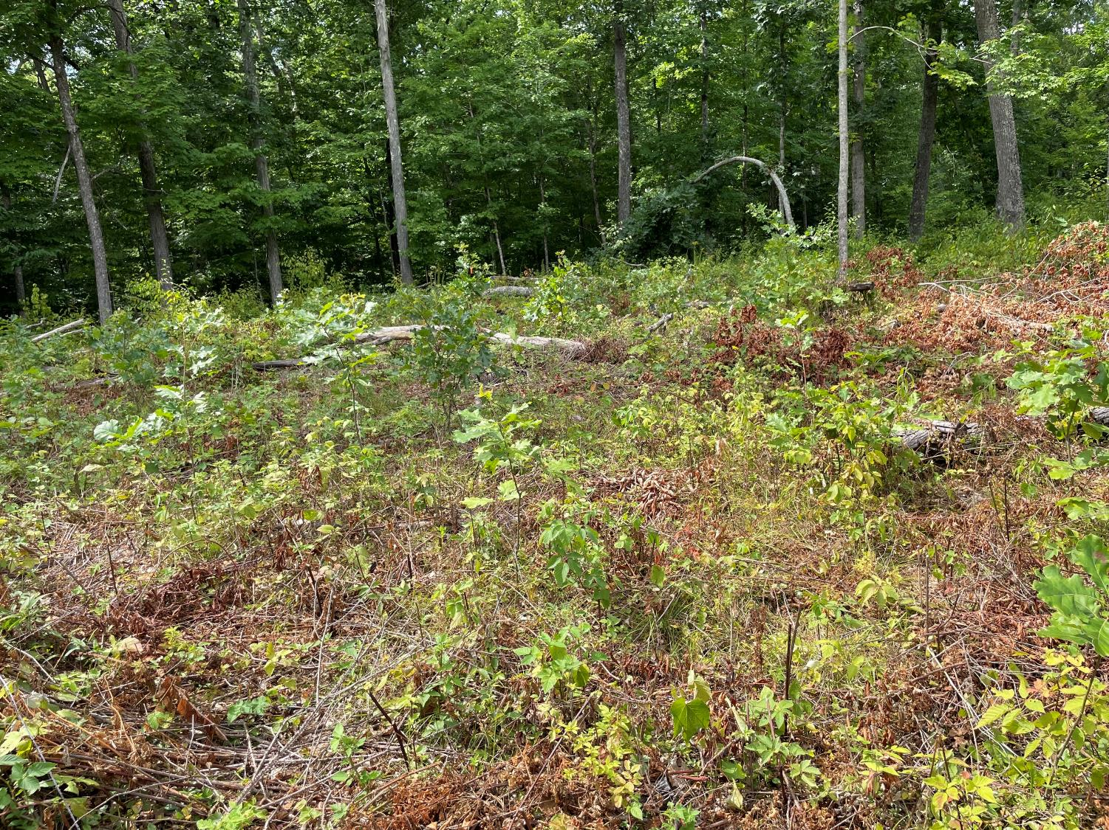

Slide 18
Everyday Creativity – DeWitt Jones
A matter of perspective
More than one right answer? Always.
No fear - make mistakes
Learn to break the pattern
See problems as opportunities
Technique and expertise are critical

Slide 19
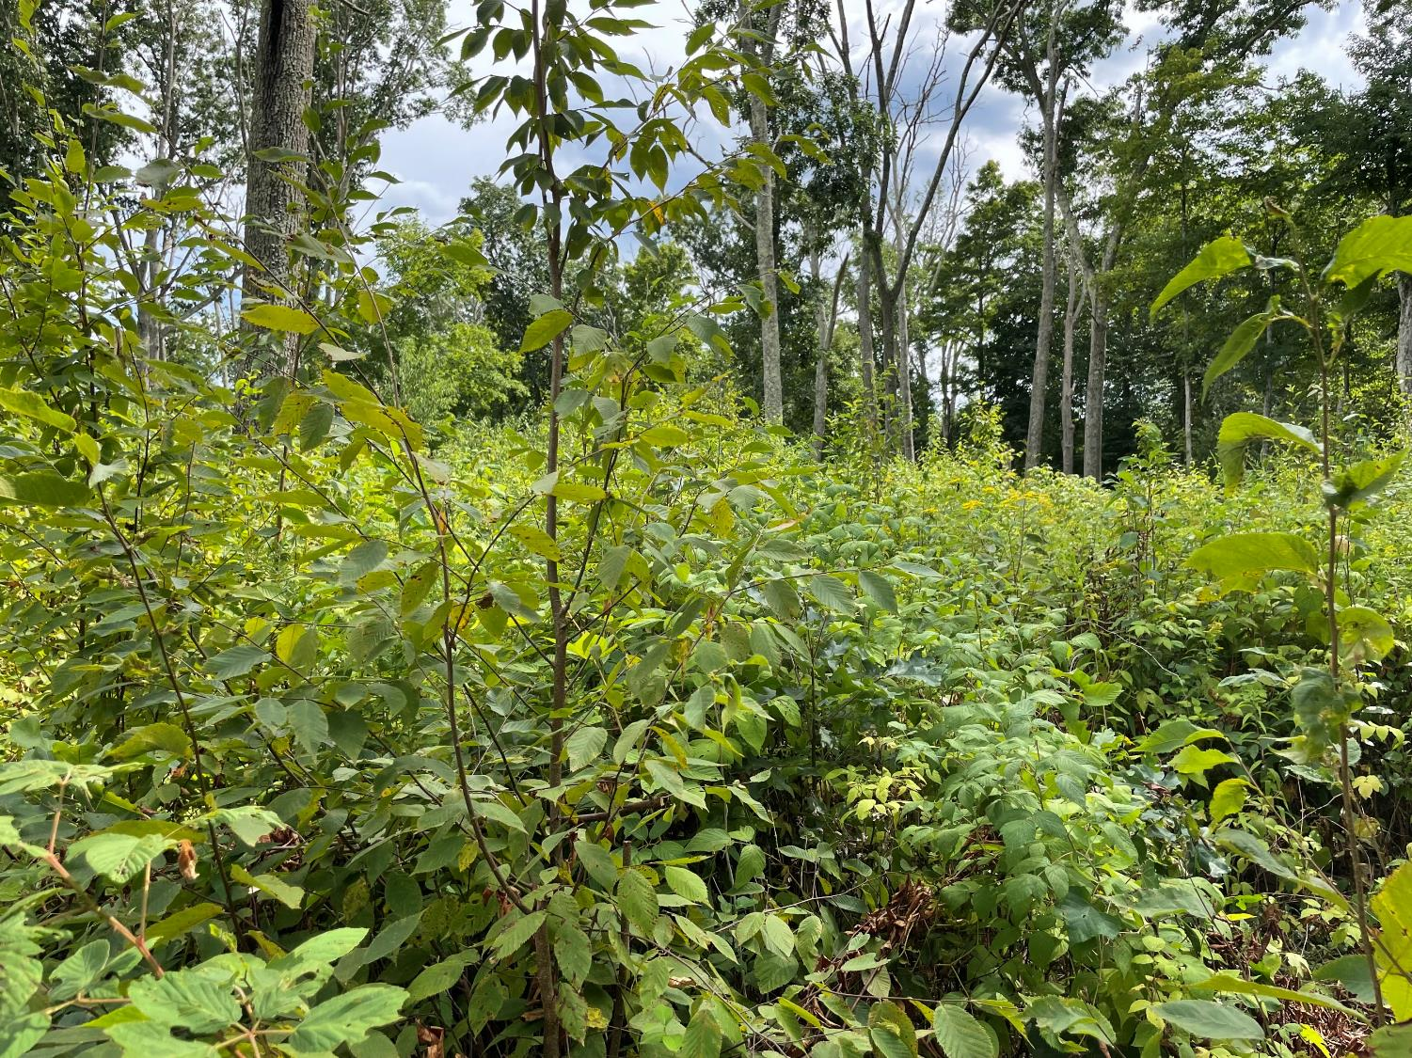
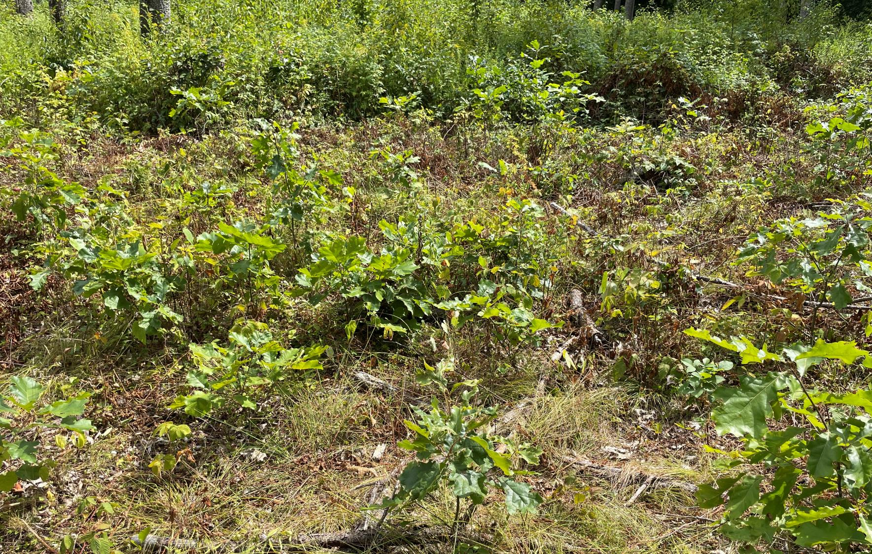

Slide 20
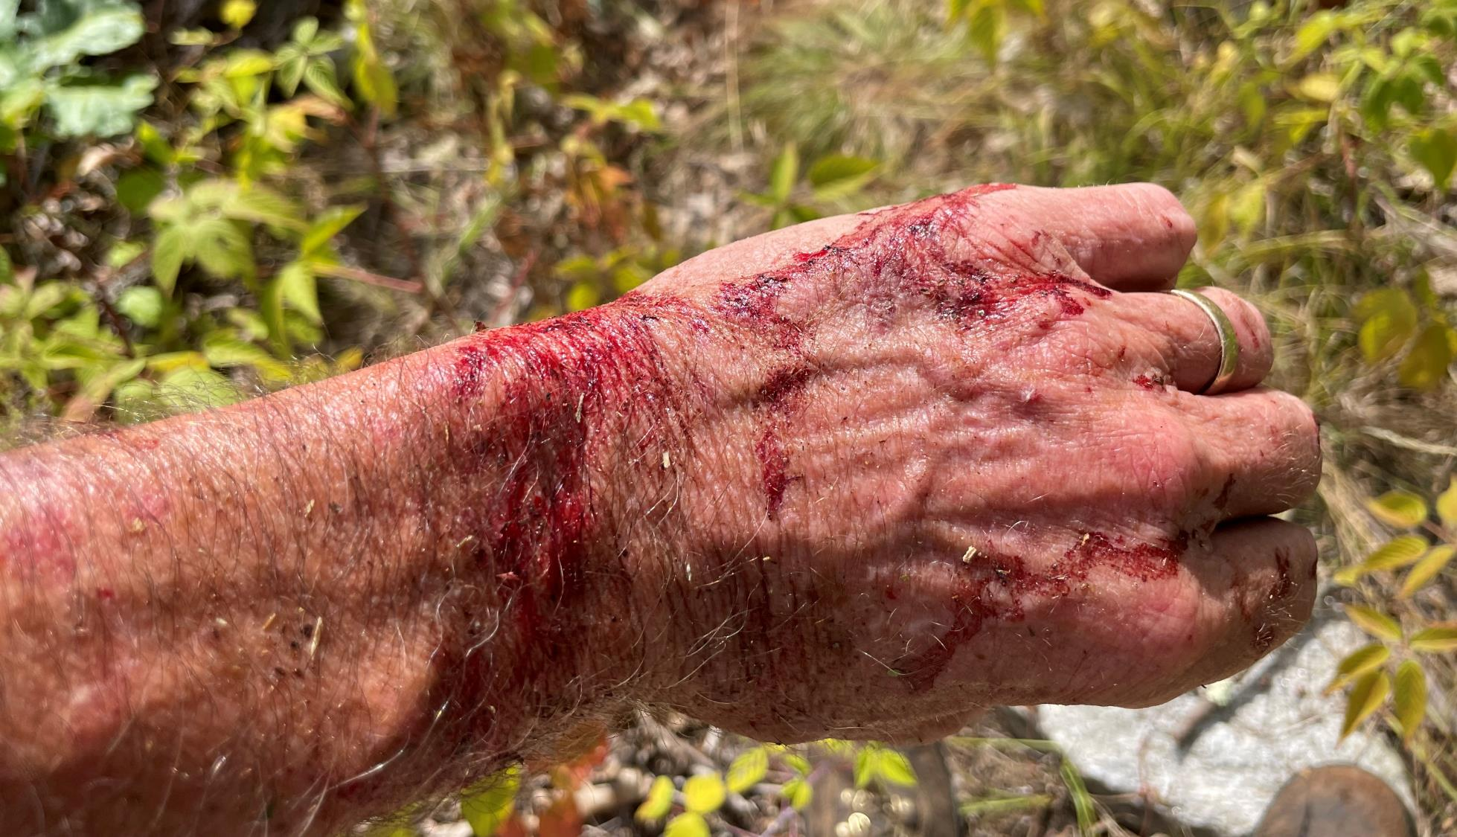
Hard work is necessary. But doing nothing (while a management decision) is perhaps not the best option.

Slide 22
Grow something different? Can we grow a future, a legacy?
Focus on growing – envision (and find the words for) the desired conditions 50 years out, 20 years out, 5 years out and what must we do tomorrow?
Communicate from those perspectives.
Knowledge, investment, commitment, policy, continuity, “the hard work” is imperative.

Slide 23
Thank you

