Slide 1
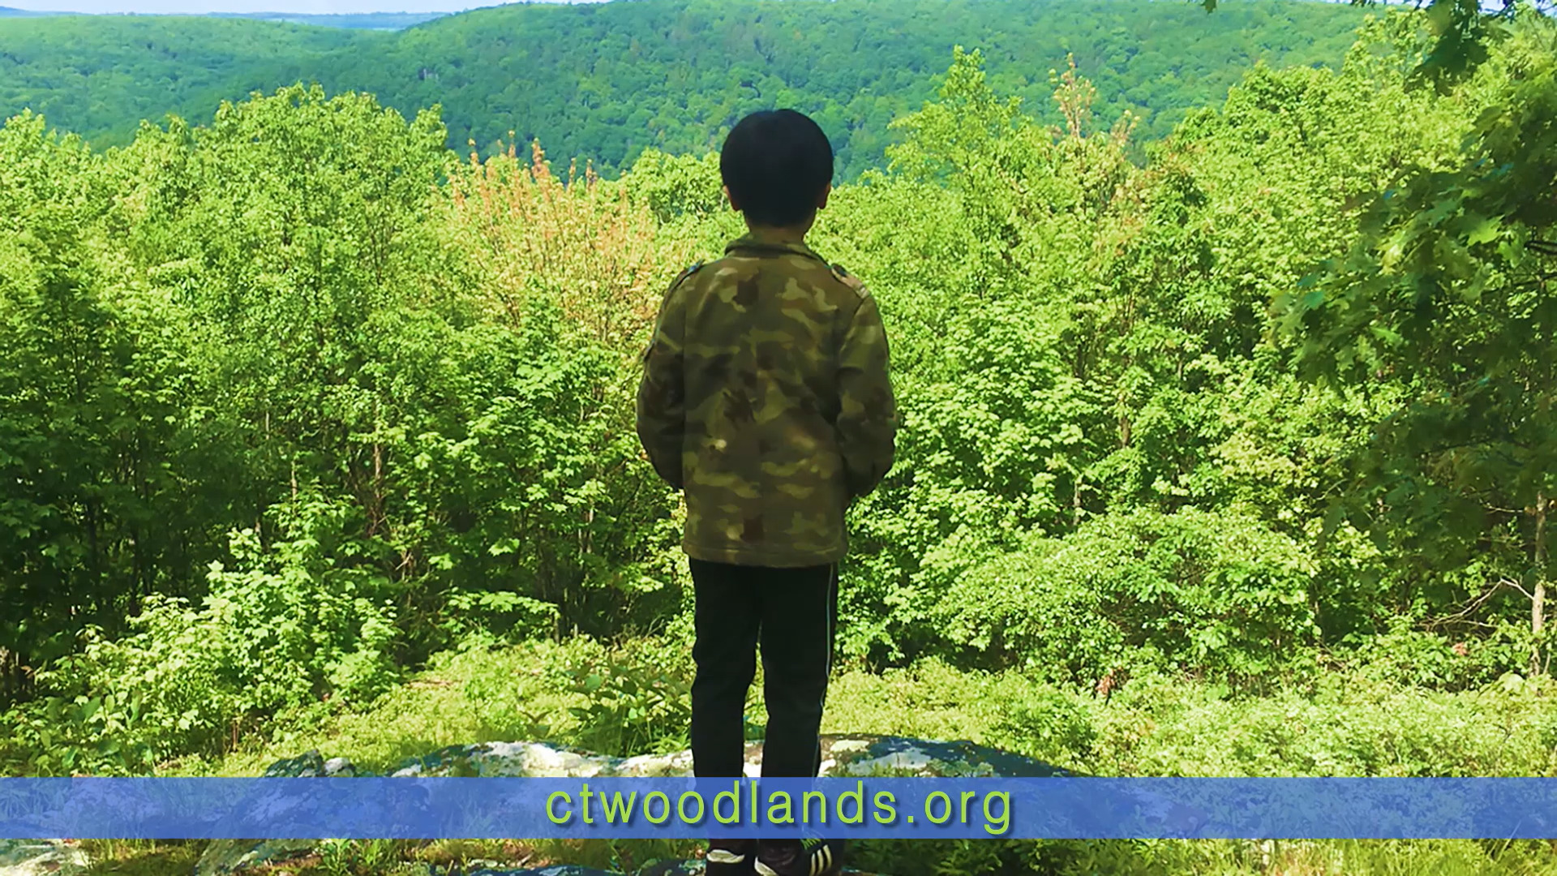
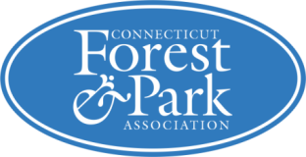
Resilient Forests (and trees) for Connecticut’s Future

Slide 2
agenda
A little bit about CFPA
PRFCT Future Recommendations
2023 Legislation Overview

Slide 3
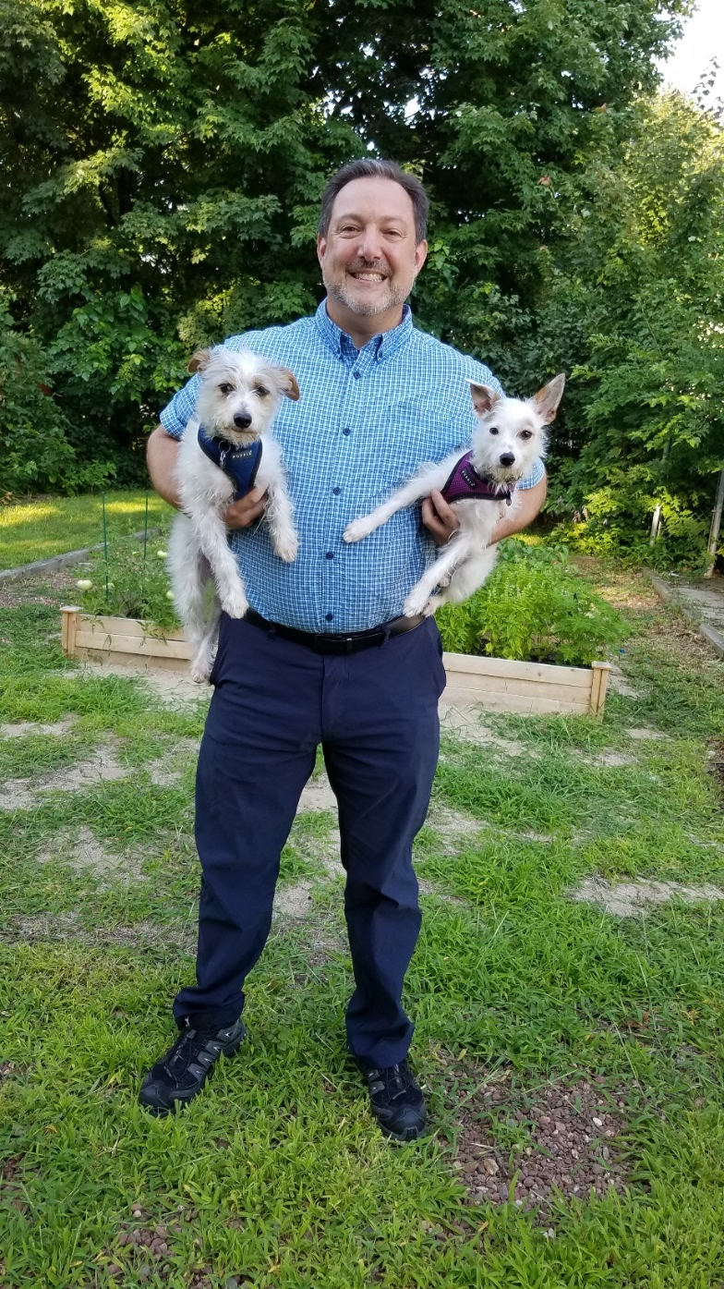
Connecticut Forest & Park Association (CFPA)
CFPA is Connecticut’s first nonprofit conservation organization (128 years old!).
Mission: Connect people to the land to protect forests, parks, and recreational trails for future generations.
CFPA’s Executive Director since 2008 (formerly ED of Farmington River Watershed Association).
www.ctwoodlands.org

Slide 4
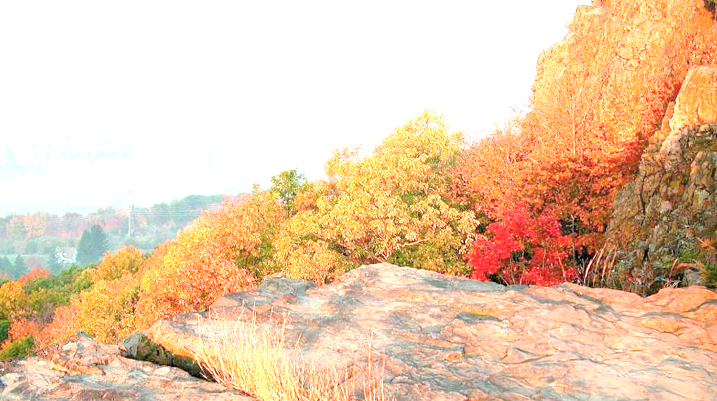
Connect People to the Land
Advocacy
Conservation
Recreation
Education

Slide 5
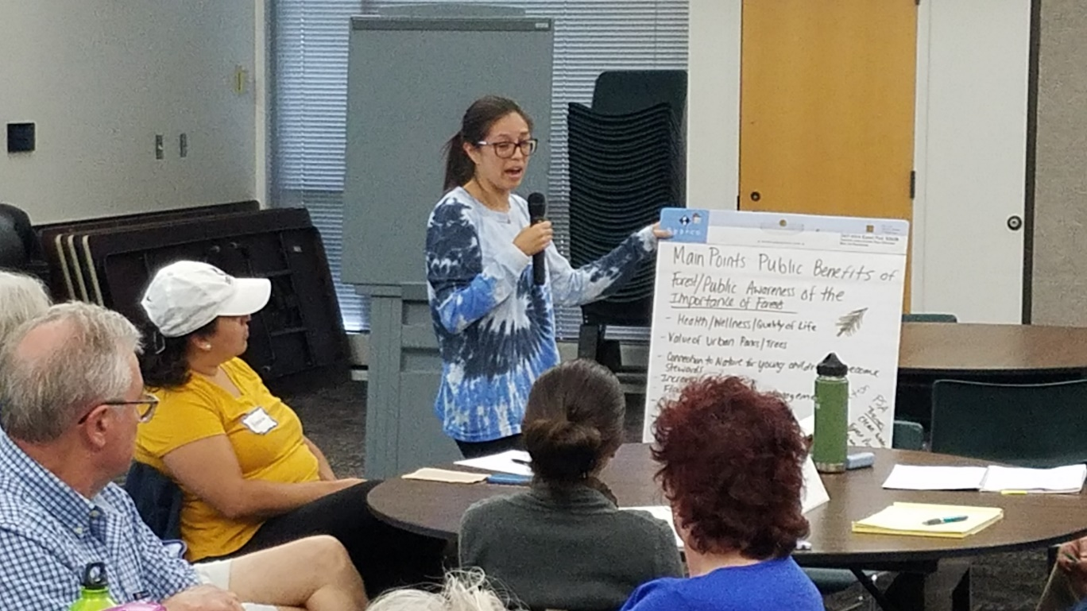
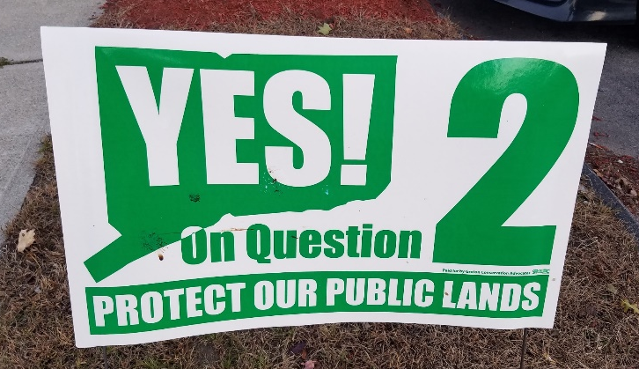
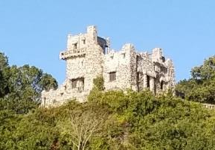
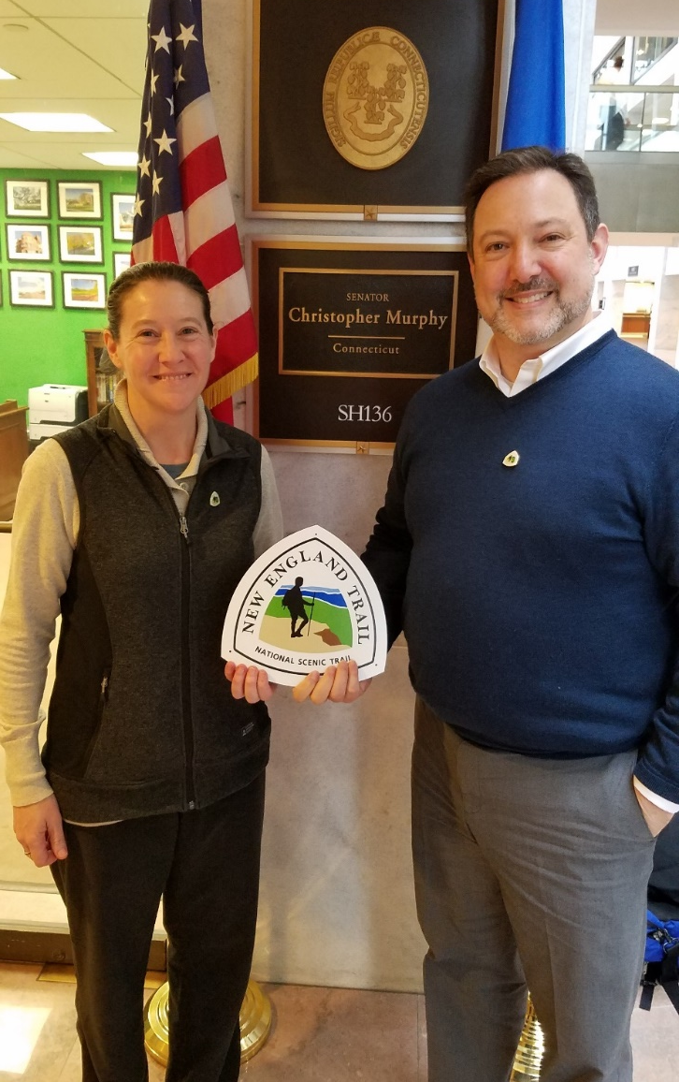
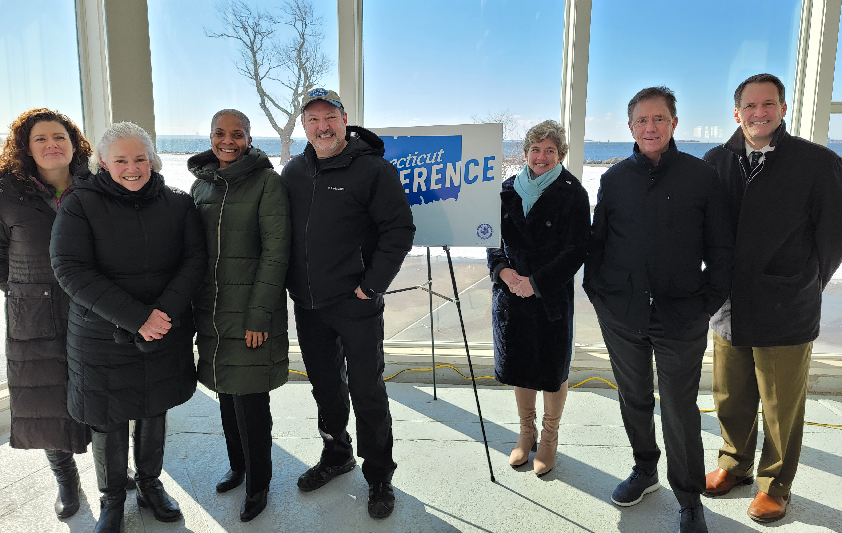
Passport to the Parks
Forest Action Plan
Hike the Hill
Advocacy

Slide 6
Sampling of forest Laws that CFPA has fought for
Municipal Tree Wardens/Shade Tree Commissions (1901)
Public Act 490 (1963)
Recreational Liability Law/Cutting Firewood (1971)
Forest Practices Act (1991)
Public Notice Process for Electric Utilities (2013-14)
Tree Warden Education Requirement (2016)
Constitutional Amendment to Protect Public Lands (2018)
Today – Forest Resiliency/Management/Climate Issues

Slide 7
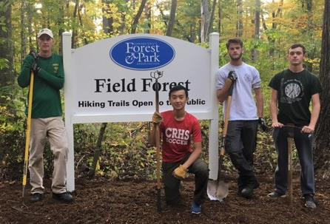
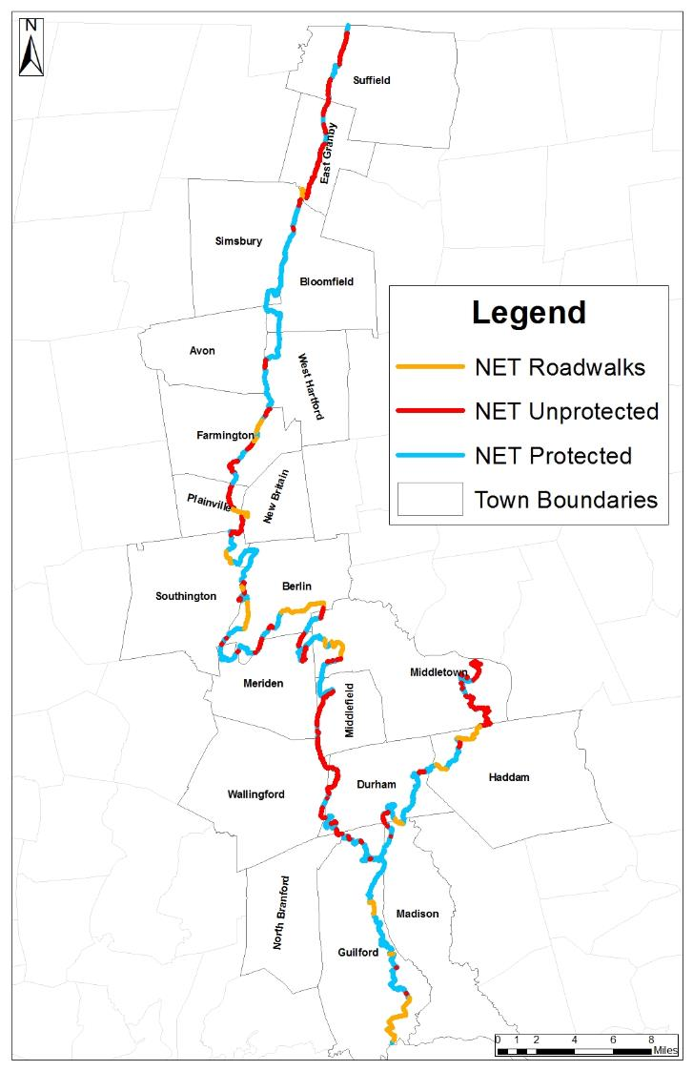
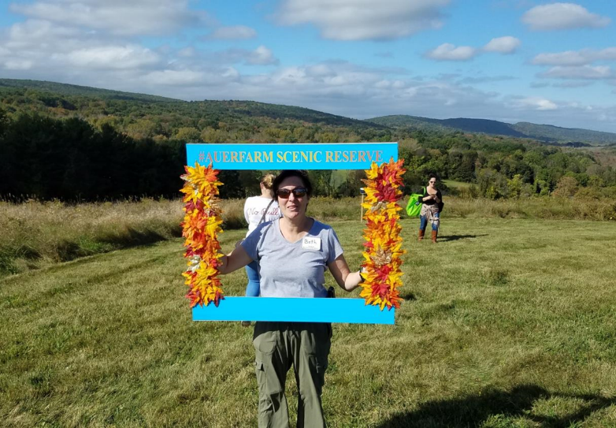
Conservation

Slide 8
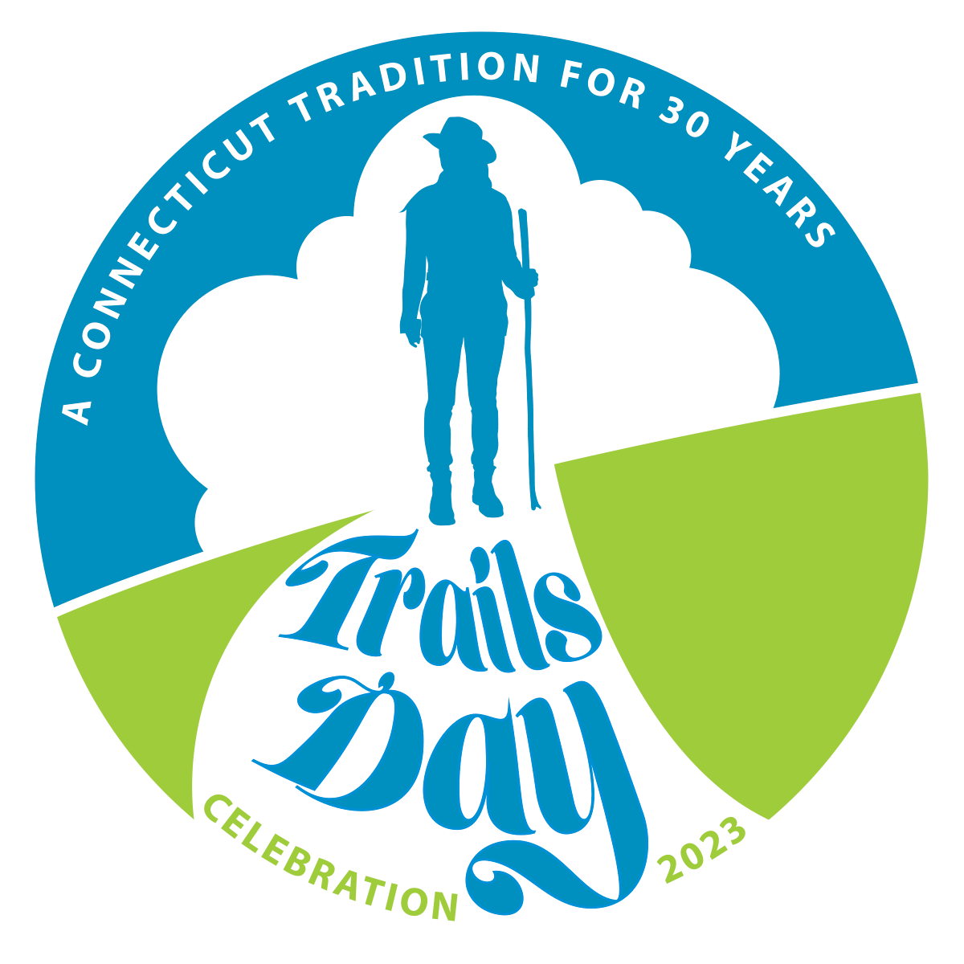
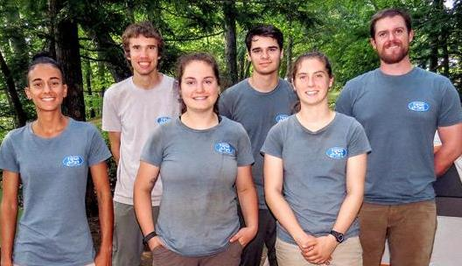
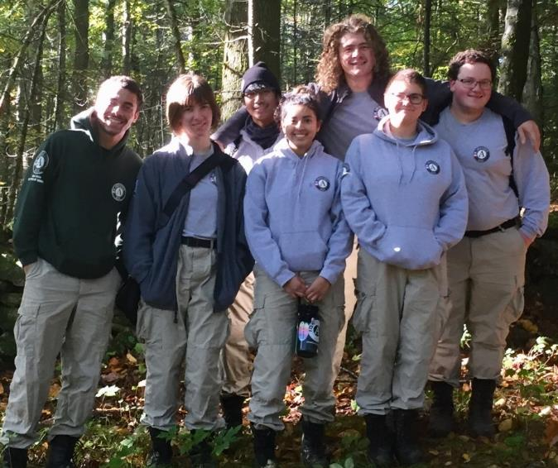
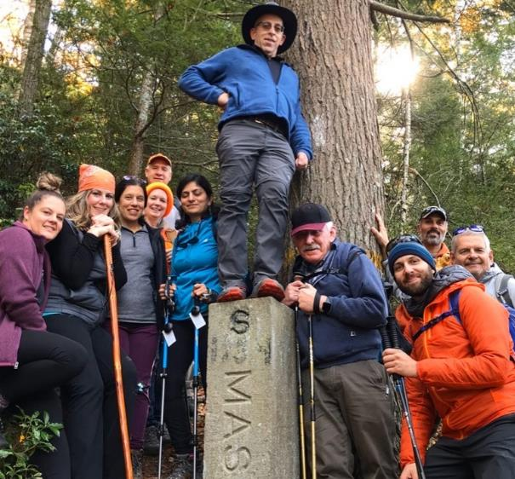
Summer & Fall Trail Crews
BBHT
Hike Challenge
AmeriCorps NCCC Team
Recreation

Slide 9
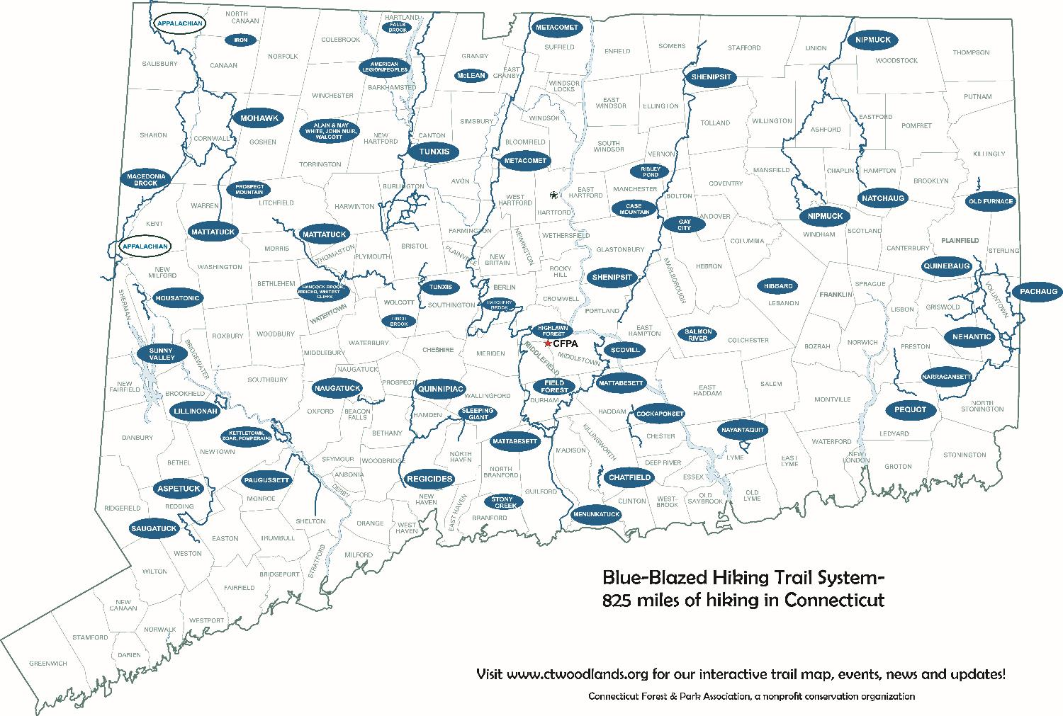
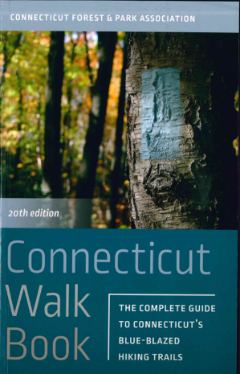
825+ Miles of Trails, 96 Towns
Recreation

Slide 10
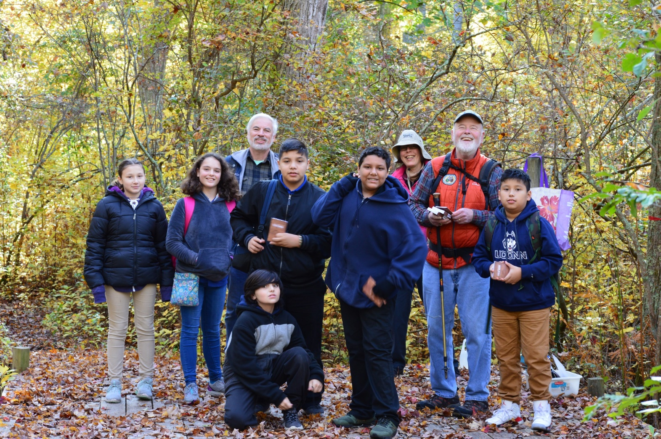

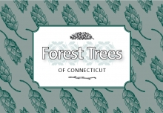
Education

Slide 11
learn more about CFPA
www.ctwoodlands.org

Slide 12
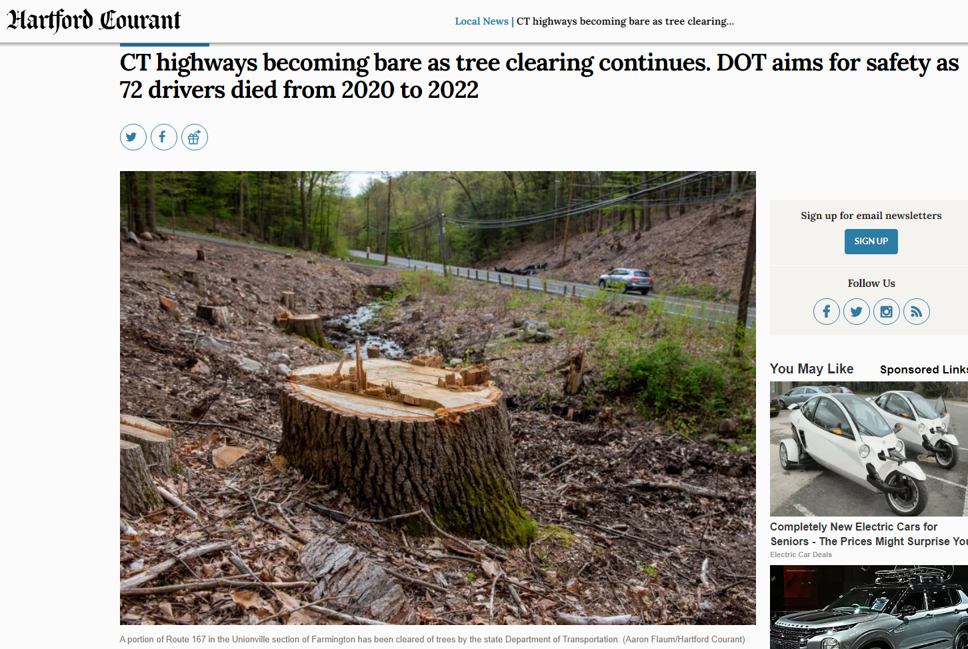

Slide 13
Quote from Hartford Courant Article
According to DoT spokesman Josh Morgan, 72 people died from 2020 – 2022 by crashing into a tree or having a tree fall on their vehicle. Clear zones on the side of the road give drivers space to stop before hitting a tree, he said.

Slide 14
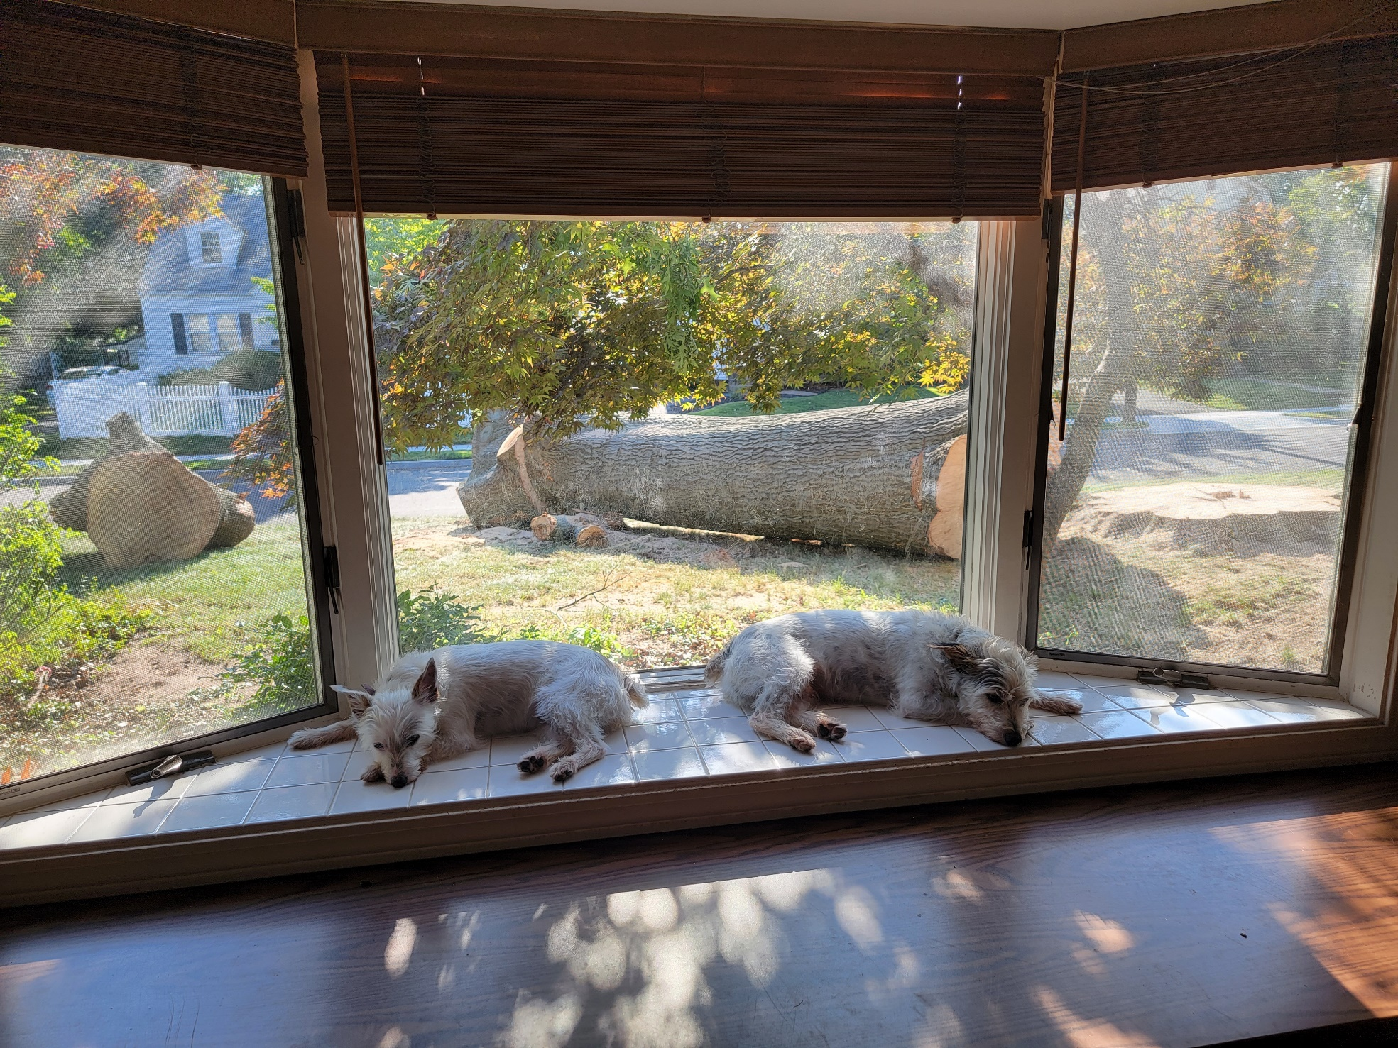

Slide 15
Lots of forest & tree issues to consider
Enhanced tree removals and pruning by utilities related to the “resilience” of the electrical grid (rarely includes re-planting)
Tree removals and pruning along highways and town roads (rarely includes re-planting)
Maintenance and replacement of tree canopies in urban and suburban areas (more often includes re-planting)
Invasive pests, climate change, deer browse, and other threats to forest regeneration

Slide 16
Forest and tree challenges can be quite different
Forest challenges
In general …
Tree challenges
Not much age diversity
Invasives/deer/fire suppression challenges
Long-term, larger acreage stewardship options
More intense municipal & individual care
Transportation/energy/local neighbor considerations
More visible to the public

Slide 17
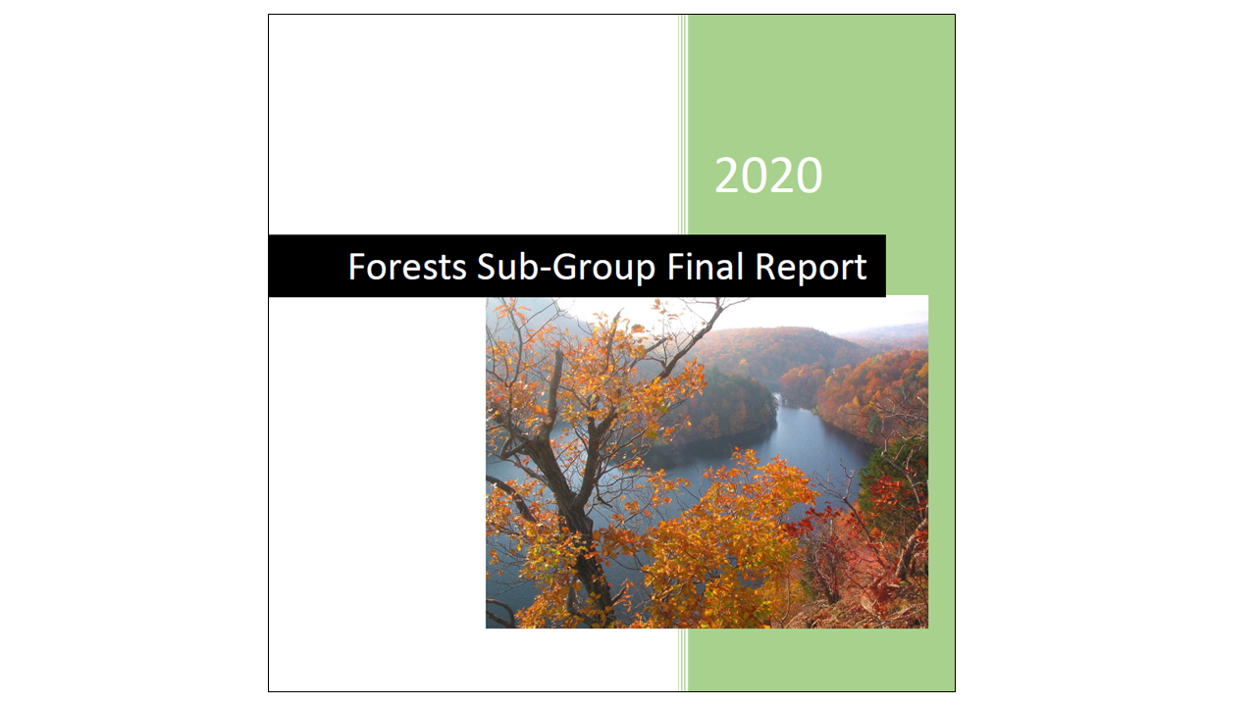
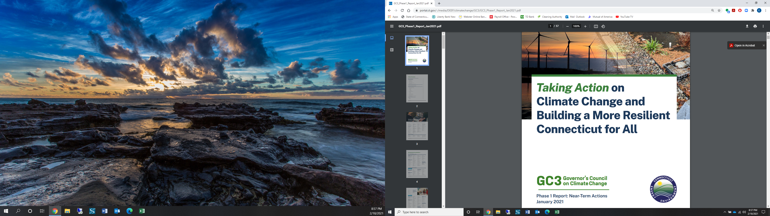
reports on Forest Resilience
Notes:
We have been fortunate to build upon a solid foundation of important research, reports, and recommendations published in the last year. So many recommendations had already been through several types of public review.

Slide 18
From Phase 1 Report
26. Explore option of statewide “no-net-loss of forest” policy. Engage with stakeholders regarding the “no-net-loss of forest” policy to evaluate its feasibility, needed resources, and associated programs to maximize mitigation potential.
Consideration should be given to the following actions as part of the evaluation of this policy:
Avoid forest conversion;
Protect healthy, intact, and resilient forests;
Offset all planned or permitted forest losses;
Provide incentives for stewardship, forest retention, and forest resiliency; and
Protect urban forests, build more parks, and plant more trees.

Slide 19
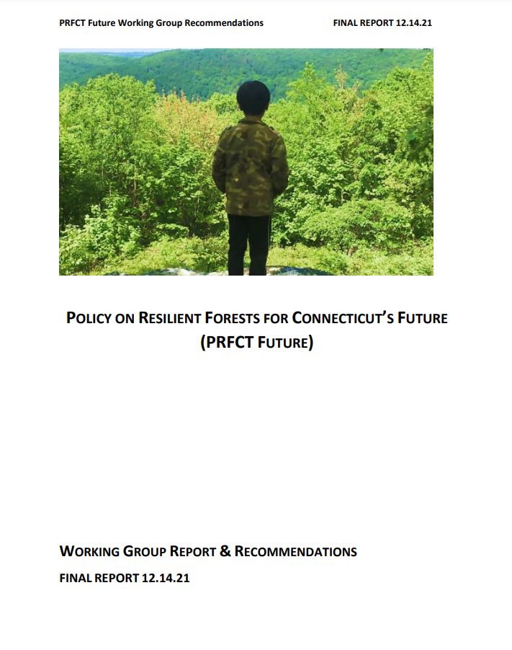
Officially Accepted by DEEP on 1.11.22
Go to www.ctwoodlands.org and search for PRFCT Future Report

Slide 20
PRFCT Future working group Members
Organizations | Representatives
American Planning Association - CT Chapter | Rebecca Augur
Connecticut Conference of Municipalities | Brian O’Connor
Connecticut Farm Bureau Association | Joan Nichols
Connecticut Forest & Park Association | Eric Hammerling
Connecticut Land Conservation Council | Amy Paterson
CT Council of Small Towns | Betsy Gara
CT DEEP | Christopher Martin
CT Metro Council of Governments | Hannah Reichle
CT Urban Forest Council | Heather Dionne
Desegregate CT | Nick Guertin
Garden Club of America, Rep to Conservation Cmte | Juliet Cain
Home Builders and Remodelers Association of CT | Jim Perras
Sustainable CT | Lynn Stoddard
Tree Wardens' Association of CT | Kevin Kelly
Yankee Div. – N.E. Society of American Foresters | Mike Ferrucci
* Facilitated by Bill Logue, Principal with The Logue Group, contracted by CFPA.

Slide 21

Resilient Forests and trees Provide Many Benefits
Improve air and water quality
Reduce heat stress/shade
Climate adaptation & mitigation
Wood products
Mental & physical health
Wildlife habitat
More livable communities
Lower cooling & heating bills
Jobs/economic benefits
Reduce stormwater/flooding
Aesthetic beauty
More foot traffic for businesses

Slide 22
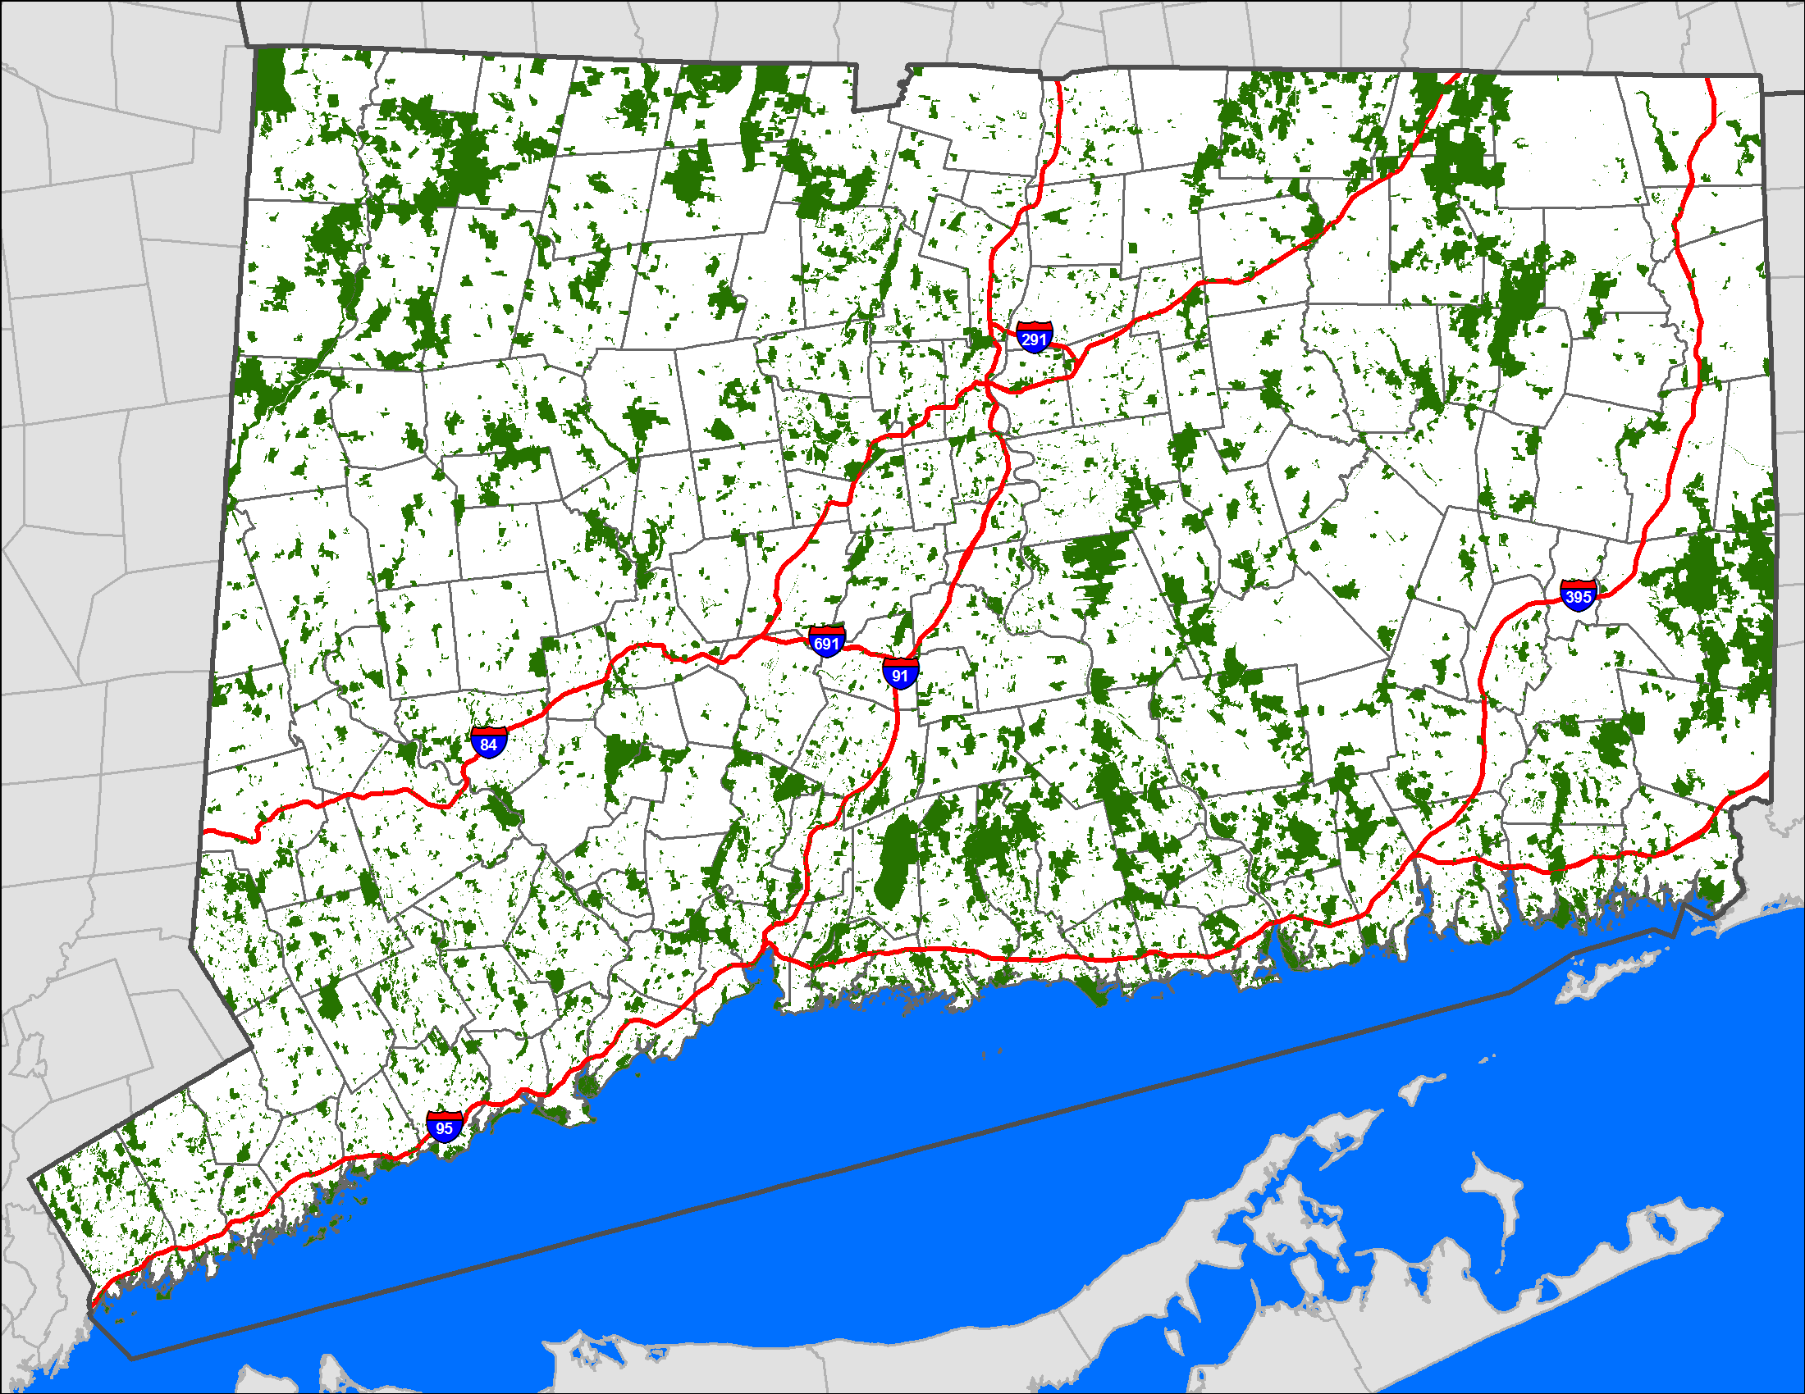
What to know about CT’s Forests
  Forest ownership
    Nearly 72% private
    Mostly small acreage
    Aging population
  Some conserved forest
    State/local gov’t
    Non-profits/land trusts
    Conservation easements
  Some incentives
    P.A. 490
    CIA/OSWA grants (USDA/NRCS grants as well)
CT is ~59% forested
Notes:
Connecticut is approximately 59% forested, and it’s important to know a few things about Connecticut’s forests:
Nearly 72% of our forests are privately owned by individuals
Most forested properties are smaller than 10 acres
If past trends have held, about 90% of forest landowners are older than 55 today. This means that there are more and more forest landowners each year who are thinking about leaving forest land to heirs, selling for conservation, or selling for other purposes. This is a critically important time to talk with landowners about the future of their forest land.
Fortunately, there are some state incentives and programs that support forest conservation such as the Public Act 490 program which reduces the tax burden for individuals who own more than 25 acres of forest. Also, state-funded open space grants supported by the Community Investment Act and bonding investments enable municipalities, land trusts, and water companies to acquire forest land.

Slide 23
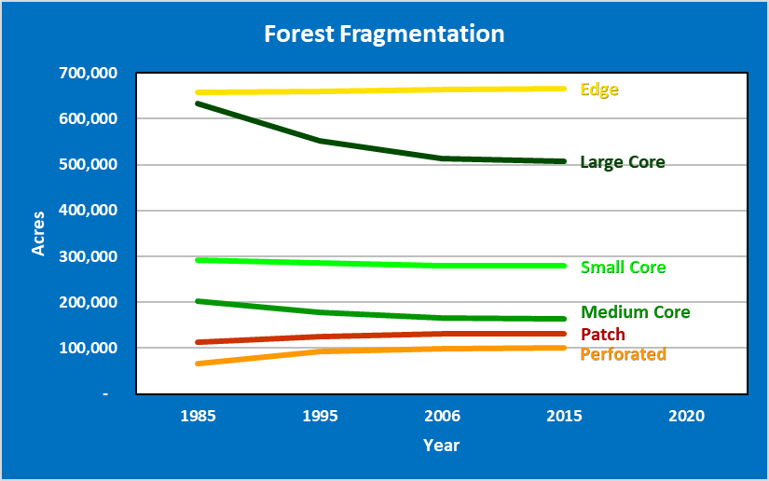
Forests are getting fragmenteD
~130,000 acres of Large Core Forest (500+ acres) was lost or fragmented between 1985 - 2015
Notes:
However, our forests have been getting fragmented over time. In the 30-year period between 1985 and 2015, UConn CLEAR documented that approximately 130,000 acres of “large core forests” (those of 500 or more acres) were either lost or fragmented into smaller pieces of forest by roads, commercial, residential, and infrastructure development, as well as other land use conversions.
Although this trend may have slowed in recent years, continued fragmentation and loss of large core forests is likely making our forests less resilient to future climatic and other challenges. When it comes to retaining forest resiliency, size does matter.

Slide 24
Tree Cover is much lower in our largest cities
Bridgeport UTC = 27% with additional 45% possible (2012 study)
Hartford UTC = 26% with additional 49% possible (2010 study)
New Haven UTC = 38% with additional 41% possible (2009 study)
Source: Urban Tree Canopy (UTC) Studies by Keith Pelletier & Jarlath O’Neil-Dunne, University of Vermont Spatial Analysis Laboratory with support from USDA Forest Service
Notes:
Although our statewide forest cover is ~59% overall, the tree cover in our largest cities is much lower. Studies that are now about a decade old showed the urban tree canopy for Bridgeport at 27%, Hartford at 26%, and New Haven at 38%. These studies also identified where the Urban Tree Canopy in these cities could be increased significantly with a well-resourced effort of tree planting, stewardship, and community engagement on both private and municipal lands.

Slide 25
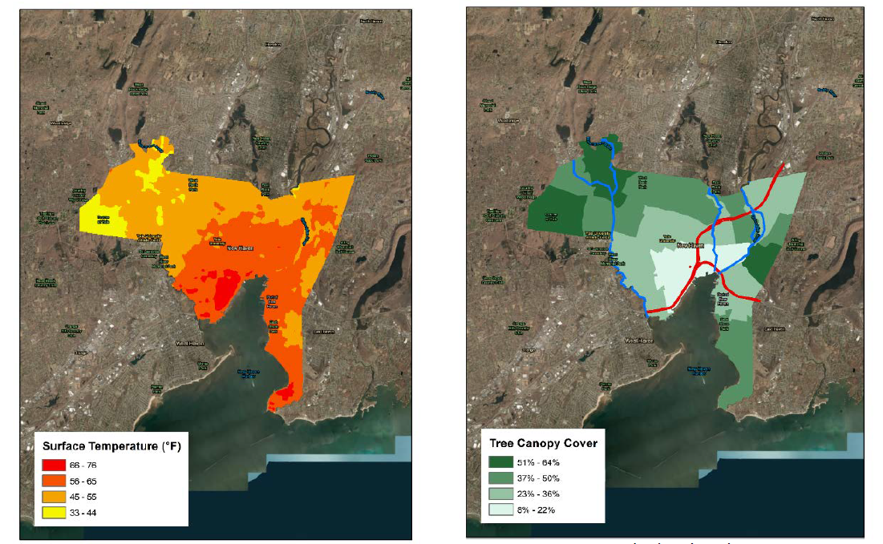
Inequities are reflected in urban tree Cover
Source: Colleen Murphy-Dunning presentation to GC3 Forests Sub-Group on 3/24/20.
Notes:
The lack of tree cover largely correlates with lower-income, often primarily Black and Brown neighborhoods like here in New Haven.
With less tree cover comes greater vulnerability to heat extremes and other stressors that are key determinants of health for the community. Conversely, those areas with greater tree canopy cover tend to have cooler surface temperatures as well as higher median incomes. These environmental inequities need to be remedied.

Slide 26
How Can we Keep Connecticut’s Forests, Trees & Communities Resilient?
Notes:
If resilient forests and trees provide the largest climate and other benefits today and into the future, what kinds of policies and actions can we implement to keep Connecticut’s current and future forests as resilient as possible?

Slide 27
Officially Accepted by DEEP on 1.11.22
https://www.ctwoodlands.org/public-policy/prfct-future-resource-page

Slide 28
Prfct future consensus Recommendations
New State Policies
New State Incentives
Budget and Staff Resource Needs
Actions with No Legislation or New Funding
Notes:
In the PRFCT Future Working Group report, we have divided the recommendations into 4 big buckets. New State Policies needed in 2022, new State Incentives needed in 2022, FY 2023 State Budget and Staff Resource Needs, and 2022 Executive Branch or Agency actions that can be done within existing resources.

Slide 29
New State Policies
Amend Global Warming Solutions Act to include working & natural lands in monitoring/reporting
Authorize new Goals for urban tree cover
Enable compensatory reforestation to mitigate actions by state agencies and utilities
Update invasive plant species list with known threats to forests
Notes:
#1 is in the Governor’s Executive Order as #20b.
#2 calls for a new goal of increasing urban tree canopy by 5%
#3 would build on the New Jersey model which requires state agencies undertaking actions that would result in the loss of forest to prepare compensatory reforestation plans for how forest losses would be mitigated in various ways.
#4 would include certain forest invasives in the naughty invasive plant species list that would prohibit sale, etc.

Slide 30
PrFCT Future Concepts in 2023 Legislation
Amend Global Warming Solutions Act to include working & natural lands in monitoring/reporting, SB 1145
Authorize New Goal for urban tree cover, SB 979
Enable compensatory reforestation to mitigate actions by state agencies, HB 6610 and 6744
Continue DEEP’s investments in urban forestry, $500,000 in budget, new staff
Notes:
In terms of “Next Steps,” there are a few that are fairly straightforward, but you may have additional thoughts…

Slide 31
Tree-Related Bills that received a public hearing in 2023
Alive as of 5.11.23

Slide 32

The future is in your hands
Any Questions?
Notes:
I’m at the end of my time so I’ll end there. Thank you for your time, and I look forward to your questions.

