Slide 1
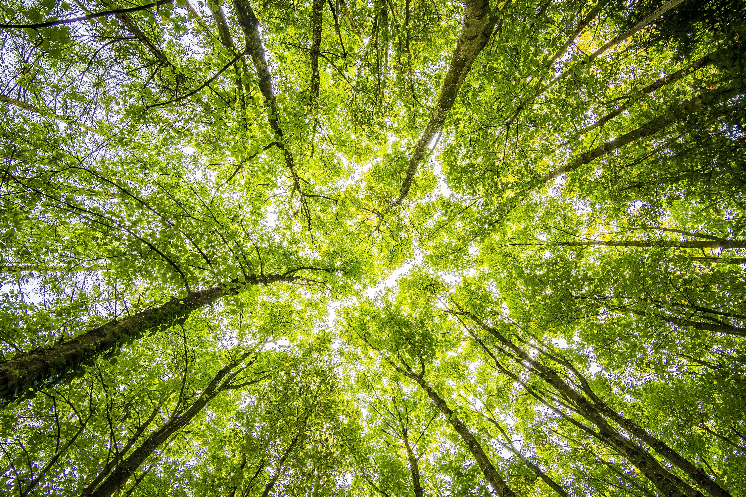
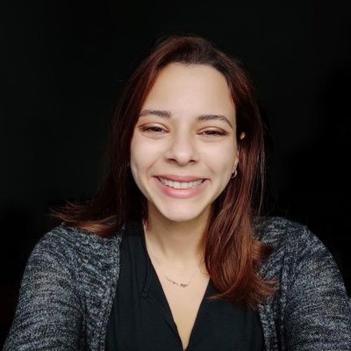
The whats, whys and hows of equity, environmental justice & greenspaces
Dr. Mayra Rodríguez
Assistant Extension Educator
Urban and Community Forestry
Hartford County Extension Center, UConn
Research on Resilient Cities Racism and Equity, UConn Hartford

Slide 2
What: UConn Urban & Community Forestry program
Extension:
Working alongside communities to empower, uplift and support them in dealing with the challenges they face and protecting the environment
Urban and Community Forestry:
Promoting a sense of shared stewardship to co-manage the urban forest (i.e., all green spaces no matter the size) for long-term community wellbeing and environmental health
Environmental Justice:
Ensuring both goals support promoting equity, and center the voices of marginalized individuals

Slide 3
Why: The issue
Nature is unequally distributed across demographics, and, in CT, these disparities are most pronounced by income.
Targeted greening/management is necessary in underserved neighborhoods
Often the least resilient environmentally
Equality ≠ Equity
Repairs
Both community and practitioner input is necessary to avoid unintended outcomes from greening/management.
Proper indicators for the sustainability of projects
Avoiding strain over local social and economic systems
Regarding public land, moving away from top-down approaches to management

Slide 4
Why: Additional challenges
Environmental:
Current climate projections for CT estimate increases in extreme heat and flooding
Social:
Intersection with highly uneven social vulnerability
Implementation:
Current municipal plans have embraced nature-based solutions, but lag in their implementation
Unclear pathways to implementation and sustainability
Poor dissemination of incentive programs
Lack of public support due to top-down approaches

Slide 5
How: UFMP as a roadmap
An Urban Forest Management Plan (UFMP) is a guide for managers to proactively manage the benefits associated with urban forests for long-term provisioning.
An UFMP should be tailored to local concerns including
Urban resilience
Invasive species management
Inequitable access
Many more interconnected issues

Slide 6
How: Developing a comprehensive UFMP
Builds genuine community partnerships
Establishes a team
Builds relationships that go from multi- to inter- to trans- disciplinary
Assesses current state of the urban forest
Creates a common vision with communities
Captures environmental and community needs
Implements and monitors
Encourages shared stewardship
Promotes program sustainability

Slide 7
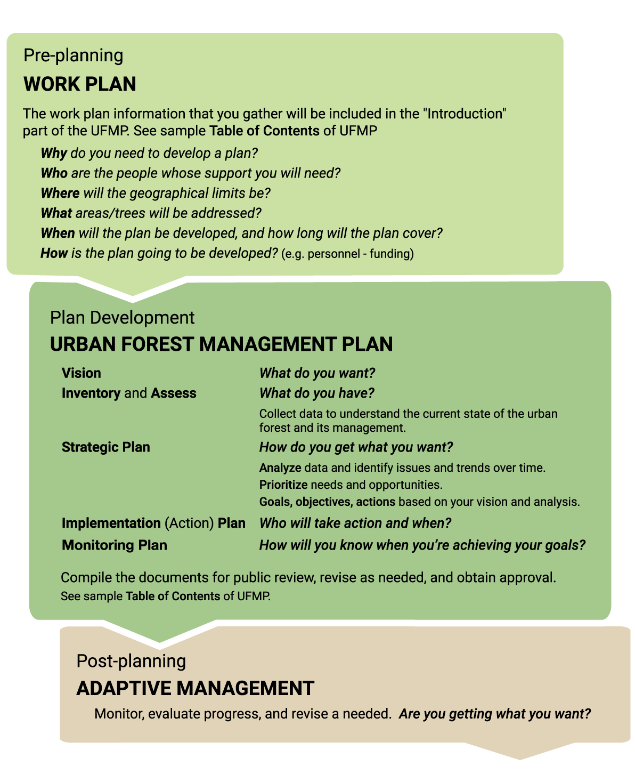
Tools and resources
Visit: ufmptoolkit.net

Slide 8
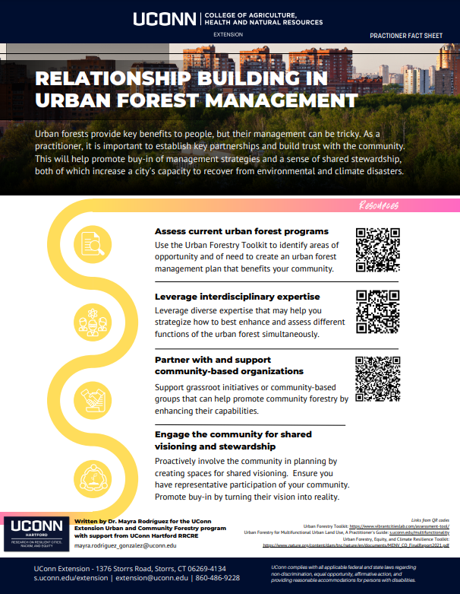
Building relationships
Team of diverse expertise willing to truly work together
True community partners are equal partners in co-assessment, co-design, etc.
Visit: s.uconn.edu/relationships

Slide 9
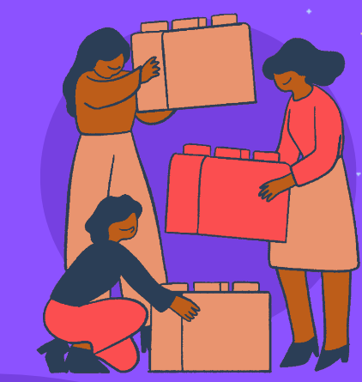
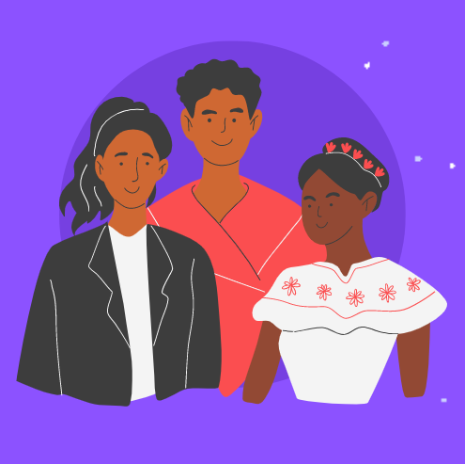
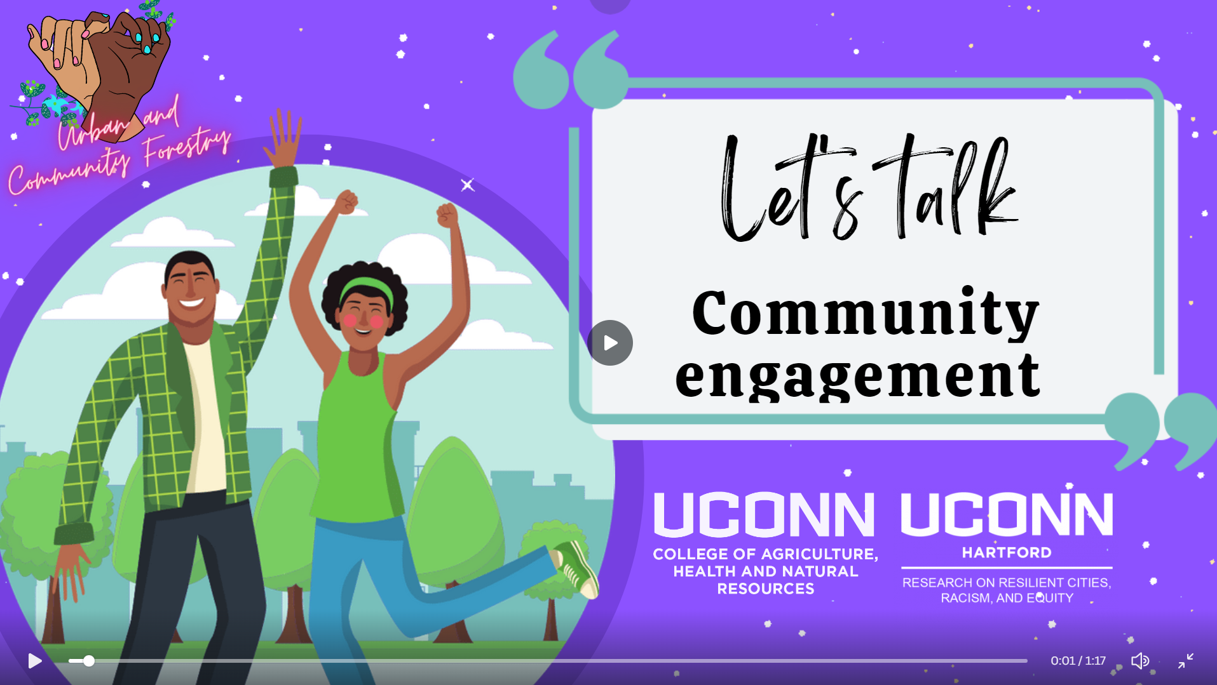
Engaging beyond your internal team
Practitioners
Community leaders
Grassroot organizations
Any other
Visit: s.uconn.edu/urban

Slide 10
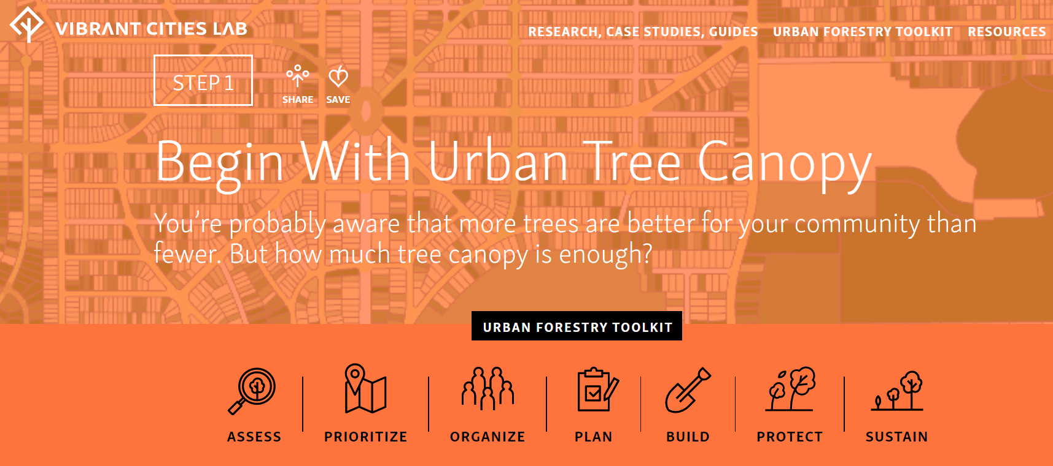
https://www.vibrantcitieslab.com/toolkit/urban-tree-canopy/
Tools and resources

Slide 11
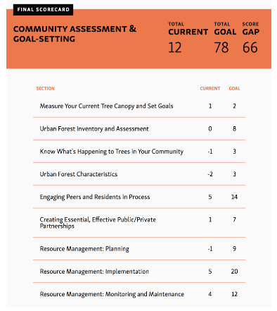
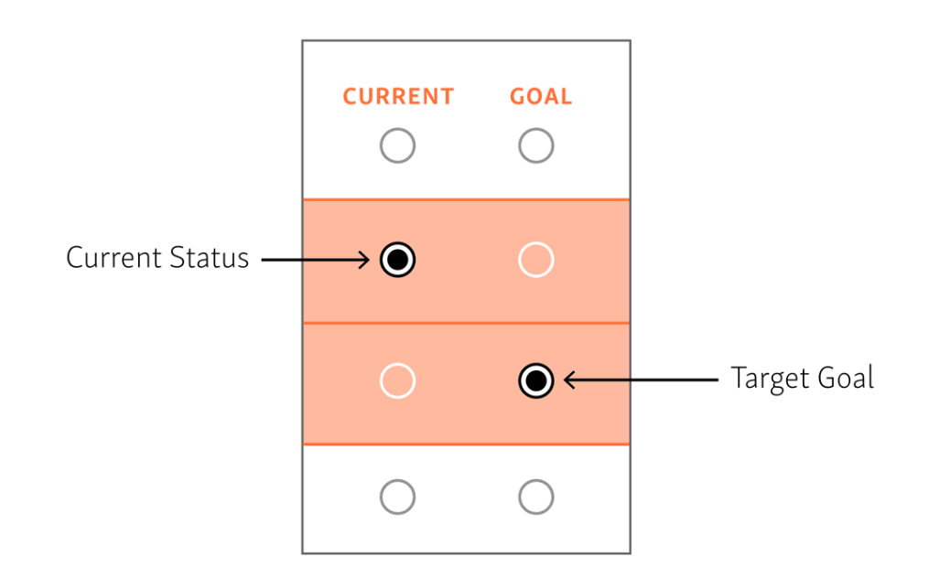
https://www.vibrantcitieslab.com/assessment-tool/
Tools and resources

Slide 12
What does this enable you to do?

Slide 13
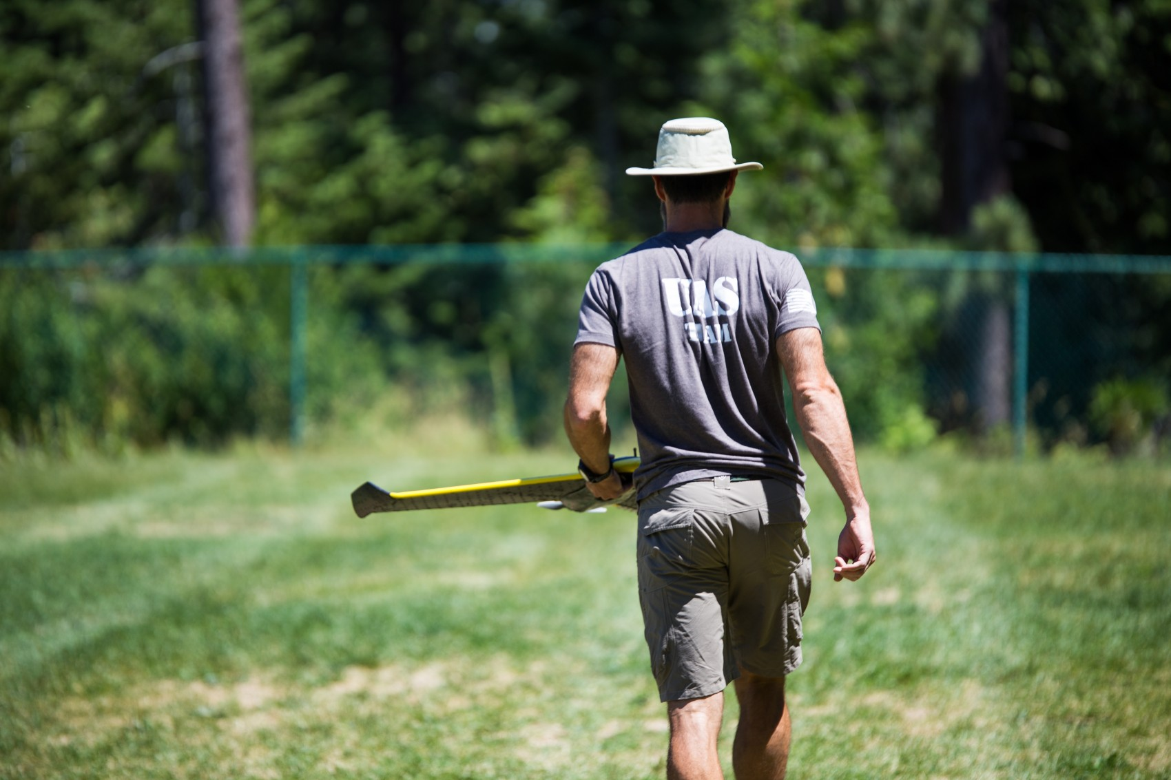
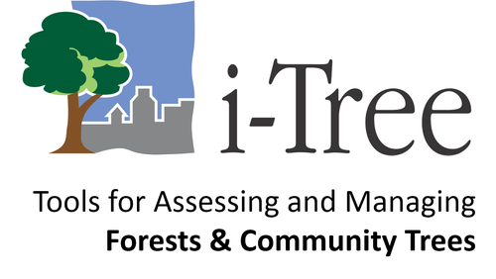
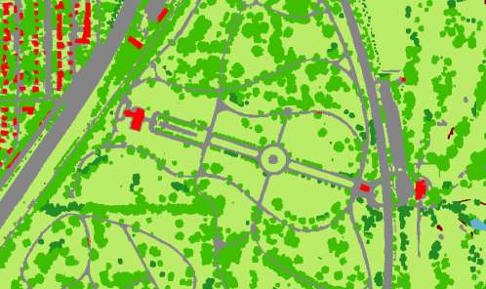
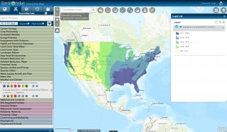
Capturing local needs

Slide 14
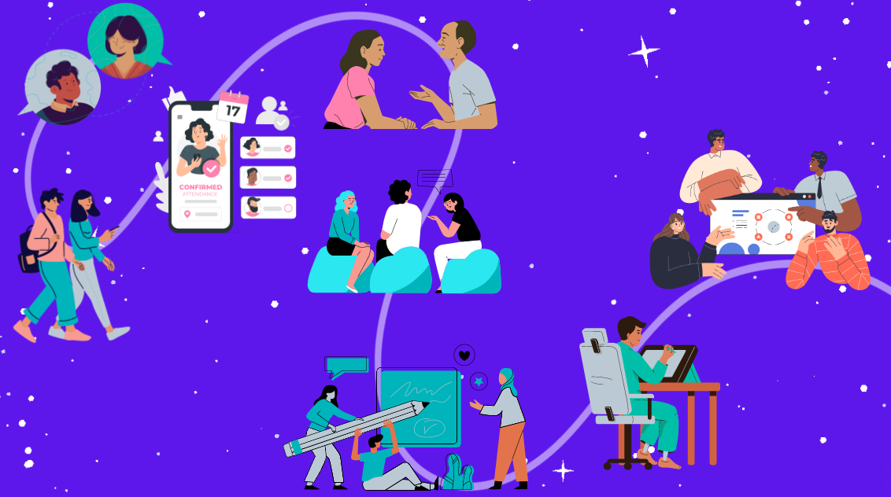
Engaging beyond your internal team
A participatory approach for
shared visioning

Slide 15
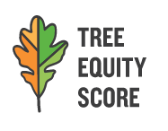
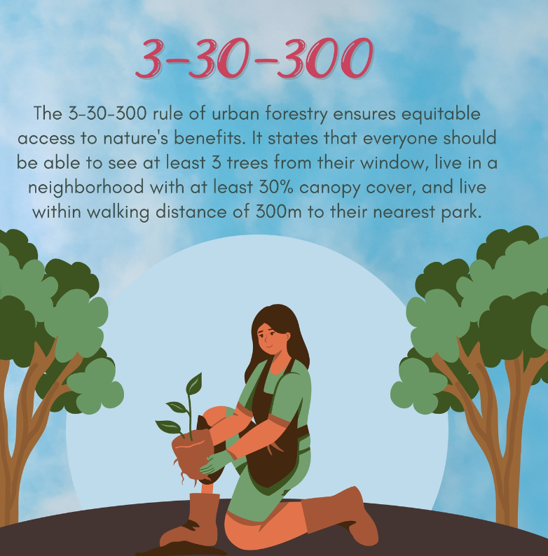
Tools and resources

Slide 16
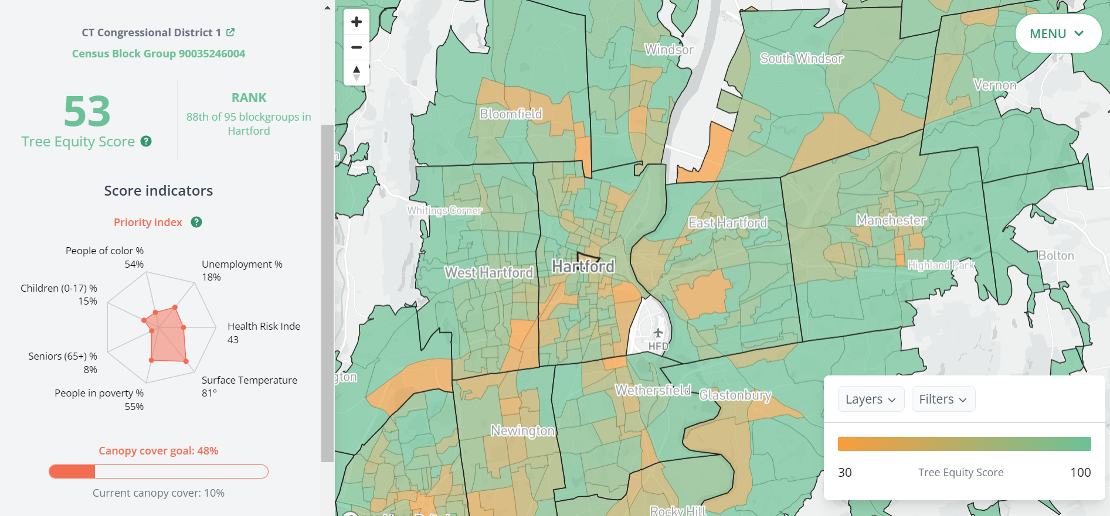
https://www.treeequityscore.org/
Tools and resources

Slide 17
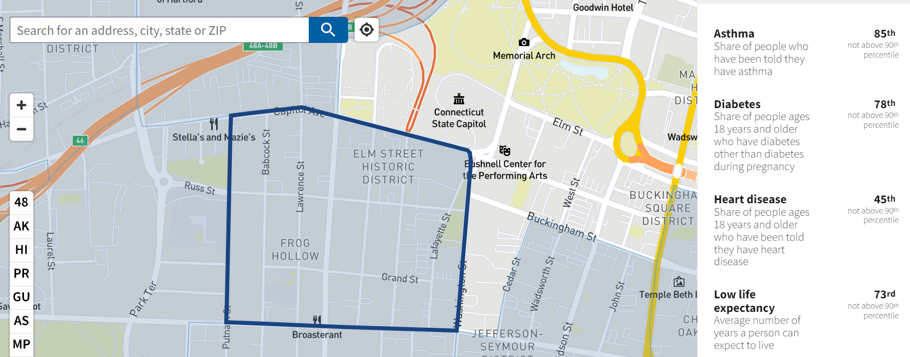
Tools and resources
https://screeningtool.geoplatform.gov

Slide 18
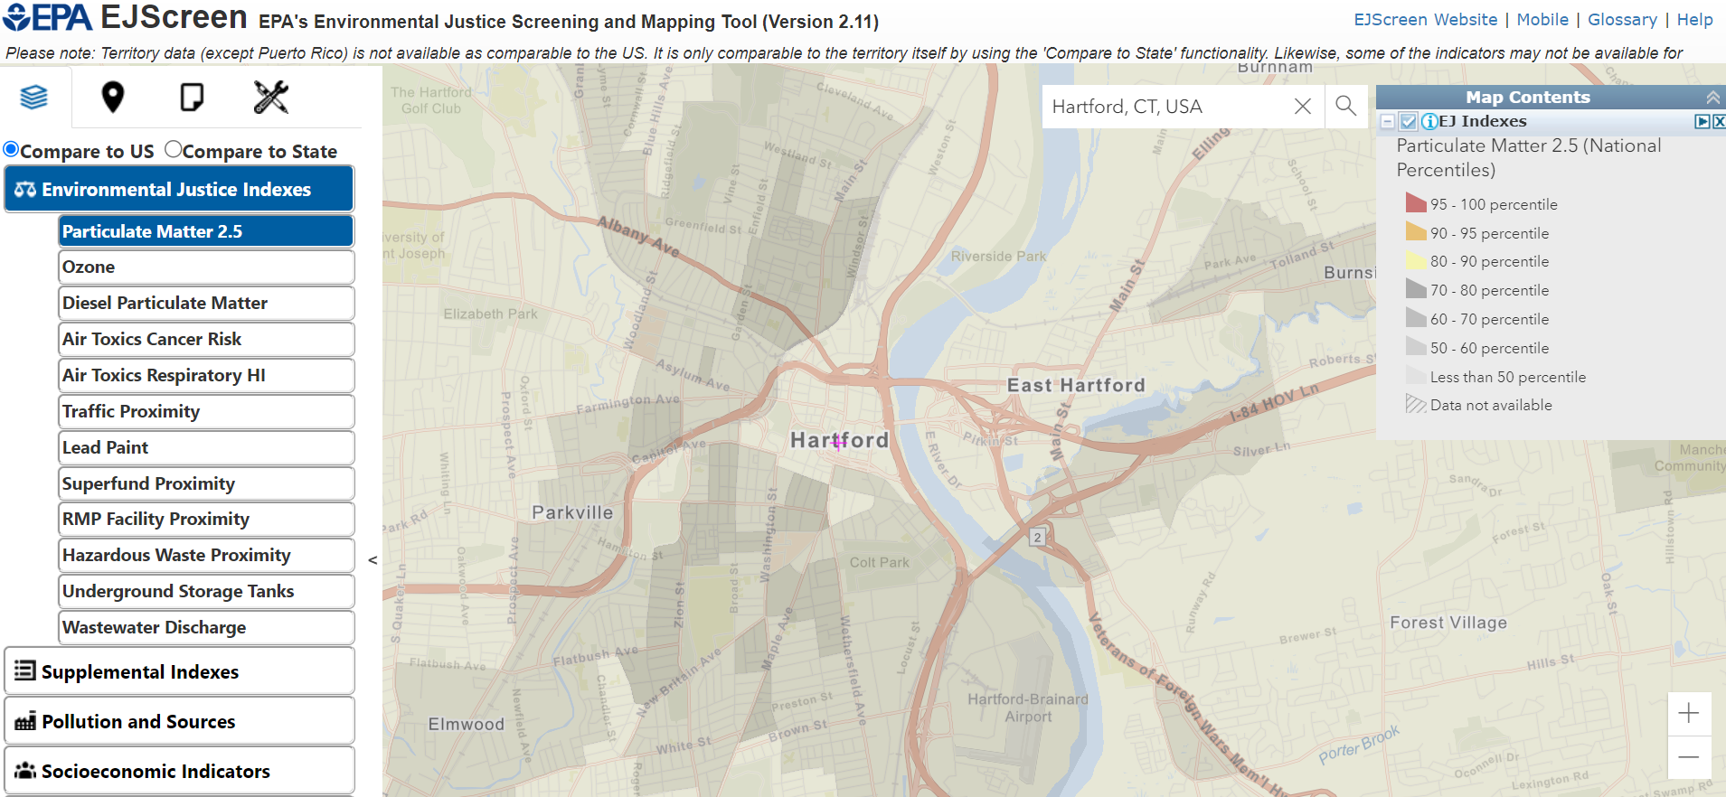
Tools and resources
https://www.epa.gov/ejscreen

Slide 19
What does this enable you to do?

Slide 20
Promoting program sustainability
Keeping an eye on funding to fund implementation and sustain monitoring
Urban Forest Council
CT DEEP
Forest Service – Urban & Community Forestry
Other potential avenues: vibrantcitieslab.com/toolkit/funding
Long-term partnerships that encourage shared stewardship

Slide 21
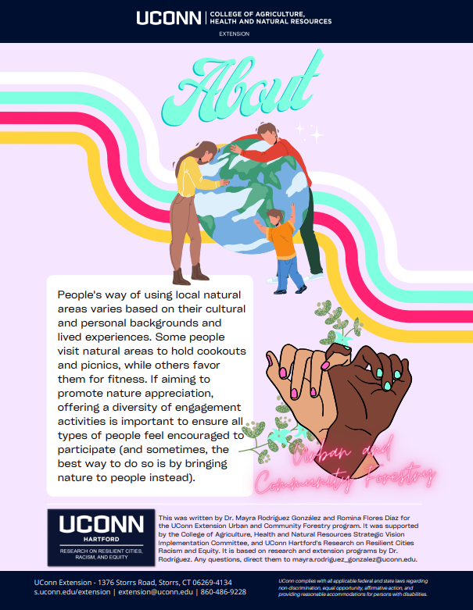
Tools and resources
Encouraging shared stewardship
Landowner incentives (NRCS – CT Environmental Quality Incentives Program)
Community outreach
Sense of belonging
https://www.arborday.org/programs/community-forestry-toolkit/
s.uconn.edu/nature

Slide 22
What does this enable you to do?

Slide 23
What next?

Slide 24
What next?
Builds genuine community partnerships
Establishes a team
Builds relationships that go from multi- to inter- to trans- disciplinary
Assesses current state of the urban forest
Creates a common vision with communities
Captures environmental and community needs
Implements and monitors
Encourages shared stewardship
Promotes program sustainability
Pre-planning
Adaptable
Planning Development

Slide 25
Questions
Dr. Mayra Rodríguez
Assistant Extension Educator
Urban and Community Forestry
Hartford County Extension Center, UConn
Research on Resilient Cities Racism and Equity, UConn Hartford

