Slide 1
Our Capital Forest
Heather Dionne
City Forester & Chair of the CT Urban Forest Council

Slide 2
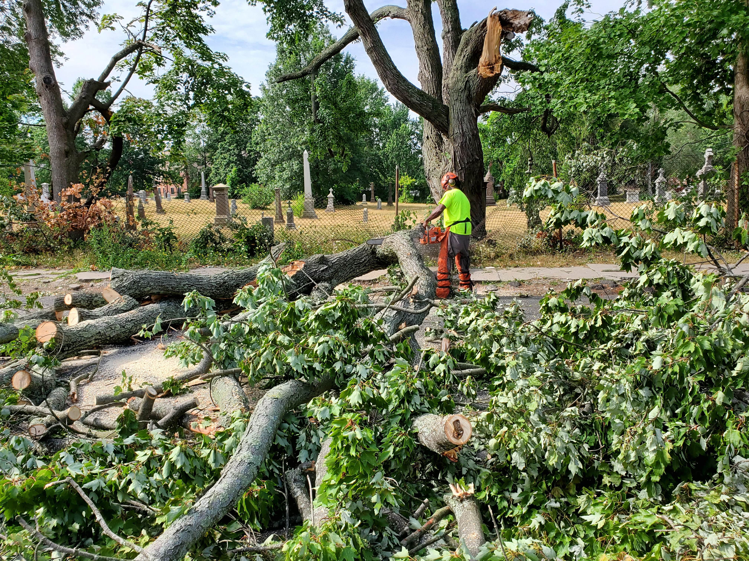
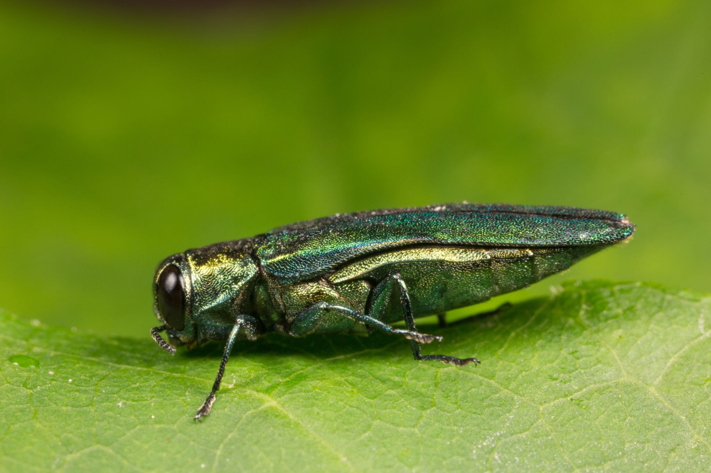
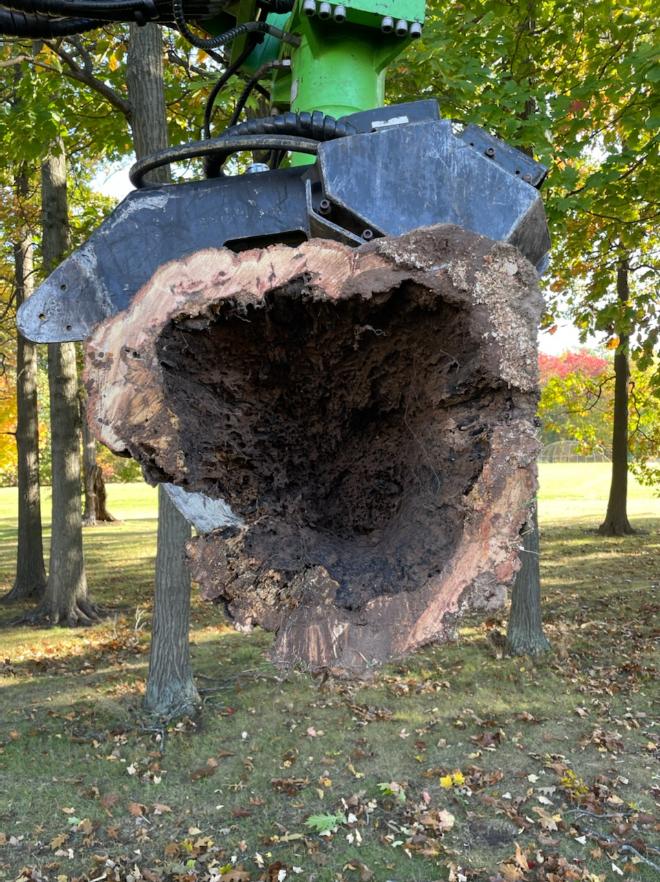
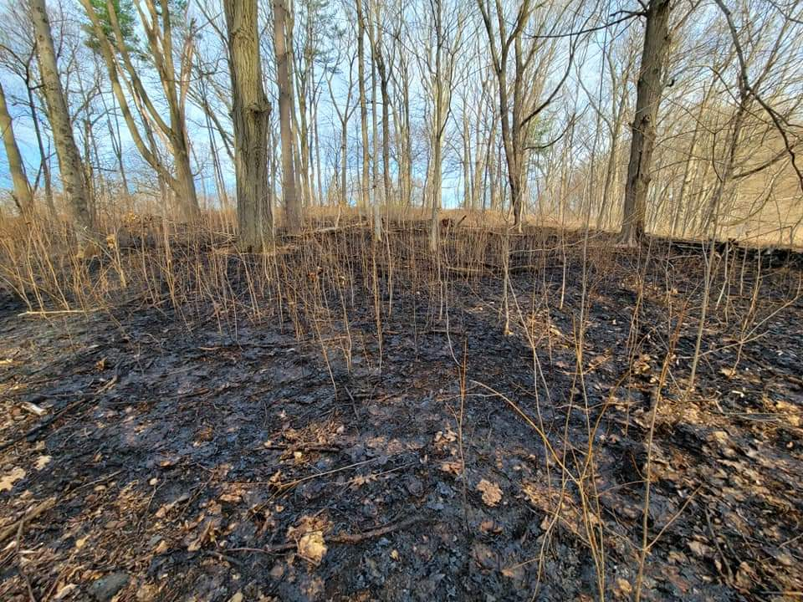
CHALLENGES:
Invasive insects
Drought (2016, 2017, 2018, 2020 & 2022)
High Intensity Storms
An Aging Canopy With a Gap in Tree Age
Funding
Staff shortage
Planting Goal of 3,500 Trees/Year for 50 Years
Educational Outreach
Forest Fires

Slide 3
The Positives:
Hartford has approximately 560,000 trees
434 Shoulder Miles of Roadway to Maintain
Approximately 2,500 Acres of Greenspace
We Have a Very Active and Engaged Tree Advisory Commission
A Robust Tree Canopy Action Plan
Great Relationships with State and Federal Agencies
People are Figuring Out How Important Trees Are for Our City
We Have Great Staff and Partnerships!

Slide 4
In 2019 the City allocated $108,641 for the inventory of 22,000 street and park trees and 8,000 vacant sites for tree planting.
We utilized Davey Resource Group and their software TreeKeeper for inventorying the locations.
We pay an annual fee to maintain our inventory which is kept up to date of all activities from planting, tree removal, pruning and stump grinding.

Slide 5
In 2020 The City of Hartford procured $60,000 in grant funds to establish a Tree Canopy Action Plan.
The 339 page document is incredibly comprehensive and helps the city plan and build off of the recommendations.
It provides examples of other cities programs, highlights neighborhoods with the least canopy coverage, and provides staff recommendations to match the need of maintenance.

Slide 7
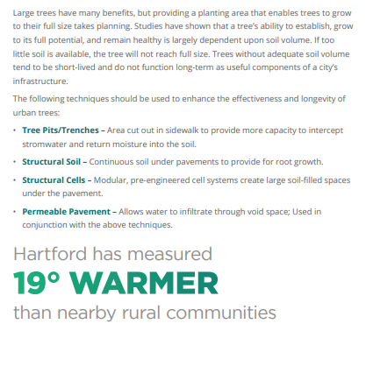
Due to lower canopy coverage, the temperatures of the city reach much higher than rural areas.
This in itself speaks volumes for the dire need of reforestation efforts and how human health is affected.

Slide 8
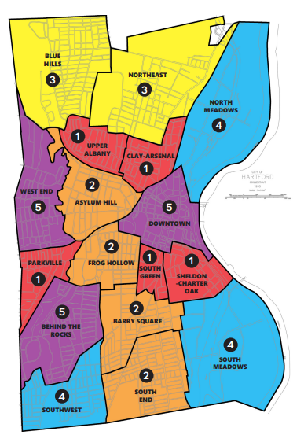
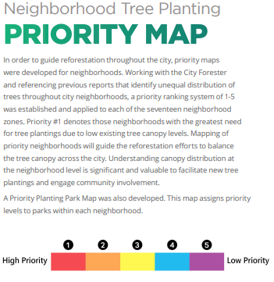

Slide 9
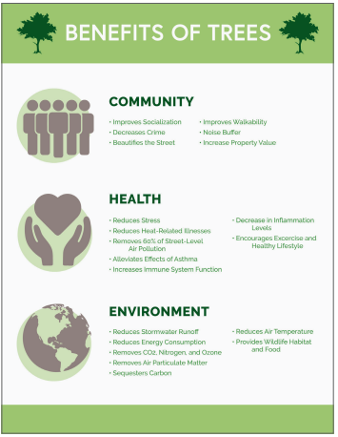
The benefits of tree planting and mature tree maintenance are obvious to us tree people.
The education and outreach must be done for the public to support a well-rounded urban and community forestry program.

Slide 10
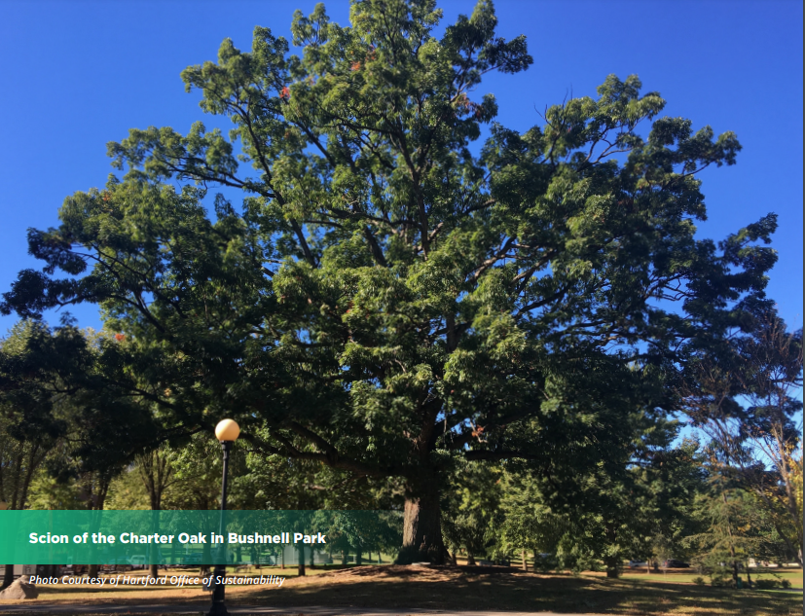
Our existing Charter Oak Scion located in Bushnell Park.
I have been working with Planters Choice Nursery, and within the next couple of years, will have a new scion to replace the one that we recently lost near the pond in Bushnell Park.

Slide 11
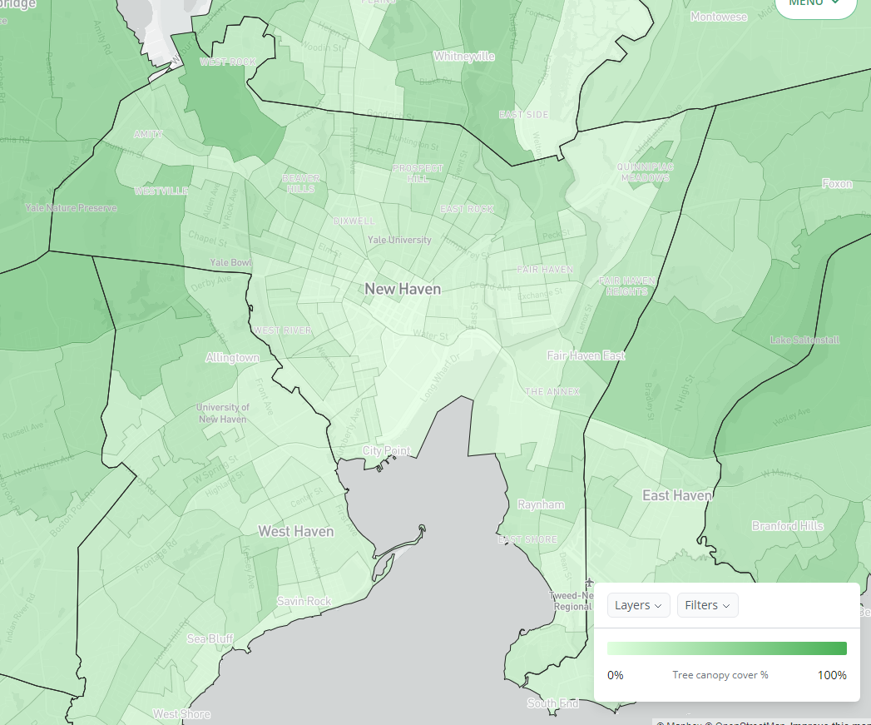
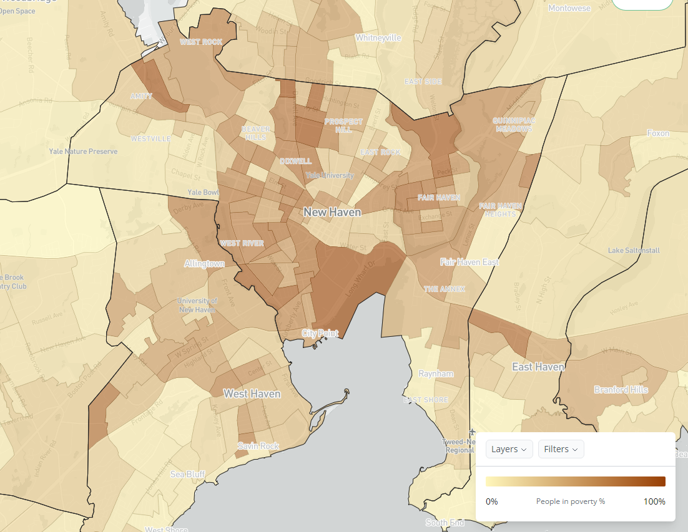
Urban and community forests in Connecticut The bad news
CT has five of the ten worst disparities in tree cover, income and temperature in the nation⁴
On average, cities remove 15 trees for every 1 tree planted
Few urban forestry NGOs
⁴McDonald et al. 2021
 | Forest Cover (%) |  |  |  | Temperature (Celsius)
Urbanized Area | Poorest census blocks | City median | Richest census blocks | Inter-quartile Range | Difference (Poorest - richest blocks)
Bridgeport--Stamford, CT--NY | 14.8% | 44.5% | 69.0% | 54.2% | 4.8
Baltimore, MD | 21.3% | 39.9% | 61.5% | 40.2% | 3.0
New Haven, CT | 20.9% | 38.9% | 61.0% | 40.1% | 3.0
Worcester, MA--CT | 21.0% | 47.7% | 60.3% | 39.3% | 4.1
Hartford, CT | 18.0% | 39.1% | 57.0% | 39.0% | 3.9
Springfield, MA--CT | 18.7% | 36.0% | 54.8% | 36.1% | 3.1
Philadelphia, PA--NJ--DE--MD | 4.6% | 22.2% | 40.1% | 35.5% | 4.1
Boston, MA--NH--RI | 13.7% | 32.3% | 48.8% | 35.1% | 3.7
Poughkeepsie--Newburgh, NY--NJ | 21.6% | 44.6% | 53.4% | 31.8% | 3.4
Providence, RI--MA | 17.5% | 29.3% | 46.8% | 29.3% | 5.4

Slide 12
Urban and community Forestry Program Overview budget – Consolidated grant Program
CT receives an average of $257,000 from the Consolidated Grant Program
Notes:
Average Award to States Programs = $257,028
FY18 - $225,720 (plus $22,500 pass-thru) = 248,220
FY19 - $227,040 (plus $25,000 pass-thru) = 252,040
FY20 - $236,420 (plus $25,000 pass-thru) = 261,420
FY21 - $225,000 (plus $25,000 pass-thru) = 250,000
FY22 - $248,462 (plus $25,000 pass-thru = 273,462

Slide 13
Urban and community Forestry Program Overview Budget – State Funding
State allocations have significantly increased in recent years
2021 - $980,000 from Regional Greenhouse Gas Initiative
$390,000 to Urban Forest Council to run Climate Change Grant program
$290,000 to University of Connecticut to run Capacity Building Grant Program and provide work training experience for students from under-represented demographics
2023 - $550,000 from American Rescue Plan Act
$290,000 to Urban Forest Council to run Climate Change Grant program
$210,000 to University of Connecticut to run outreach and engagement campaign
2023 and beyond…?
Hopes to transition the UCF coordinator position from federal to state funds

Slide 14
Program highlights, challenges, and future vision
Maintain existing canopy cover and increase tree cover in target areas – Grant Programs
Unprecedented investments in urban and community forestry grant programs
$927,805 available for sub-grants from 2018-2022*
$628,221 has been allocated to date with $130,623 to be allocated soon*
40 sub-grants awarded to 22 different municipalities*
*Data excludes CUFC’s small grants program 2018-2020

Slide 15
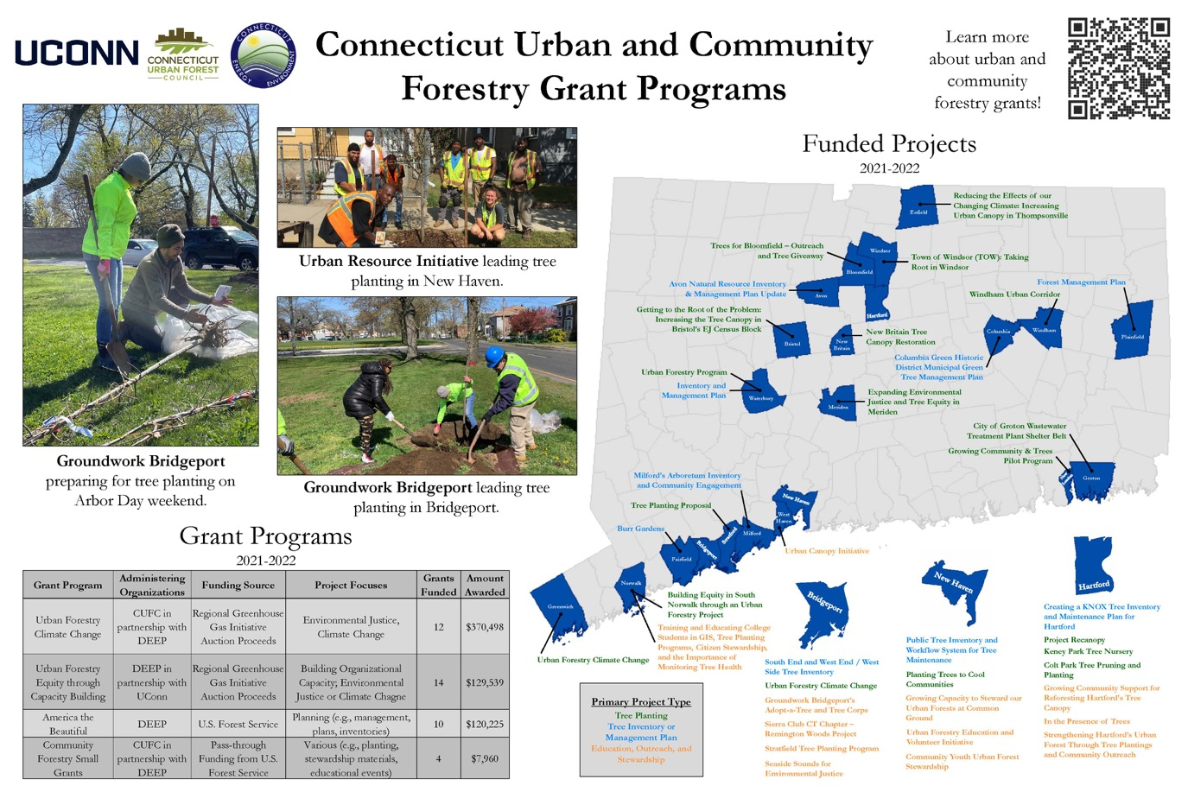
Program highlights, challenges, and future vision
Maintain existing canopy cover and increase tree cover in target areas – Grant Programs
Grant Program | Grants Funded | Amount Awarded
Urban Forestry Climate Change | 12 | $370,497
Urban Forestry Equity through Capacity Building | 14 | $129,539
America the Beautiful | 10 | $120,225
Community Forestry Small Grants | 4 | $7,960

Slide 16
Program highlights, challenges, and future vision
Maintain existing canopy cover and increase tree cover in target areas – Grant Programs
Grant Ladder – iterative grant opportunities to help urban forestry groups grow
Grant Prerequisites – some grant project types would require prior planning projects
Climate Change Grant Program
Tree Planting
Pruning & Maintenance
Natural Areas Management
Capacity Building Grant Program
Tree Inventory
Tree Cover Assessment
Management Plan
Small Grants Program

