Slide 1


Climate Change &
Connecticut Forests
Andrea Urbano
May 2023
Andrea.urbano@ct.gov

Slide 2
Climate change IN CONNECTICUT | At a glance
Elevated temperatures
Altered disturbance regimes
Invasive pests & pathogens
2.5⁰F increase globally, 3.5⁰ inc. in CT
Longer growing season
3.6⁰F warmer in winter, 20 fewer days w/ snowpack, 10” less
Increase in intensity & frequency of natural disturbances
More drought
Changes in precipitation patterns
Disproportionately benefit
Increase in rate of spread and population abundances
Suitable habitat for southerly species
NOAA National Centers of Environmental Information, State Climate Summaries, Connecticut
Seidl et al. 2017
Templer et al. 2012
IPCC
Notes:
Temperatures in CT have risen, however they’ve risen 3.5 degrees F since the beginning of the 20th century, which is about 1 degree higher than the global average. Like the global average, however, CT air temperatures have the potential to increase another 3-8 degrees by 2100. This potential depends on emissions and current/future human activity. In fact, the winter temperature increase is greater than the average increase in CT’s air temperature (3.6 degrees versus 3)
So even though CT is getting more precipitation, less of it is falling as snow. Compared to 1950, we have an average of 20 fewer days of snow cover per winter, and our maximum snowpack, on average, is 10 inches less than it used to be.
In Connecticut, sea level has risen at a rate of 10-11 inches per century, which is faster than the global rate. Connecticut under business as usual and high emissions scenarios, CT is expected to experience greater rises than the expected global rises (global seas levels likely to rise another 1-4 feet by 2100, which falls into a greater possible range of up to 7 feet.)
Natural disturbances function as important drivers of change. All forests are adapted to and infact require disturbances to function. However, climate change is increasing the frequency and intensity disturbances. Increase in the intensity and frequency of other natural distrubances (micro bursts, ice storms, hurricanes, etc.)
Invavice insects, disease, and plants are spreading more quickly, and beocme more abudant. We’ll also see introductions of new species from the south and elsewhere as our climate becomes more suitable. Already a major issue threatening current forest health, it is likely that invasive plants will disproportionately benefit under CC due to their broad environmental tolerances, extended leaf phenology, more effective exploitation of changed environments and more aggressive colonization of new areas.
From 1901-2011, OBSERVED CHANGES
Avg Temp: 2.4 F increase. projected to increase 3-8 degrees by 2100 = longer growing seasons
As a result of increased temperatures, there is a longer growing season, which ultimately negatively effects forests through increased respiration rates (so releasing more carbon) and vulnerability to frost damage)
Precip: greater annual precip (winter & spring), increase in extreme precip events with longer, drier periods in between , DECREASE IN SNOWFALL
Increase in occurance, duration, and severity of drought. Drought, more than any other disturbance, leads to additional/secondary stressors to trees/
forests
5. Increase in the intensity and frequency of other natural distrubances (micro bursts, ice storms, hurricanes, etc.)
6. Sea level rise already greater than 12” in CT. most likely to rise by another 1-4 feet by 2100. causes an increase in tidal floods associated with nuisance-level impacts
7. Invasvice insects, disease, and plants will spread more quickly, and beocme more abudant. We’ll also see introductions of new species from the south and elsewhere as our climate becomes more suitable.

Slide 3
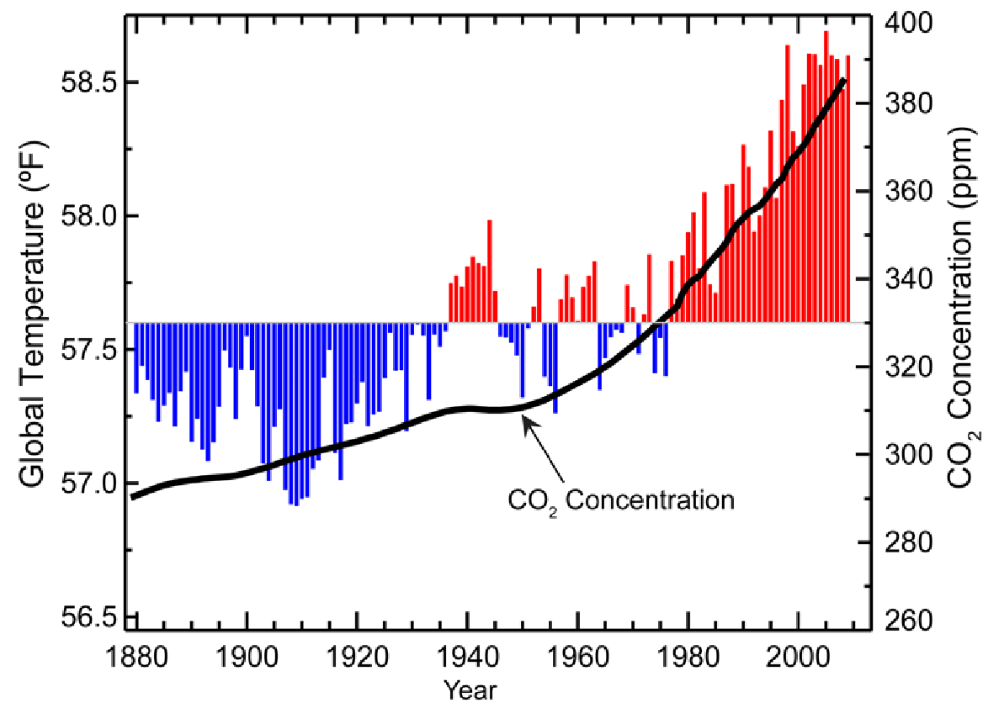
Global change
Elevated temperatures
NOAA Mauna Loa Observatory
Notes:
There is scientific consensus that our global atmospheric temperature are rising. This graphic depicts data from the Mauna Loa Observatory in Hawaii. You can see that temperatures are increasing in correspondence with atmospheric CO2 concentrations, and since the late nineteenth century, global air temperatures have risen nearly 2.5 degrees F
It’s important to note that while climate change is occuring globally, it has varied regional and local impacts. Meaning, its effects are not the same or consistent throughout the globe. Similarly, in New England, the effect of climate change also vary seasonally. I will introduce all of these impacts, providing global, local, and seasonal context.

Slide 4
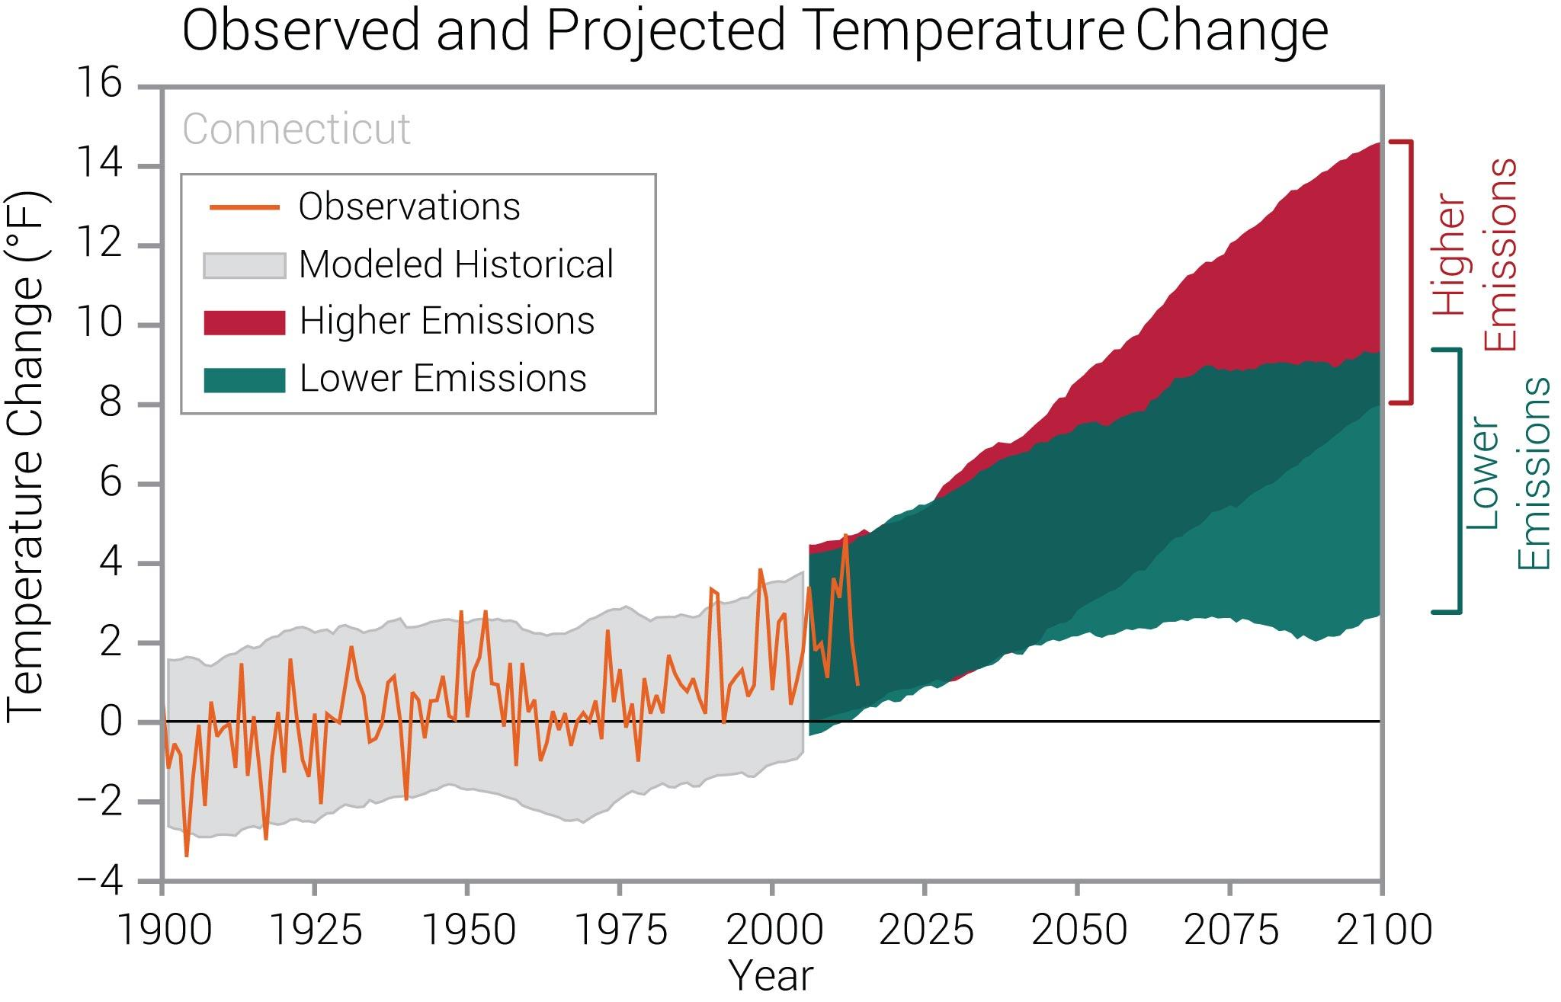
Localized effects
NOAA National Centers of Environmental Information, State Climate Summaries, Connecticut
Notes:
Connecticut - State Summaries 2019 (ncics.org)
data and observations support global temperature rising, but this has localized and seasonal effects. Similar to the global trend, temperatures in CT have risen, however they’ve risen 3.5 degrees F since the beginning of the 20th century, which is about 1 degree higher than the global average. Like the global average, however, CT air temperatures have the potential to increase another 3-8 degrees by 2100. This potential depends on emissions and current/future human activity.
Here you see CT’s observed and projected changes in air temperature for Connecticut (compared to the 1901–1960 average). Observed data, the orange line, span from 1900 to 2014. Expected changes are projected out to year 2100 and are based on global climate models for two possible futures: one with a higher greenhouse gas emissions (indicated by the red block/line) and another in which greenhouse gas emissions increase at a slower rate (the lower emissions scenario, indicated by the green block/line).
As you can see, observed temperatures in Connecticut depict the 3.5°F temperature increase since the beginning of the 20th century. Unprecedented warming is projected to continue through the 21st century. Less warming is expected under a lower emissions future (the coldest years being about 3°F warmer than the long-term average; green shading) and greater warming is expected under a higher emissions future (the hottest years being about 10°F warmer than the hottest year in the historical record; red shading). Source: CICS-NC and NOAA NCEI.
Shading indicates the range of annual temperatures from the set of models. Observed temperatures are generally within the envelope of model simulations of the historical period (gray shading).

Slide 5
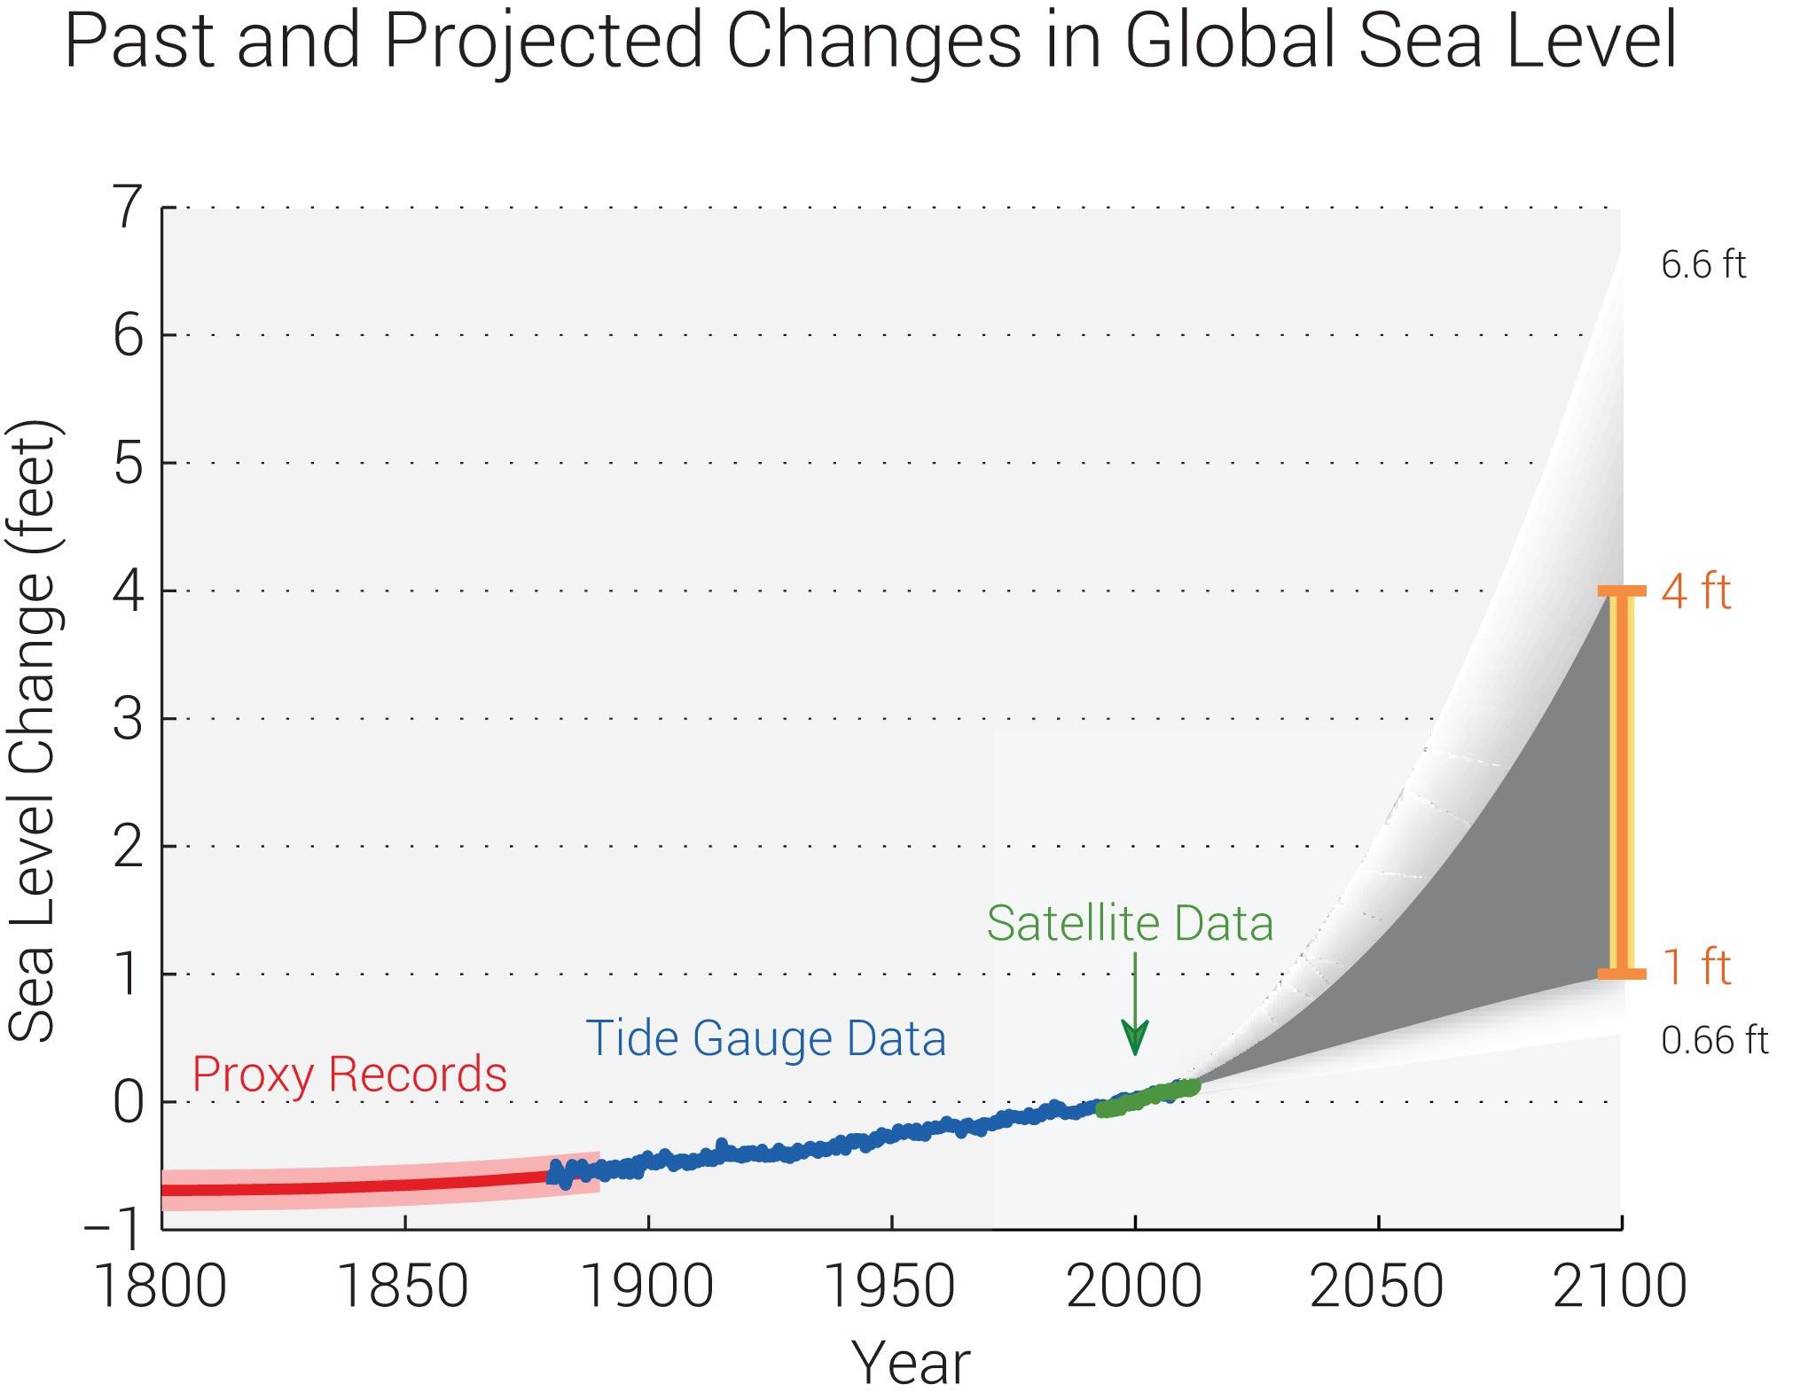
Global change
Sea level rise
Melillo et al. 2014 and Parris et al. 2012
Notes:
Increasing temperatures raise concerns for sea level rise in coastal areas across the globe.
Here you see another depiction of global data that has localized effects in CT, which we’ll see in the next slide. This shows the estimated, observed, and possible future amounts of global sea level rise from 1800 to 2100, relative to the year 2000. Since 1980, the global sea level has risen about 8 inches. The orange line at right the shows the global seas levels are most likely to rise by another 1-4 feet by 2100, which falls within a larger possible range of 0.66 feet to 6.6 feet. Source: Melillo et al. 2014 and Parris et al. 2012. based on an assessment of scientific studies.
In Connecticut, sea level has risen at a rate of 10-11 inches per century, which is faster than the global rate. Connecticut under business as usual and high emissions scenarios, CT is expected to experience greater rises than the expected global rises.

Slide 6
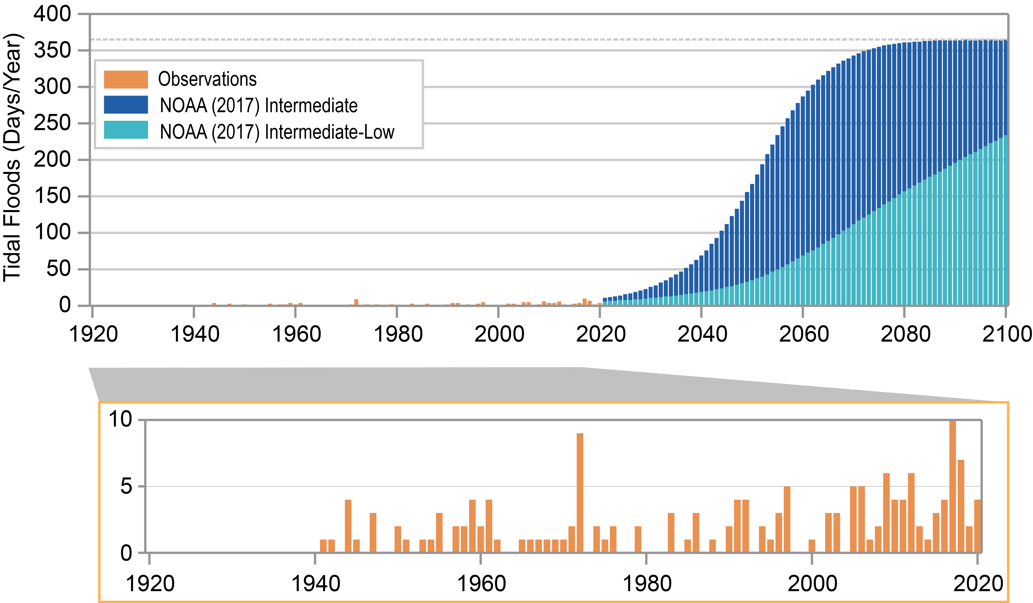
Localized effects
Observed and projected annual number of tidal floods for New London, CT
NOAA National Centers of Environmental Information, State Climate Summaries, Connecticut
Notes:
So what does this mean for us?
Sea level rise has caused an increase in tidal floods associated with nuisance-level impacts, meaning, the water levels exceed local thresholds, causing impacts that can damage infrastructure, cause road closures, and overwhelm storm drains. As sea level has risen along the Connecticut coastline, the number of tidal flood days (all days exceeding the nuisance level threshold) has also gradually increased.
The orange bars in this figure depict the observed number of tidal flood days per year from 1938-2020. The dark blue bars represent projections of tidal floods from 2021 to 2100 under an intermediate sea level rise scenario and the teal or light blue bars represent the projection of tidal floods up to 2100 under an intermediate to low sea level rise scenario.
The greatest number of tidal flood days (all exceeding the nuisance-level threshold) occurred in 2017. Data from New London is being used as a metric for all of CT’s coast. Projected increases are large even under the Intermediate-Low scenario. Under the Intermediate scenario, tidal flooding is projected to occur every day of the year by the end of the century. Rising sea levels will have important coastal and floodplain impacts on local communities concentrated in these hazard prone areas.
This sheds light on the importance of coastal floodplain forests in mitigating the impacts of sea level rise on these communities.

Slide 7
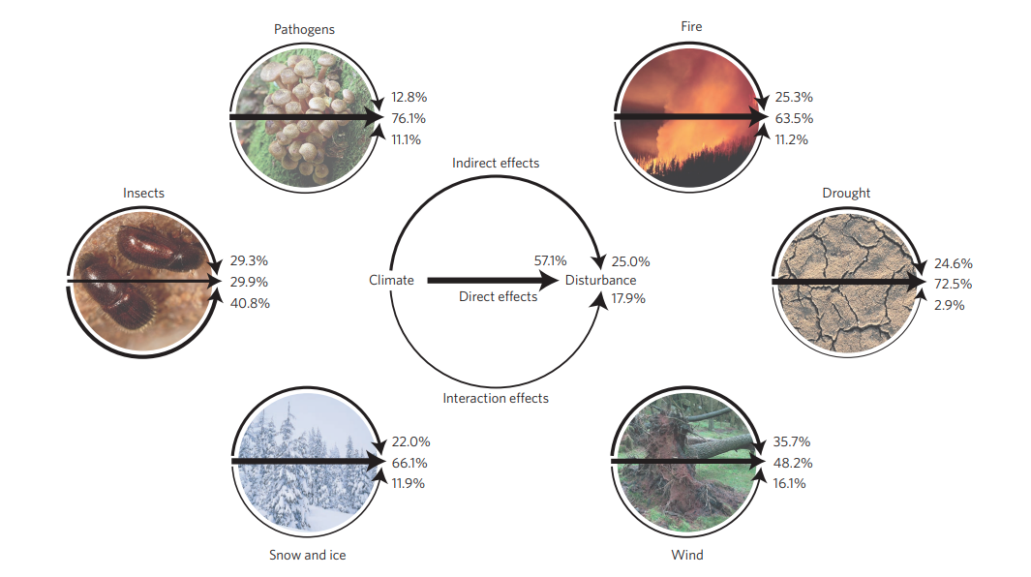
Altered natural disturbance regimes
Seidl et al. 2017
Notes:
Seidl et al 2017.
The changes in temperature and sea level are altering natural disturbance regimes, like those you see depicted here. Keep in mind that forests are adapted to each of these disturbances. They function as important drivers of change. However, climate change is increasing the frequency and intensity disturbances. Note that disturbances can be biotic (insects, pathogens, invasive species) or abiotic (extreme weather events, etc.). Both are altered as a result of climate change.
Here is a depiction of the current understanding of forest disturbances under climate change. It synthesizes the existing knowledge of how climate change is affecting disturbance regimes via direct, indirect and interaction effects. This is based on a literature review of disturbance ecology from 1990 onwards. It reports four abiotic (fire, drought, wind, snow/ice) disturbance agents, and two abiotic disturbance agents (insects and pathogens).
For every agent, arrow widths and percentages indicate the relative prominence of the respective effect as expressed by the number of observations extracted from the analyzed literature supporting it. The central panel displays the aggregate result over all disturbance agents. Direct effects are unmediated impacts of climate on disturbance processes, while indirect effects describe a climate influence on disturbances through effects on vegetation and other ecosystem processes. Interaction effects refer to the focal agent being influenced by other disturbance agents.
This study found that climate change considerably increases forest disturbance activity at the global scale, and that positive, amplifying effects of climate change on disturbances dominate negative, dampening effects.
I will touch an a few altered disturbance regimes compromising the health and resilience of CT forests.
Image credits: David R. Frazier Photolibrary/Alamy Stock Photo (fire); PhotoDisc/Getty Images/Don Farrell (drought); Chris Warham/Alamy Stock Photo (wind); Royalty-Free/Corbis (snow and ice); Nigel Cattlin/Alamy Stock Photo (insects); and Naturepix/Alamy Stock Photo (pathogens).

Slide 8
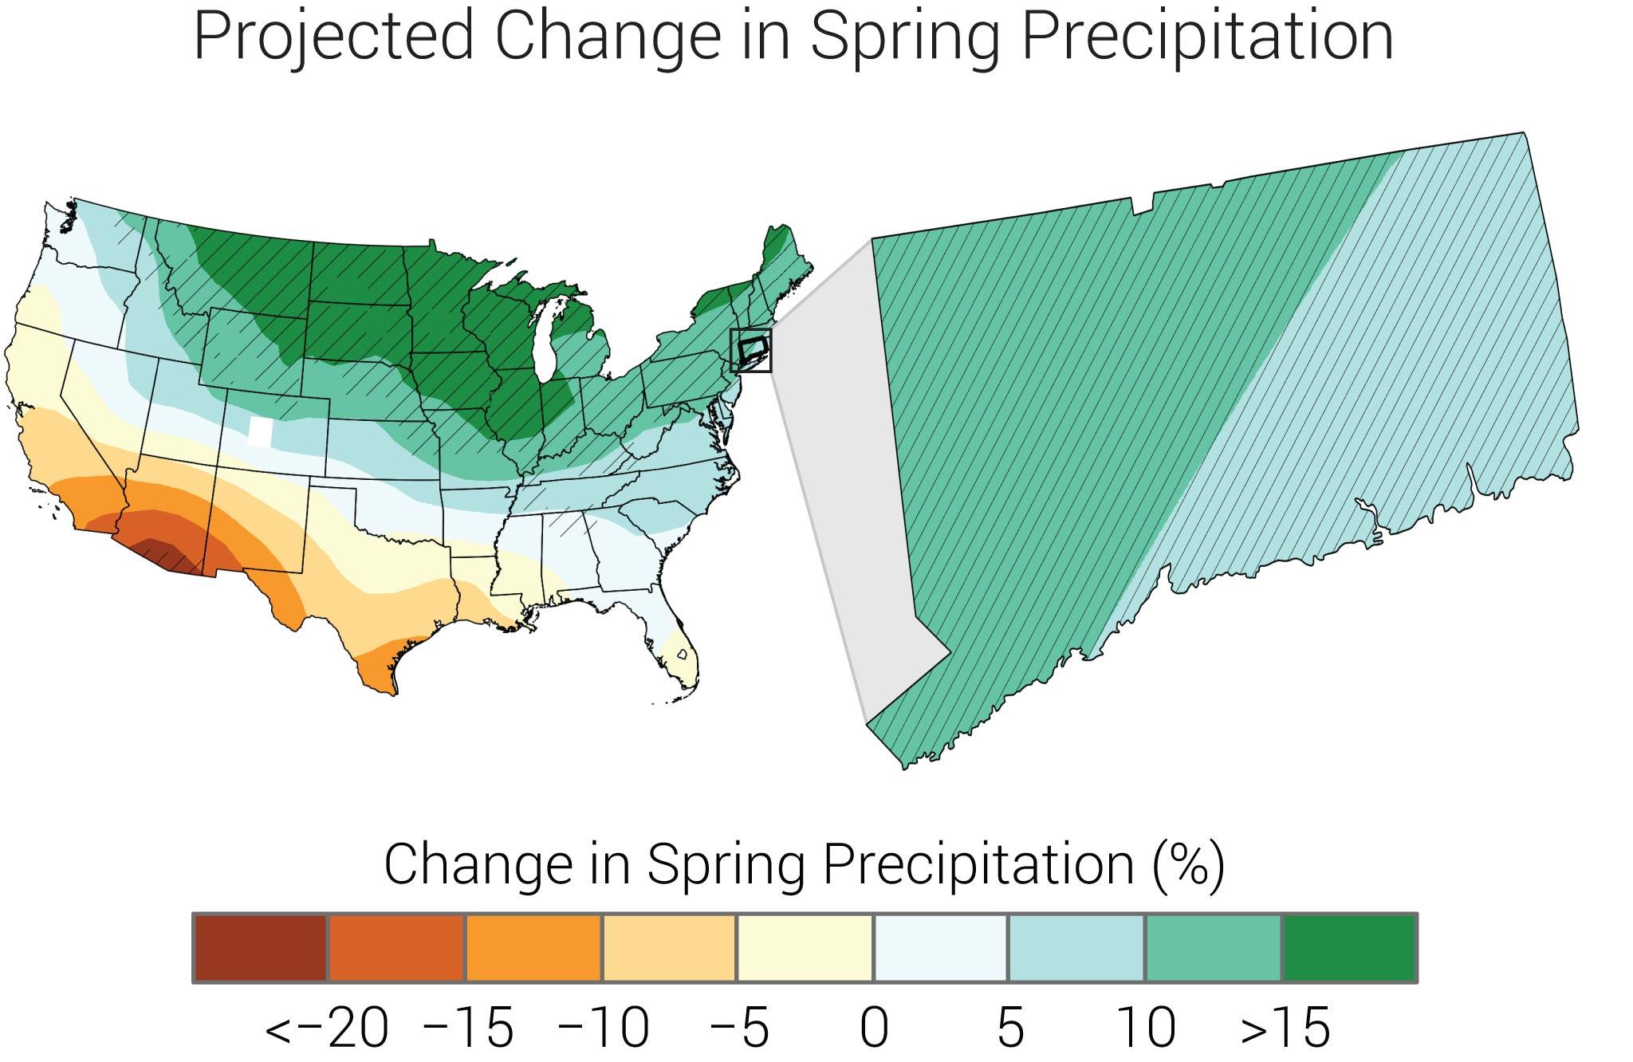
Localized effects
Spring Precipitation
NOAA National Centers of Environmental Information, State Climate Summaries
Notes:
So let’s start with an abiotic disturbance example: precipitation.
Precipitation in CT has increased during the last century, with the highest number of extreme weather events occurring other the last decade. Annual average precipitation will continue to increase. Increases in the frequency and intensity of extreme precipitation events are projected in both the winter and spring. This also results in increased coastal and inland flooding risks.
Here you see projected changes in total spring (march-may) precipitation (%) by the middle of the 21st century relative to the late 20th century under a higher emissions pathway. Hatching represents areas where the majority of climate models indicate a statistically significant change. Though CT will experience a 5 to nearly 15% increase in spring precipitation, this change will occur, as we’ve already observed, in intense rainfall events with dry periods in between.
Source: CICS-NC and NOAA NCEI.
Coastal communities, characterized by many rivers, are particularly vulnerable to increases in total precipitation and the number of extreme precipitation events.

Slide 9
Localized effects
Drought 2000-2023
Notes:
Interestingly, though the intensity and frequency of precipitation events are increasing, particularly during CT’s springs and winters, CT is also experiencing extended periods of dryness between these extreme weather events.
Drought is playing a greater role across CT’s landscape.
Here you see data from the U.S. Drought Monitor, which started monitoring drought in 2000. The D0-D4 classifications indicate drought duration – so a D4 is a longer drought than D0. Since 2000, the longest duration of drought (D1-D4) in Connecticut lasted 46 weeks beginning on June 21, 2016 and ending on May 2, 2017. The most intense period of drought occurred the week of November 15, 2016 where D3 affected 44.5% of Connecticut land.

Slide 10
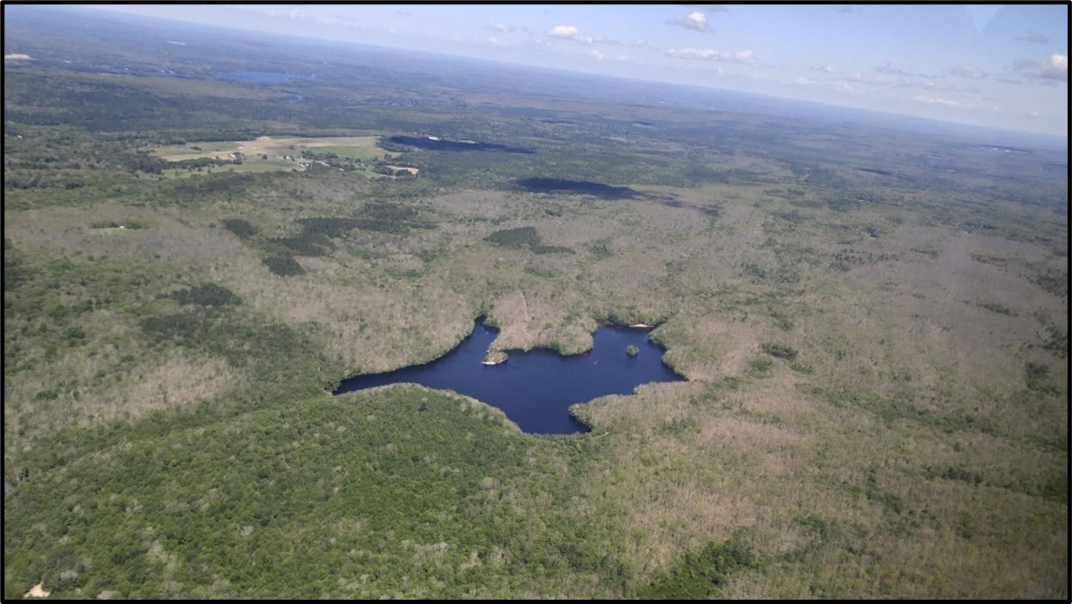
Drought
Widespread oak mortality following drought and insect outbreaks in
Pachaug State Forest, CT. Photo taken in the summer (leaf on) of 2019
156,000 defoliated acres in 2020 | 45,550 defoliated acres in 2021
Notes:
As discussed in Module 1, droughts are among the greatest stressors on forest ecosystems, and often lead to secondary effects of insect and disease outbreaks on stressed trees, and increased fire risk . We’re witnessing an example of this present day in eastern CT, and pockets in western CT with spongy moth and the native two-lined chestnut borer.
Annual forest pest and disease aerial surveys conducted by our Ag. Exp. Station documented Eurasian spongy moth caterpillars defoliated 156,000 acres in 2020 (mostly eastern CT) and 45,550 acres in 2021 (mostly Litchfield County).
The potential effects of drought on forests will depend on many factors, including duration and severity of the drought and site-level characteristics of the forest. High stand density may compound susceptibility to moisture stress as high-density stands face increased competition for available moisture (D’Amato et al. 2011, Magruder et al. 2012). Tree species also respond differently to drought. For example, drought during the past century has been linked to dieback in sugar maple and some species of birch and ash
bc precipitation is more likely to occur during larger precipitation events, the number of consecutive days without precipitation is also expected to increase
Temperatures rises and inc. evapotranspiration from climate change causes moisture stress. Drought can occur when increases in evapotranspiration are not offset by a corresponding increase in precipitation and soil moisture.

Slide 11
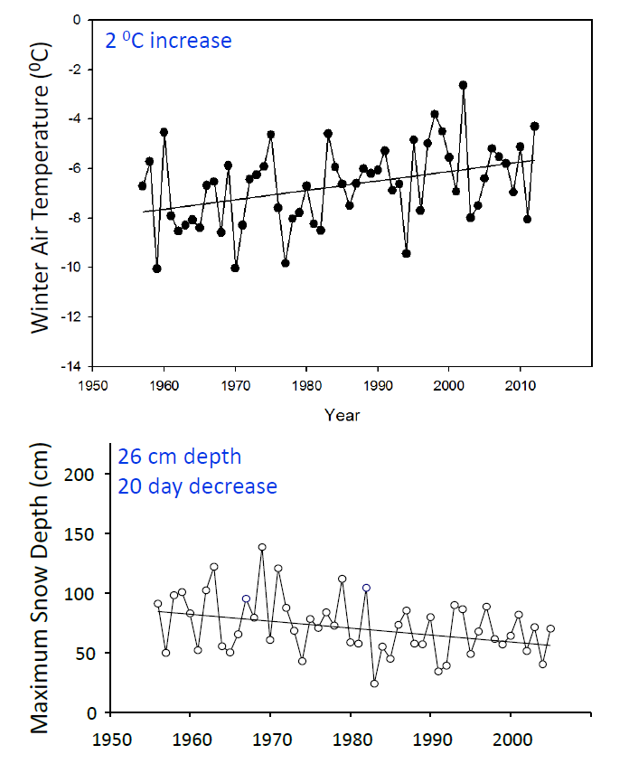
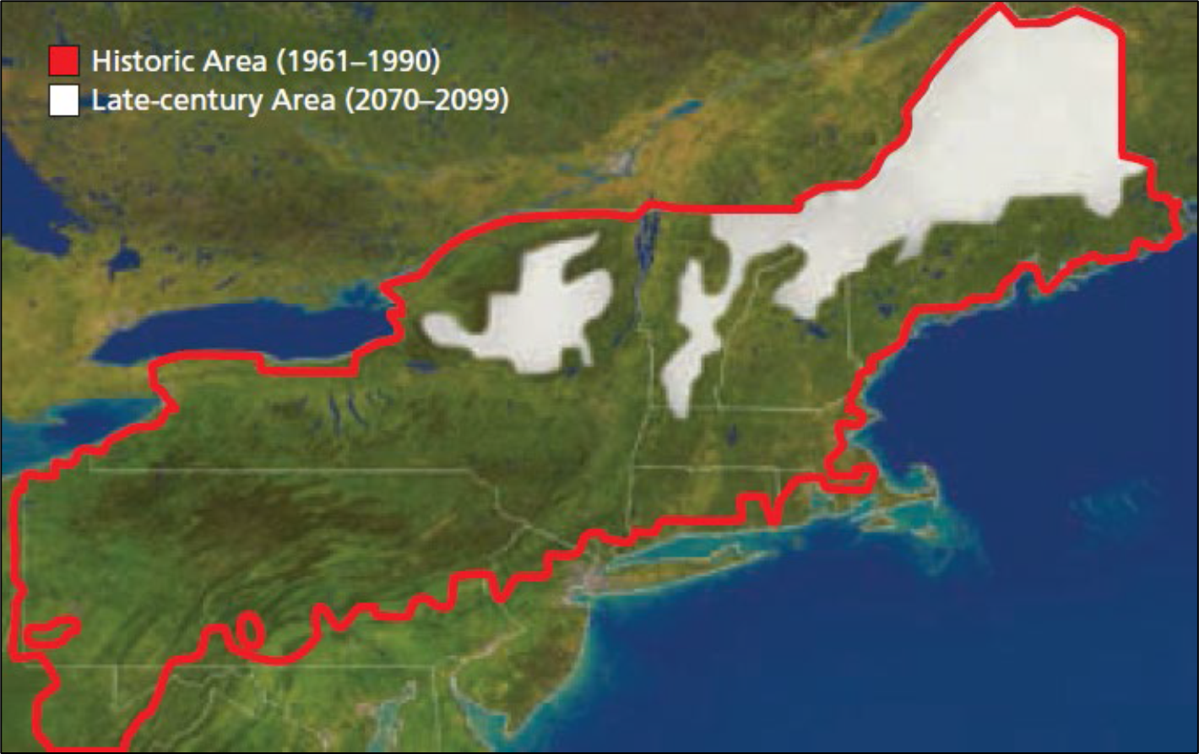
Seasonal effects
Winter Precipitation
°F
32
28.4
24.8
21.2
17.6
14
10.4
6.8
3.6°F
(10”)
Pamela Templer, Ph.D. Boston University
IPCC
Templer et al. 2012
Notes:
Winter precipitation is also changing in CT and the US Northeast. Our warming winter temperatures have a direct impact on snow pack. temperatures have risen and are rising disproportionately in the winter (versus summer or spring). In fact, the winter temperature increase is greater than the average increase in CT’s air temperature (3.6 degrees versus 3)
So even though CT is getting more precipitation, less of it is falling as snow. Compared to 1950, we have an average of 20 fewer days of snow cover per winter, and our maximum snowpack, on average, is 10 inches less than it used to be.
Models have projected this change over time. You can see that by 2100 the IPCC products CT will have no snow cover.
Now you may think., how nice, less snow removal and maintenance to have to deal with. But this has negative impacts on our forests by compromising their ability to function and provide their imperative ecological, social, and economic benefits. Let’s discuss.

Slide 12
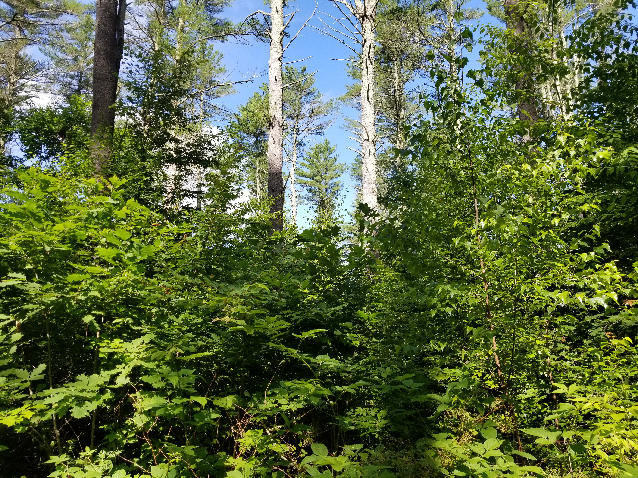
Longer Growing Seasons
_
+
Forest Productivity
Photosynthesis & respiration
Biomass
Offset by soil respiration
Vulnerability to late spring frosts
Frozen soils
Notes:
Many sciences have debated whether the observed and projected increase in atmospheric temperatures will increase forest productivity (i.e., growth), or limit it. On the one hand, with warmer winters, there is a longer time for plants to photosynthesis, which can mean greater growth rates and carbon sequestration. However, on the other hand, CLICK scientists are finding that these benefits can be and are offset by increased respiration associated with warmer temperatures. Forest plants are also more vulnerable to late spring frosts and impacts from soil frosts, which can reduce productivity. Additionally, where present, the warmer temperatures tend to disproportionately benefit invasive plant populations.

Slide 13
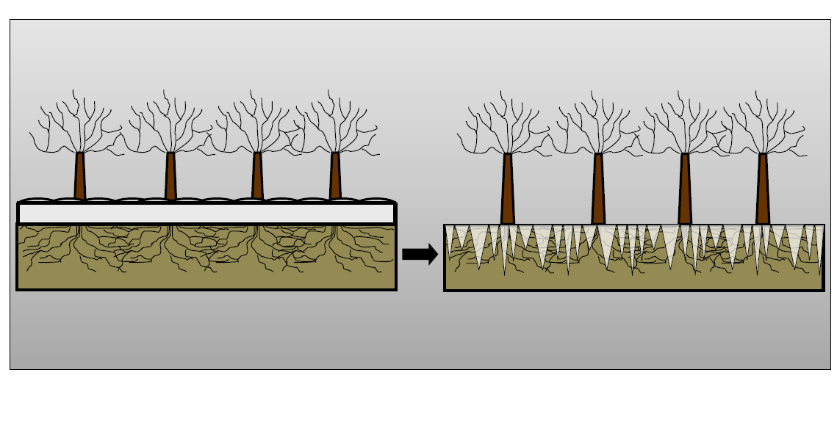
Seasonal effects | winter precipitation
Reduced Snowpack Leads to Soil Freezing
Which can reduce carbon storage capacity in northeastern forests by over 15%
Templer et al. 2012
Notes:
so the longer growing seasons and lack of snow cover is proving to compromise the health and function of US norhteastern forests. On the left you see a forest with adequate snow cover and on the right, in our warming climate, there is no snow cover. Instead you see soil frost penetrating. Snow acts as insulation. A lack of this insulation…
Soil freezing reduces forest health & function which damages biota. Specifically it leads to root injury, and compromised microbial and insect populations, and increased plant respiration. This compromises forests’ ability to function and provide their imperative ecological, social, and economic benefits. Specifically, it reduces air and water quality and carbon storage potential. In fact, Templer et al. 2012 found that it can reduce carbon storage capacity in northeastern forests by over 15%.

Slide 14
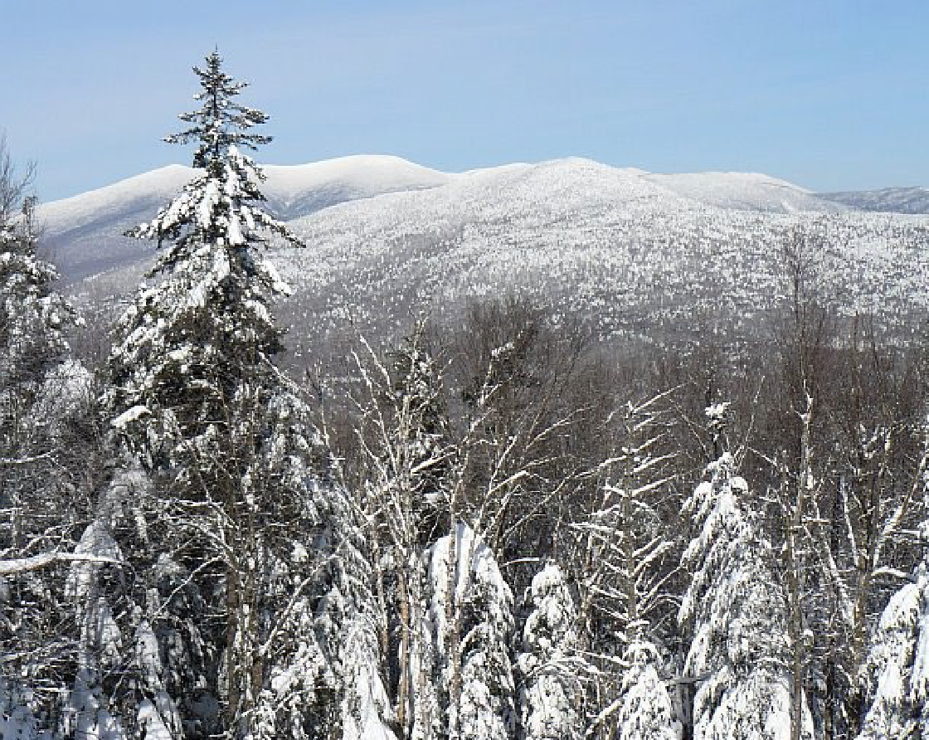
Soil frost reduces ecological function
Which damages biota in forests
Plant roots
Microbes
Arthropods
Water & air quality
Forest carbon storage
Notes:
In addition to damaging biota and reducing carbon storage capacity, soil frost and lack of snow cover can increase erosion, impede infiltration of water into the soil, export nutrients into streams, and reduce root biomass. Compromising carbon storage capacity, it also reduces the mitigation benefits our forests provide in the context of climate change.
(Soil frost induces root injury of sugar maples by 37% (commerford et al.2013)
Soil frost reduces N uptake by sugar maples by 36%)
Frozen soils from lack of snow pack can increase erosion, impede infiltration of water into the soil, export nutrients into streams, and reduce root biomass.
Plant roots
Microbes
Arthropods
Water & air quality
Forest carbon storage

Slide 15
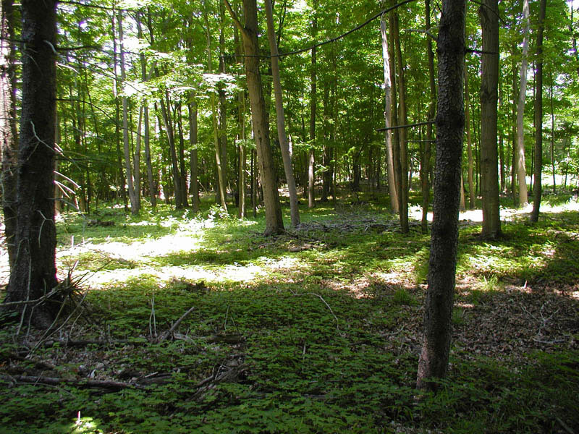
Herbivory
16-year old deer-stunted maple seedlings | Mansfield, CT | Credit: Jeff Ward, CAES
Notes:
In addition to the weather-related/abiotic disturbances we discussed, biotic disturbances are altered by climate change and compromising CT forest health.
Changes in snowfall amount and duration throughout the northeast may change the winter foraging behavior for herbivores such as white tailed deer – a current threat to CT forest health.
Though it’s still a bit unclear, changes in climate may benefit deer.
warmer temps and lack of snow depth are expected to reduce the energy requirements for deer and increase access to forage during winter months.
deer browsing pressure may limit the ability of forests to respond to climate change. Northern white cedar, has already been negatively affected by excessive deer browse
tree species that are anticipated to expand their ranges northward (many hardwoods) are browsed much more heavily than some of our more northerly species.

Slide 16
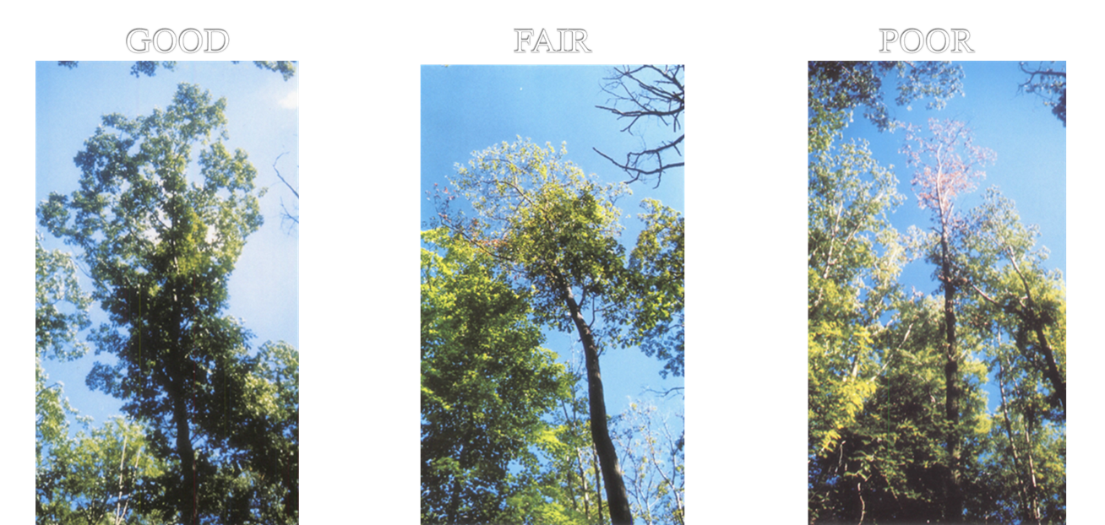
Increase in Pests & Pathogens
Varying conditions of red oak following recent spongy moth outbreaks. Pachaug State Forest,
Credit: D. Evans, CT DEEP Forestry
Notes:
Pests and pathogens are becoming more damaging, as they adapt more quickly to new climatic conditions, migrate more quickly to suitable habitat, and reproduce at faster rates than host tree species.
insects and disease become more problematic when trees are stressed by factors such as drought (EX: gypsy moth and two lined chestnut borer)
Less severe winters may increase insect survival and spread (hemlock wooly adelgid, balsam wooly adelgid, southern pine beetle, ticks, etc.)
It is also likely that fungal pathogens will become more aggressive due to longer active season, enhanced colonization under warmer and drier conditions, increased stress on host trees.
According to 2018 FIA data, the average annual mortality of trees in cubic feet increased by 41% between 2013 and 2018. Though this is in part due to the natural aging and decline of our forests, it is largely attributable to pests and pathogens. Specifically that of the invasive emerald ash borer, targeting ash species, and the spongy moth, that has recent widespread effects on CT’s oak populations. Here you see varying conditions of red oak following recent spongy moth outbreaks.

Slide 17
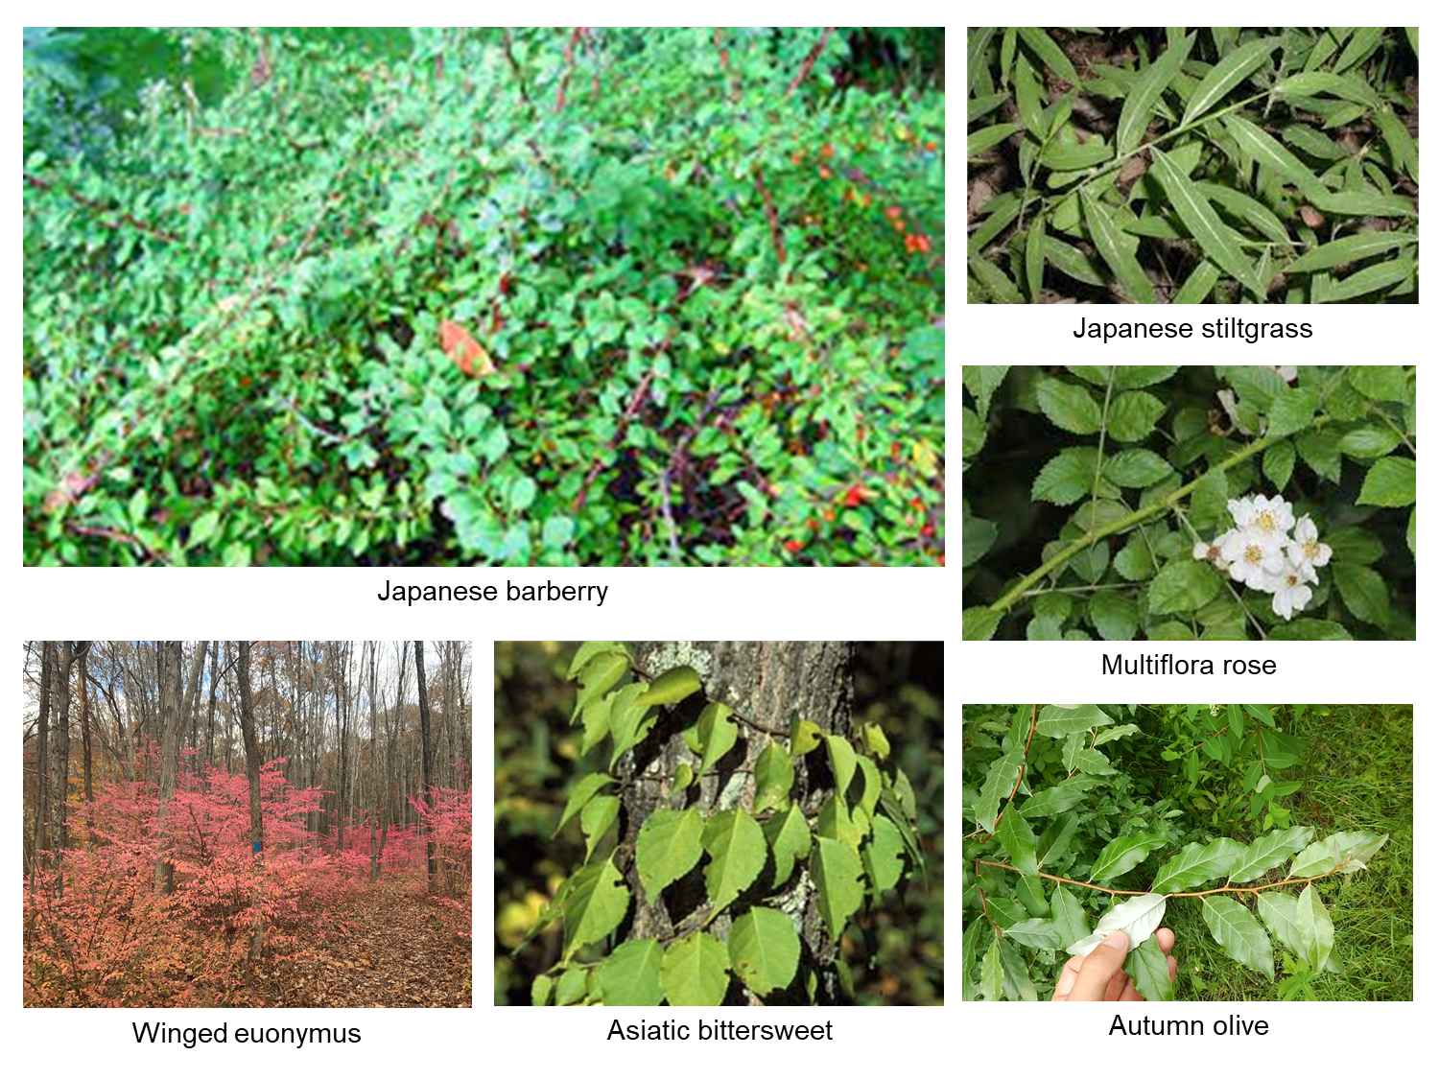
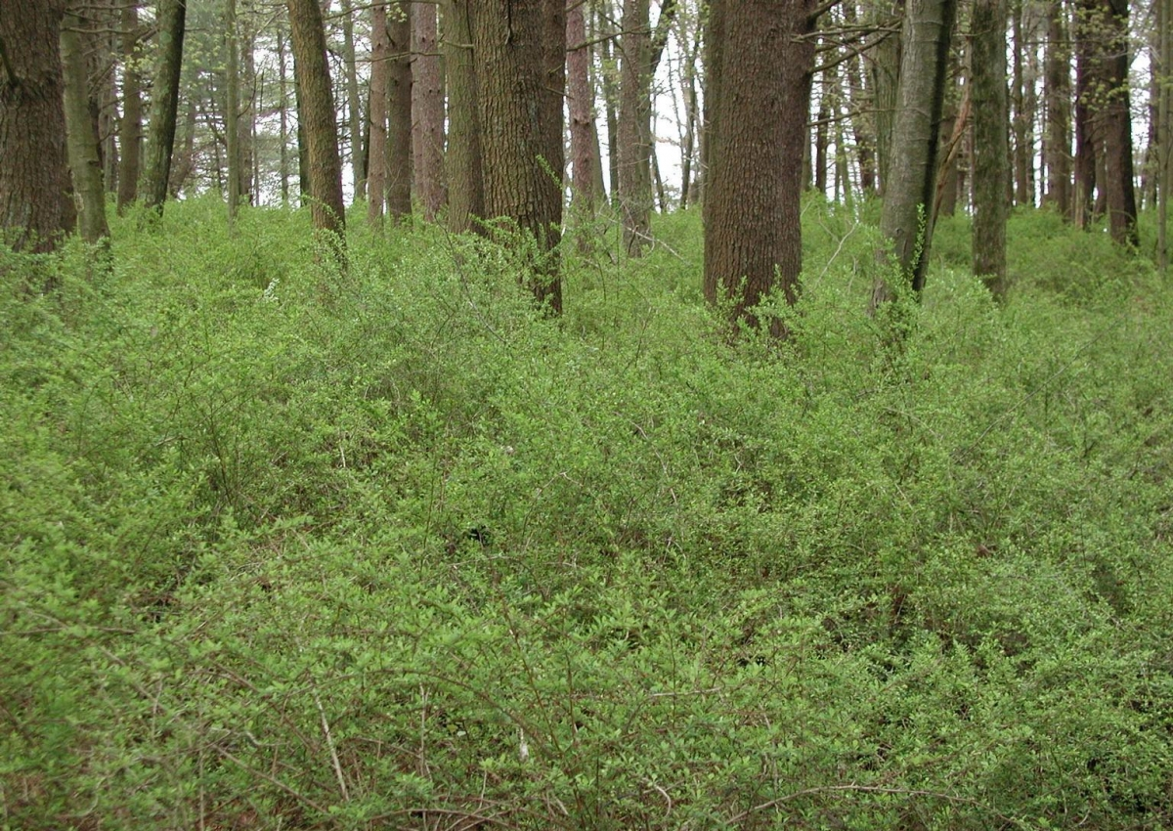
Increase in Extent & Abundance of Invasive Speices
Notes:
Invasive plants reduce forest health and resiliency by preventing tree establishment and growth, reducing species and structural diversity, reducing wildlife biodiversity, and decreasing larger biomass, which has significant impacts on forest carbon dynamics.
Here you see some of the most prolific invasive plants that plague CT’s landscape. Already a major issue threatening current forest health, it is likely that invasive plants will disproportionately benefit under CC due to their broad environmental tolerances, extended leaf phenology, more effective exploitation of changed environments and more aggressive colonization of new areas.
The spread of invasive plants is facilitated and exacerbated by disturbances: for example, Japanese knotweed (which is not depicted here) spread extensively in CT post hurricane sandy and tropical storm Irene in 2012/13.
so in addition to warmer temps, earlier springs, and reduced snowpack, climate change is also contributing to the spread and abundance of invasive plants through associated altered disturbance regimes. As such, they are becoming even more competitive with tree and native plant regeneration/establishment
Additionally, CC will increase the range of many invasive plant species including kudzu, bush honeysuckles, and privet. So be on the look out.
due to their broad environmental tolerances, extended leaf phenology, more effective exploitation of changed environments, and more aggressive colonization on new areas, invasive plants are benefiting from climate change. These dynamics are further being exacerbated by disturbances, particularly extreme wind and precipitation events, and these are two major ways plants spread seeds.
climatic factors that influence invasive plants ability to invade include warmer temps, earlier springs, and reduced snowpack. Increased CO2 in the atmosphere increases growth for many species, including invasives, making them even more competitive with tree and native plant regeneration/establishment
just as forest ecosystems will favor southerly species over time, CC will increase the range of many invasive plant species including kudzu, bush honeysuckles, and privet
Why do we care? Well invasive species reduce forest health and resiliency by preventing tree regeneration, reducing species and structural diversity, reducing wildlife habitat quality, decreasing larger biomass

Slide 18
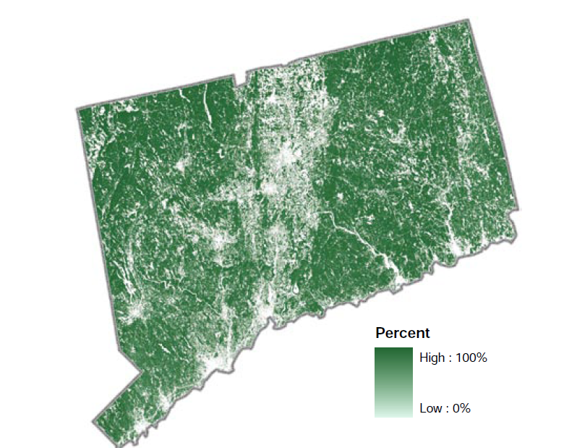
forests are a natural solution to climate change the good news
Protect & promote biodiversity
Dynamic systems: multiple pathways of recovery
Can reduce impacts of disturbances
Combat temperature increases
Slow the rate of change
Reduce flooding & associated impacts
Provide sustainable & renewable resources, clean air and water
  14th most forested state
  4th most populated state
Oswalt 2018
Notes:
So we are all hopefully in consensus that climate change is happening, and how have better sense of its impact on our beloved forested landscape. To put it boldly, but accurately, we are amidst a climate crisis. There is good news, however. Forests are a natural solution to climate change.
And we’re fortunate in CT, because about 56% of our landcover is forested. In fact, we’re the 14th most forested state in the nation. And the 4th most populated, so we are putting a lot of pressure on our forests to deliver this “good news”, so to speak.
Urban land cover was 38% in 2010 and is projected to increase to 62% by 2060²

Slide 19
Climate change compromises CT forest health & function the bad news
Elevated temperatures
Altered disturbance regimes
Invasive pests & pathogens
Increased soil respiration
Vulnerability to frost
Damages biota, reduces C storage capacity by over 15%
5-15% inc. spring precip., intense events w/ dry periods in-between
Increase in duration & severity of drought
Reduce native biomass & biodiversity
Compounding effects with disturbances
Economic, ecologic, and human health implications
NOAA National Centers of Environmental Information, State Climate Summaries, Connecticut
Seidl et al. 2017
Templer et al. 2012
IPCC
Notes:
but the bad news is that climate change and land-use conversion compromises our the ability of our forests to function as a natural solution to climate change.
I will delve into each of these topics deeper, but here’s a snap shot/introduction to the “bad news”
Elevation temperatures, longer growing season and the disproportionate warming in winter results in: increased soil respiration and vulnerability to frost. In addition to damaging biota and reducing carbon storage capacity, soil frost and lack of snow cover can increase erosion, impede infiltration of water into the soil, export nutrients into streams, and reduce root biomass. Compromising carbon storage capacity, it also reduces the mitigation benefits our forests provide in the context of climate change.
Sea level rise has caused an increase in tidal floods associated with nuisance-level impacts, meaning, the water levels exceed local thresholds, causing impacts that can damage infrastructure, cause road closures, and overwhelm storm drains. As sea level has risen along the Connecticut coastline, the number of tidal flood days (all days exceeding the nuisance level threshold) has also gradually increased.
Invasive plants reduce forest health and resiliency by preventing tree establishment and growth, reducing species and structural diversity, reducing wildlife biodiversity, and decreasing larger biomass, which has significant impacts on forest carbon dynamics. The spread of invasive plants is facilitated and exacerbated by disturbances: for example, Japanese knotweed (which is not depicted here) spread extensively in CT post hurricane sandy and tropical storm Irene in 2012/13. due to their broad environmental tolerances, extended leaf phenology, more effective exploitation of changed environments, and more aggressive colonization on new areas, invasive plants are benefiting from climate change. These dynamics are further being exacerbated by disturbances, particularly extreme wind and precipitation events, and these are two major ways plants spread seeds.

Slide 20
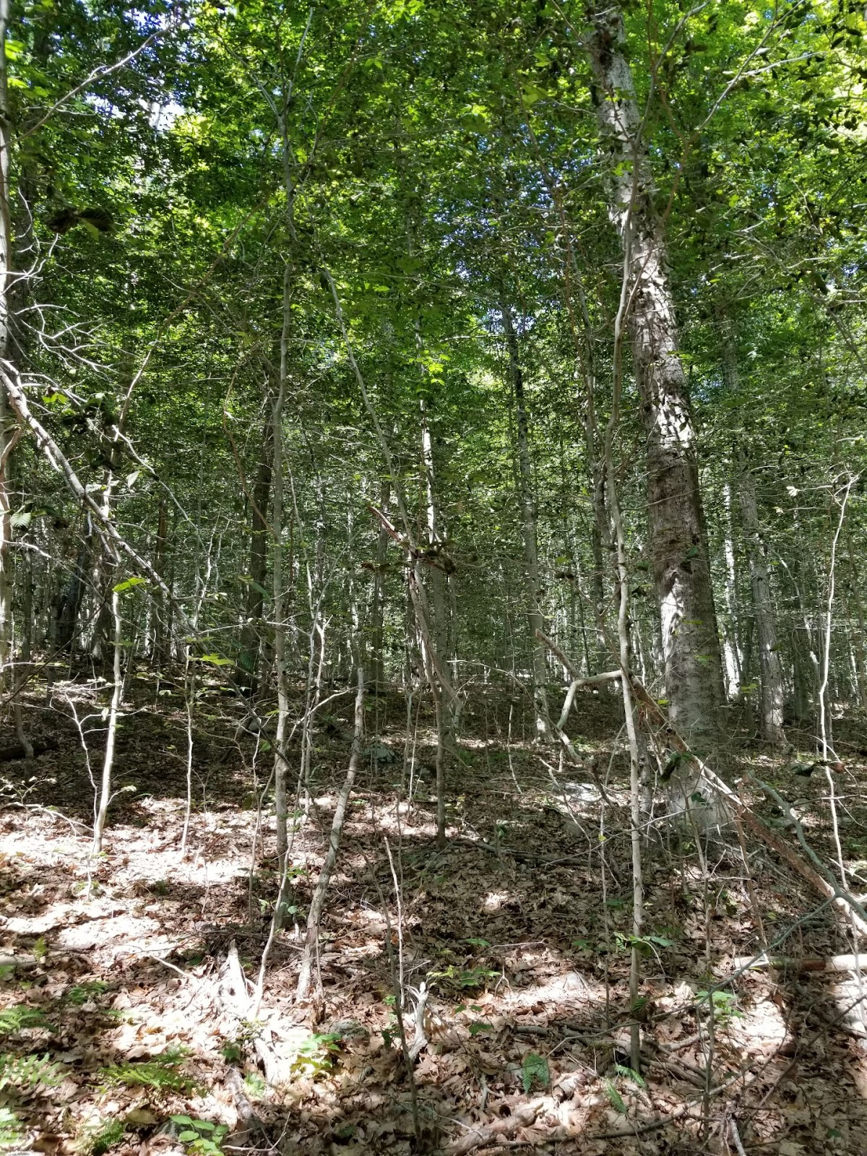
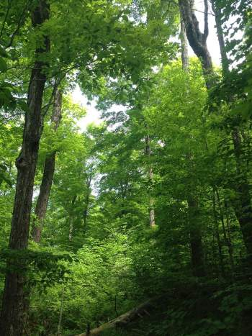
Forest are only effective in combating climate change if they are healthy and resilient
Unhealthy beech understory Bozrah, CT. Photo Credit: Cervo, CT Forestry
Diverse & healthy Understory Northern Woodlands, Spring 2020, W. Keeton, UVM
Notes:
AU
Remind audience the responsibility falls on us, the private and municipal landowners to promote a healthy an dresilient forested landscape
So that forests function as solution and we can continue to live the high quality lives we do
So we know why we need to promote forest health, but how?
In both photos you see forests with mixed canopy layers and regeneration, but are both healthy and functioning to meet our societal and ecological needs? To left you see an American beech understory, to the right you see a mixed species understory. What do you know about American beech? (BBD & BLD, stump sprouting, invasive tendency, low resilience/adaptability). It is not functioning with any meaningful adaptive mechnanism…

Slide 21
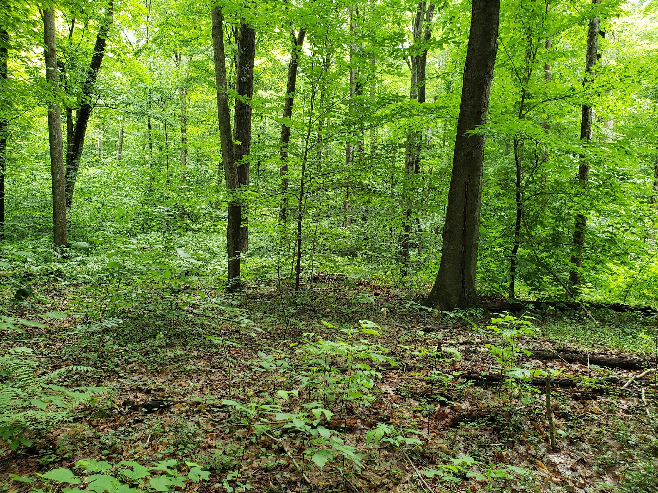
A resilient forest
The capacity of a forest to respond to a disturbance by resisting damage or stress and recovering quickly
(Northern Institute of Applied Climate Science)
7 years after an uneven aged selective harvest | Jerry Milne, CT DEEP
Notes:
So what do we need?
We need a resilient forested landscape.
What does this mean? This means that forests in CT need to respond to a disturbance by resisting damage or stress and recover from that disturbance quickly.

Slide 22
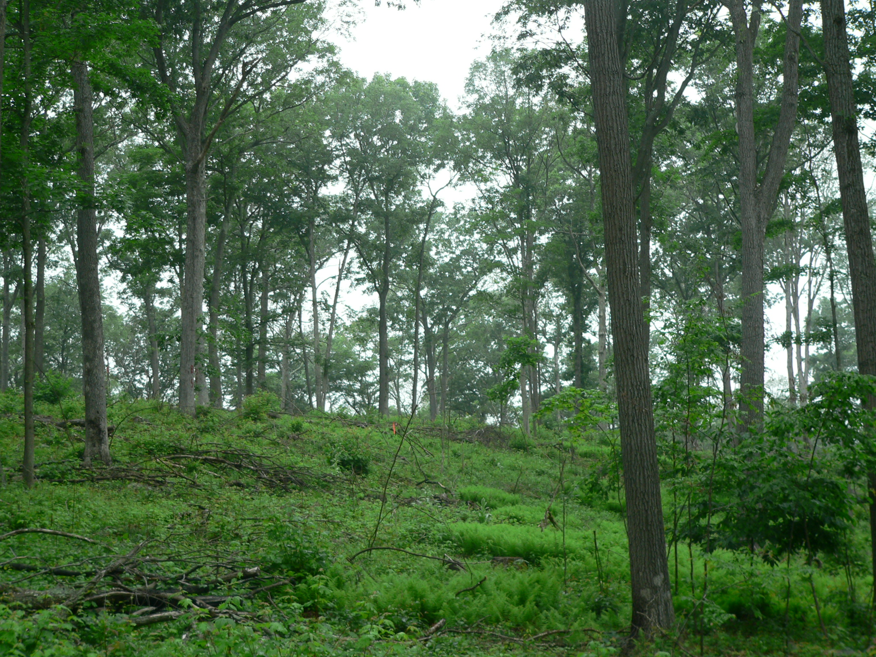
Why manage for resilience?
2020 Forest Action Plan, GC3 Working Lands Report, Plan and Policy on Resilient Forests in Connecticut prioritize:
No net loss of forest land
Forests function as a natural solution to climate change
The integration of climate-smart forest practices
Shelterwood employed at Cockaponset State Forest
Credit: J. Ward, CAES
Notes:
Furthermore, the State of CT, through the 2020 Forest Action Plan, the 2021-22 Governor’s Council on Climate Change (or GC3) Working/natural Lands (later referred to Agriculture and Forestry) report, and the Plan and Policy on Resilient Forests in Connecticut, has called out the need for forest management in CT.
Through these documents, recent and proposed legislation, and other policy developments, Connecticut is putting significant emphasis on the valuable role forests play in fostering a healthy and high-quality life for CT residents. CT has put forests and their management at the center of natural resource policy goals. The State has designated forests as a natural solution to climate change, and as such, has set a no net forest loss goal.
However, since 72% of the State’s forestland is privately owned, these ambitious g oals can only be met through engagement from private forest landowners like you. So let’s now focus on how to promote forest resilience.

Slide 23
Diversify age and size classes (landscape level)
Keep Forests as Forests: estate plan
Increase structural complexity (stand level)
Consider site conditions & species-specific tolerances
Control deer and invasive species
Have a forest management plan: integrate climate-smart practices
Increase species diversity
How?
Notes:
It is largely because of these threats to forest health and our ever-increasing need for healthy forests, that forest management plays such a critical role in making forests a natural climate change solution. There are a portfolio of forest management options, all of which should be represented across the landscape. These include passive and active forms of management – but the key to the success of forest management (active or passive) is ensure the data and boots on the ground expertise informs the process and decision making.
4.Diversity is key. We need a representation of all forest successional and developmental stages across the landscape. We need diversity of flora and fauna, which in part is driven by diverse habitat types. Consider how the land you manage fits into CT’s forested landscape at large.
Forest composition
Functional characteristics of species (drought tolerance, regeneration strategies, disturbance response)
Forest structural conditions
Size and cohort structures, heterogeneity
Site conditions
Is adaptation a priority based on edaphic factors and disturbance vulnerability

Slide 24

Questions?
Andrea.urbano@ct.gov
860-424-3635

Slide 25
In review:
A changing climate…
Alters forest productivity & function
Alters abiotic & biotic disturbance regimes
Reduces biodiversity
Threatens coastal & boreal forests
Requires a portfolio of mgt. options
Requires private landowner engagement
Notes:
It is largely because of these threats to forest health and our ever-increasing need for healthy forests, that forest management plays such a critical role in making forests a natural climate change solution. There are a portfolio of forest management options, all of which should be represented across the landscape. These include passive and active forms of management – but the key to the success of forest management (active or passive) is ensure the data and boots on the ground expertise informs the process and decision making.
4.Diversity is key. We need a representation of all forest successional and developmental stages across the landscape. We need diversity of flora and fauna, which in part is driven by diverse habitat types. Consider how the land you manage fits into CT’s forested landscape at large.
Forest composition
Functional characteristics of species (drought tolerance, regeneration strategies, disturbance response)
Forest structural conditions
Size and cohort structures, heterogeneity
Site conditions
Is adaptation a priority based on edaphic factors and disturbance vulnerability

