Slide 1
Maintenance and Design for
Vector Control
Or: Mosquitoes and Their Control 101
Rockfall Foundation and UConn Climate Adaptation
Academy Symposium
April 12, 2019

Slide 2
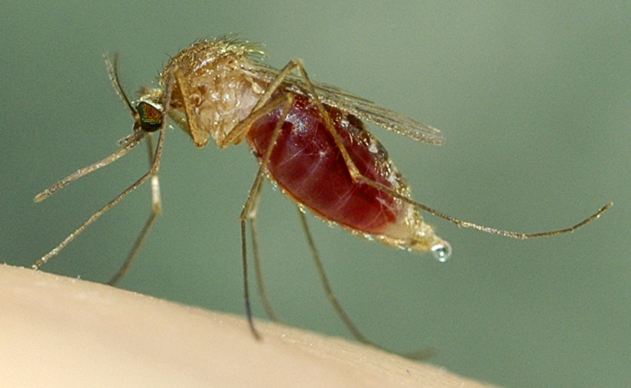
Mosquitoes
54 species in CT (~3000 worldwide, >200 in US)
Only female bites (irritation and disease transmission)
Univoltine vs. multivoltine (>risk)
Overwintering strategies
Emergence is temp dependent
Specific vs. general feeding (>risk)

Slide 3
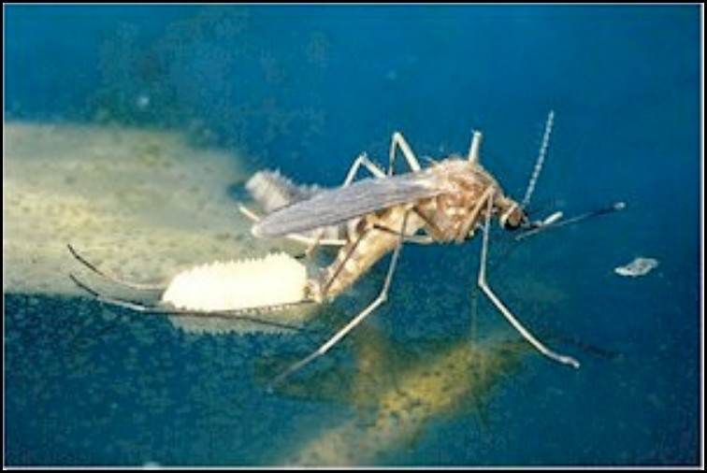
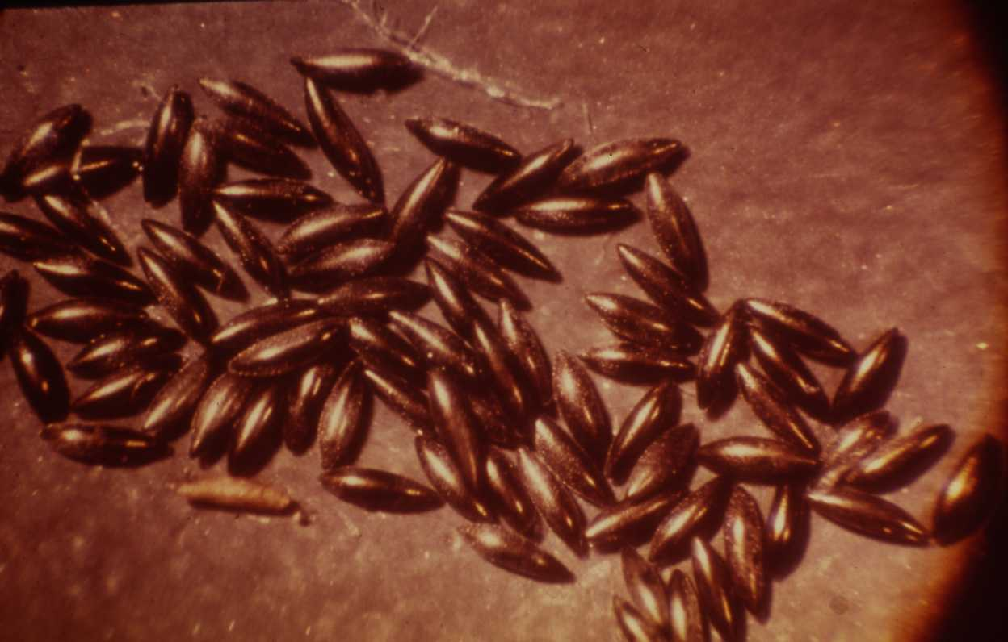
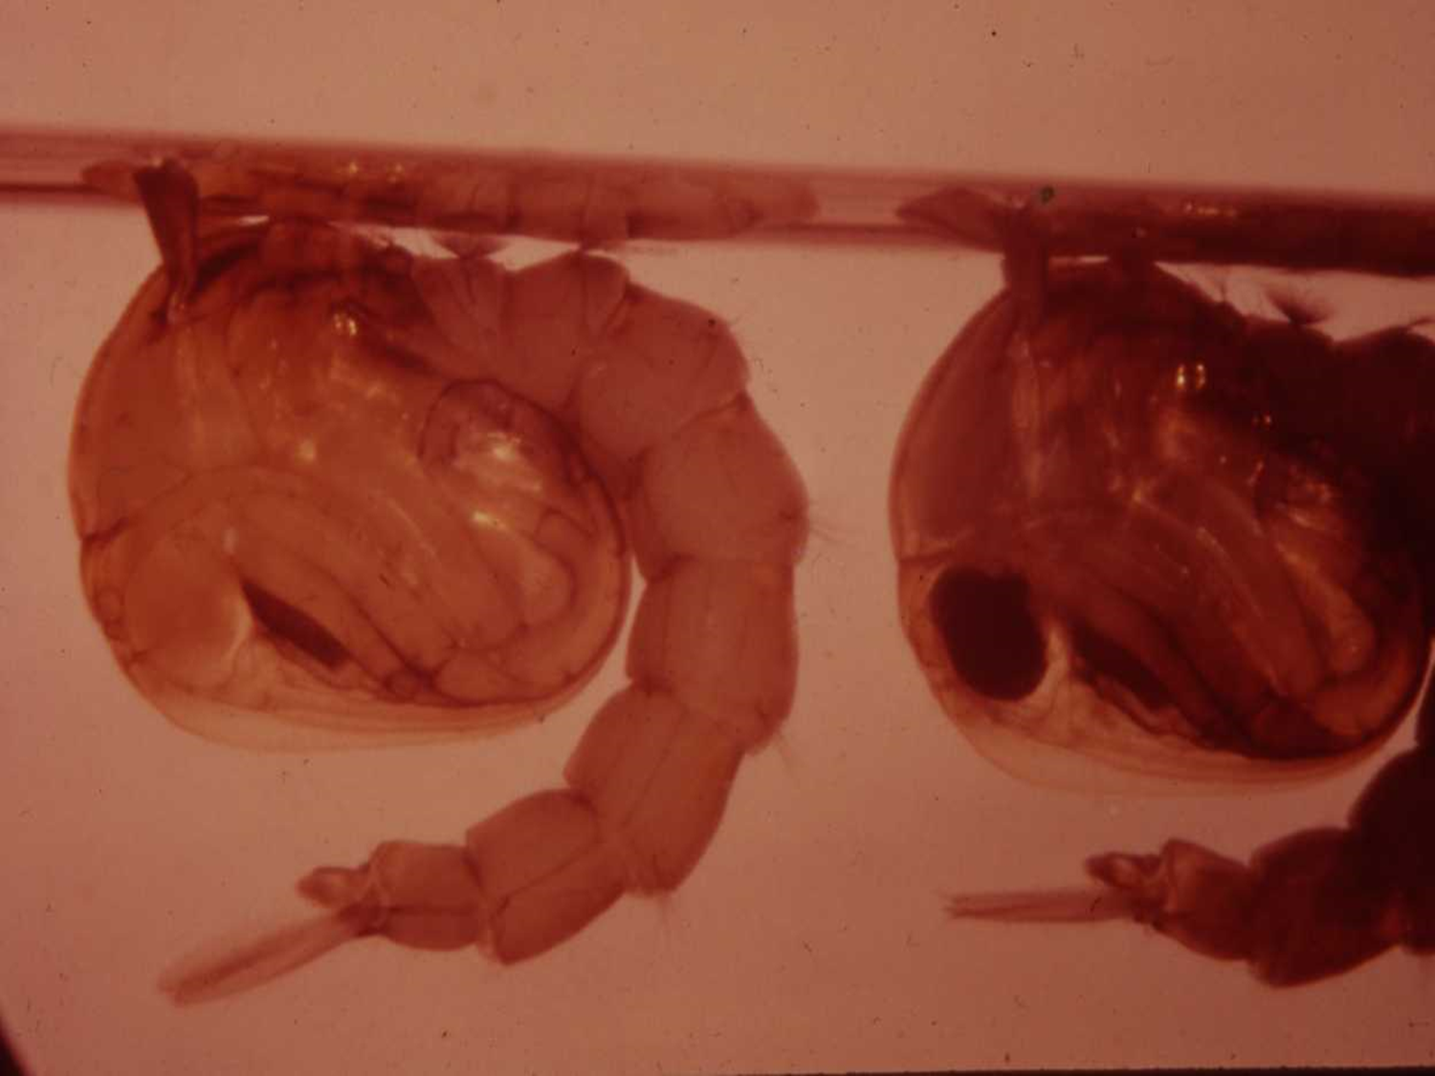
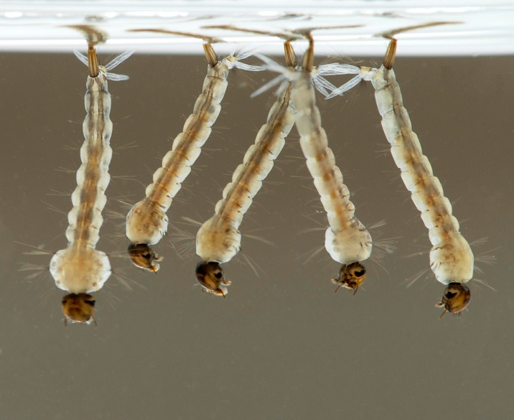
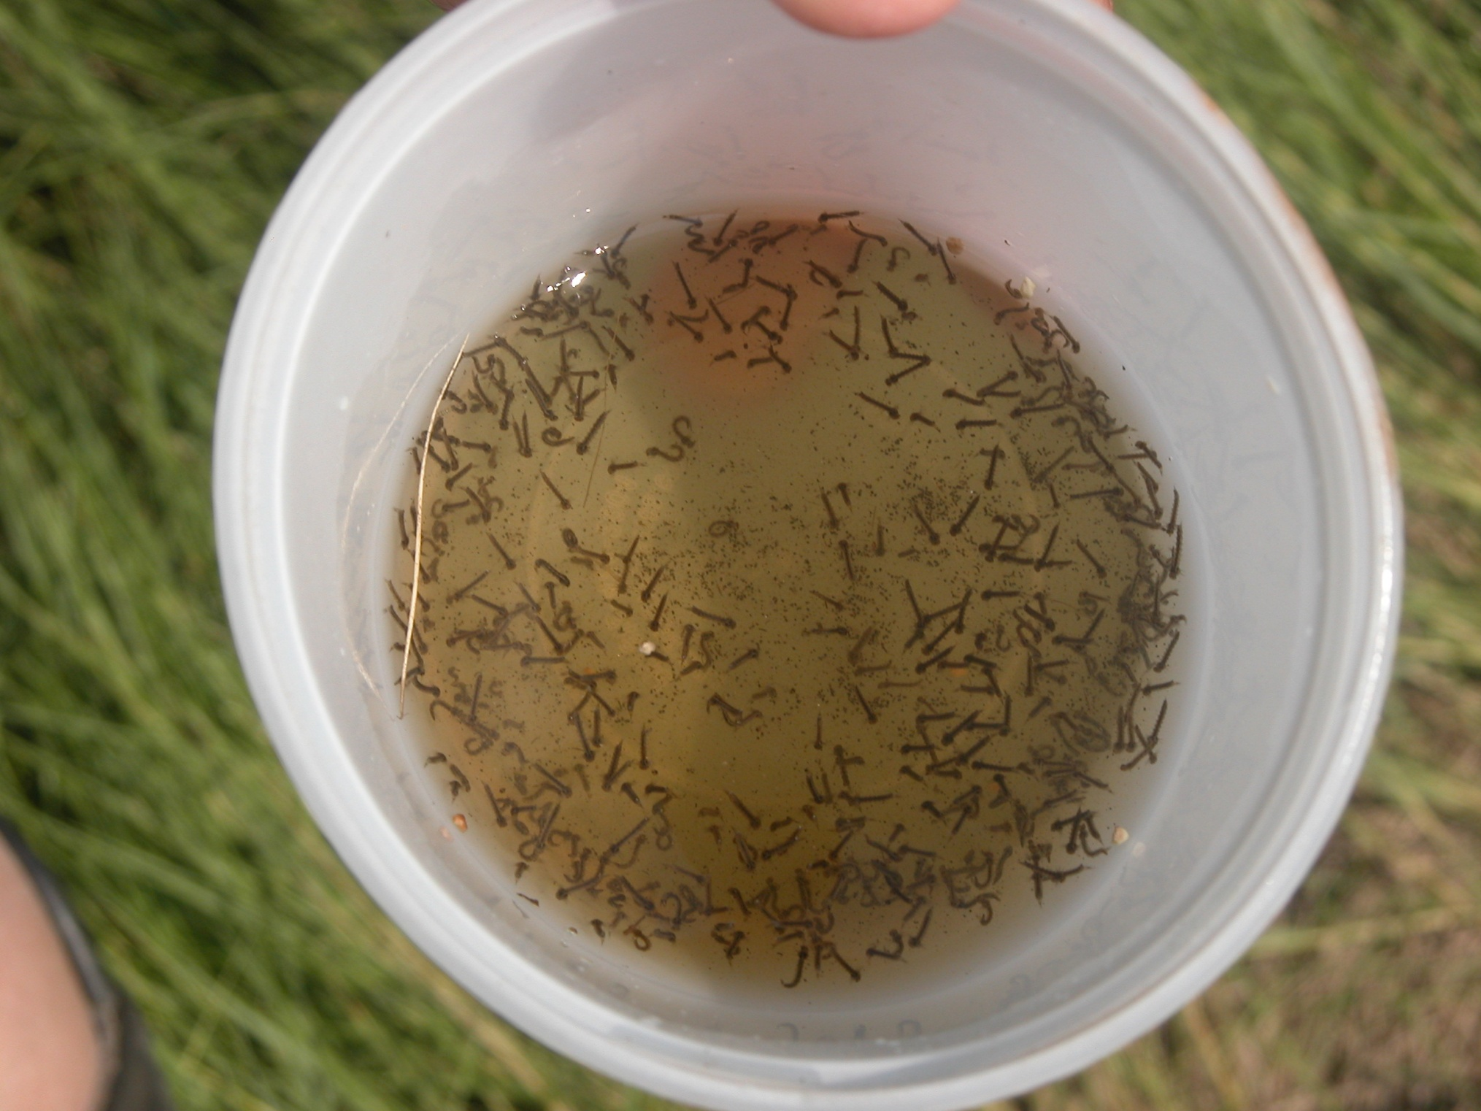

Slide 4
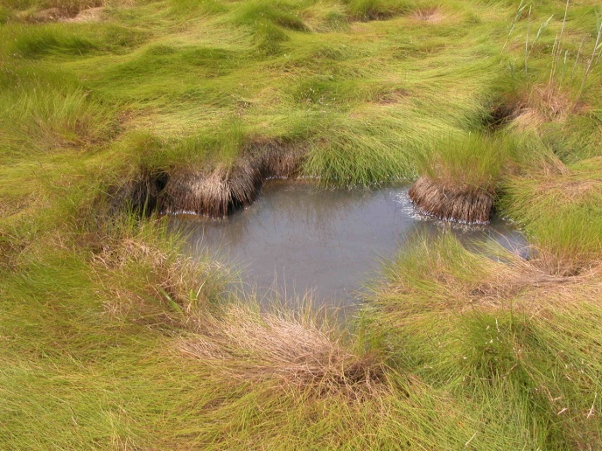
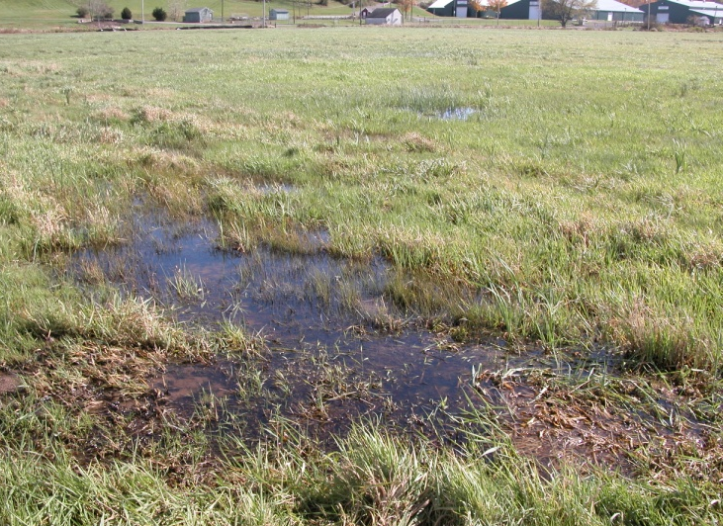
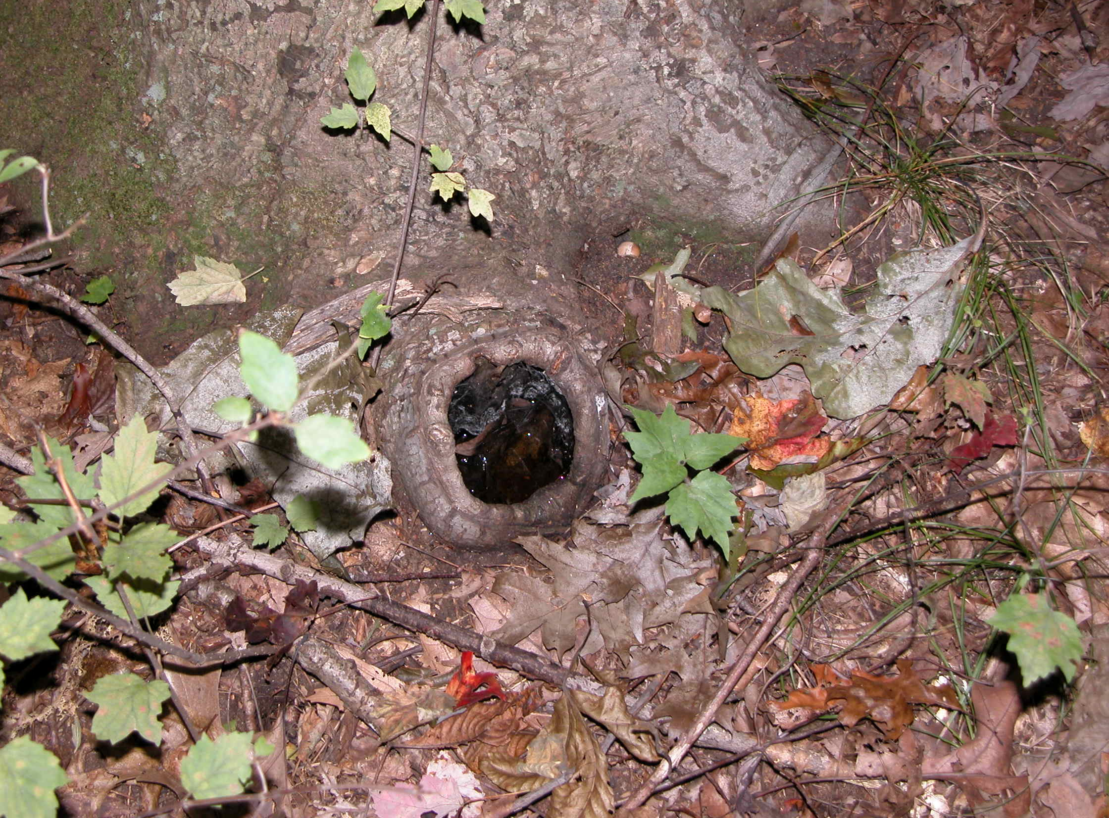
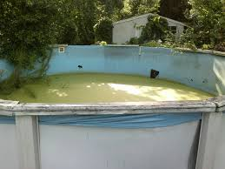
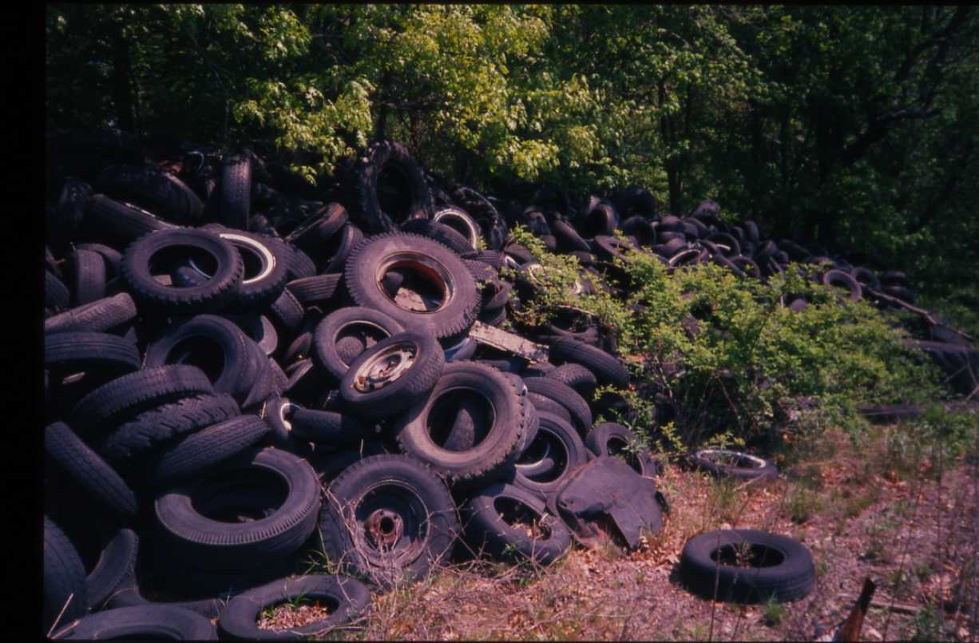
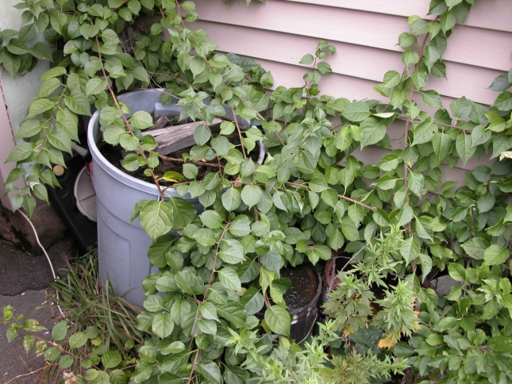
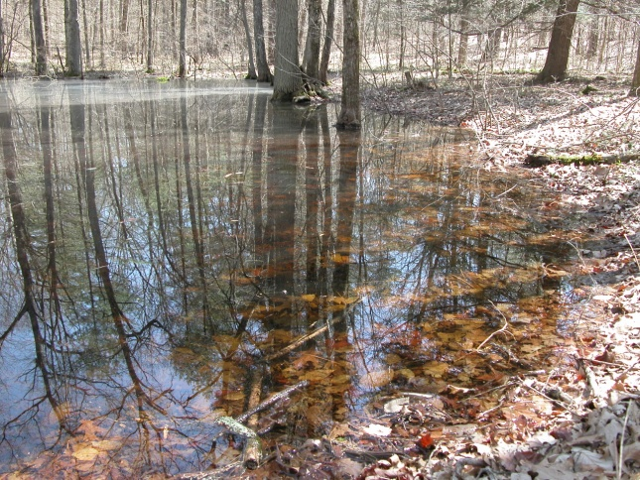
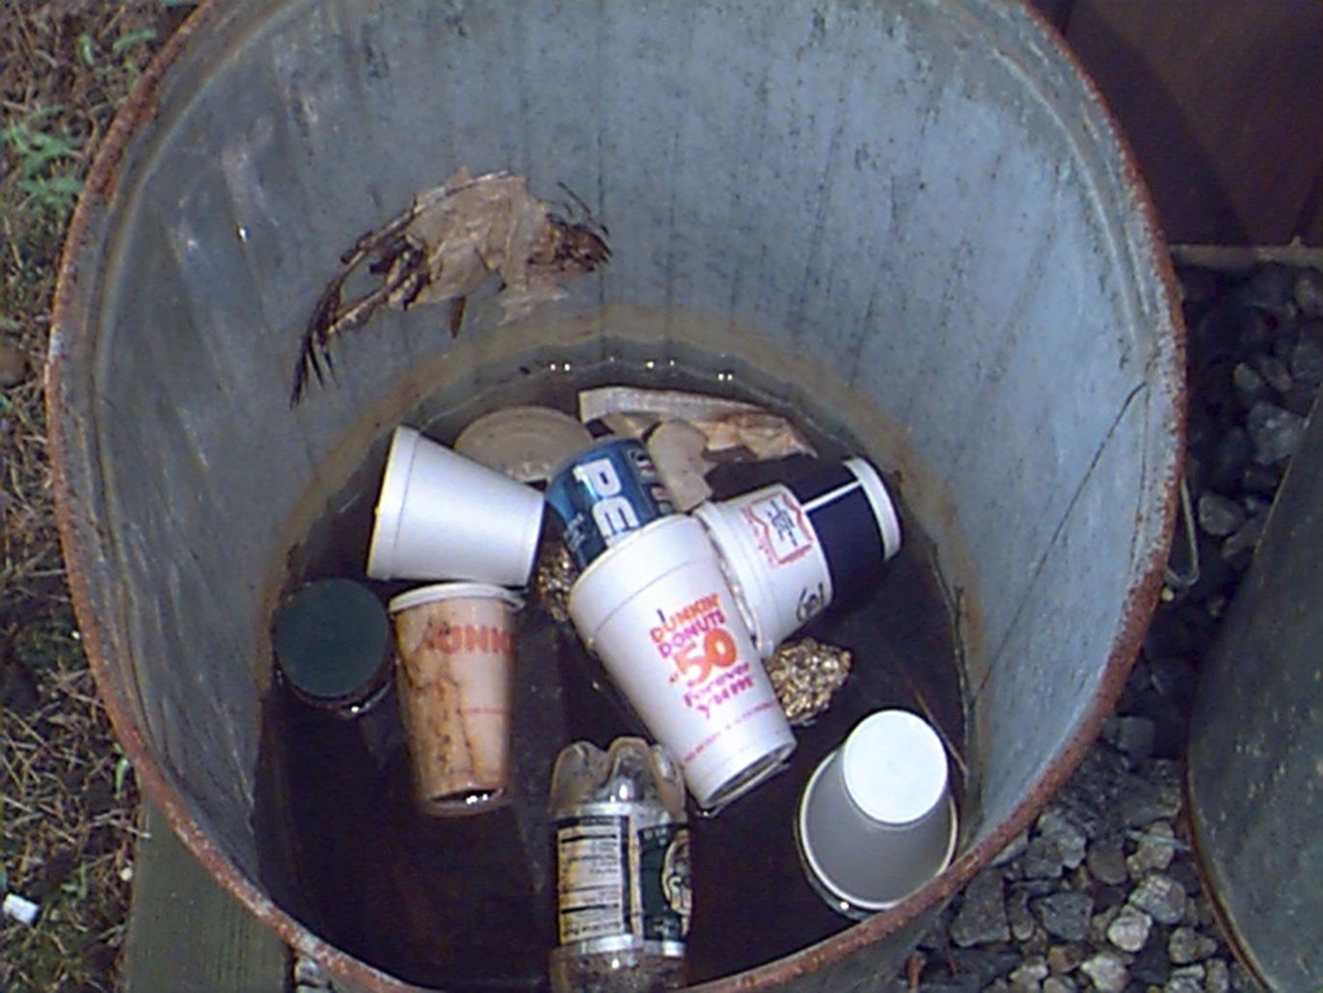
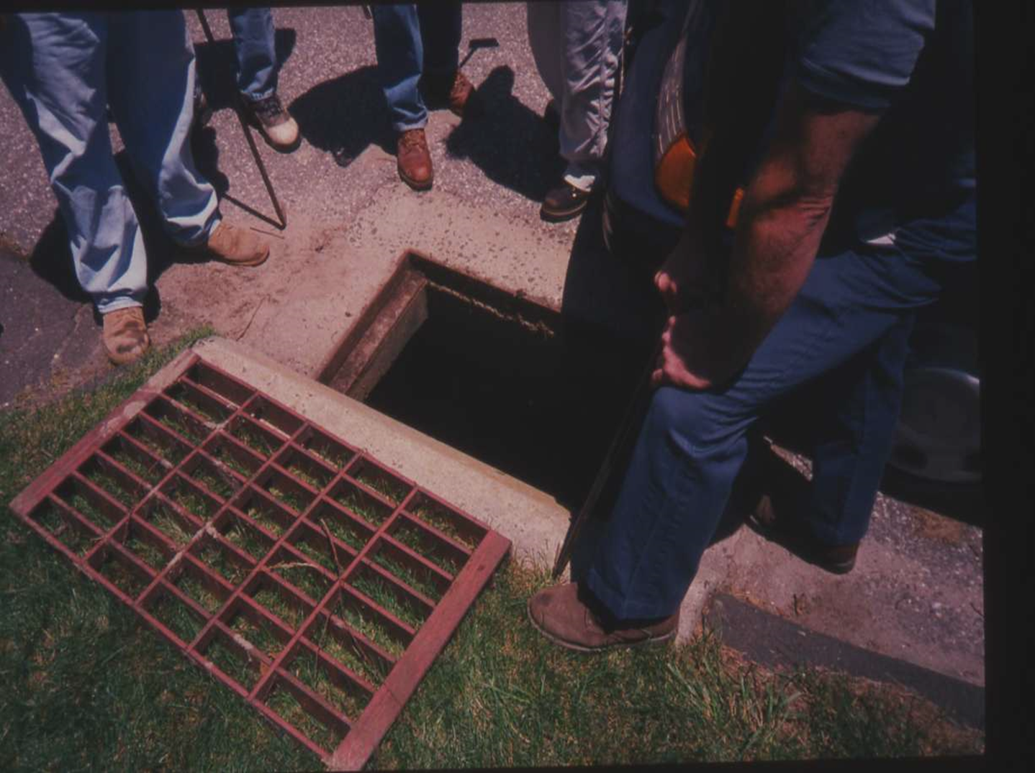

Slide 5
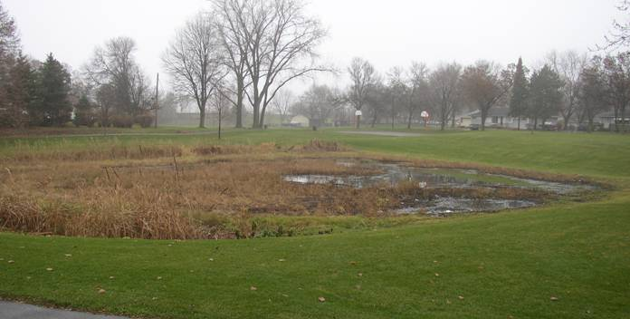
Created Wetlands/Stormwater BMP’s: “If you build it they will come.” (?)
Photo: N. Read

Slide 6
_____________________________________ Connecticut Mosquito Management Program
_____________________________________
Mosquito surveillance - CAES
Human surveillance - DPH/LHD
Mosquito control/tech assistance - DEEP
Domestic bird and animal - DoAg, UCONN
Communication and public awareness - DPH/DEEP/CAES
Notes:
As we approached this season, we, like everyone else were faced with the task of developing and implementing a WNV Surveillance and Response Plan. Fortunately, we already had in place a comprehensive multi-agency Mosquito Management Program, (1997) that was principally designed to monitor mosquitoes for EEE so at least for the mosquito surveillance aspect this was simply an expansion of that program with the addition of more trapping sites. In addition to the mosquito surveillance, we put into place an active wild bird surveillance working with the local health districts and municipalities . Targeted crows (DPH) - DPH and veterinary pathologists at UCONN (necropsies, removed tissue), DPH did testing. Domestic animal - horses (DOA and local veterinarians)

Slide 7
IPM for Mosquito Control
Monitoring and Surveillance
Education
Source Reduction
Personal Protection
Biological control
Chemical control
-Larvaciding
-Adulticiding
Notes:
Integrated Pest Management Programs

Slide 8
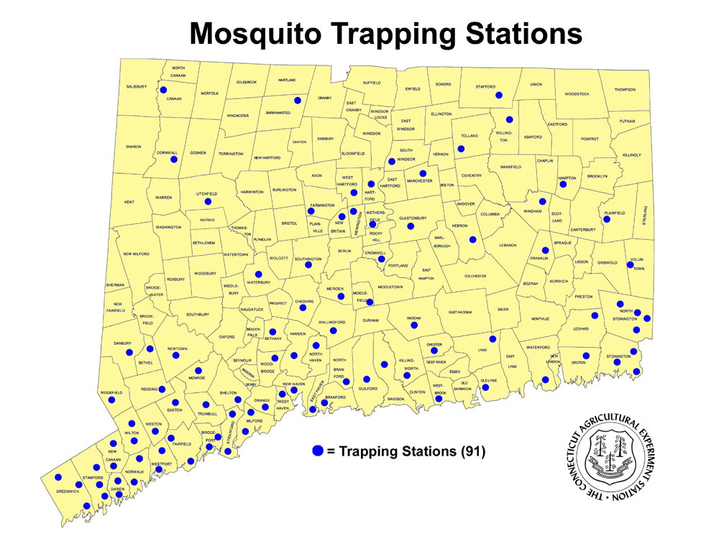
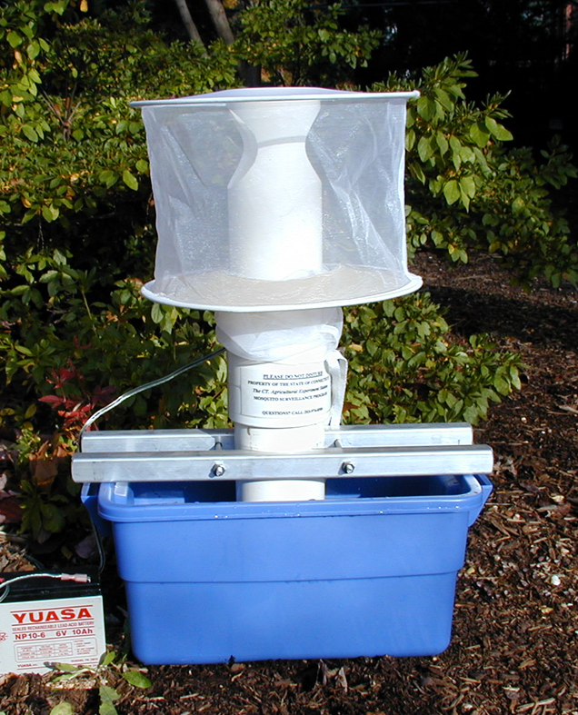
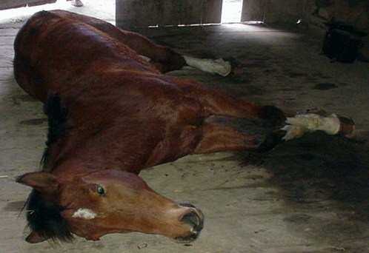
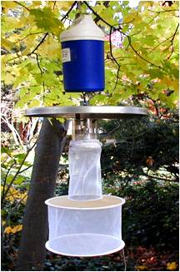
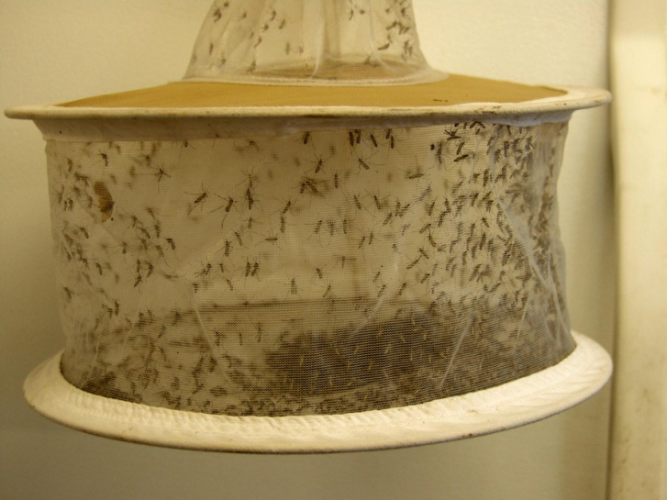
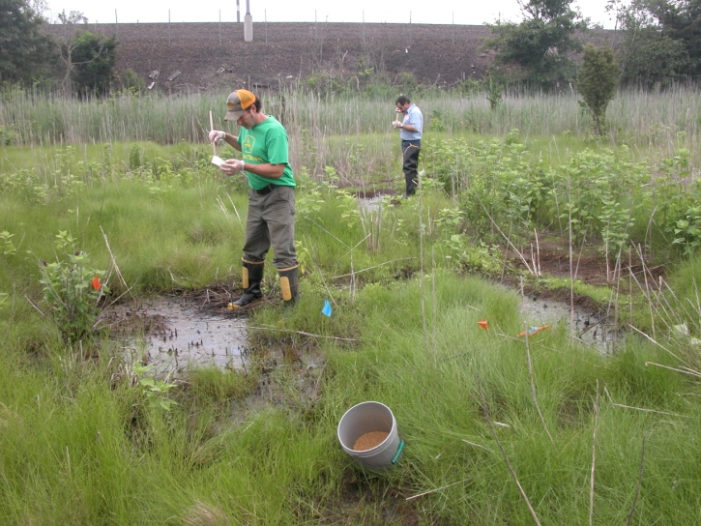
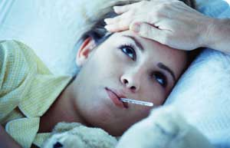

Slide 9
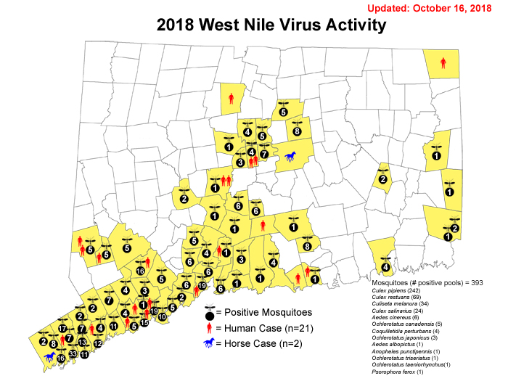
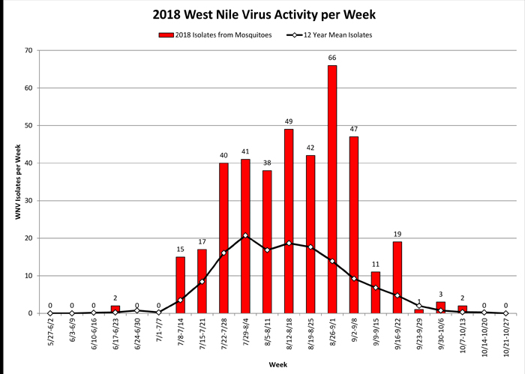

Slide 10
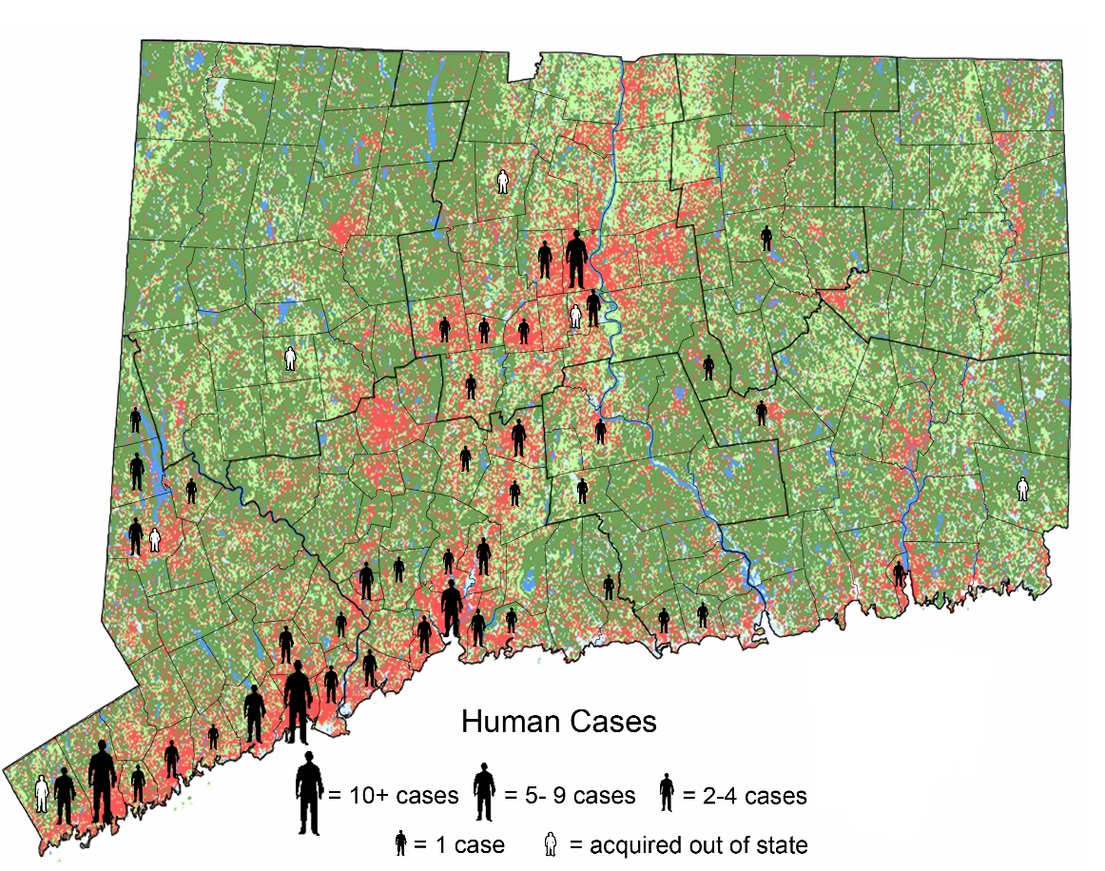
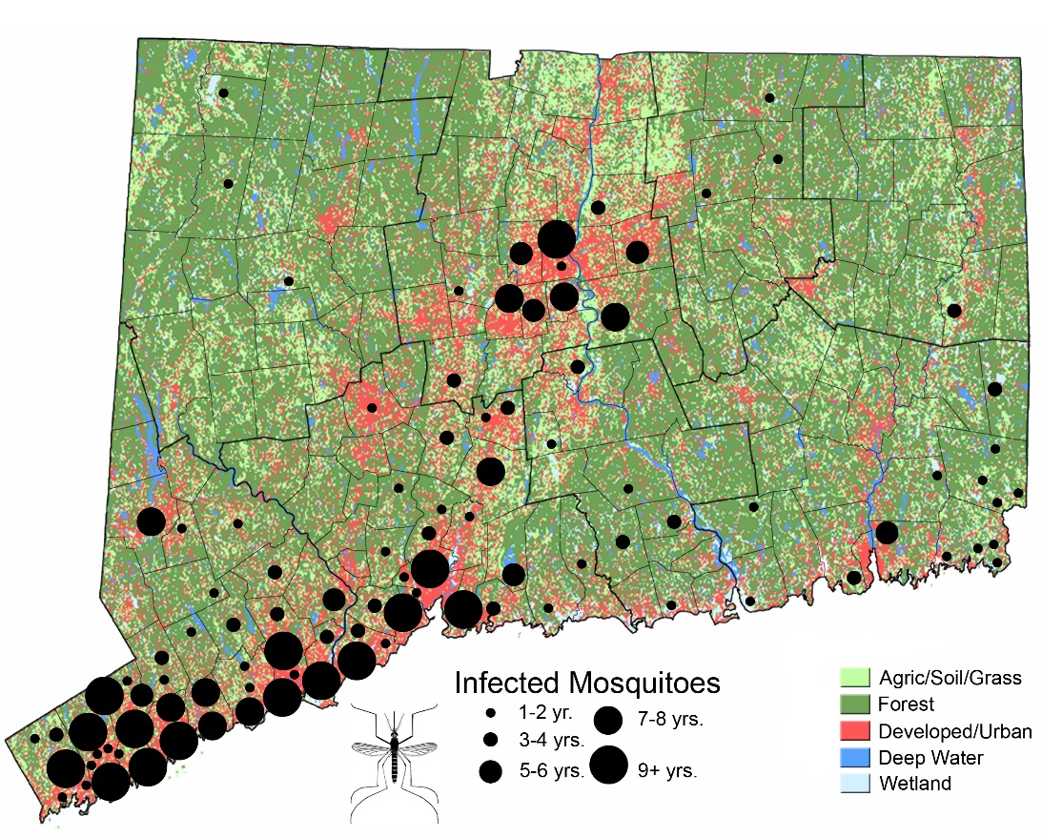
WNV 2000-2018: 157 human cases
(4 fatalities)

Slide 11
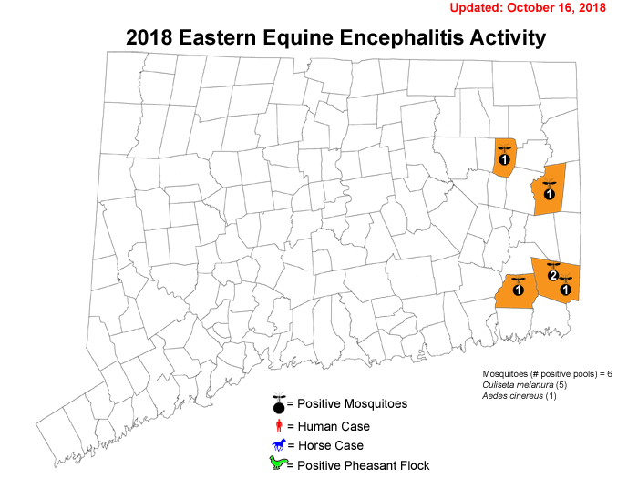

Slide 12
Elements of a Municipal Mosquito Control Program
Educate your constituents (sources of mosquitoes).
Clean up yards/neighborhoods. Stress source reduction/personal protection.
Enforce public health regs: e.g., abandoned pools
If contracting with private company, use only DEEP licensed applicators (Cat. 7f)
Consider catch basin larvaciding. Coordinate with DPW clean outs. Also parks, schools (check regs).
Judicious use of adulticides is OK.

Slide 13
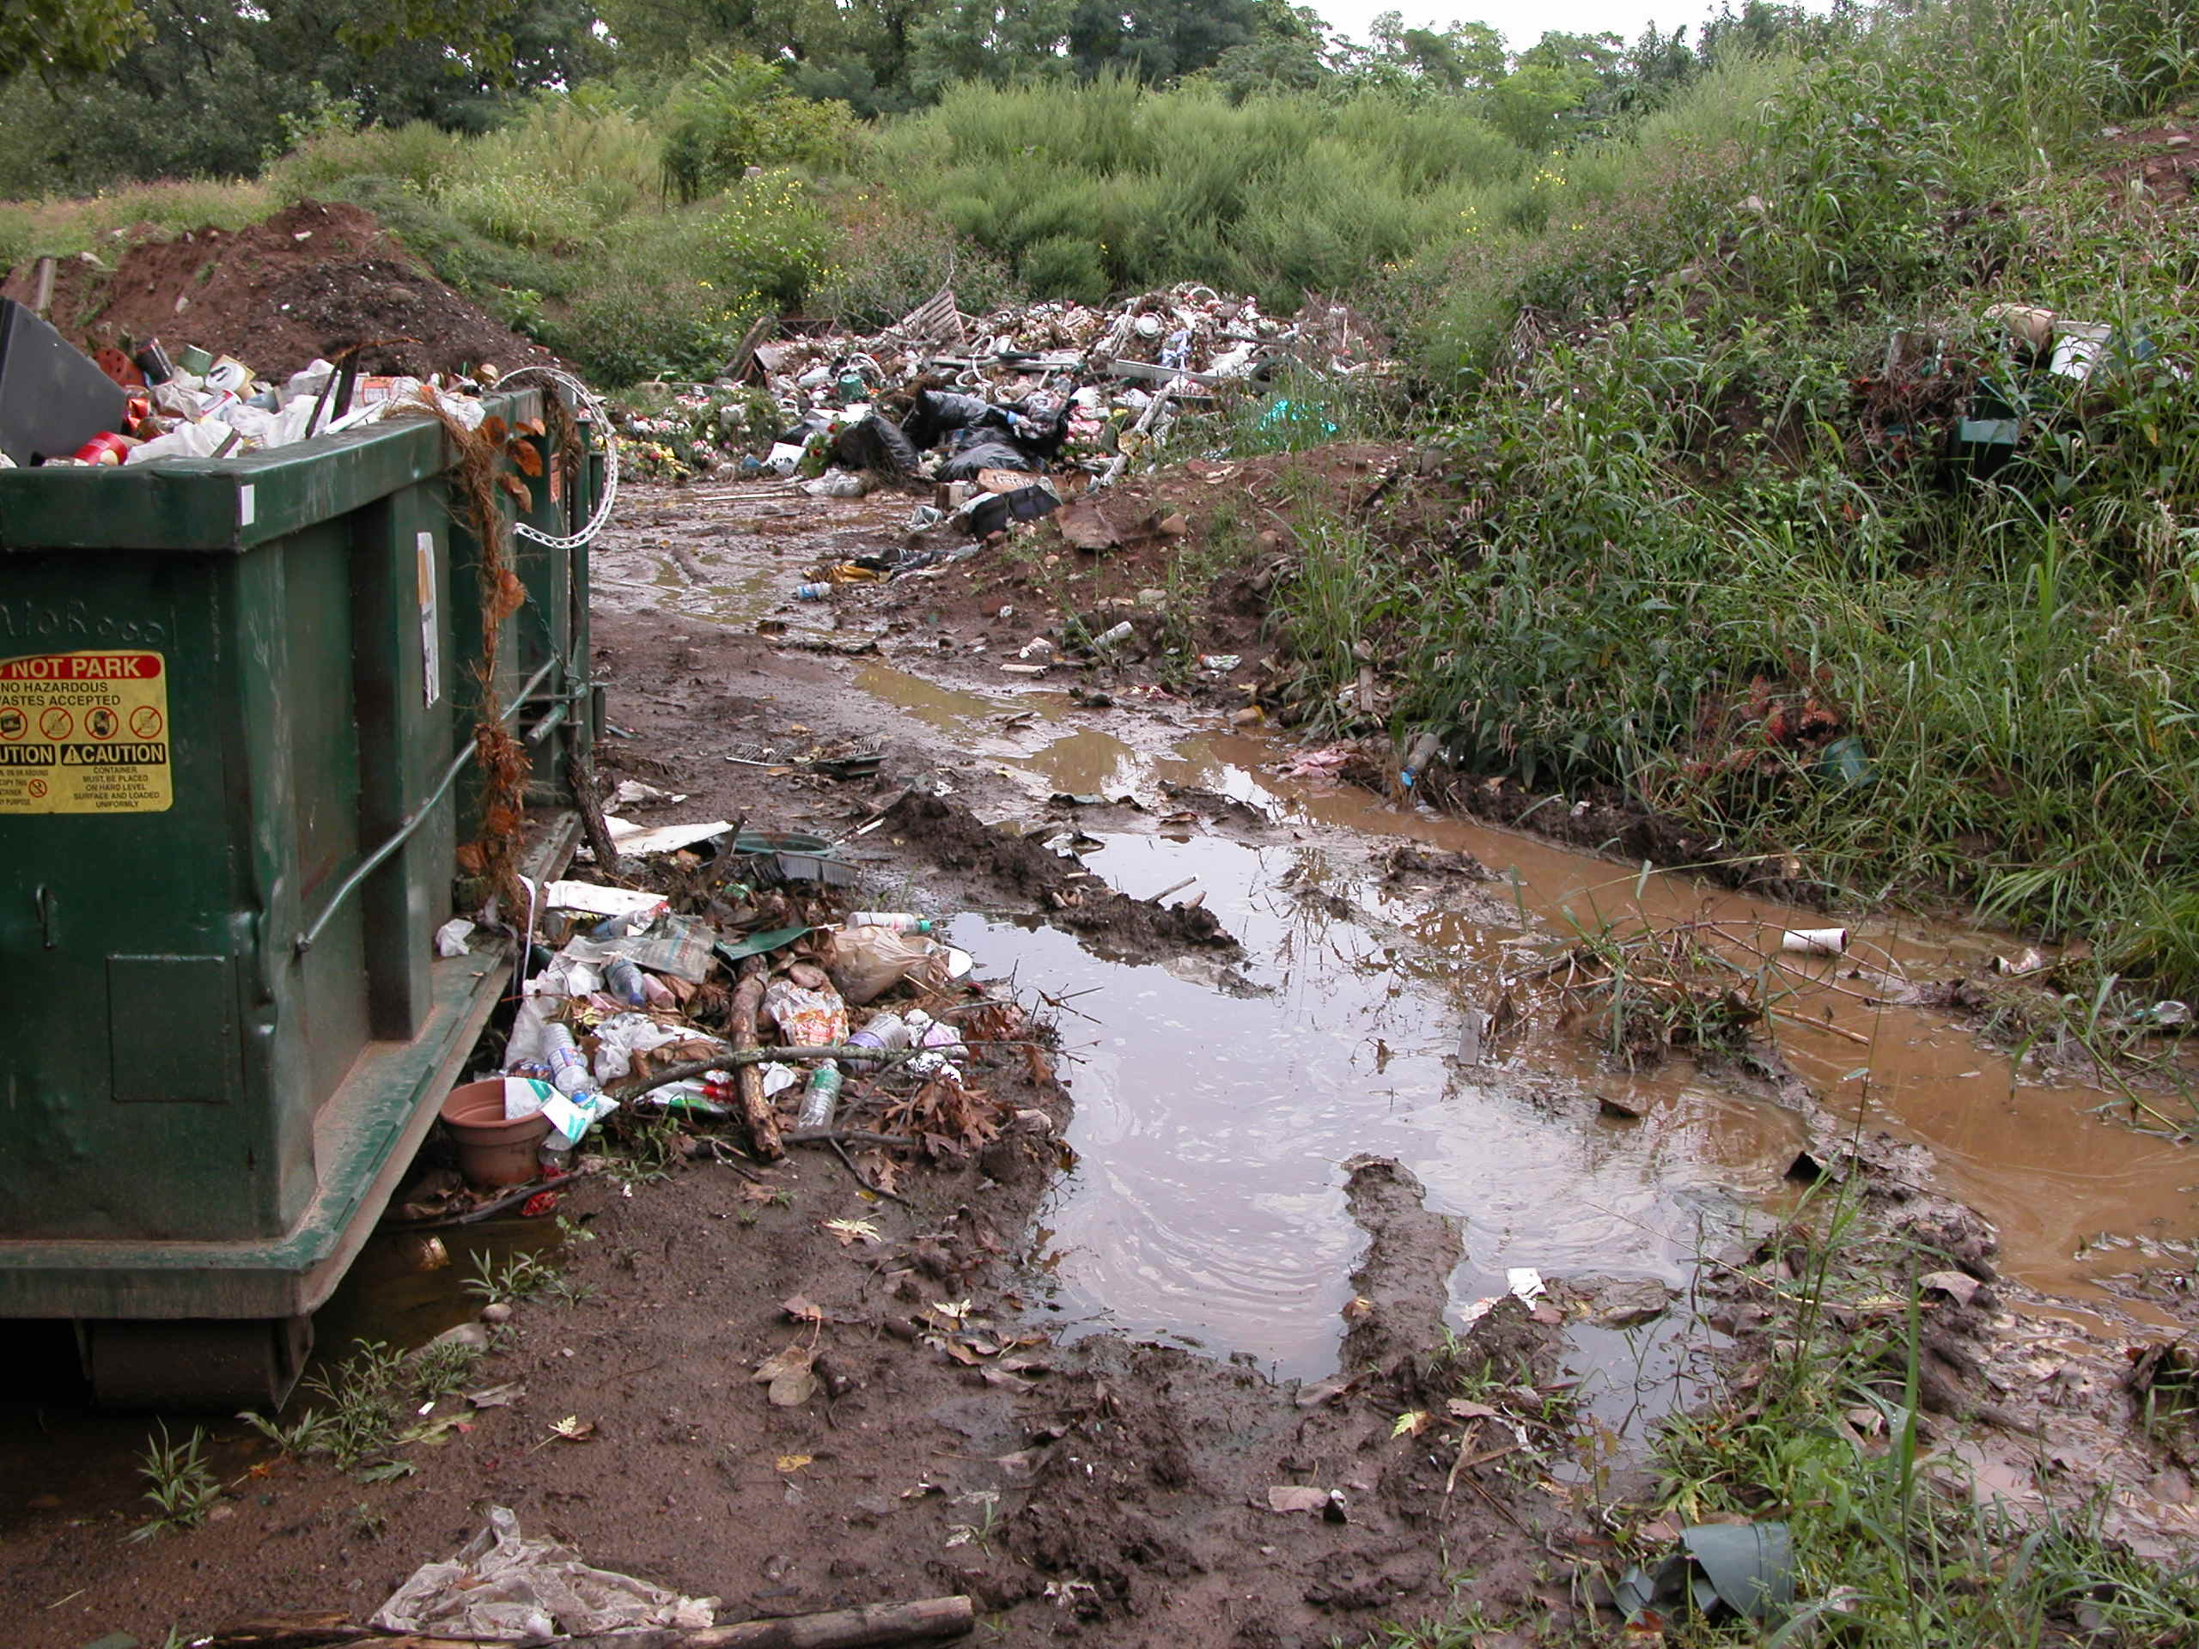
Source reduction
Eliminate standing water around home and workplace.
Notes:
In addition to our direct control efforts, the DEP Office of Communication and Education put on a huge education campaign with the help of local Pub Health agencies to make people aware of mosquito breeding sites around the home, and to clean up sources of mosquito breeding like this.

Slide 14
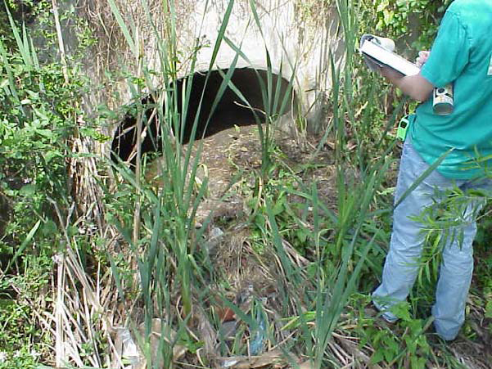
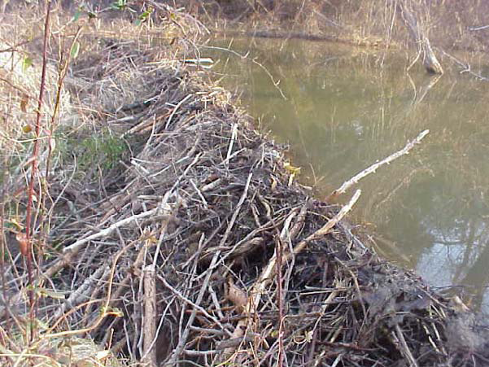
Created Wetlands/Stormwater Basins:
Recommendations
1:3 or 1:4 side slopes
Veg/beaver management
<72 hrs. detention
maintenance!
Photo: N. Read

Slide 15
Personal Protection Measures to Prevent Mosquito Bites
Minimize outdoors activities at dawn and dusk or when mosquitoes are most active.
Cover arms and legs (pants, long sleeves). Wear light colored, loose fitting clothing.
Repair holes in screens.
Avoid camping near swampy areas. Use netting on tents and outdoor playpens.
Notes:
(common sense ways of preventing mosquito bites). Compounds containing DEET have been used since the 1940’s with an amazing track record of effectiveness and minimal risk to humans. With regard to using repellants containing DEET, the state Mosquito Management Program recommends using (sparingly) formulations containing no more than 30-40% DEET(10% or less on children). Studies have shown that formulations containing higher concentrations do not work that much better and individuals may have a higher risk of experiencing a skin reaction. Never let children put repellants on themselves (fingers end up in eyes and mouths). Apply repellant to your hand and put on your child. Do not apply around eyes, nose and mouth. Repellants containing permethrin can also be applied to clothing. Never apply permethrin-based products directly to the skin. ALWAYS READ THE LABEL.

Slide 16
Personal Protection Measures Repellants
Repellants (are pesticides):
DEET (<30-40%), picaridin, oil of lemon eucalyptus, IR3535 (on clothes or skin).
Sprays, creams, towelettes.
Have an adult apply repellants to children. <10% DEET - not around eyes/nose/mouth. Wash off when you come indoors.
Permethrin-based products to clothes only. Kills mosquitoes and ticks.
Notes:
(common sense ways of preventing mosquito bites). Compounds containing DEET have been used since the 1940’s with an amazing track record of effectiveness and minimal risk to humans. With regard to using repellants containing DEET, the state Mosquito Management Program recommends using (sparingly) formulations containing no more than 30-40% DEET(10% or less on children). Studies have shown that formulations containing higher concentrations do not work that much better and individuals may have a higher risk of experiencing a skin reaction. Never let children put repellants on themselves (fingers end up in eyes and mouths). Apply repellant to your hand and put on your child. Do not apply around eyes, nose and mouth. Repellants containing permethrin can also be applied to clothing. Never apply permethrin-based products directly to the skin. ALWAYS READ THE LABEL.

Slide 17
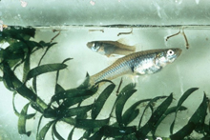
Biological control
The control of a pest by the introduction of a natural enemy or predator
Gambusia (mosquito fish), guppies, dragonfly nymphs.
*Introduction of non-native orgs in open waters is prohibited in CT
OK in water gardens, abandoned pools, closed systems (no outlet).
Mummichogs, fathead minnows, sunfish, ‘top minnows’ - OK

Slide 18
Integrated Marsh Management
A holistic approach to wetlands management utilizing a variety of techniques to achieve site specific goals.
These techniques can be simple or complex.
IMM takes into consideration many aspects of wetland management/restoration including mosquito control, vegetation management, wildlife habitat enhancement, hydrologic modification and education.
Usually involves partnerships to share resources.

Slide 19
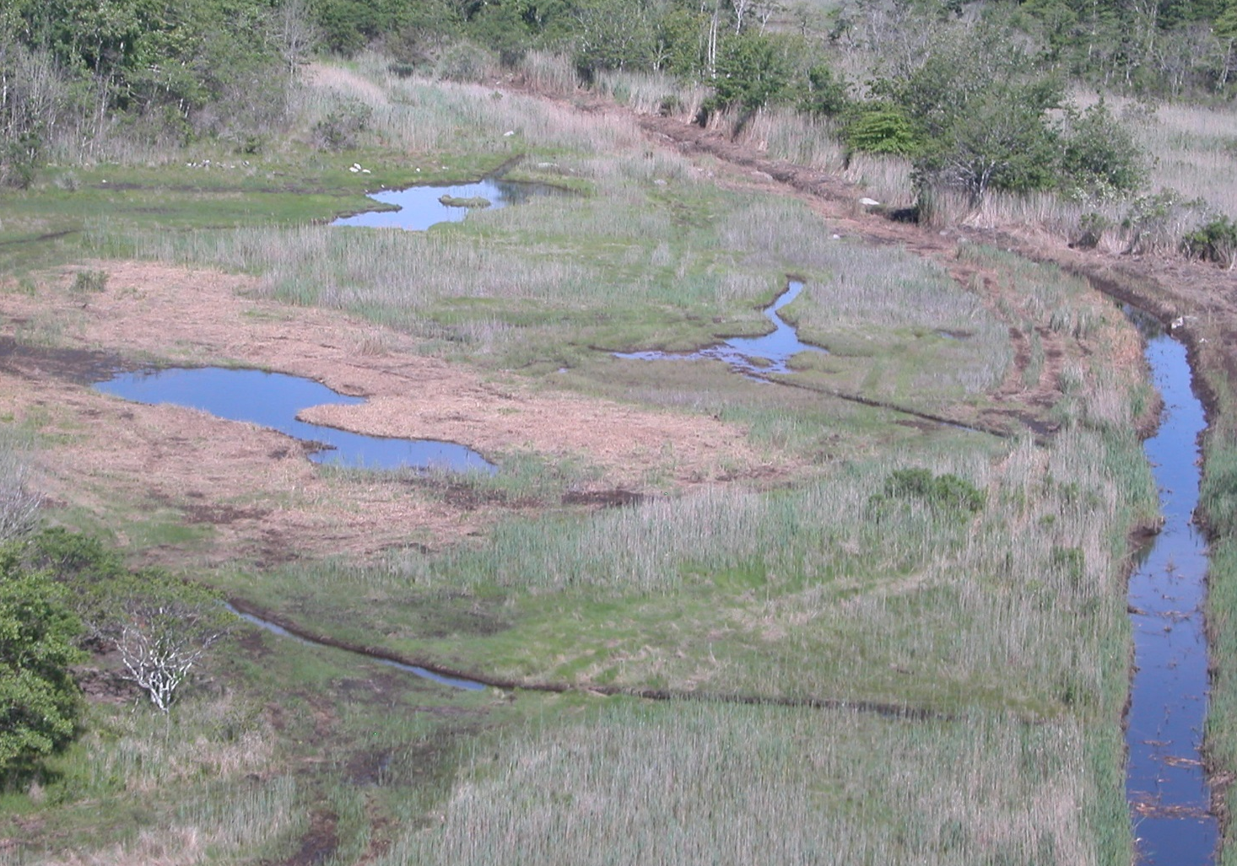
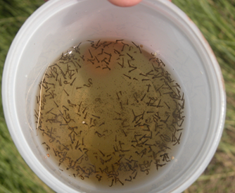
Open Marsh Water Management (OMWM)

Slide 20
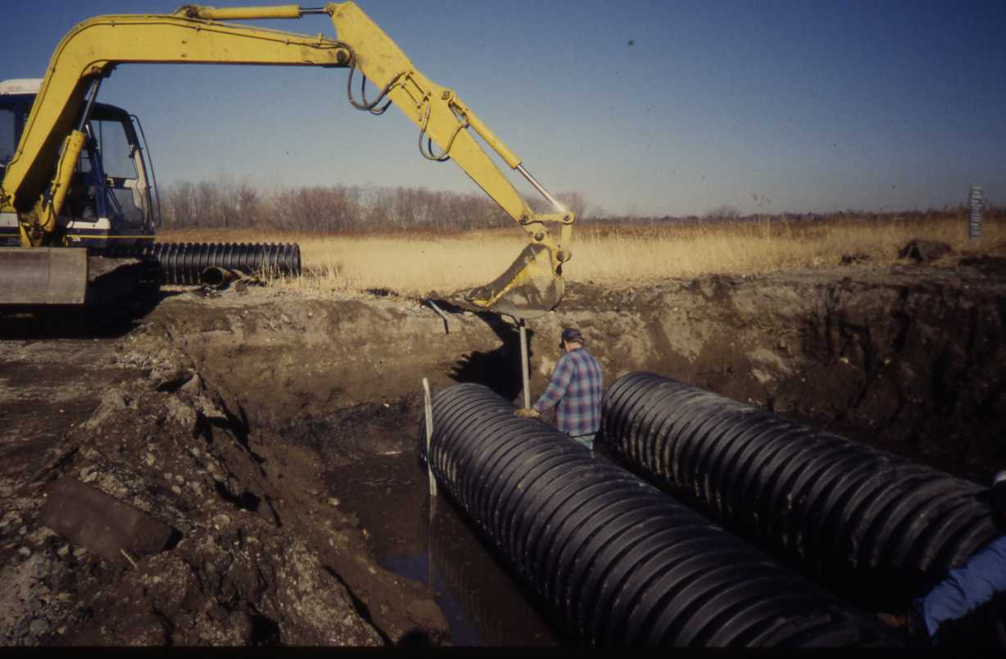
Tidal Flow Restoration
Culvert replacement
(removal where feasible)

Slide 21
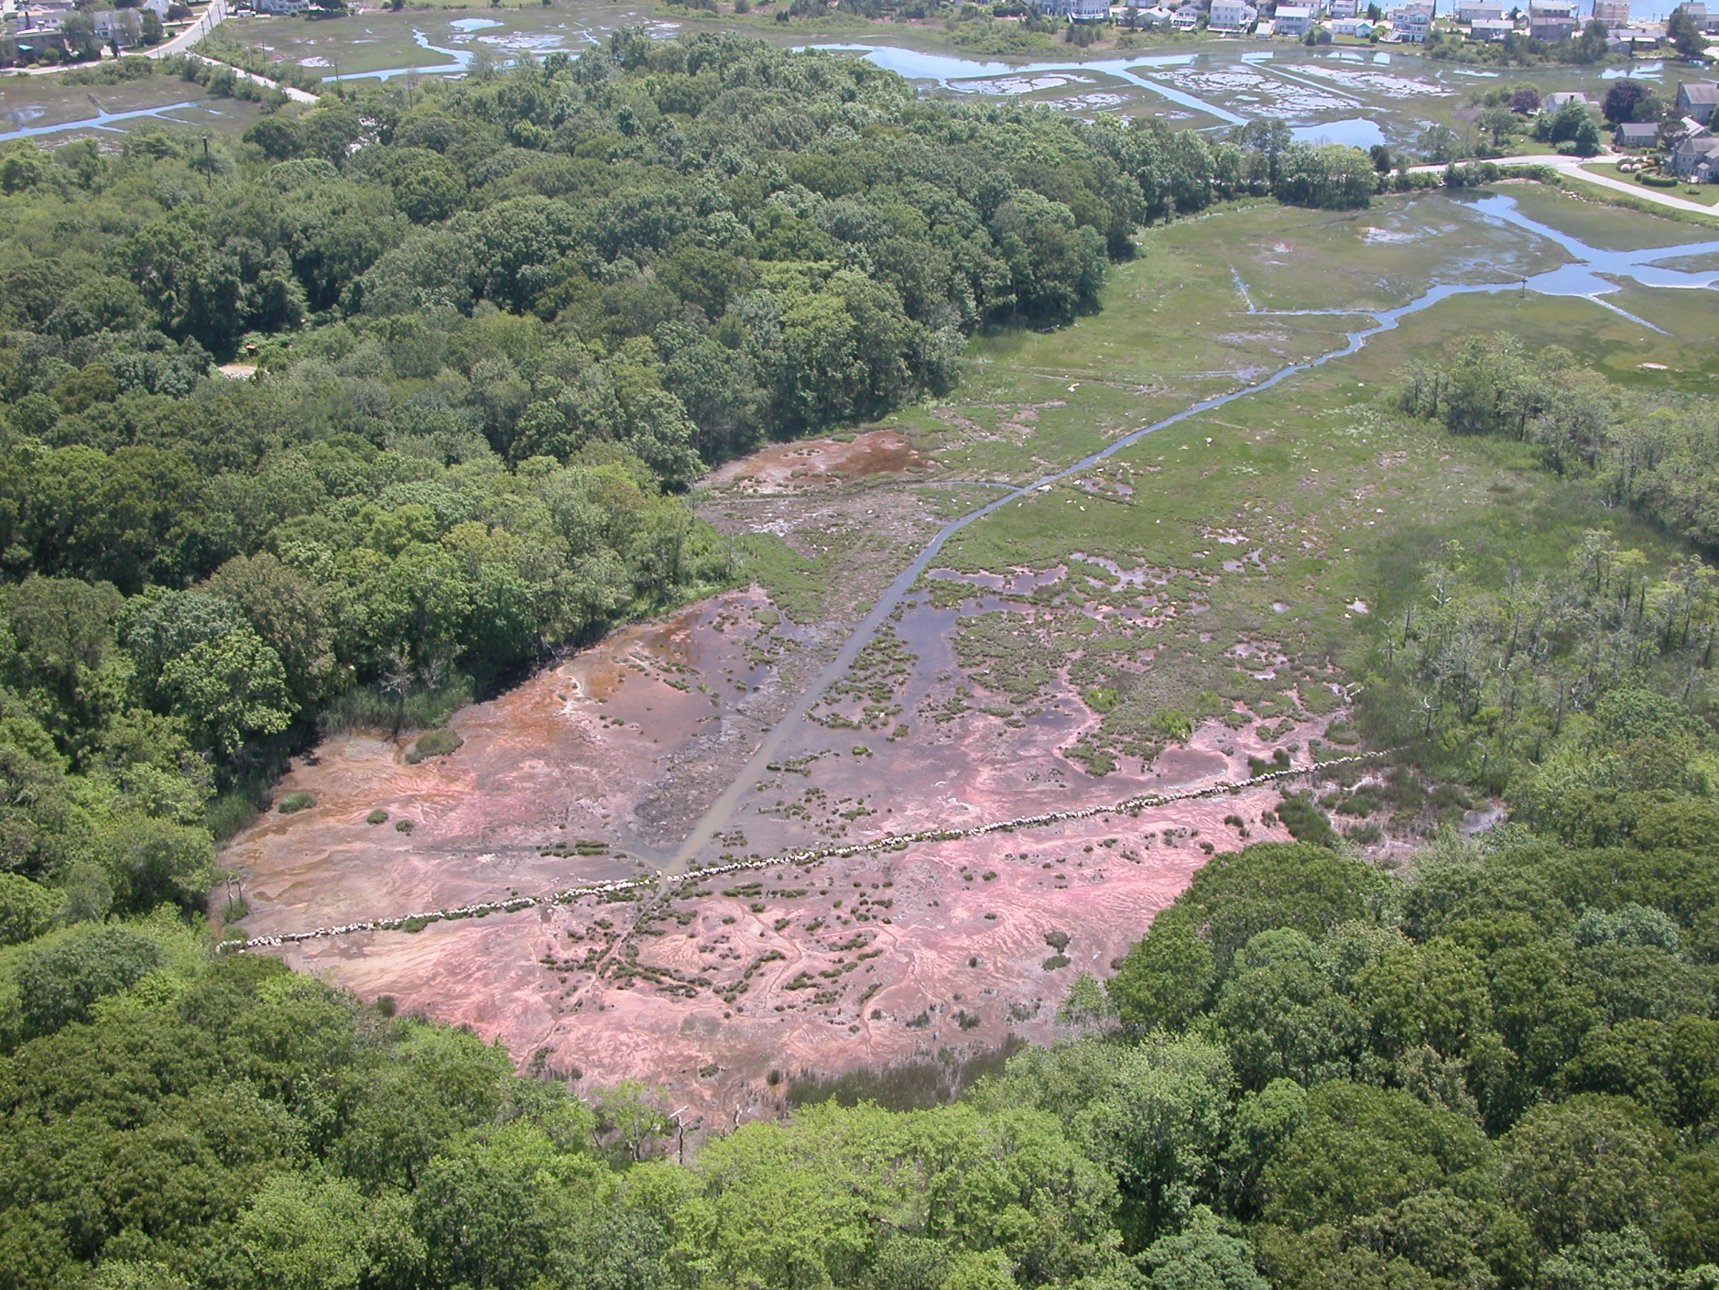
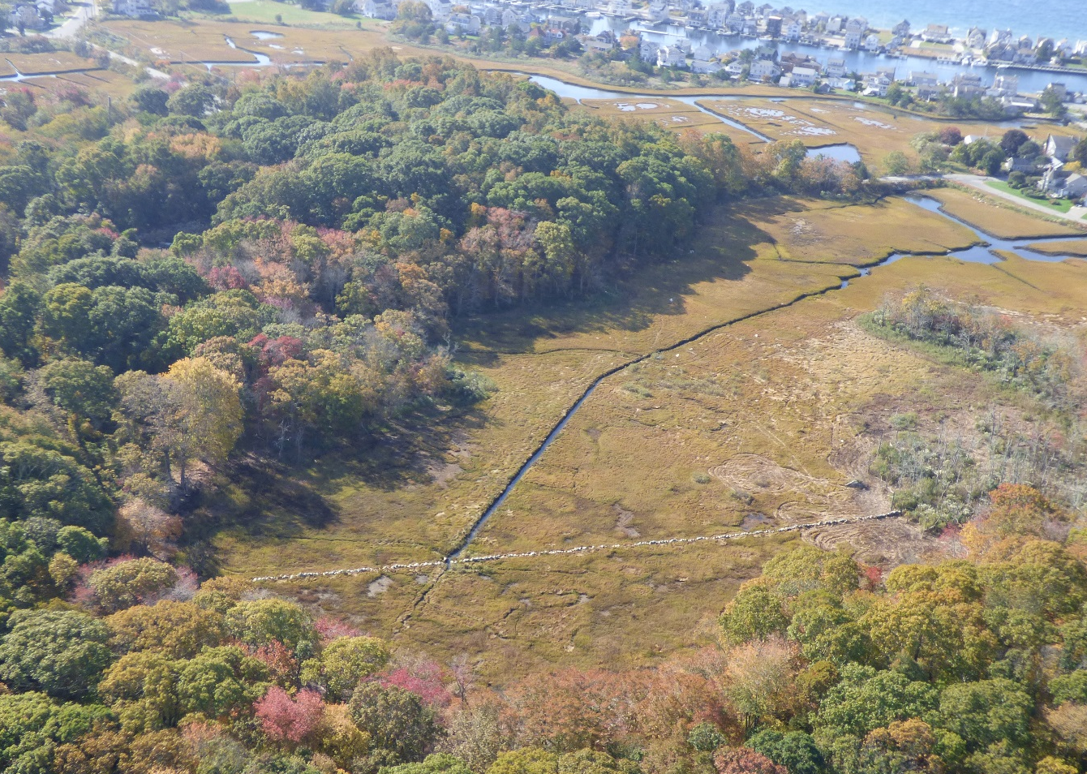
Tidal flow restoration
Channel recleaning

Slide 22
Chemical control
Larvaciding
Pupaciding
Adulticiding

Slide 23
Larvacides Applied to water where larvae are active or to areas likely to produce mosquitoes (pre-emergent). Formulations: liquid, granular, pellets, briquettes, WP, EC
Organophosphates (temephos) – not regist in CT
Biologicals
Bti (Bacillus thuringiensis var. israelensis)
Bs (B. sphaericus)
Spinosad (Natular®)*
Insect growth regulators (IGR’s)*
Methoprene (can’t use in coastal zone except in New Haven, PA13-197)
*requires Aquatic permit from DEEP

Slide 24
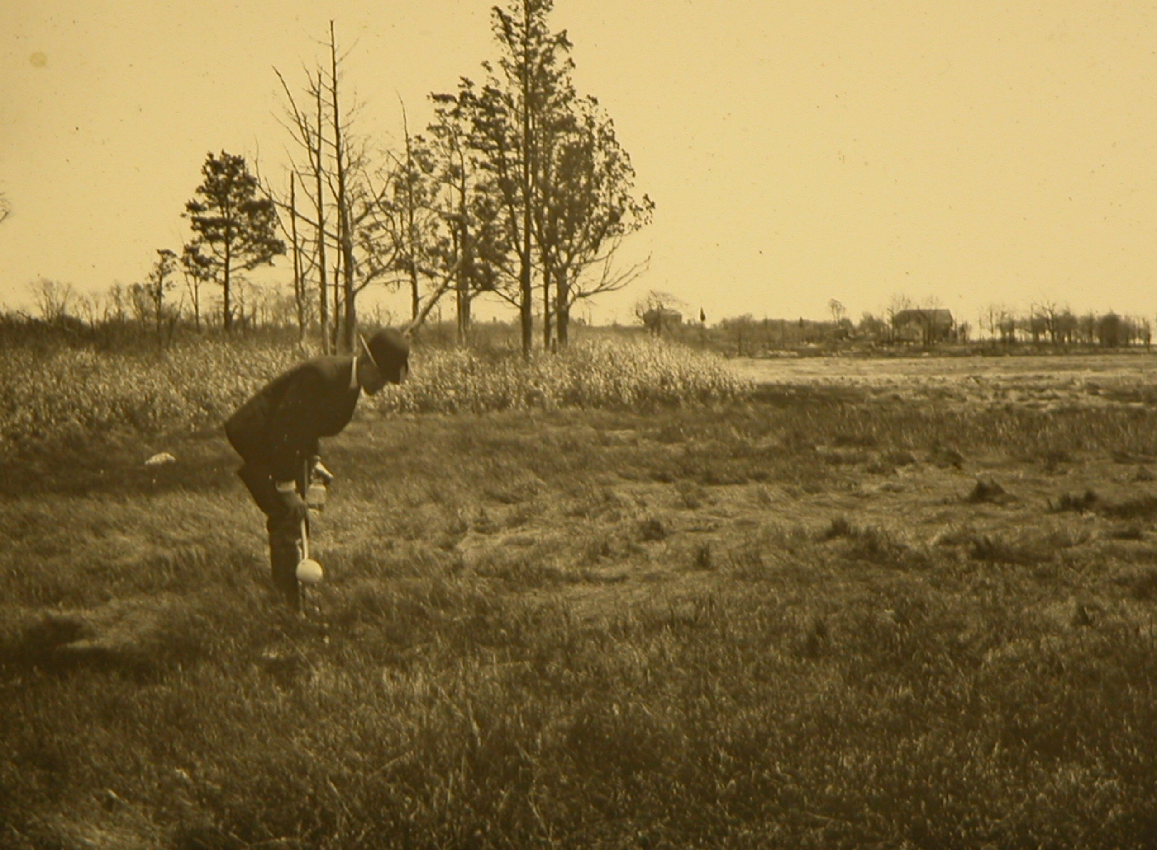
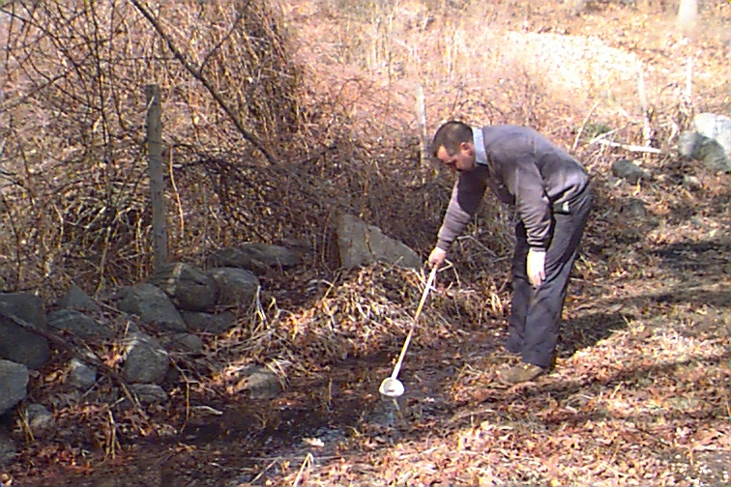
Notes:
Larvae dipping in the past and present, look for larvae, if present use larvicide.

Slide 25
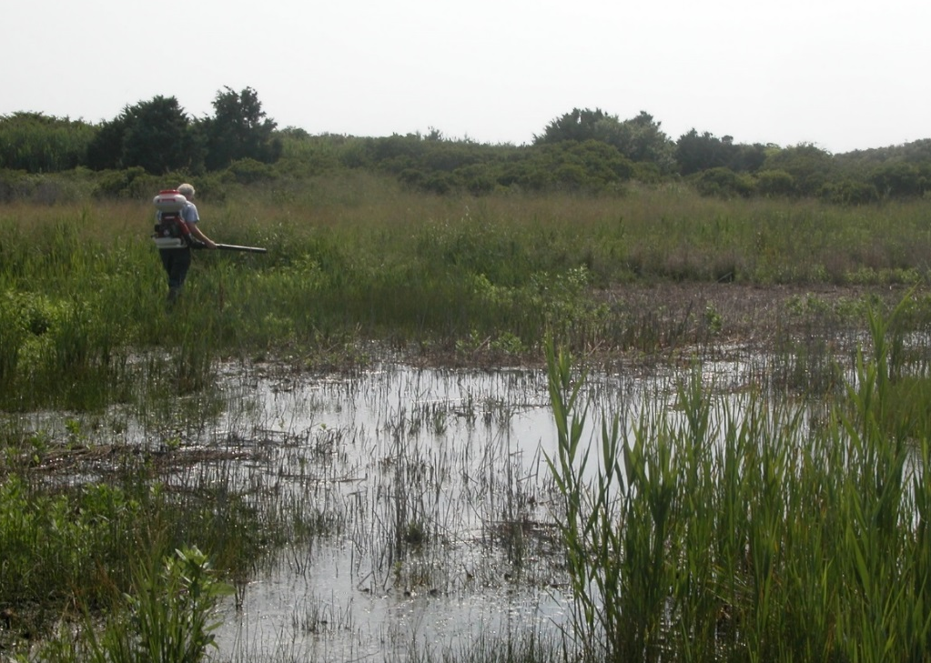
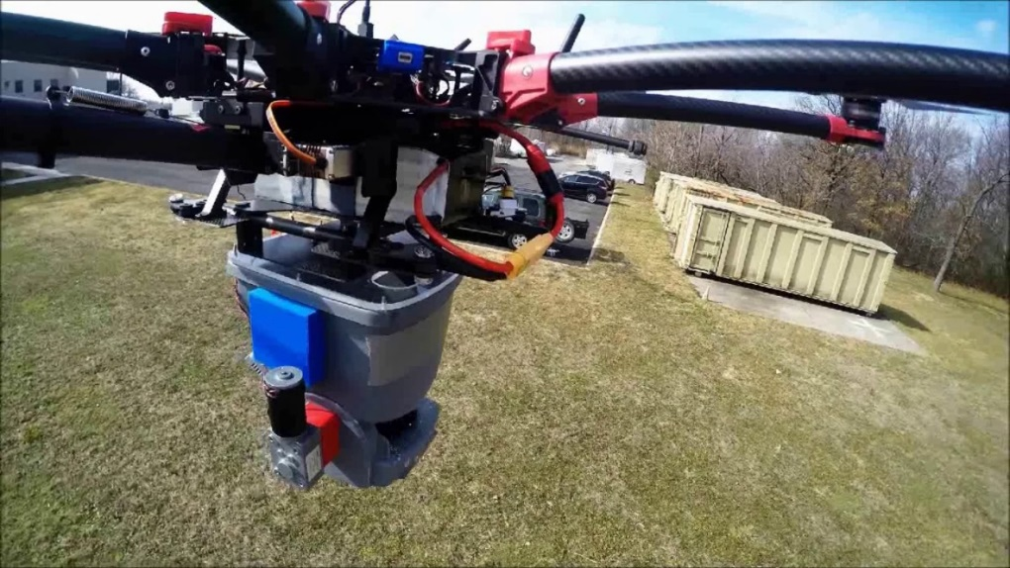
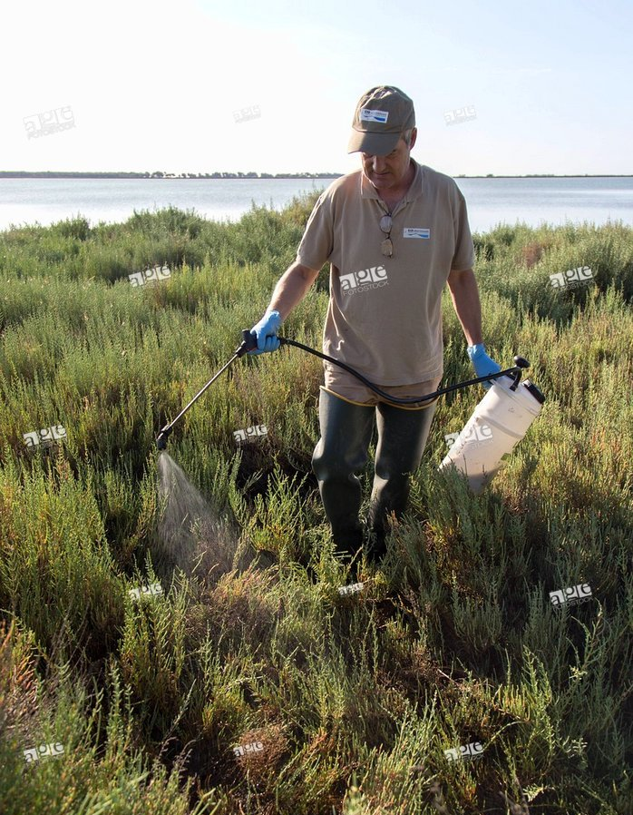
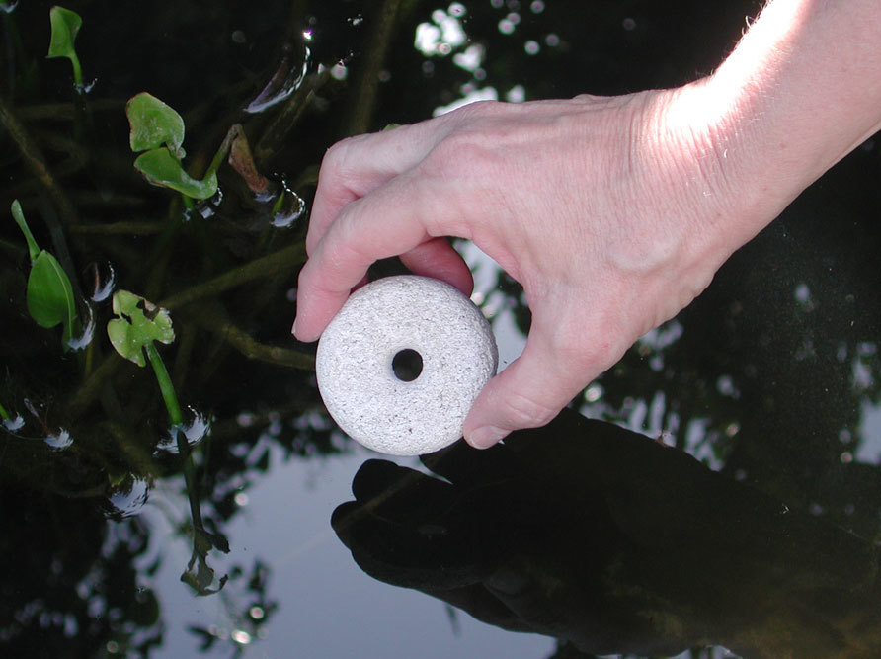
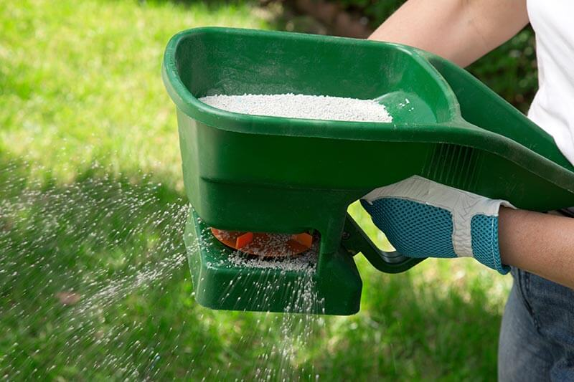
Notes:
A gas-powered back pack blower, (next slide)

Slide 26
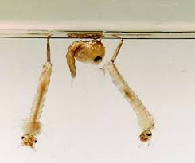
Pupacides control of pupae and larvae by suffocation
Surface films (Agnique MMF)
Oils/alcohols
*requires Aquatic permit from DEEP

Slide 27
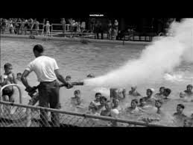
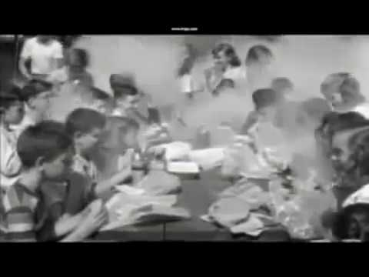
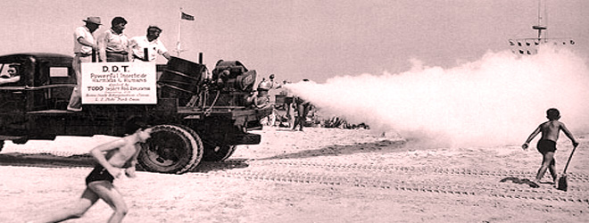
Adulticiding (“spraying”)

Slide 28
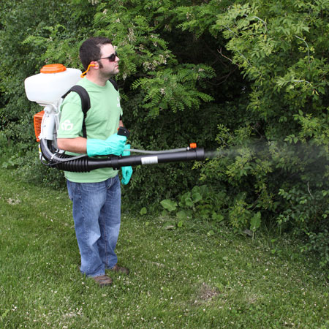
Adulticiding
Barrier spray

Slide 29
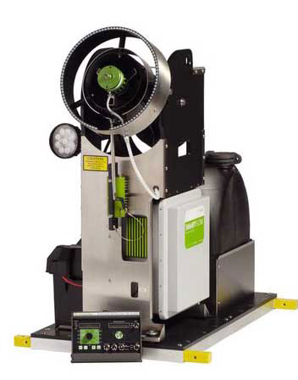
Adulticiding
Ultra low volume (ULV)
Truck mounted spraying

Slide 30
Aerial application
Notes:
Aerially by helicopter or airplane to cover large areas.

Slide 31
Adulticides
Organophosphates (OP’s) - malathion
Natural pyrethrum – derived from chrysanthemums (very expensive)
Synthetic pyrethroids (most anything ending in “thrin”), resmethrin (1st gen syn py);
-sumithrin, permethrin, deltamethrin, bifenthrin, etc. Potential for resistance.
Etofenprox (Zenivex®) - ether

Slide 32
EPA exempt products (25b) may not hold up to mnfctr claims
garlic, essential oils, torches, coils, plants, citronella candles, wristbands, a good cigar
– buyer beware! CR report.
“All Natural” doesn’t mean all safe
arsenic
strychnine
hemlock (Socrates’ “last call”)

Slide 33
Other devices and myths
Sonic devices
Mosquito trap/”magnet”
Misting systems
Bug zappers
Bats and birds

Slide 34
Other Biting Flies
Greenhead Fly (Tabanidae)
Coastal saltmarshes

Slide 35
Horse and Deer Flies (Tabanidae) Brackish and freshwater wetlands/mud

Slide 36
Black Flies (Buffalo gnats) (Simuliidae.) freshwater streams and rivers

Slide 37
Biting midges (“No-See-Ums”) (Ceratopogonidae) pond bottoms and coastal marshes

Slide 38
Stable Fly (Muscidae) compost, manure, rotting vegetation
House fly

Slide 39
Want to know more?
CT Mosq. Mgt Program: www.portal.ct.gov/mosquito
Amer. Mosq. Control Assoc: www.mosquito.org
Nat’l Cent. Disease Contr. and Prev: www.cdc.gov
Rutgers Univ (NJMCA): vectorbio.rutgers.edu/outreach

Slide 40
Roger Wolfe Mosquito Management Coordinator/ Wetland Restoration Biologist
CT DEEP Wetland Habitat and Mosquito Management (WHAMM) Program
roger.wolfe@ct.gov
(860) 418-5987
Notes:
Title slide

