Slide 1


Soil-Based Wastewater Treatment and the Challenges of Climate Change
Jose A. Amador
Laboratory of Soil Ecology and Microbiology
University of Rhode Island
Kingston, RI

Slide 2

OVERVIEW
OWTS
Climate change
Effects
What to do?

Slide 3
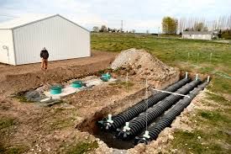
OWTS: A PRIMER

Slide 4
What is an Onsite Wastewater Treatment System (OWTS)?
AKA:
  Septic system
  Individual sewage disposal system (ISDS)
Effectively treat wastewater
Two flavors:
  Conventional
  Advanced
Performance generally not regulated after installation
All underground (out of sight, out of mind…)

Slide 5
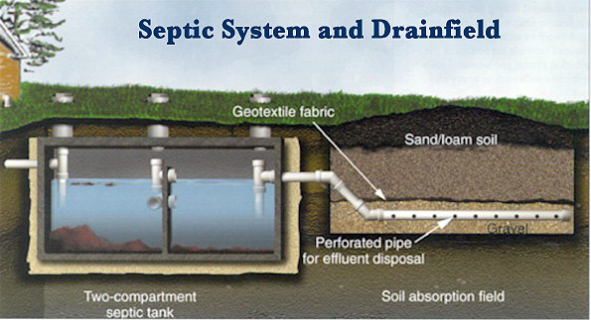
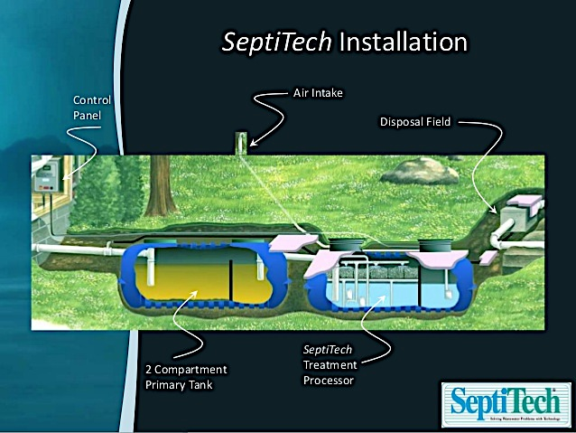
Two flavors of OWTS:
Conventional
Advanced

Slide 6
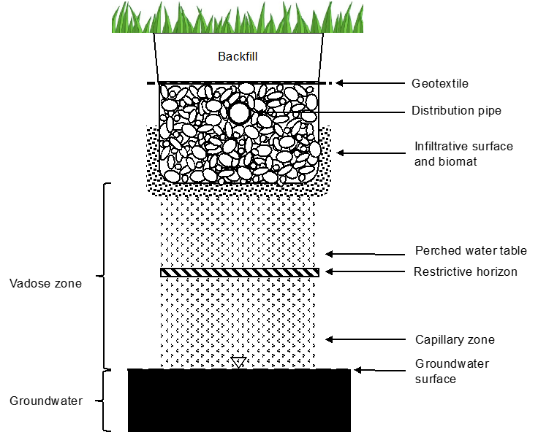
Drainfield

Slide 7
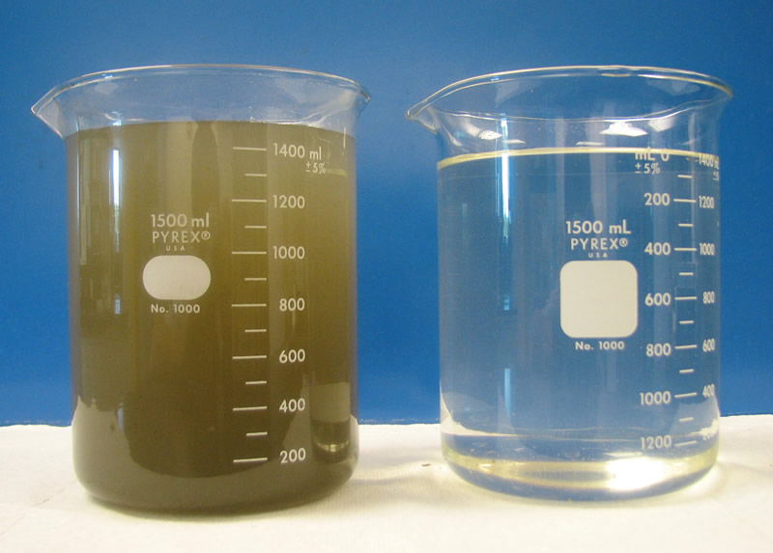
What’s in Effluent?
Suspended solids
Organic C (BOD)
Pathogens
Phosphorus & Nitrogen
  Ammonium/Nitrate
Emerging pollutants
Anoxic/Oxic

Slide 8
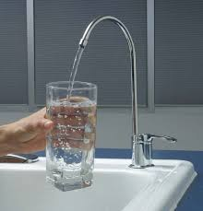
What Do They Do?
Keep wastewater away from people
Groundwater recharge/stream flow
Remove
  Suspended solids
  C, N, P
  Emerging pollutants
  Pathogens

Slide 9



How Do They Do It? – The Tank

Slide 10


How Do They Do It? – The Drainfield

Slide 11
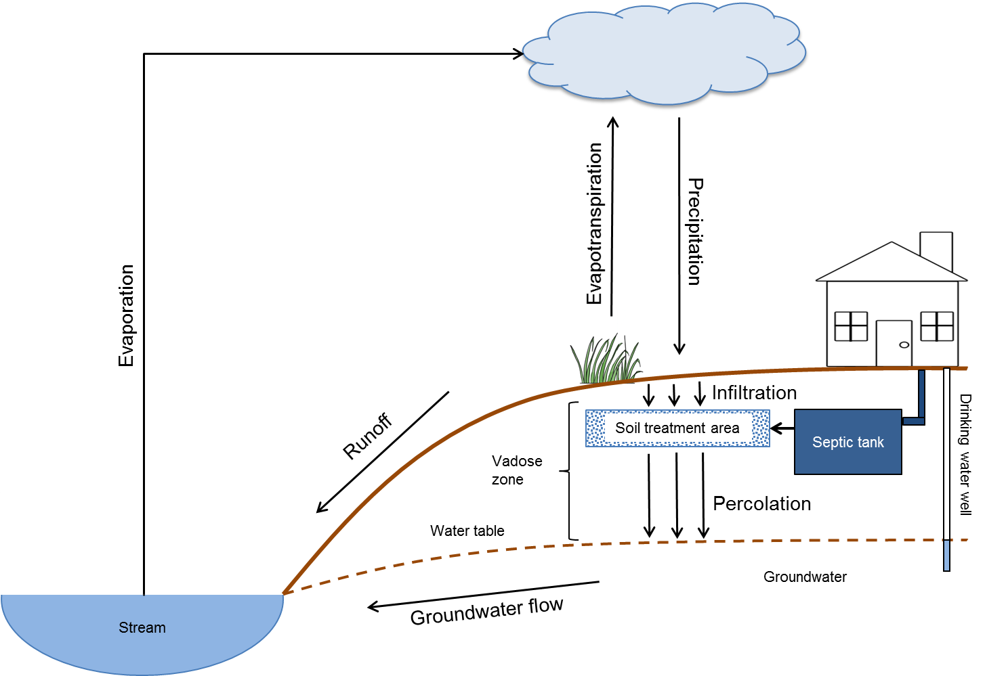
Larger Context

Slide 12
Part of Water Infrastructure

Slide 13
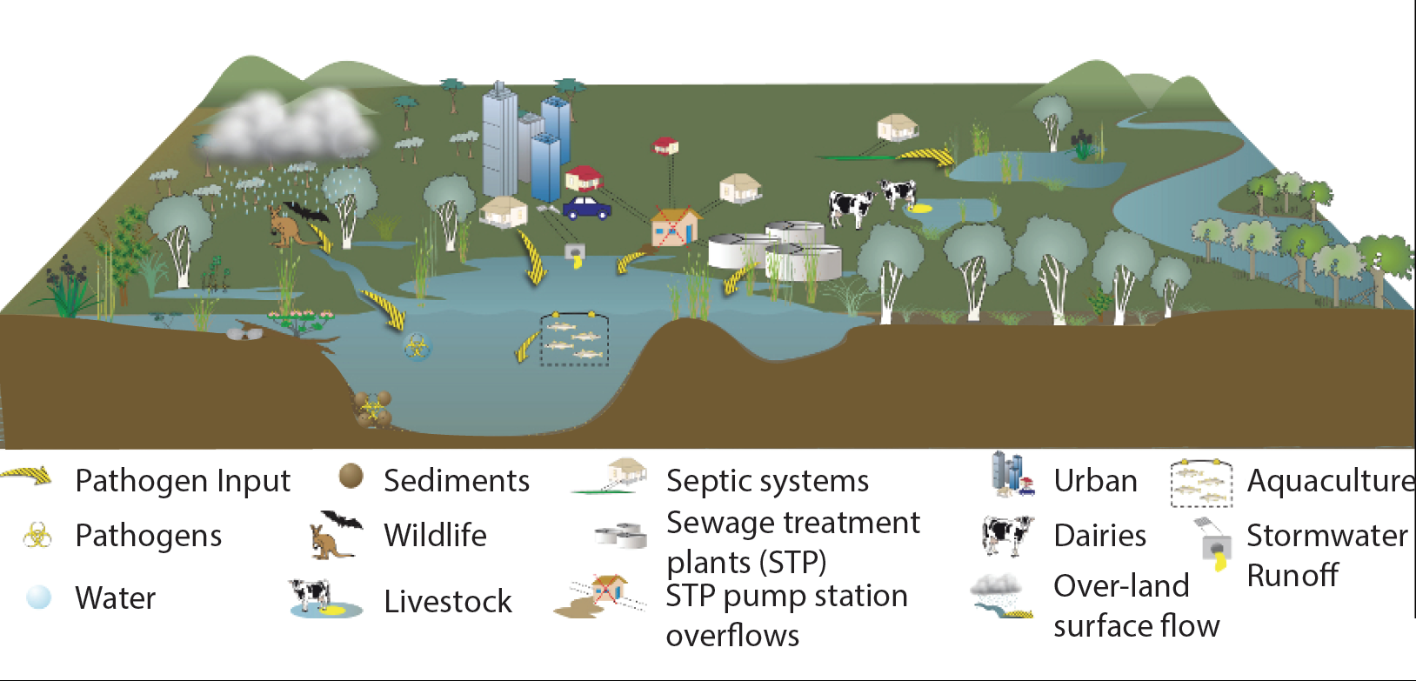
Source of Contaminants

Slide 14

Climate Change

Slide 15

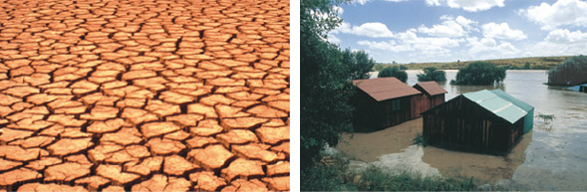

Sea level rise? Drier? Wetter? Warmer?

Slide 16
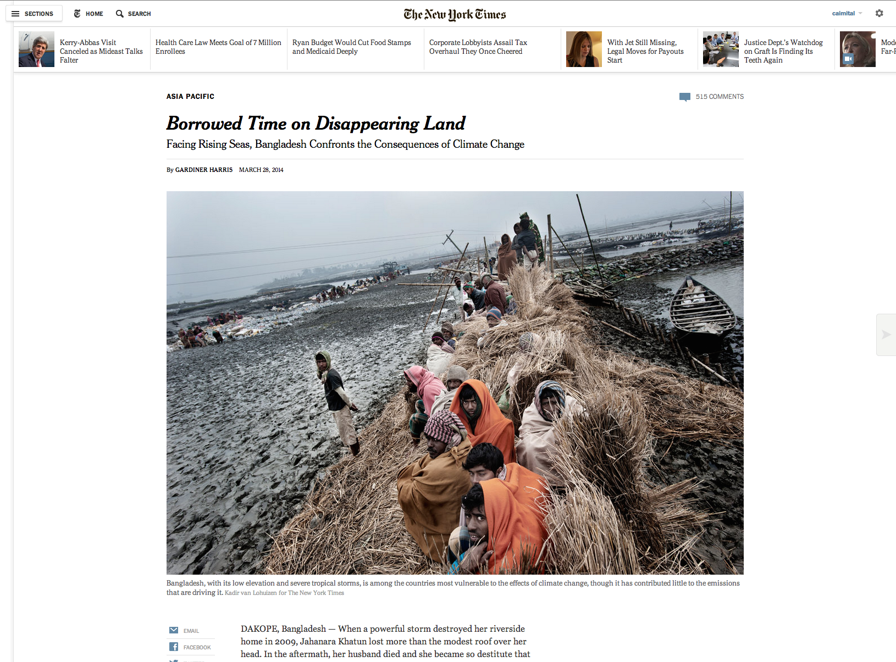

Slide 17
Sea Level is Rising
IPCC (2013)

Slide 18
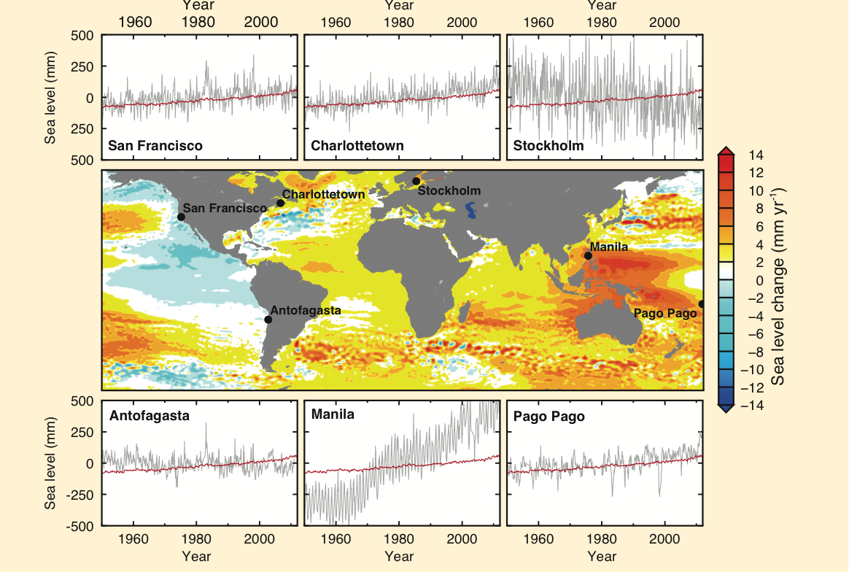
Rising Faster in Some Areas
IPCC (2013)

Slide 19
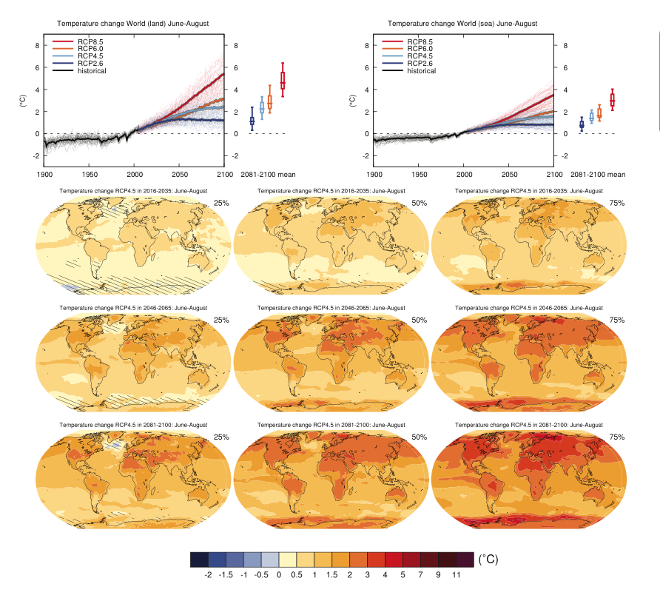
Temperature is Increasing
IPCC (2013)

Slide 20
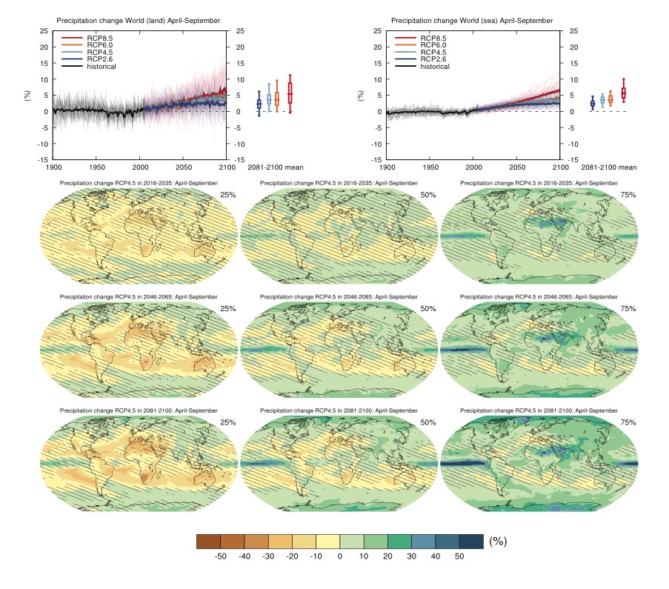
Precipitation Patterns Are Changing
Precipitation will change
IPCC (2013)

Slide 21
Probability of Extreme Events is Increasing
Phenomenon & direction of trend | Early 21st century | Late 21st century
Warmer and/or fewer cold days and nights over most land areas | Likely (66 - 100%) | Virtually certain (99 - 100%)
Warmer and/or more frequent hot days and nights over most land areas | Likely (66 - 100%) | Virtually certain (99 - 100%)
Warm spells/heat waves. Frequency and/or duration increases over most land areas | Not assessed | Very likely (90 - 100%)
Heavy precipitation events. Increase in the frequency, intensity, and/or amount of heavy precipitation | Likely (66 - 100%) over many land areas | Very likely (90 - 100%) over most of the mid-latitude land masses and over wet tropical regions
Increases in intensity and/or duration of drought | Low confidence | Likely (66-100%) on regional to global scale
Increased incidence and/or magnitude of extreme high sea level | Likely (66 -100%) | Very likely (90 - 100%)
Adapted from IPCC (2013)

Slide 22
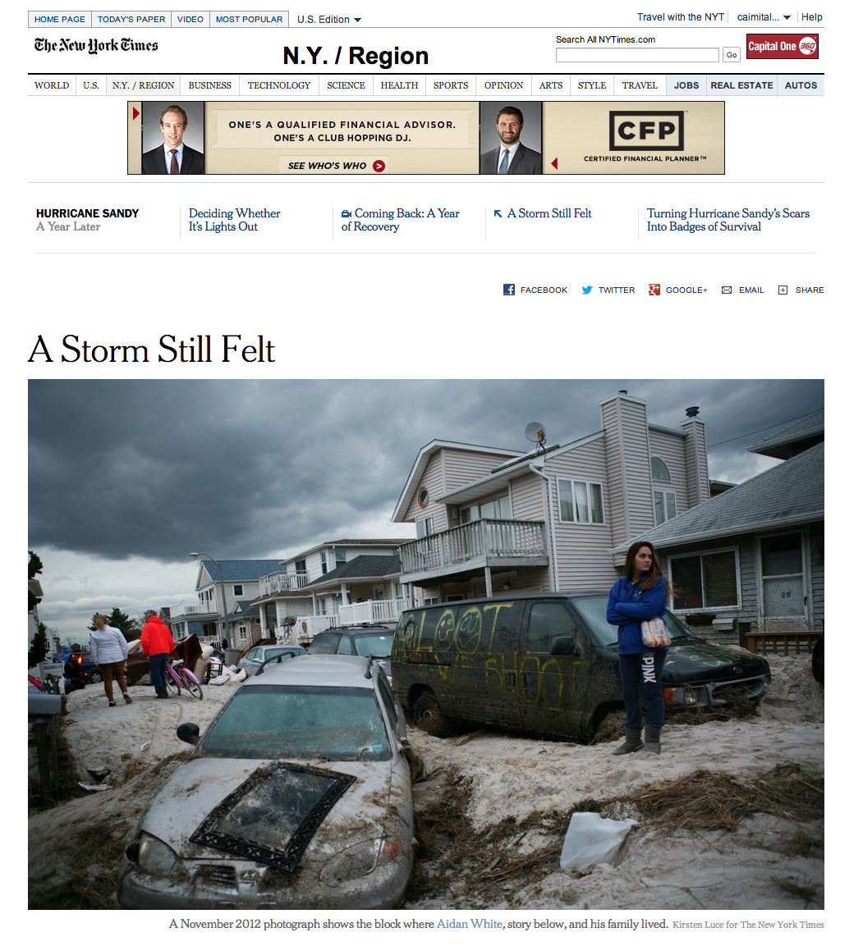

Slide 23
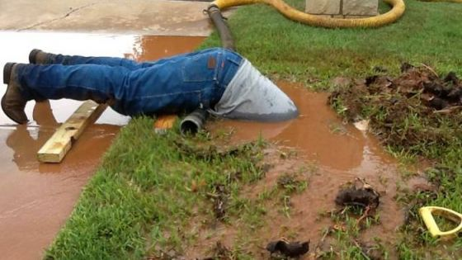
Potential Effects

Slide 24
OWTS
Sea level rise
Increased temperature
Change in precipitation

Slide 26
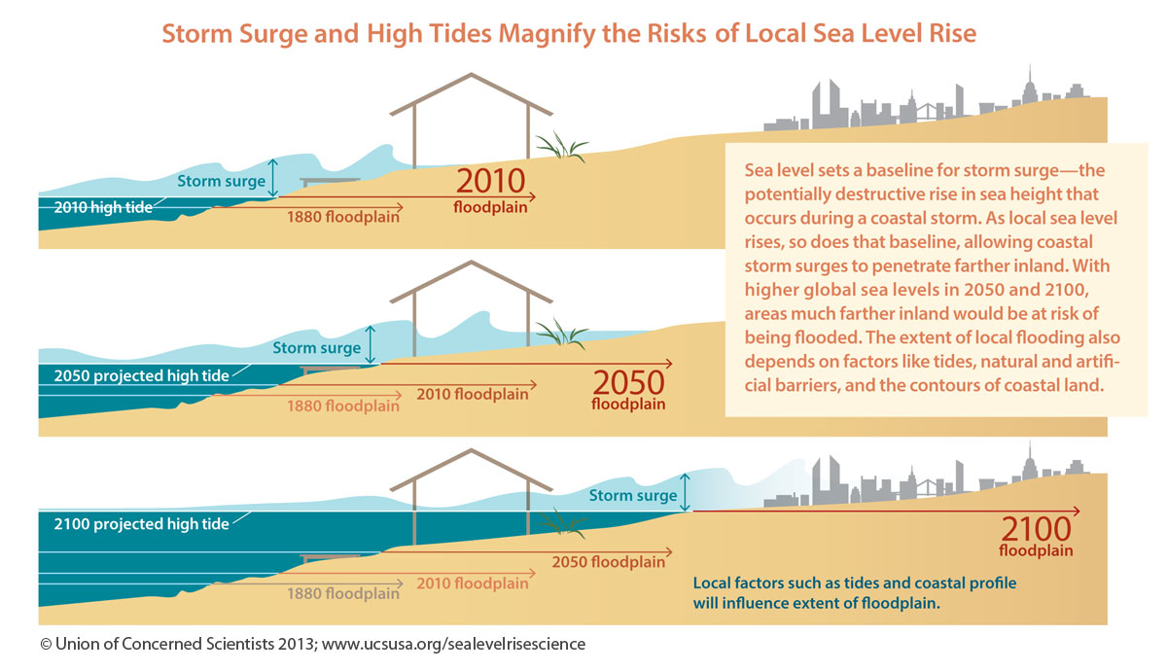
SLR: Acute Effects

Slide 27
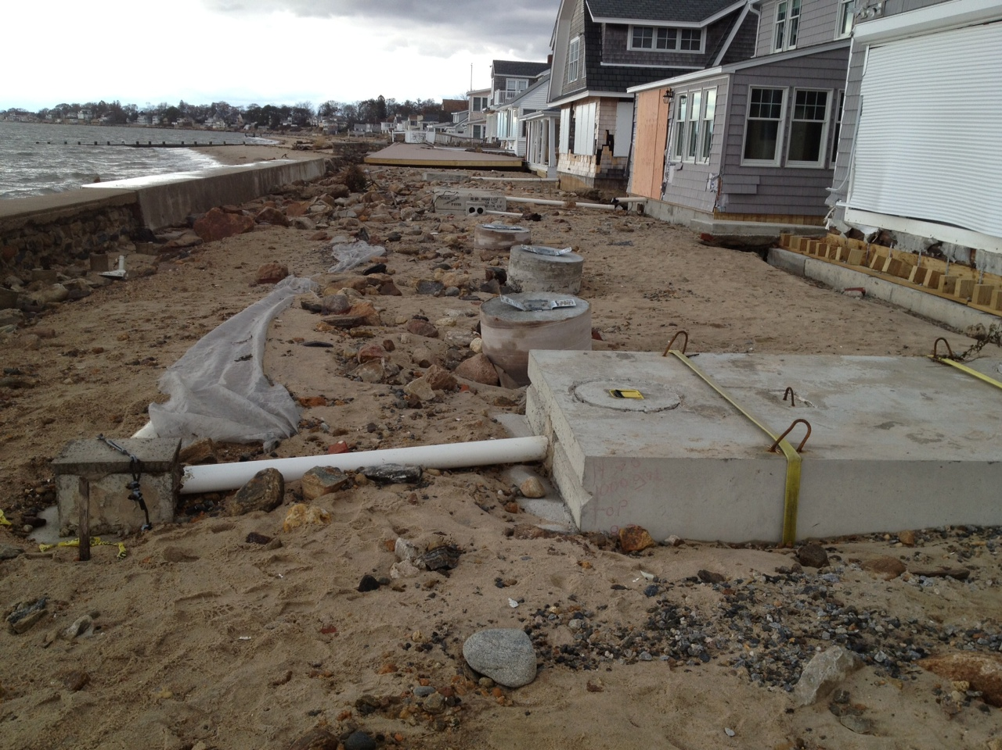
SLR: Acute Effects
Westport, CT
Photo: D. Potts

Slide 28
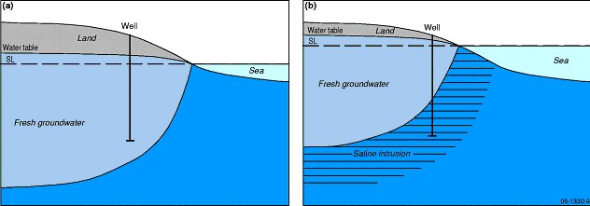
SLR & Rising Water Tables

Slide 29
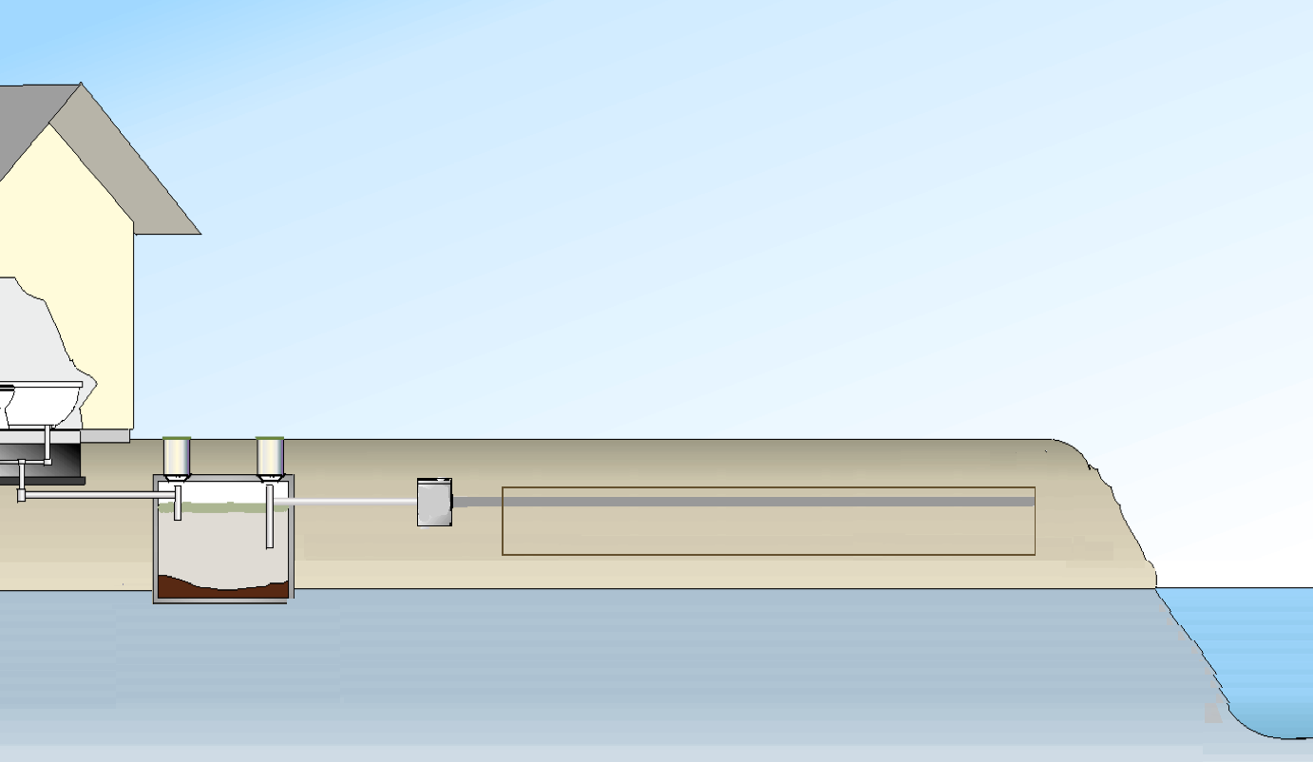
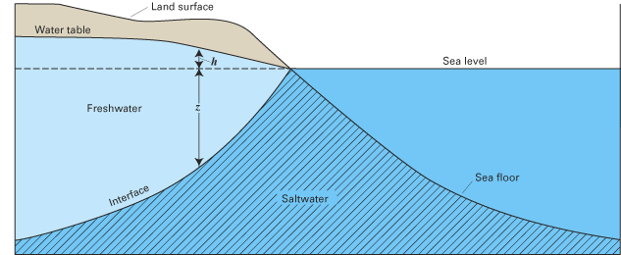
SLR: Chronic Effects
<1’
Reduced OWTS function under elevated sea level/groundwater conditions

Slide 30
HIgher Temperature: Less Oxygen Available
[O₂] (mg/L)
T (ºC)

Slide 31
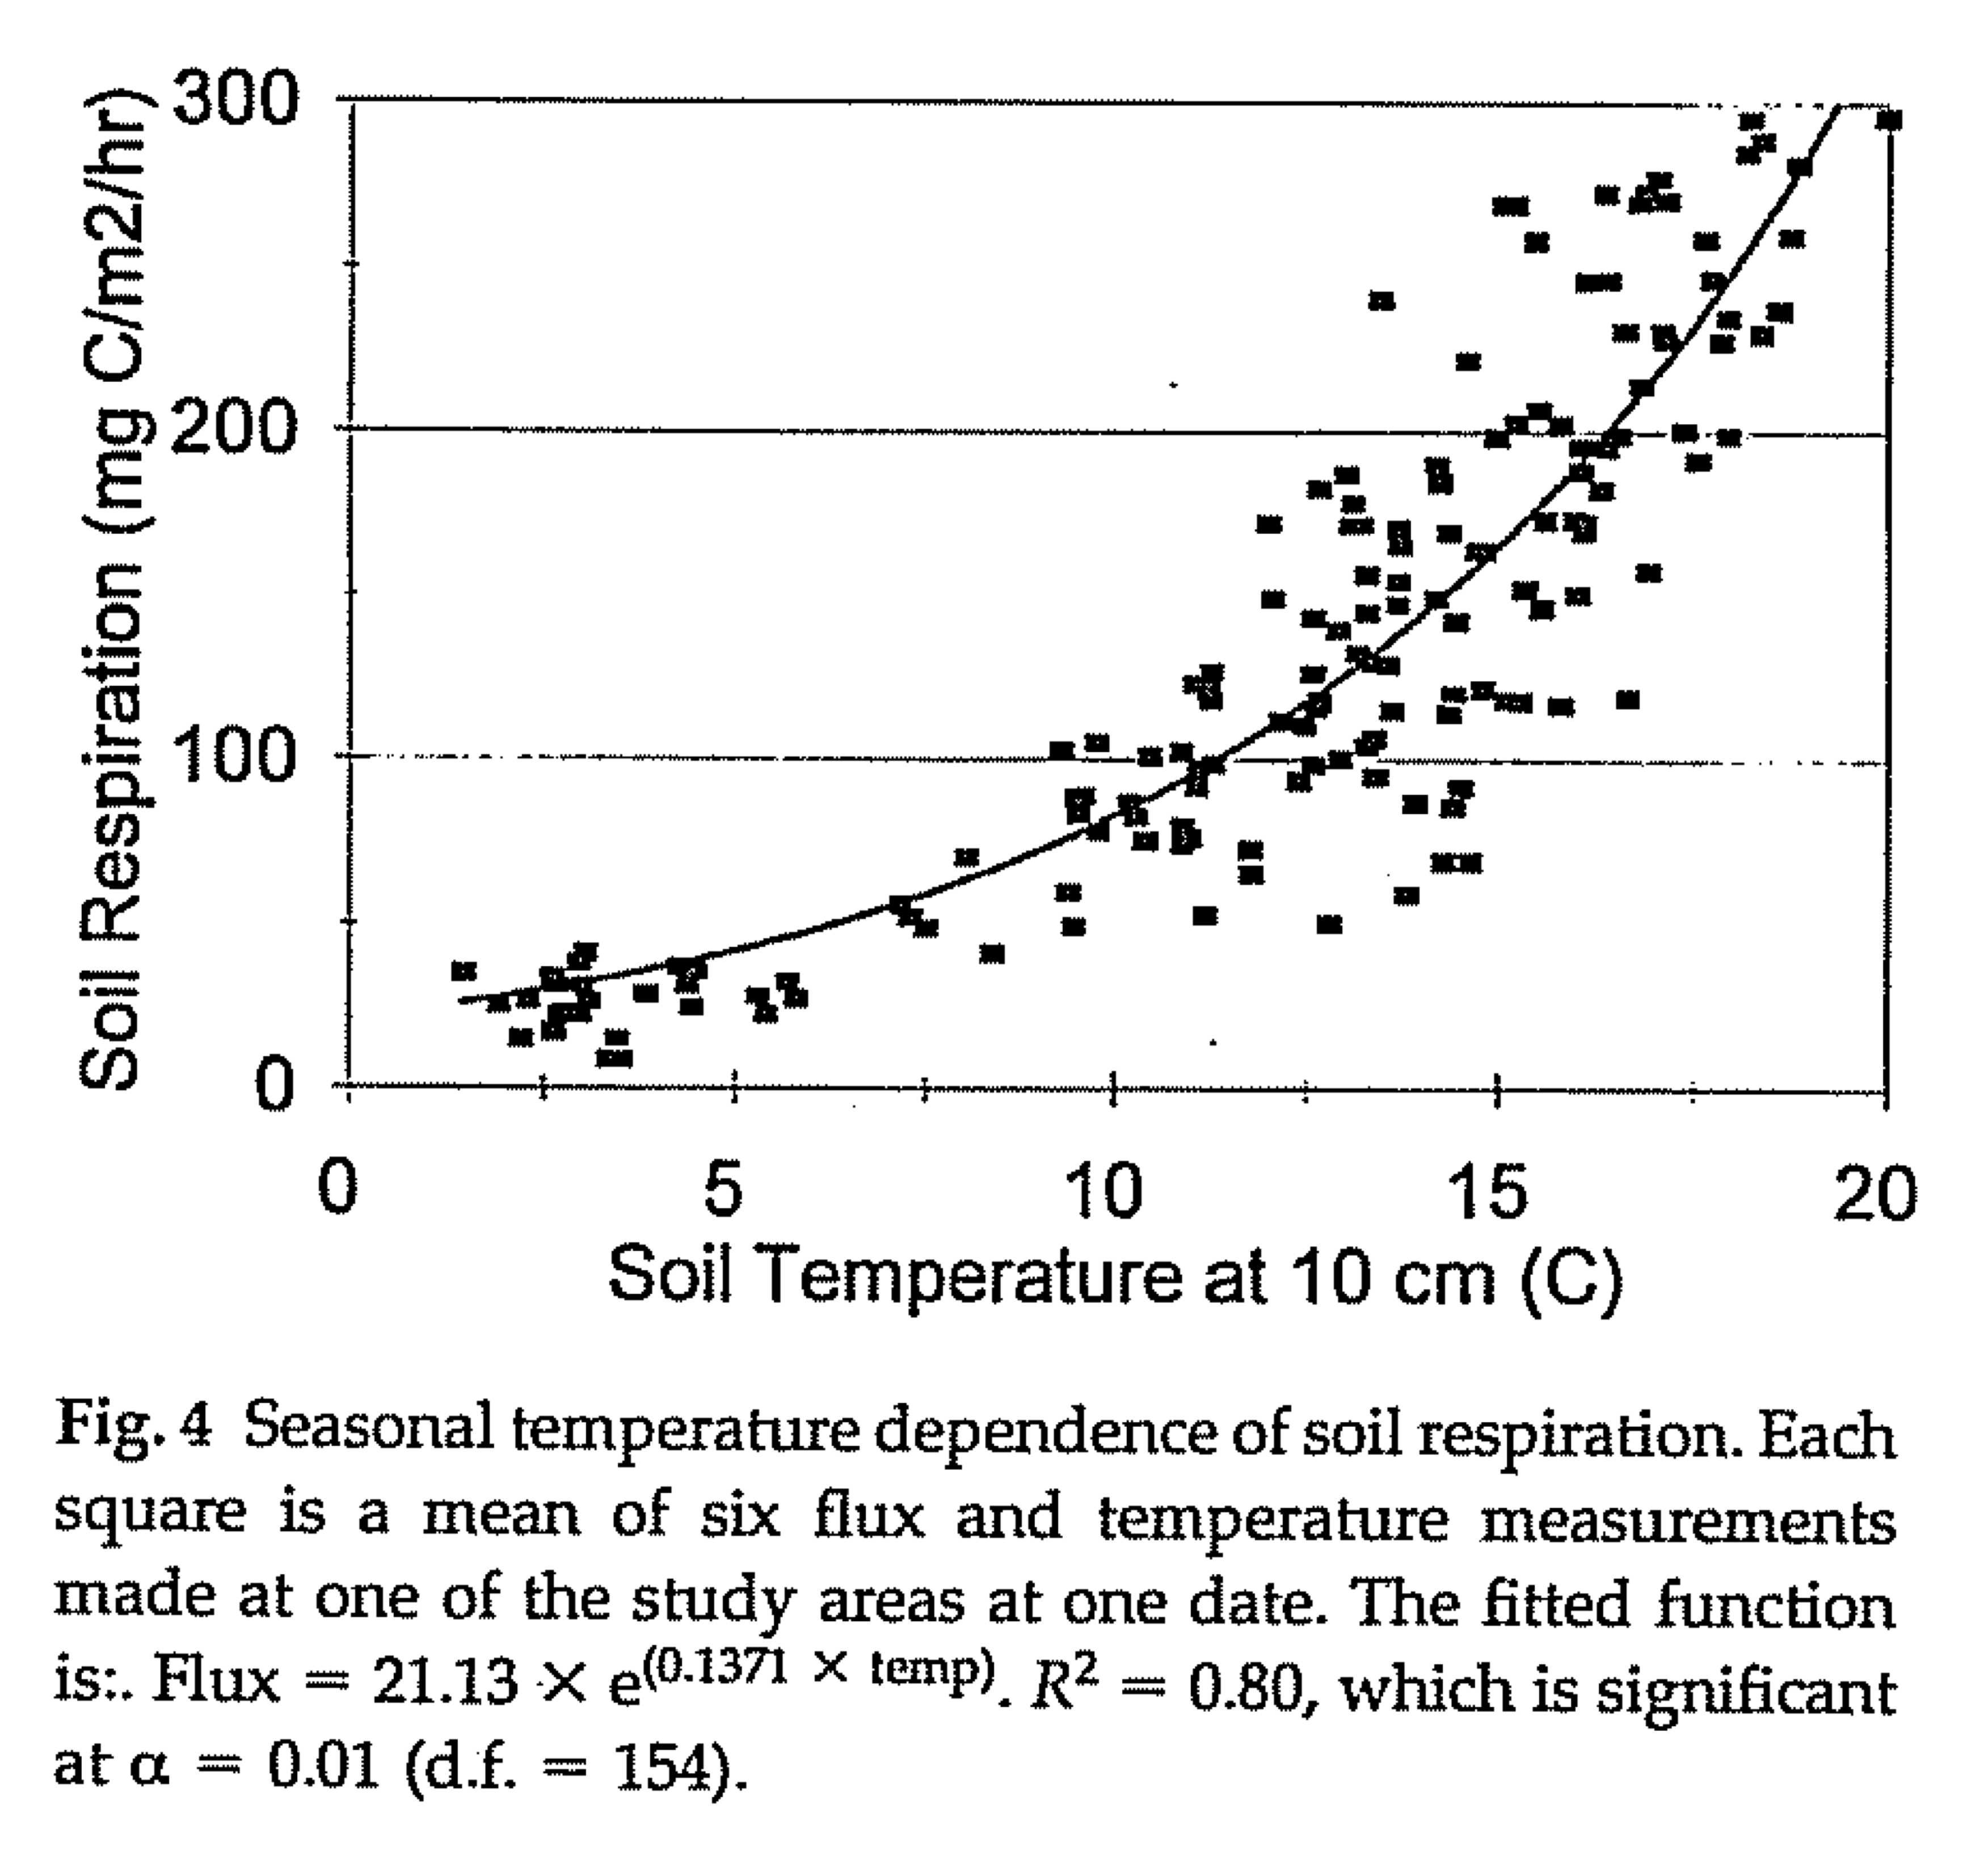
Higher Temperature: More Oxygen Use
Davidson et al. (1998)

Slide 32
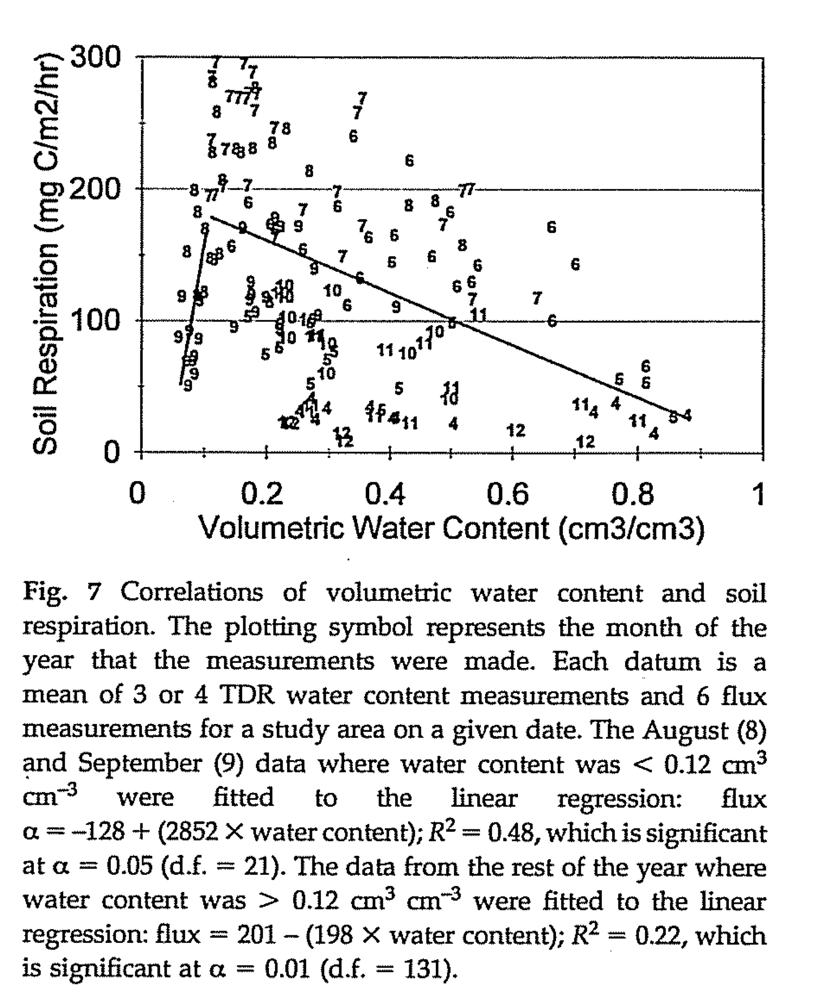
Changes in Soil Water: +/- Microbial Activity
Davidson et al. (1998)

Slide 33
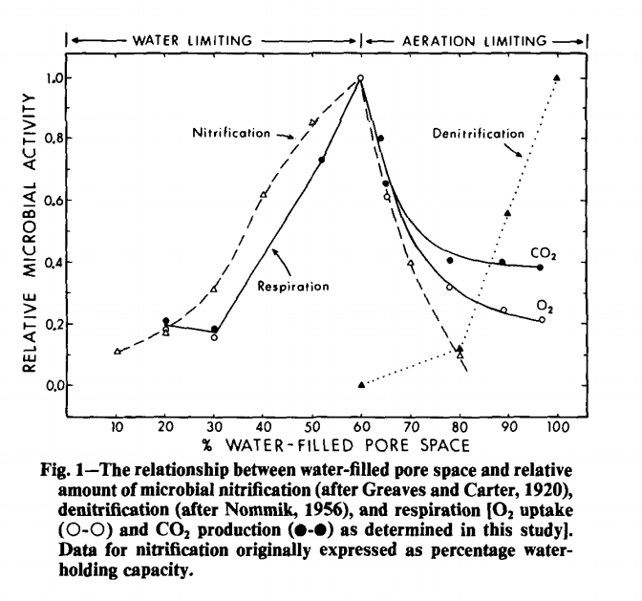
Changes in Soil Water:
Aerobic vs. Anaerobic Processes
Linn and Doran (1984)

Slide 34


Hypothesized Effects of Climate Change
Property/Process
Volume | ⬆ | ⬇
Strength | ⬇ | ⬆
Oxygen | ⬇ | ⬇
Respiration | ⬆ | ⬆
Nitrification | ⬇ (?) | ⬇ (?)
Denitrification | ⬆ (?) | ⬆ (?)
Xenobiotic degradation | ⬇ | ⬇
S oxidation | ⬇ | ⬇
P retention | ⬇ | ⬇
Pathogen removal | ⬇ | ⬆

Slide 35
Impact of Climate Change on Drainfields
Intact Soil Core Mesocosms
Three Drainfield Types:
  Pipe & stone – P&S
  Shallow narrow – SND
  Shallow narrow – GeoMat
Climate Conditions:
  Present climate: 70ºF
  Climate change: 77ºF; Water table up 1 ft

Slide 37
Oxygen

Slide 38
Fecal coliform bacteria

Slide 39
Phosphorus

Slide 40
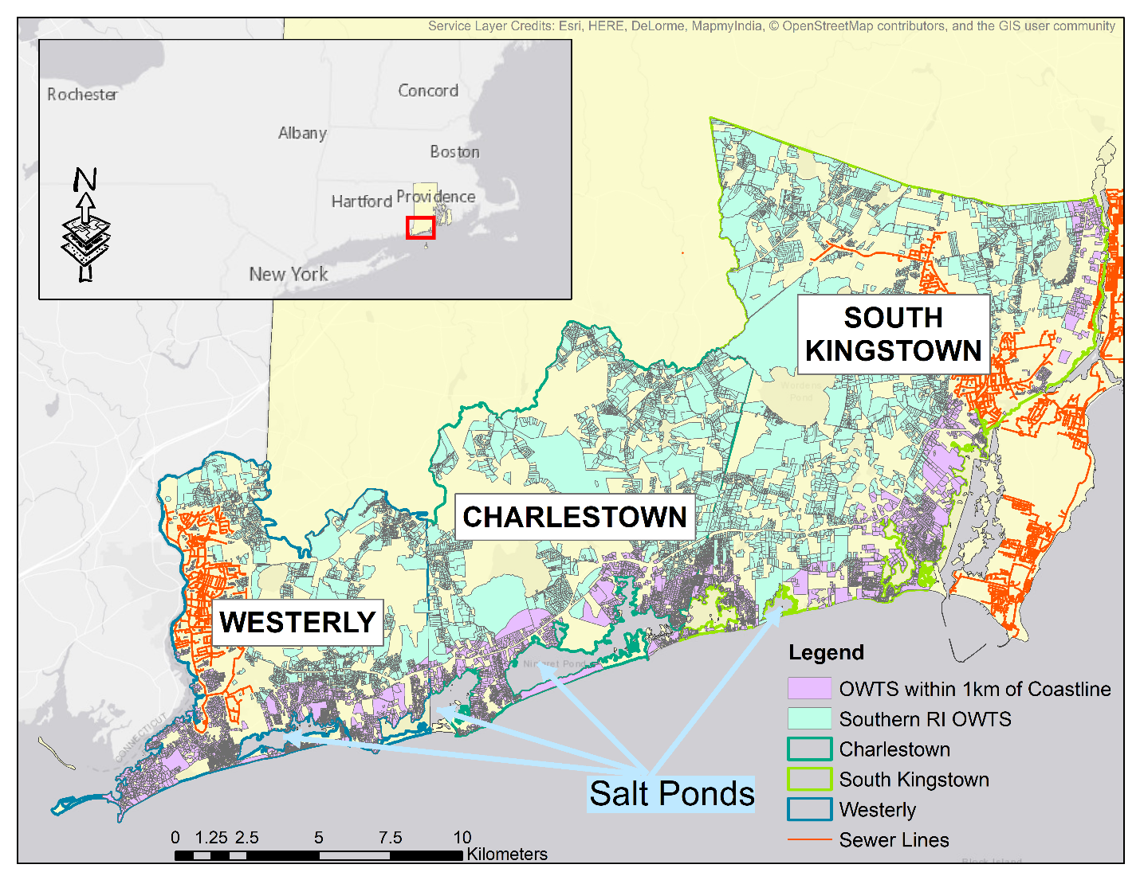
Quantifying Rising Water Tables

Slide 41
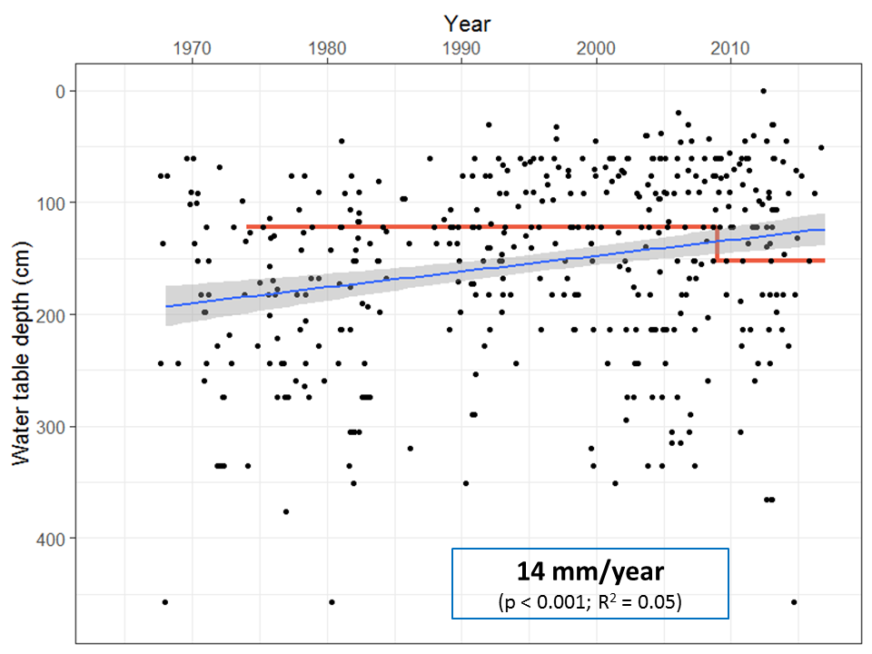

Slide 42
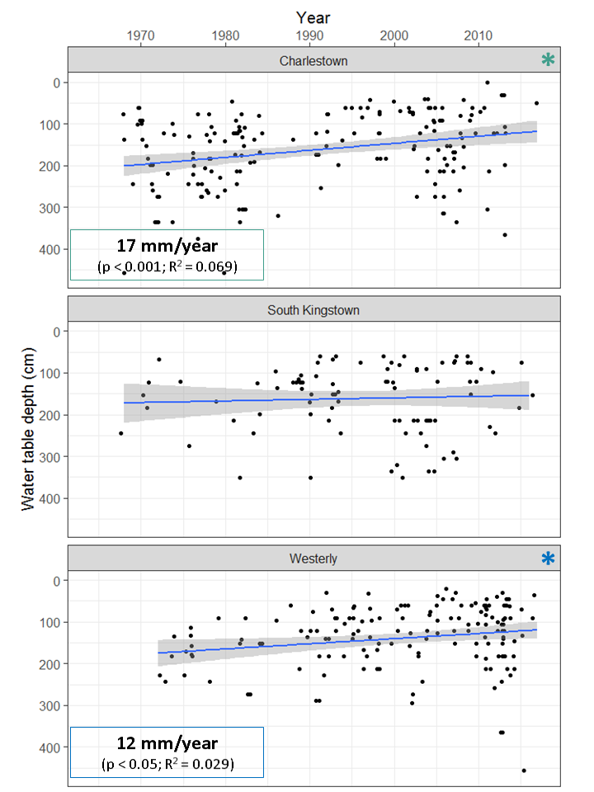

Slide 43
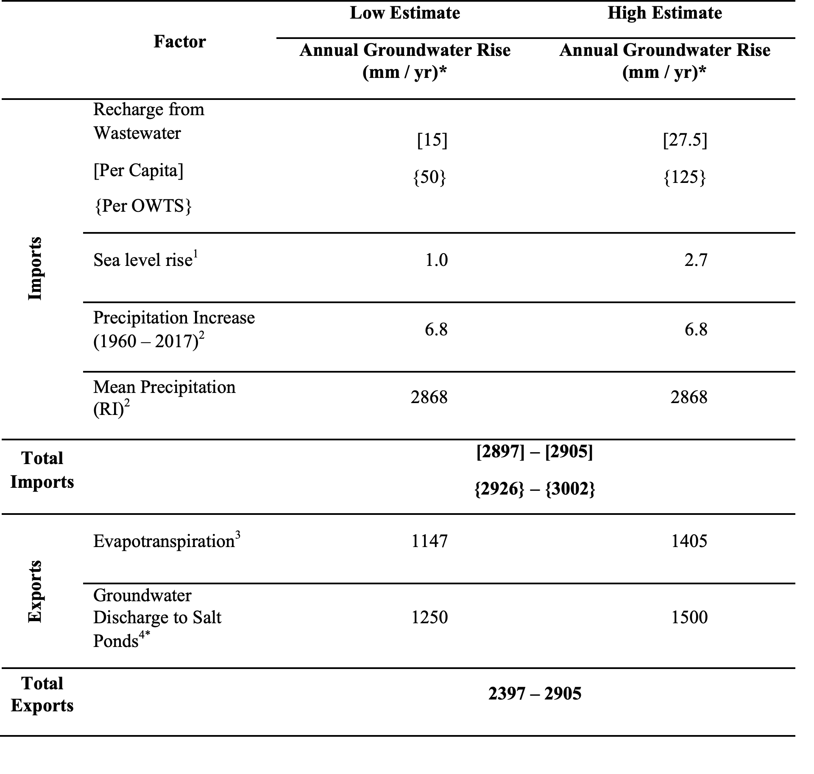

Slide 44
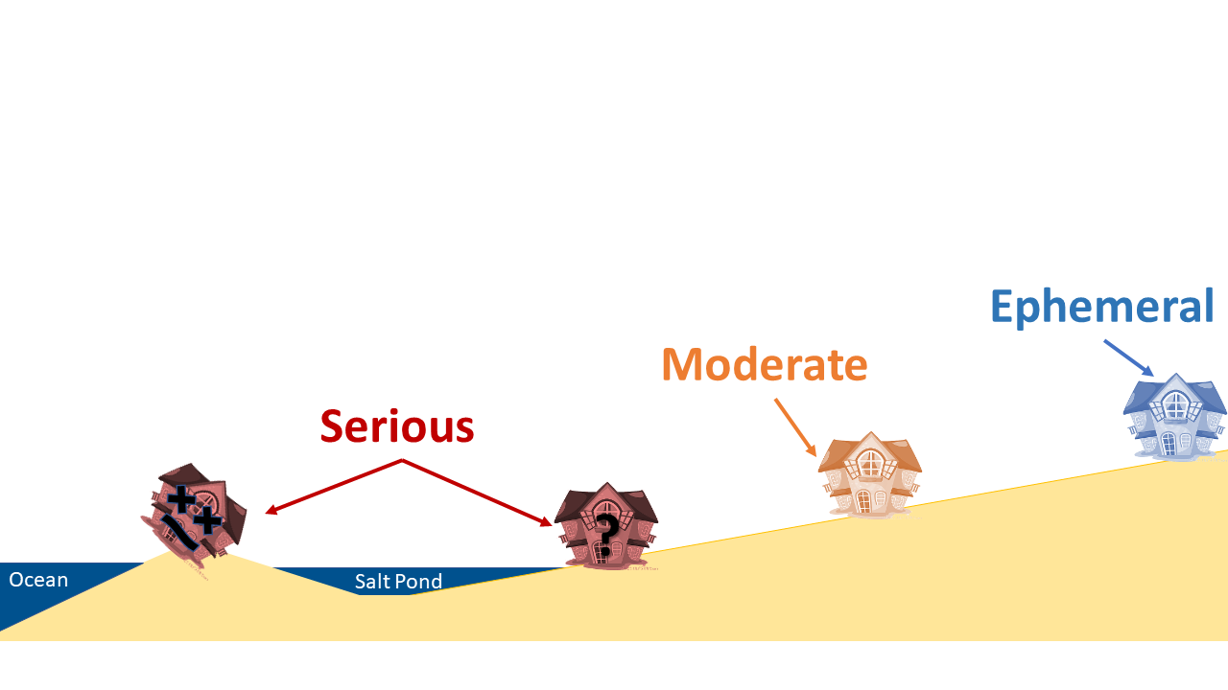
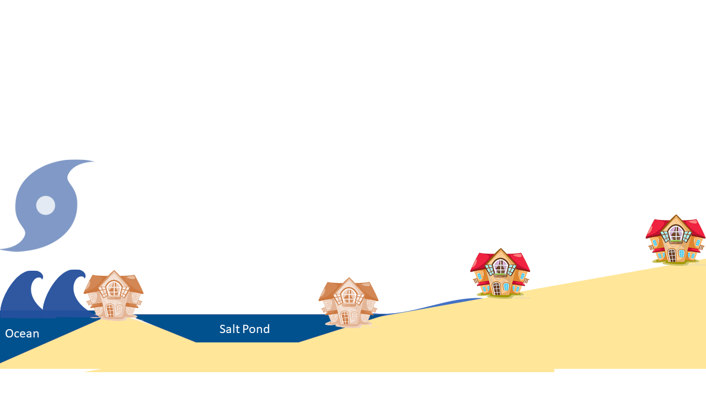
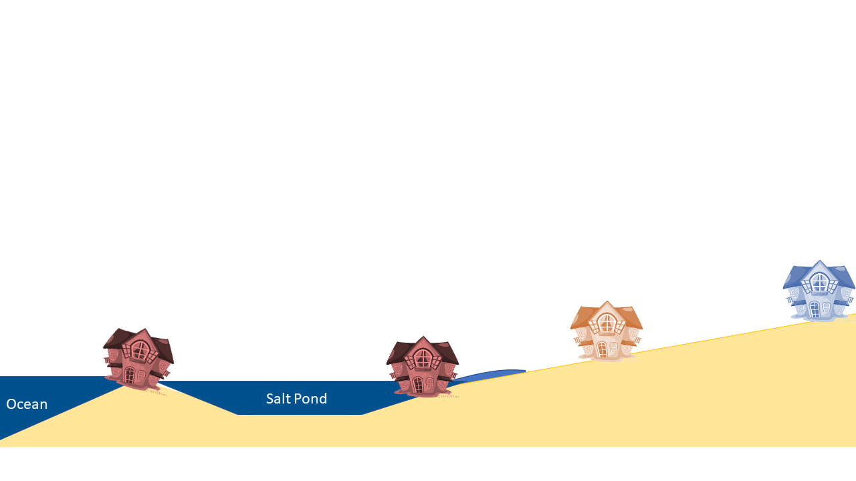
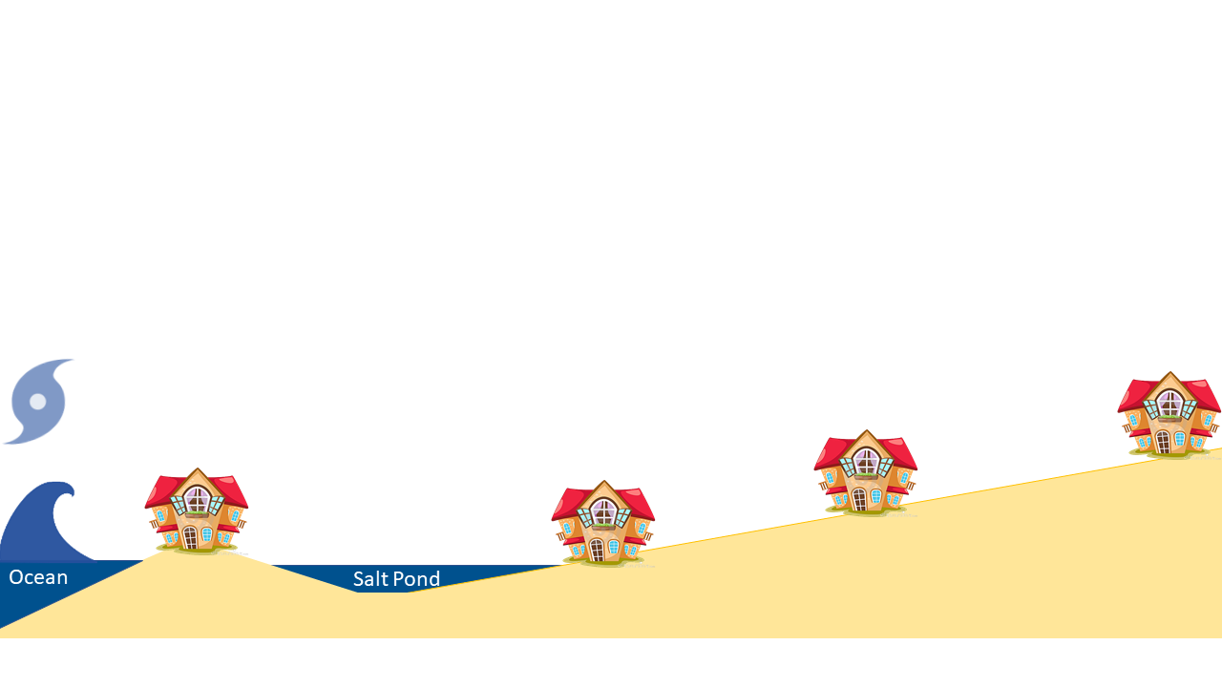
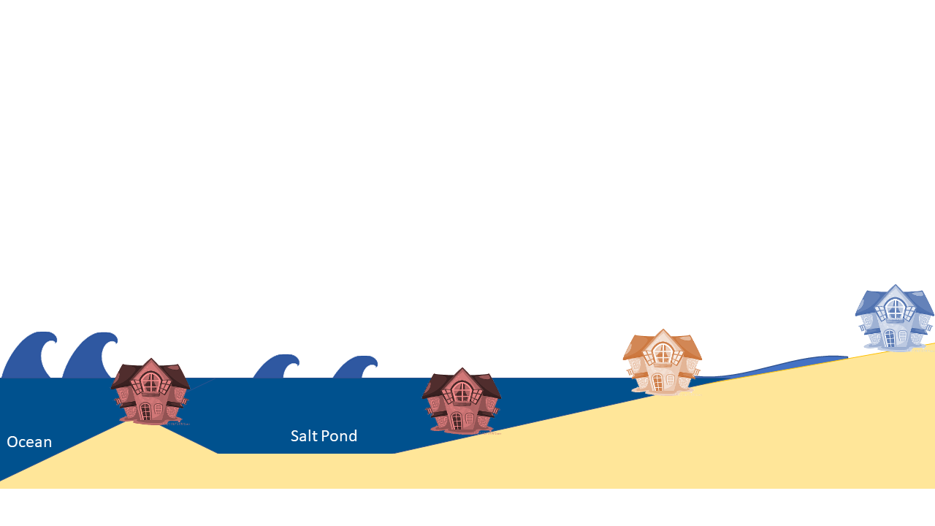
Quantifying Storm Impacts
Model different storm conditions along southern RI coast…
Count number of septic systems affected
Notes:
What if a ____ storm hits the coast, how many systems would be affected?
Severity of impact depends on location (storm surge damage), as well as length of inundation during storm/flood event (elevation)

Slide 45
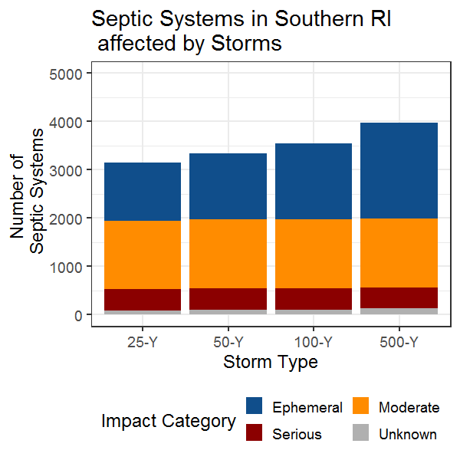
Summary of Storm Impacts (no SLR)
Require repairs!

Slide 46
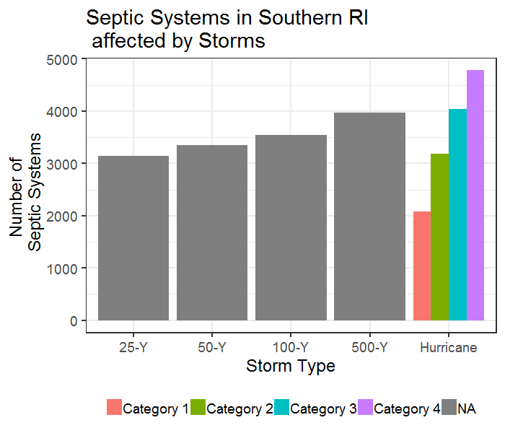
Overall Impacts on Septic Systems
Notes:
Update #s

Slide 47
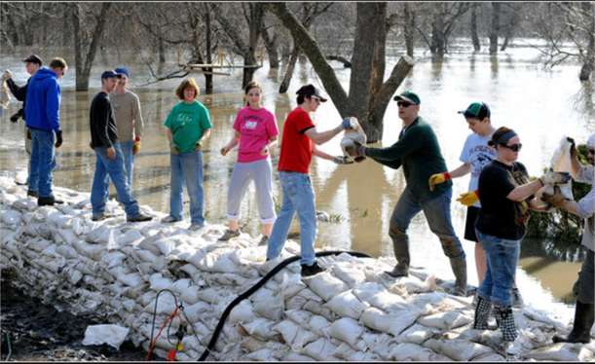
What to do?

Slide 48
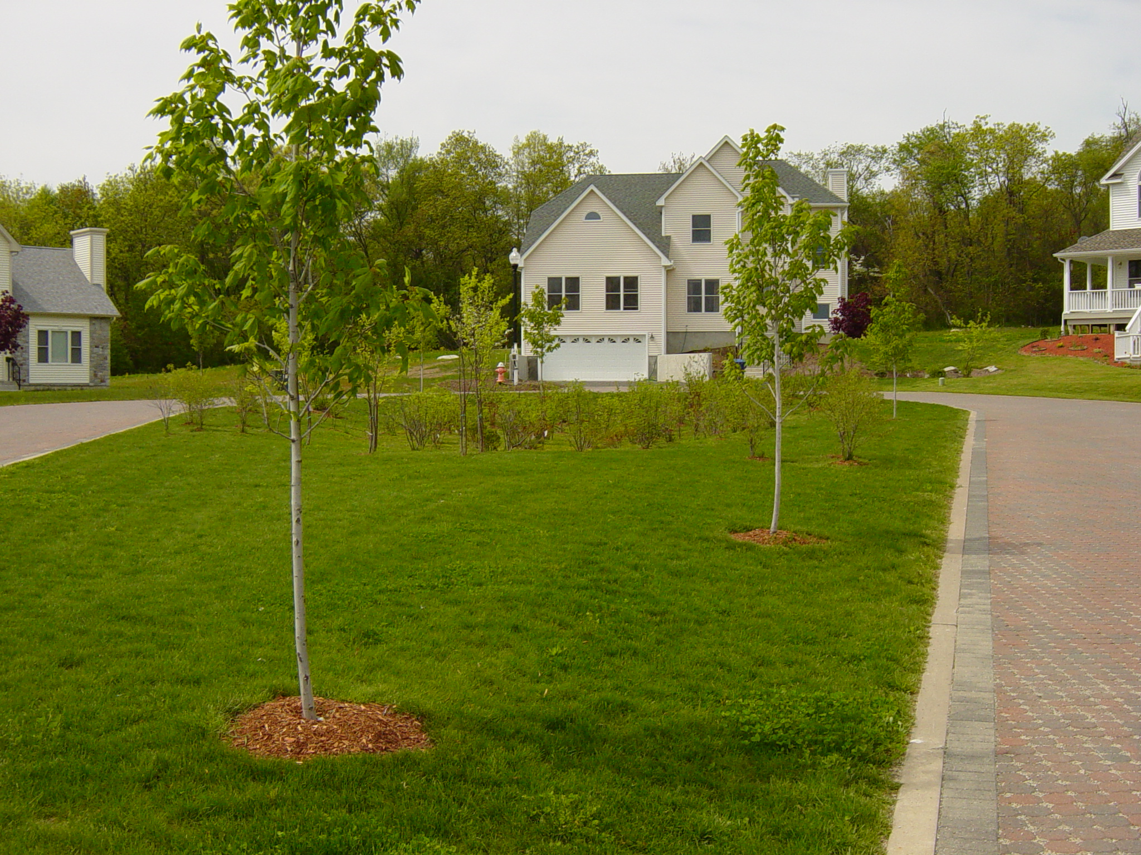
Adaptation and mitigation
Think integrated water management:
Manage stormwater & wastewater
Use low impact development (LID) measures
Use green infrastructure practices
Increase wetland setbacks and buffers

Slide 49
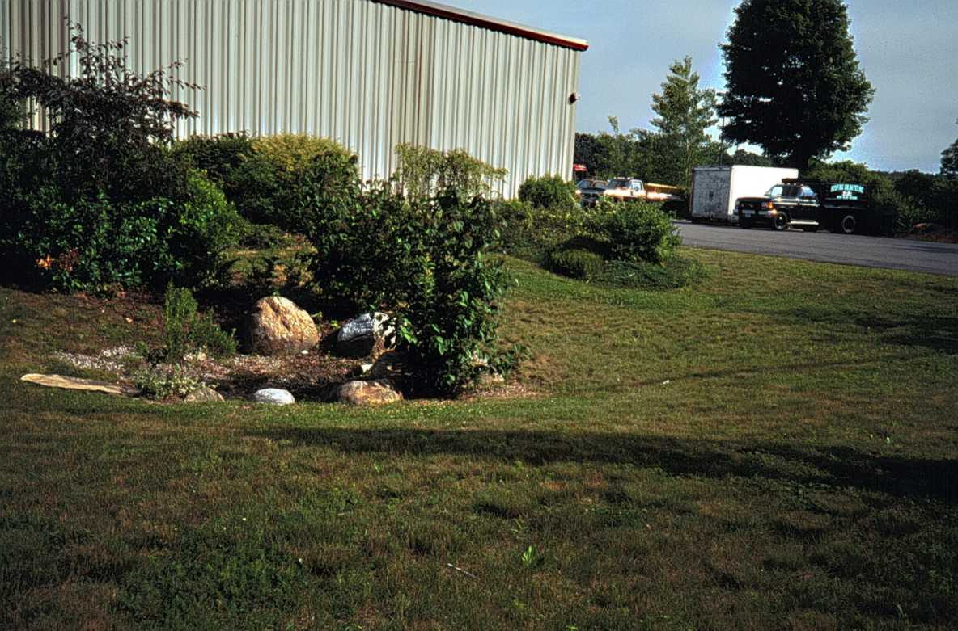
Think integrated water management:
Protect areas that collect and infiltrate stormwater
Minimize disturbance (maintain natural hydrology)
Uncompact soil – restore to original soil hydrologic conditions

Slide 50


Adaptation and mitigation
OWTS Manufacturers:
Adapt existing technologies
Improve component-based treatment efficiency
Develop new technologies
Incorporate moisture managementt into treatment trains (i.e. flow equalization, timed-dosing)

Slide 51
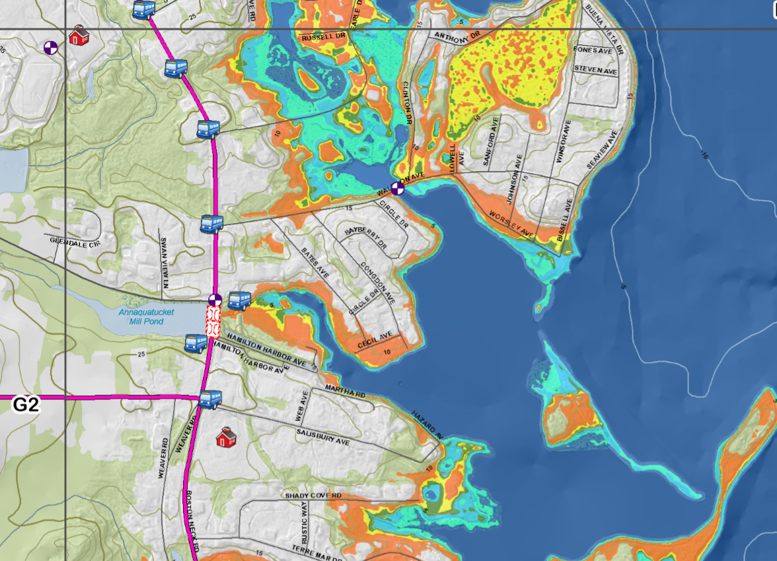
Adaptation and mitigation
Regulators:
Map at-risk areas – set priorities
Develop risk-based policy and regs
Require accountability for treatment and O&M performance

Slide 52
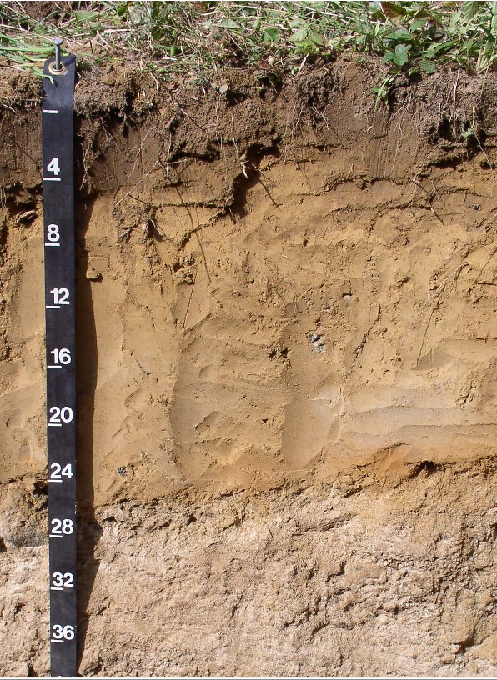
In wetter areas
Manage soil moisture:
  Promote timed-dosing and flow equalization
Promote shallow wastewater dispersal
  More biochemically reactive soil
  Maximize vertical separation distance
  Maximize retention time

Slide 53
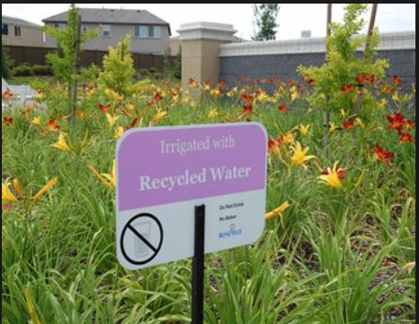

In drier areas:
Soil treatment area dispersal?
Landscape irrigation
Wastewater recycling and reuse
Advanced treatment will become more important

Slide 54
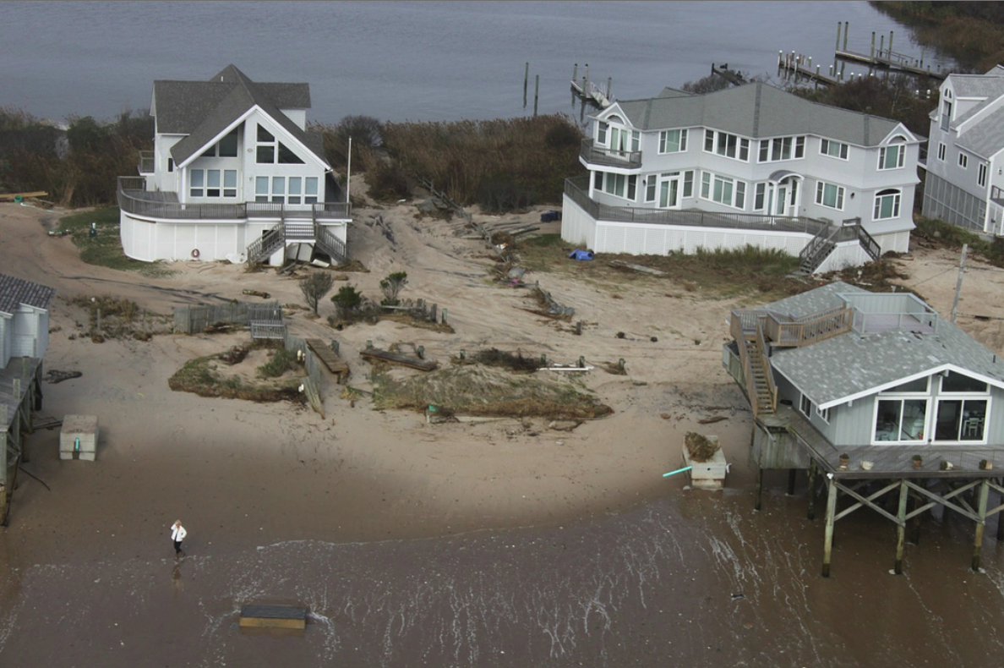
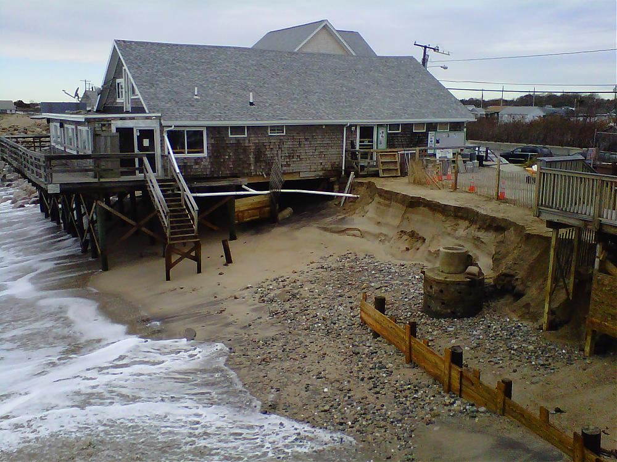
Example: Mitigating Acute Effects in East Coast Storm Impact Zones
Rhode Island high risk flood and erosion areas
Repair systems - holding tanks, if 50 ft. to eroded feature; denitrification technologies otherwise
Greenhill, RI
(post Hur. Sandy Oct. 2012)
Matunuck, RI

Slide 55
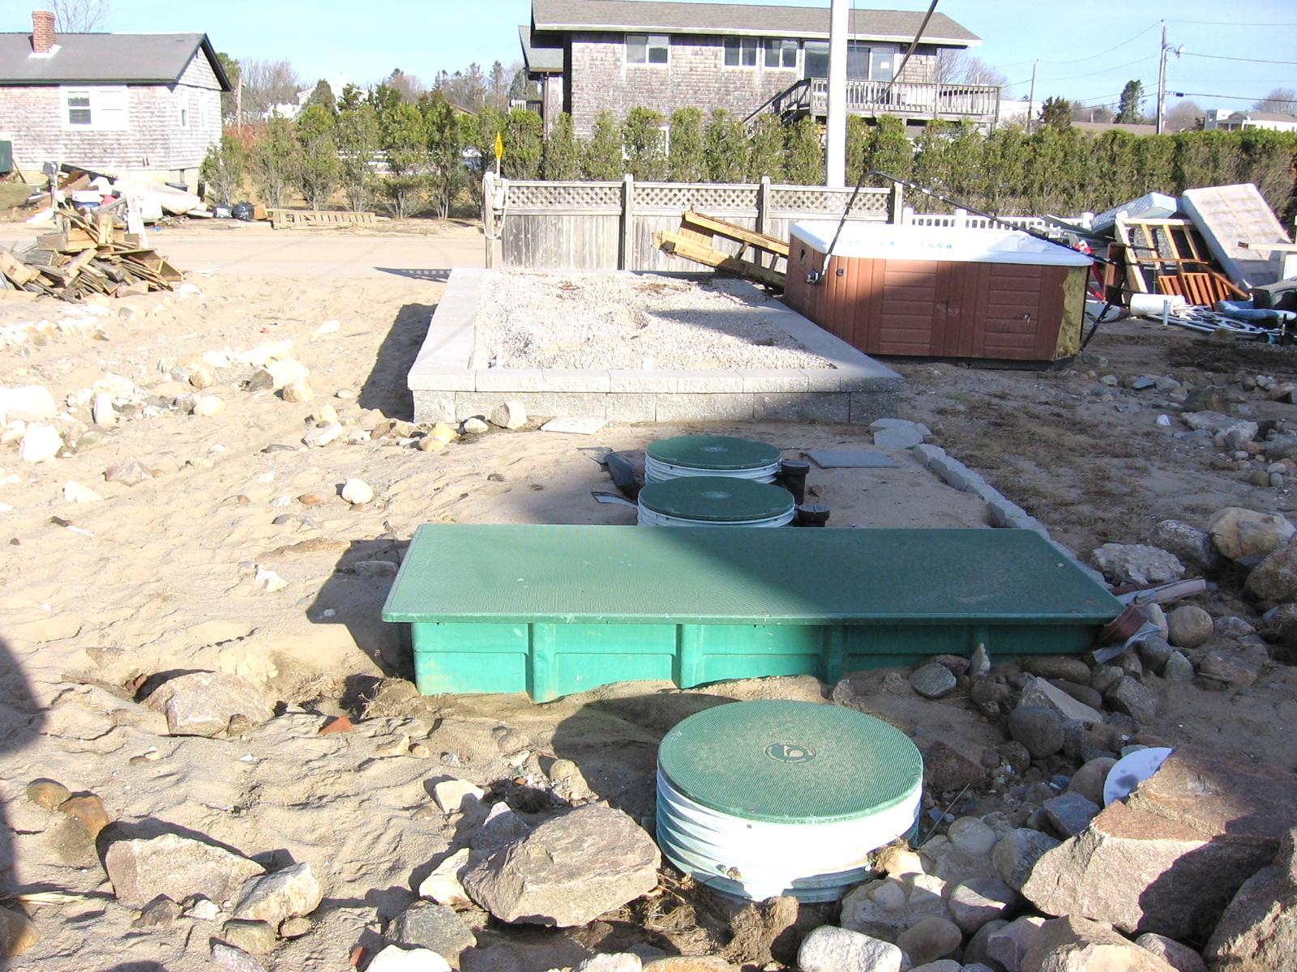
Use risk-based BMPs in designs -
Stone BSF enclosures
Hurricane Sandy Damage - Atlantic Ave., Misquamicut, RI
Anti-floatation and strapping
on tanks and components
Photo: Brian Moore, RIDEM
Watertight lids
Elevated control panel boxes

Slide 56
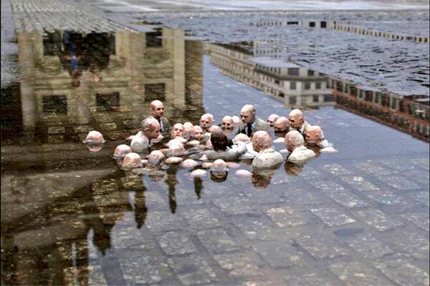
Isaac Cordal, Follow the Leaders, Berlin, Germany, 2011

