Slide 1
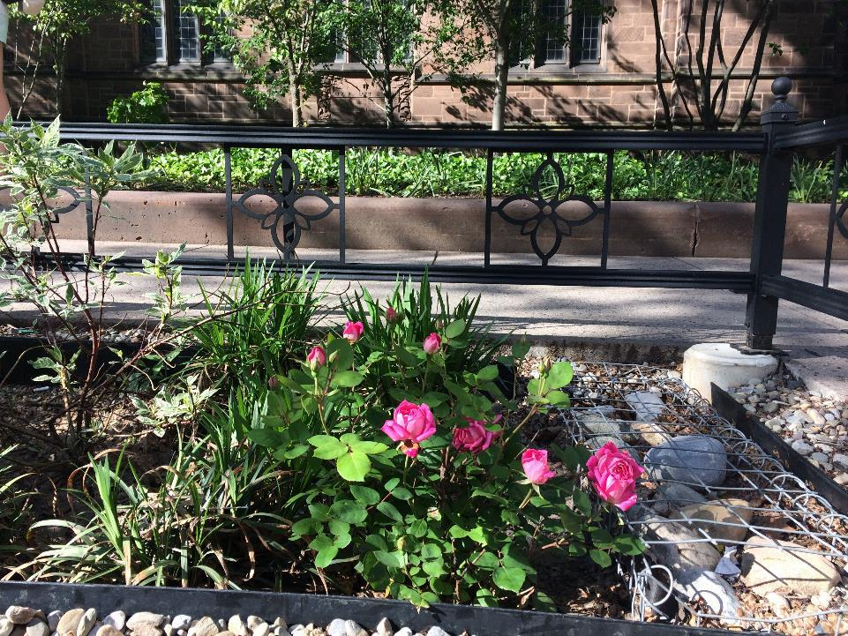
Municipal Stormwater Management:
New Haven’s Green Infrastructure/LID and How It’s Working
Giovanni Zinn, PE
City Engineer
City of New Haven

Slide 2
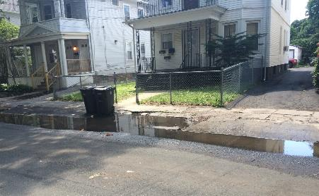
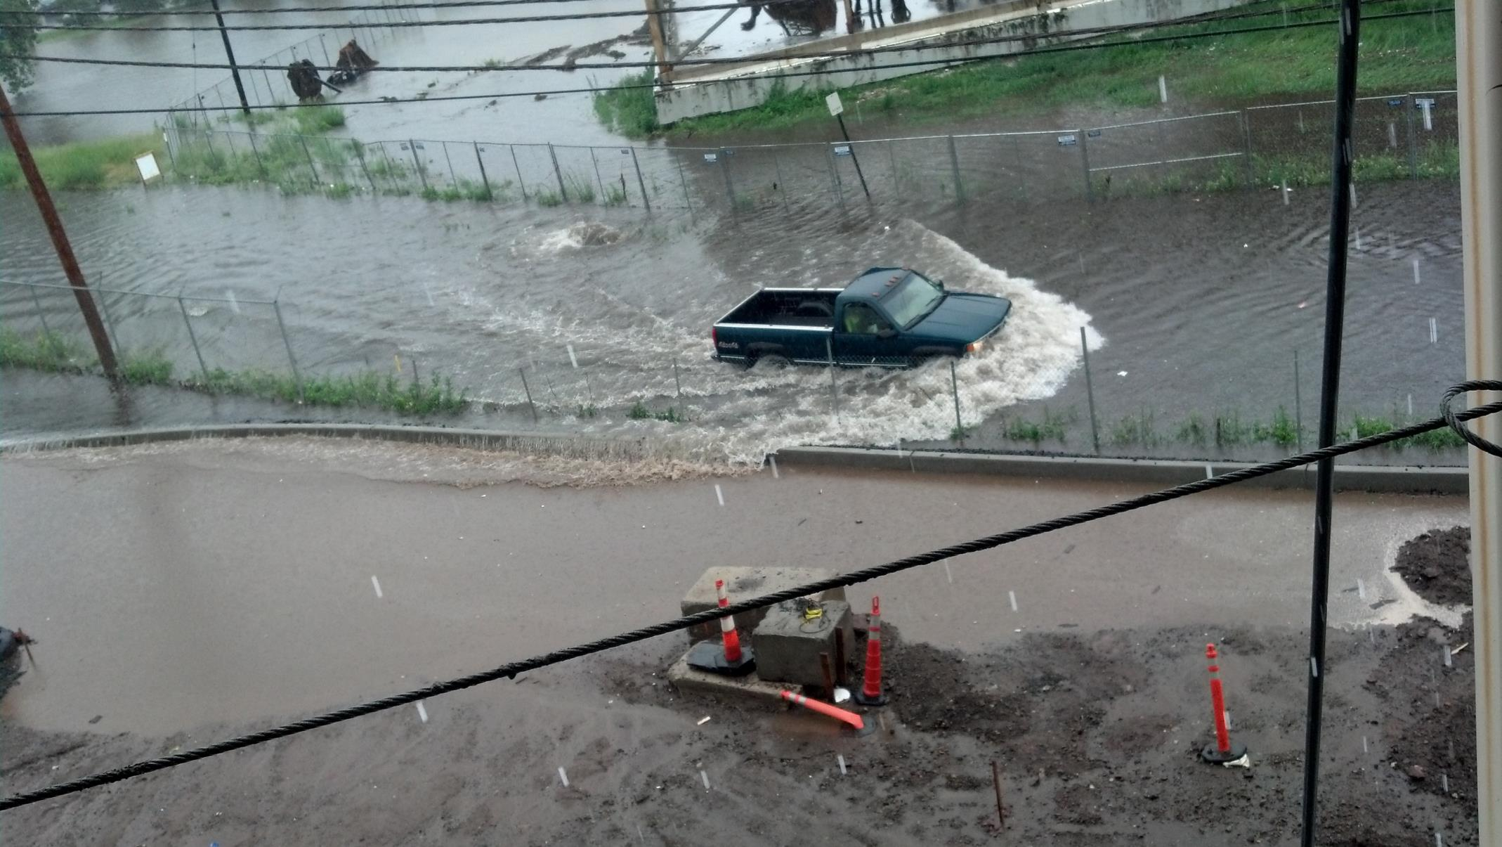
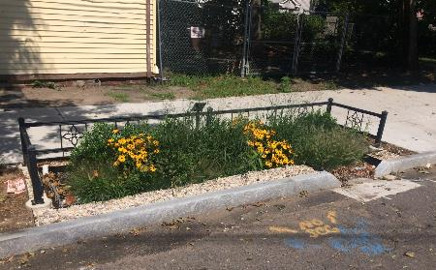
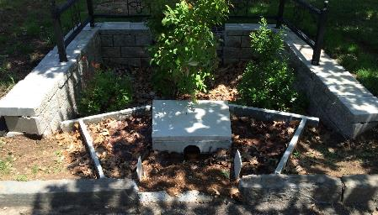
Motivations for GI Installations
Localized drainage solution (capital funds)
Flood prevention (capital funds and grants)
CSO mitigation (grant funded)
Research (grant funded)

Slide 3
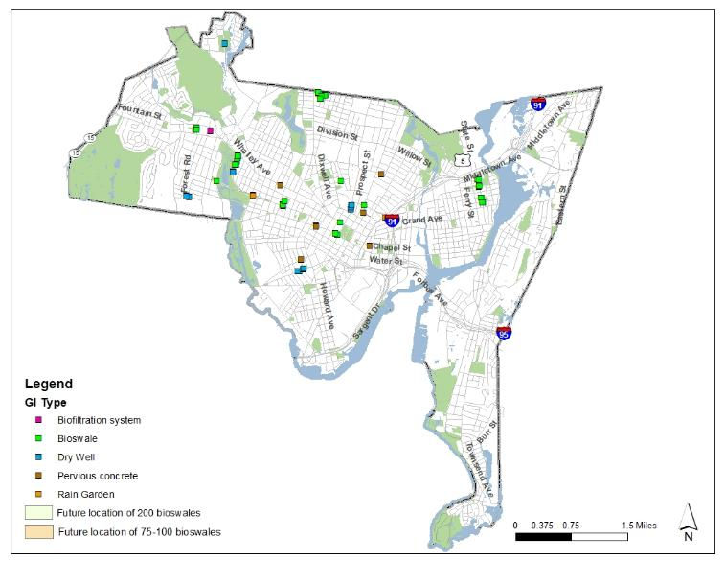
Existing GI Installations
35 bioswales
19 dry wells
7 pervious concrete installations
3 rain gardens
Notes:
Had 20 bioswales last presentation- up to 35. New additions 3 downtown, 4 at Troup School, 8 on Clinton Ave

Slide 4
Lesson 1: Simplify Design

Slide 5
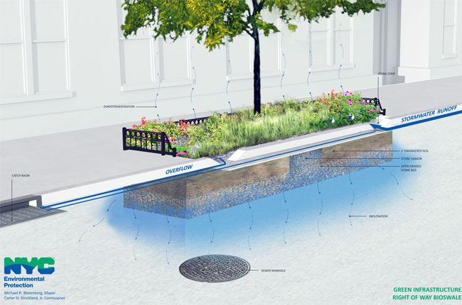
Bioswale Design

Slide 6
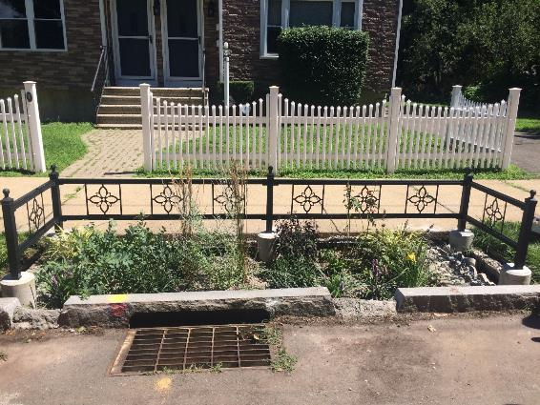
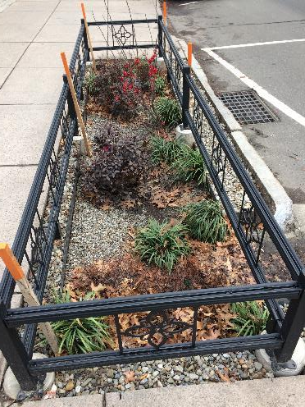
Bioswale Design
Remove the overflow curb cut
Remove concrete header - use precast concrete footings
Add storm chamber for additional storage
Peastone cover
Low maintenance plantings
Notes:
Evolution of the design– most changes made for ease of construction with low skilled labor and no heavy machinery and ease of future maintenance

Slide 7
Lesson 2: What Can Break, Will Break
(at least Downtown)

Slide 8
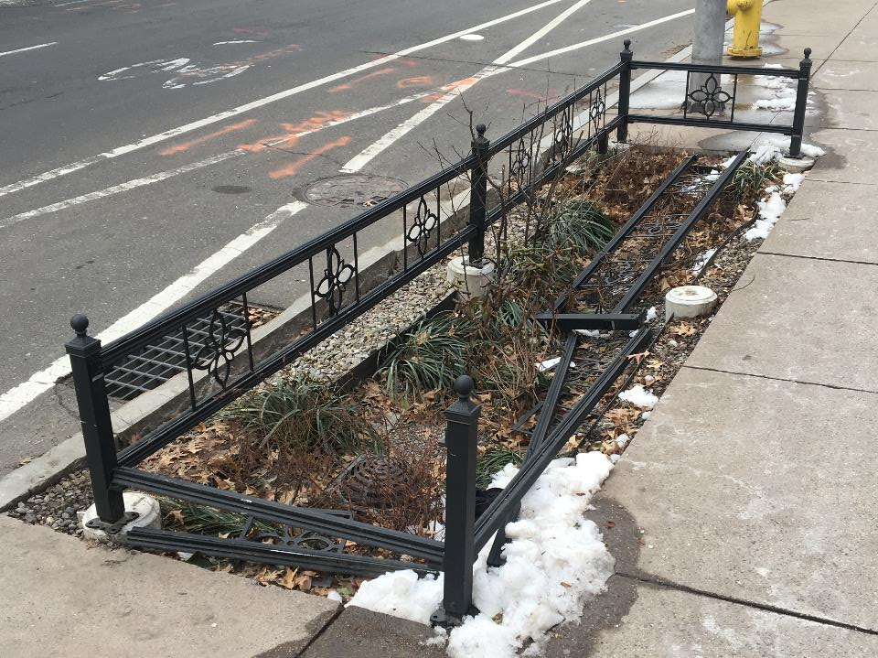
Bioswale Design
Fail…

Slide 9
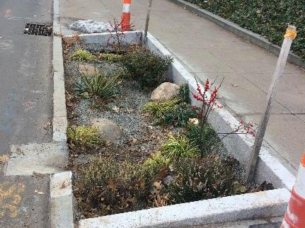
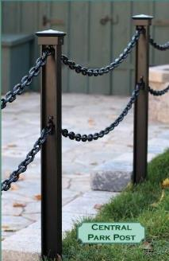
Bioswale Design
Granite Curb edging
Simple chain fence

Slide 10
Lesson 3: Green Infrastructure is SO much more than a catch basin

Slide 11
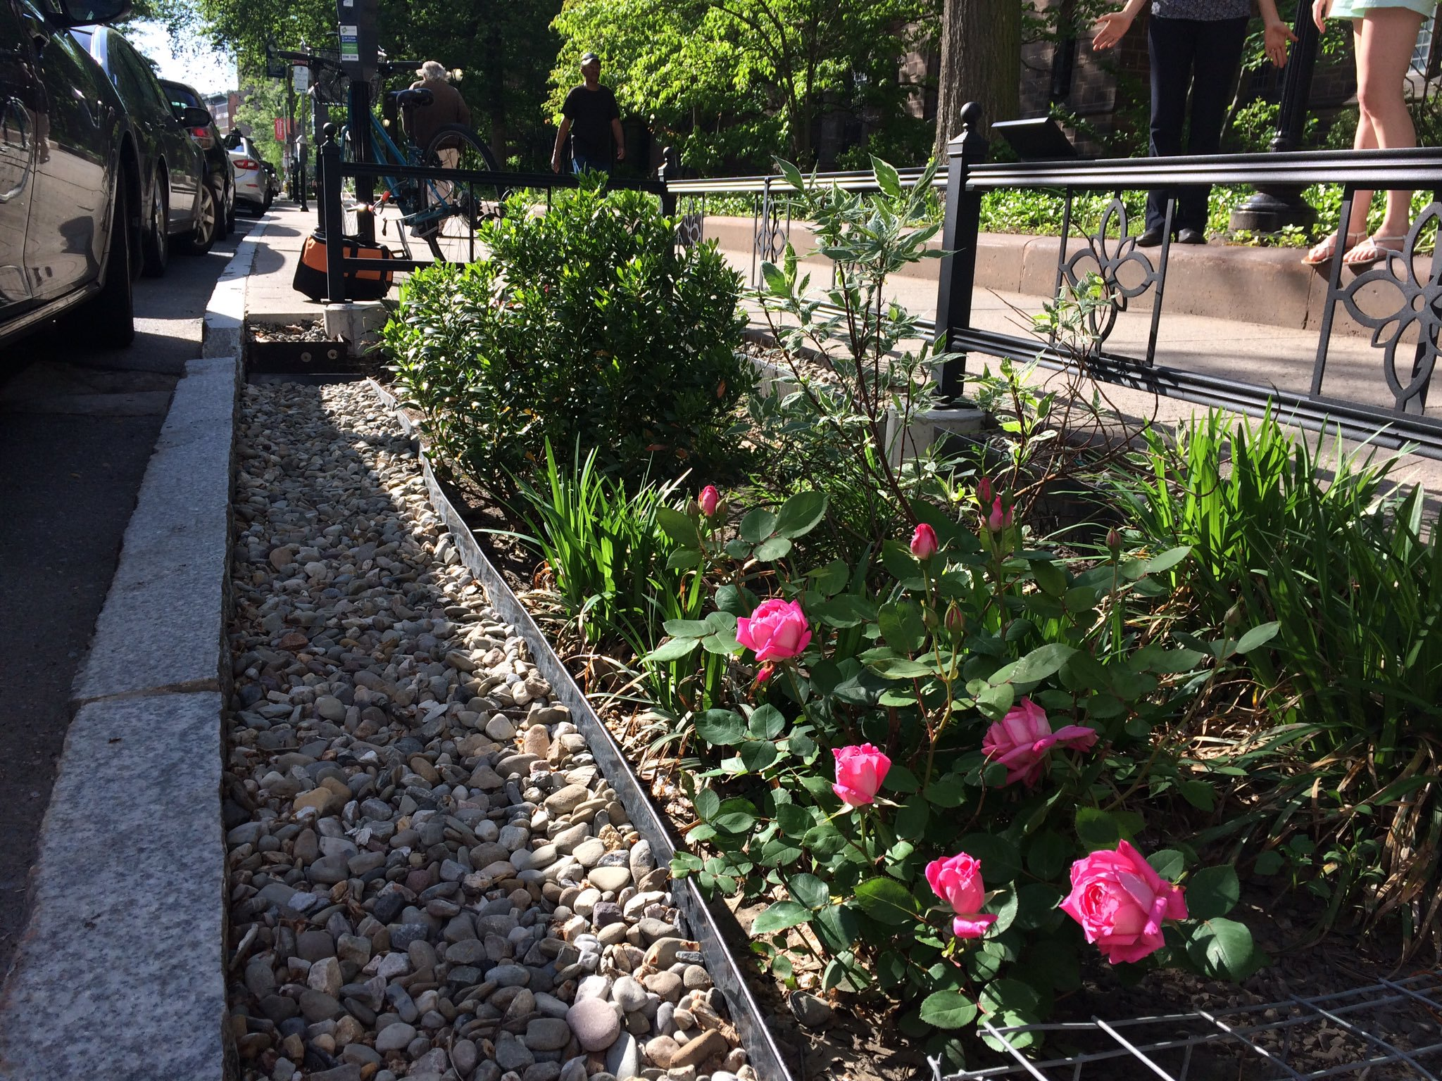
Need to Build GI Differently
Bring Community into Project Team
Design for more skill levels
Embrace GI’s strengths
GI is different things to different people
Inspire best practices on private property
Create opportunities

Slide 12
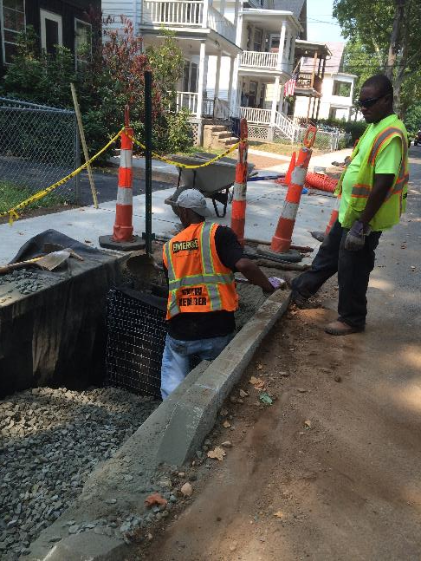
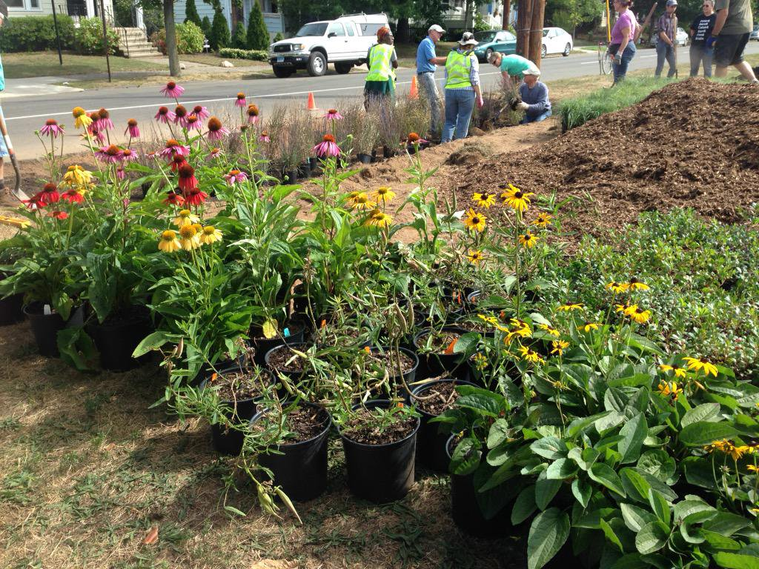
Partner with Non-profits
Urban Resources Initiative
EMERGE
CFE/Save the Sound
Good at things we are not!

Slide 13
Lesson 4: Stormwater isn’t a particularly hot funding goal

Slide 14
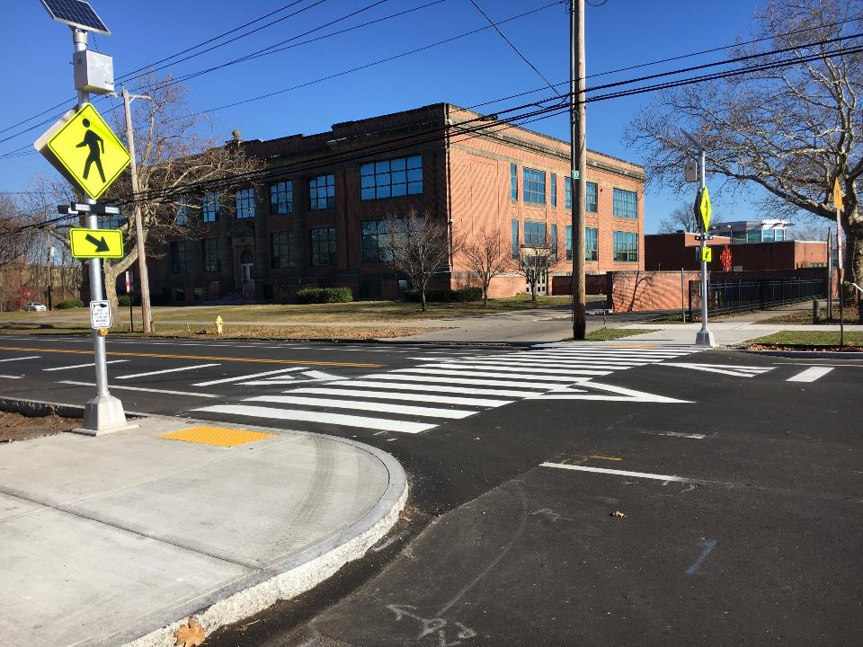
Clinton Avenue
Achieve multiple objectives by incorporate GI into traffic calming projects

Slide 15
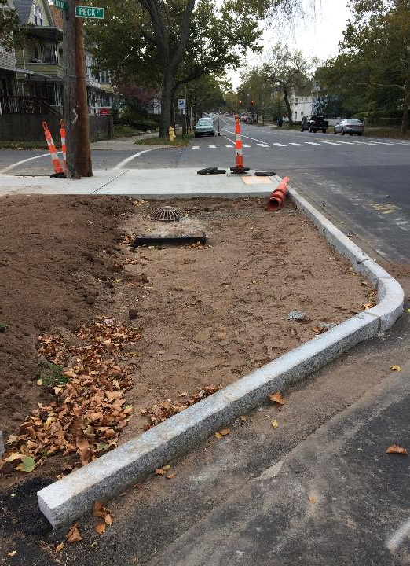
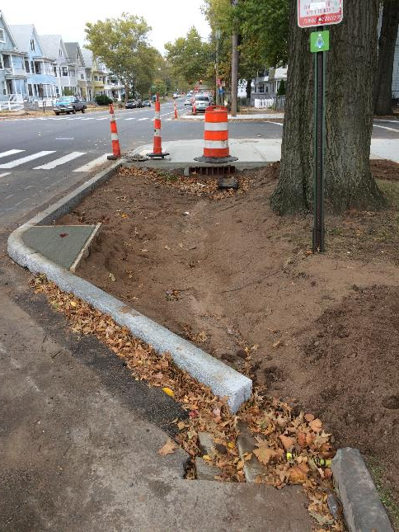
Clinton Avenue

Slide 16
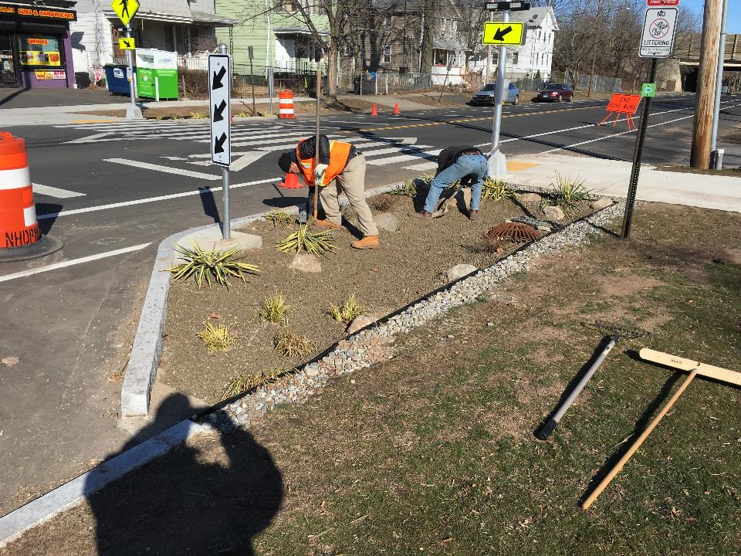

Slide 17
Lesson 5: Actively reach out to your installation’s neighbors

Slide 18
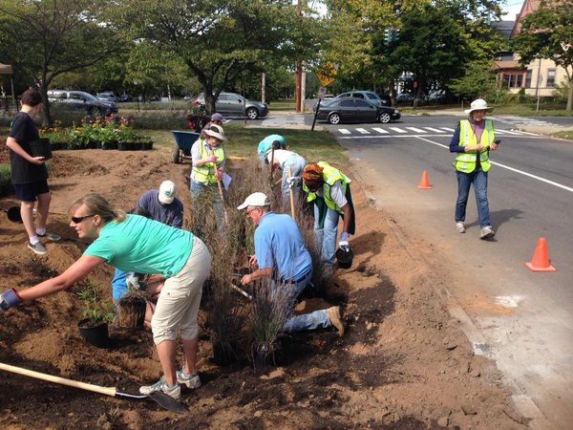
Work with Neighbors
Let neighbors make decisions!
Use workers who live there
Go deep into design details
Sweat equity

Slide 19
Outreach
-to school
-to neighbors
-to church
Door to door knocking
Meetings
Announcement at church
Troup School

Slide 20
Lesson 6: Measure your success (or failure)

Slide 21
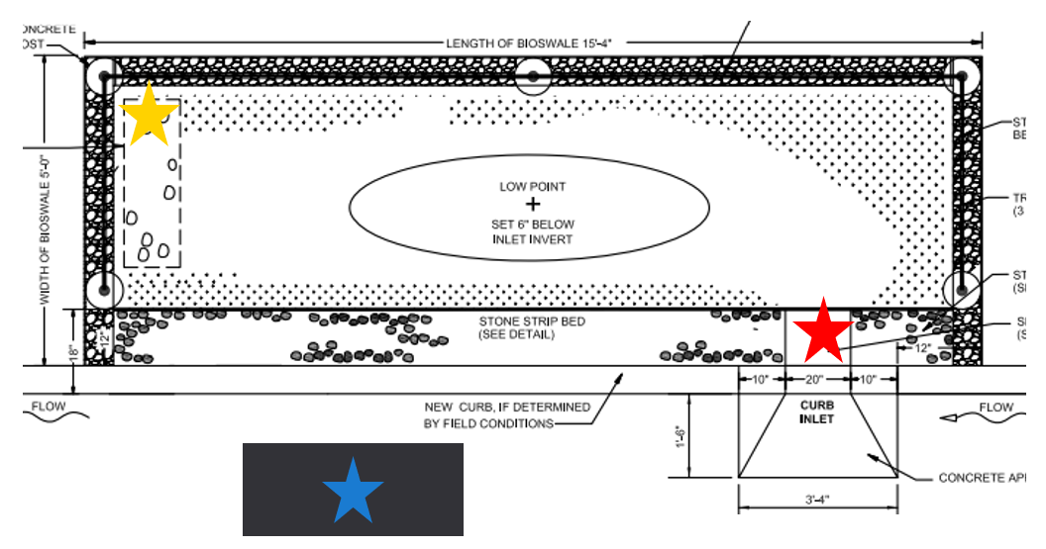
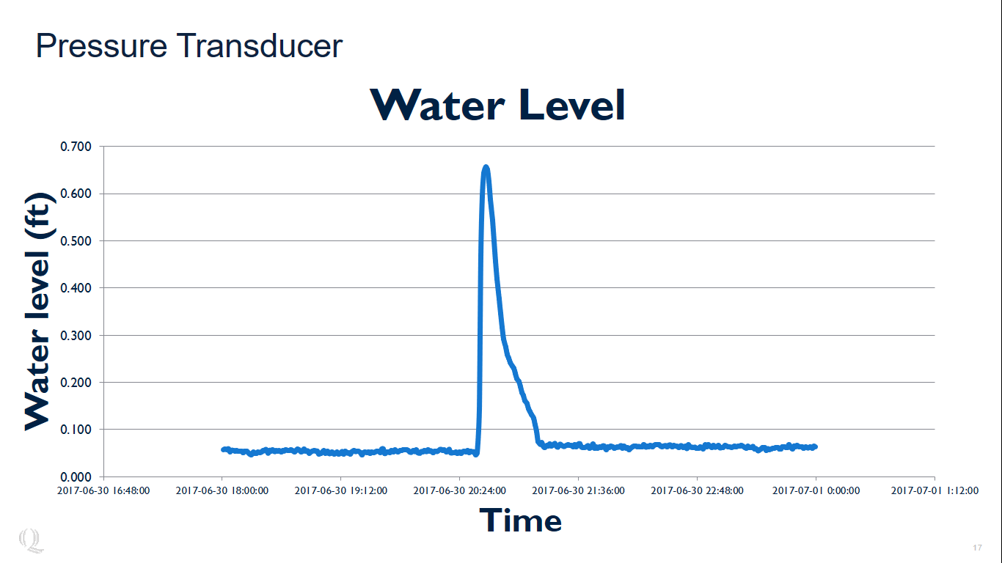
Research
Individual Bioswales
Infiltration rates in observation well approximately 13 in/hr during storm
Bacteria levels reduced as runoff moves through bioswale
Dr. Kim DiGiovanni
Quinnipiac University

Slide 22
Research
Compare a sewer segment with GI to one without
Quantify effects of GI over a catchment area, rather than individual performance
Dr. Gaboury Benoit
Yale University

Slide 23
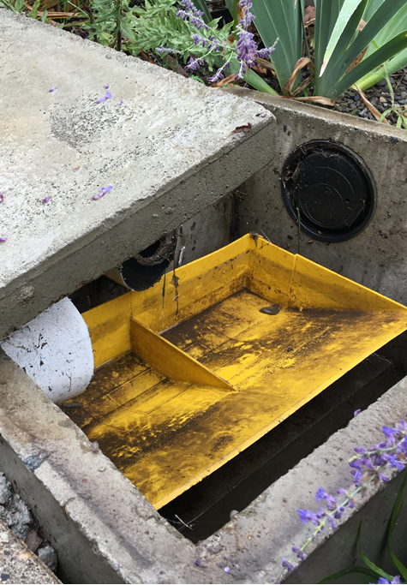
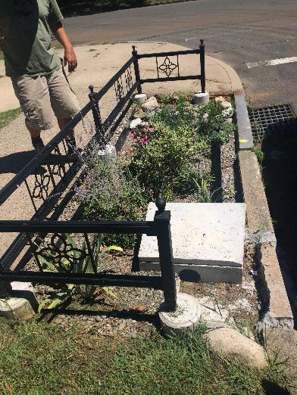
Research

Slide 24
Research
Initial results show bioswale + cistern capturing 77% of street runoff (56% by bioswales alone)
Limited more by blockages at inlets than capacity in bioswale
Dr. Gaboury Benoit
Yale University

Slide 25
Lesson 7: Just because you can’t use a giant truck to maintain it, doesn’t mean it is unaffordable

Slide 26
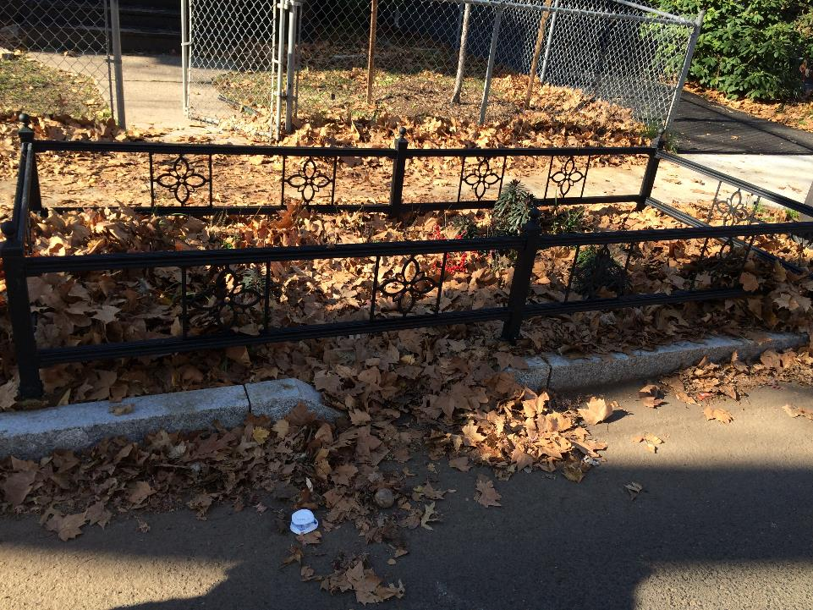
Maintenance

Slide 27
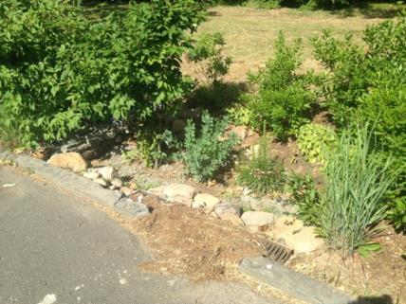
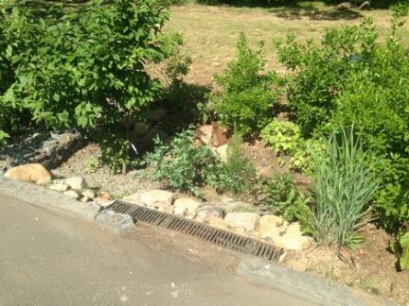
Maintenance
Maintenance Study by URI
Between $200 (minimum) and $300 (ideal) per year
Maintenance includes:
  Leaf, trash, and sediment removal
  Pruning
  Weeding
  Does not include major repair

Slide 28
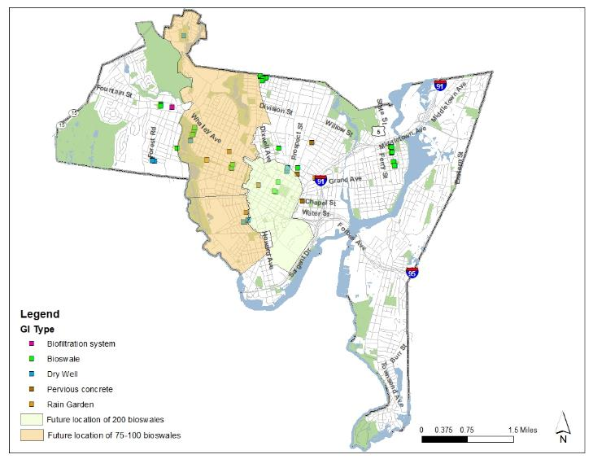
Upcoming GI Projects
Flood prevention- approx. 200 bioswales- City project- grant funded (Federal CDBG-DR)
CSO prevention- approx. 75 bioswales- GNHWPCA project- grant funded (CT Clean Water Funds)
Notes:
The City received a $2.5M CDBG-DR (Community Development Block Grant- Disaster Resiliency) after Superstorm Sandy to resolve flooding- shave off peak flows and reduce the gray infrastructure piece of the solution
CSO reduction- Troup School and GNHWPCA received about $1M of CSO prevention money (Clean Water funding) to implement bioswales in combined sewer areas

Slide 29
Next Steps in Research
Wide-Scale GI Monitoring
Measure large catchment areas
Pre- and Post- monitoring
Measure effect of 200 bioswales
Smart City Sensor Network
Doppler Flow Meters
Ultrasonic Level Sensors
Tide Gauges
Rain Gauges

Slide 30
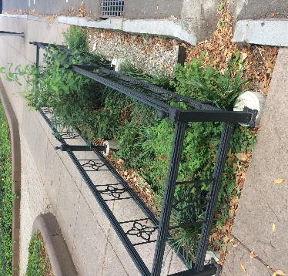
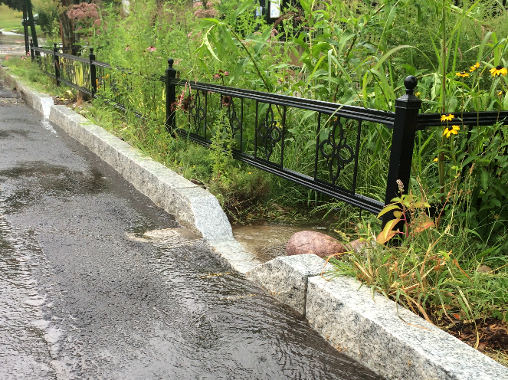
Thank You!
Questions?
Giovanni Zinn
gzinn@newhavenct.gov
@NewHavenEng

