Slide 1

David Dickson
NEMO Program
Center for Land Use Education & Research
University of Connecticut
LID in CT:
Where are We &
Where are We Going?

Slide 2
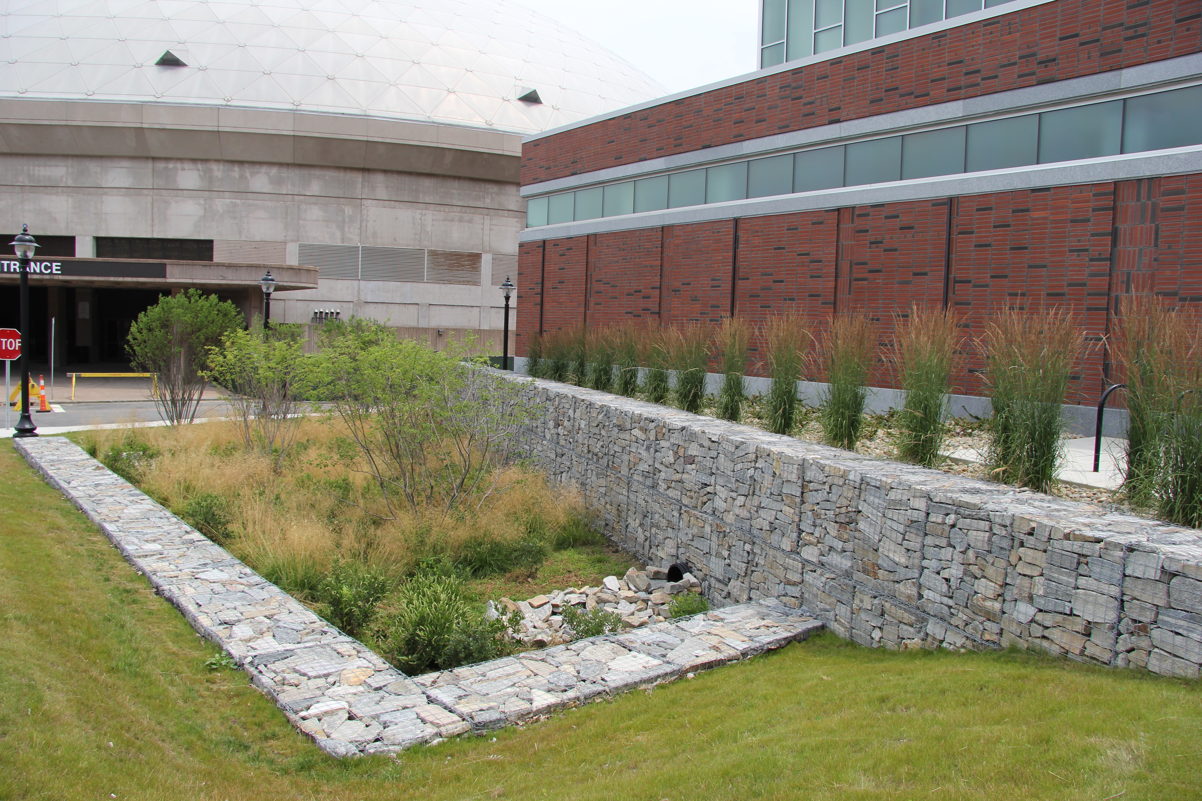
Today’s Agenda
Mercifully brief intro to LID
Where are we?
Where are we going?

Slide 3
UConn CLEAR
Established 2001
Depts. of Extension and Natural Resources & Environment, & CT Sea Grant
Water (NEMO)
Land Use & Climate Resiliency
Geospatial Tools & Training
STEM & Local Conservation
Mission: Provide information and assistance to land use decision makers and other audiences in support of better land use decisions, healthier natural resources, and more resilient communities

Slide 4
UConn CLEAR
Established 2001
Depts. of Extension and Natural Resources & Environment, & CT Sea Grant
9 faculty, primarily grant funded
Water (NEMO)
Land Use & Climate Resiliency
Geospatial Tools & Training
STEM & Local Conservation
Mission: Provide information and assistance to land use decision makers and other audiences in support of better land use decisions, healthier natural resources, and more resilient communities

Slide 5
Today’s Agenda
Mercifully brief intro to LID
Where are we?
Where are we going?

Slide 6

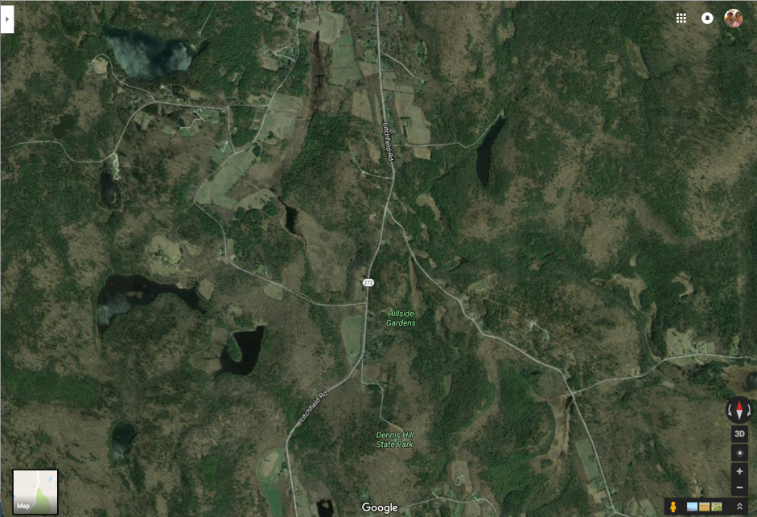
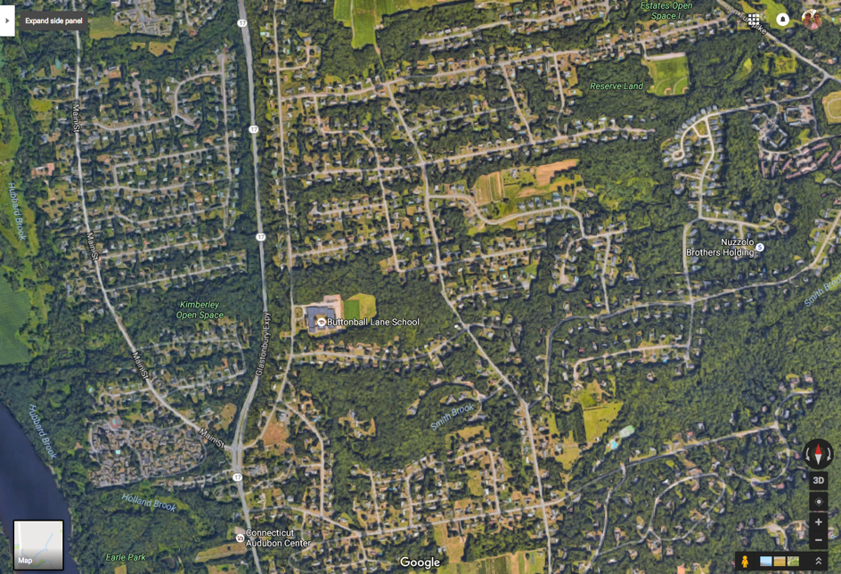
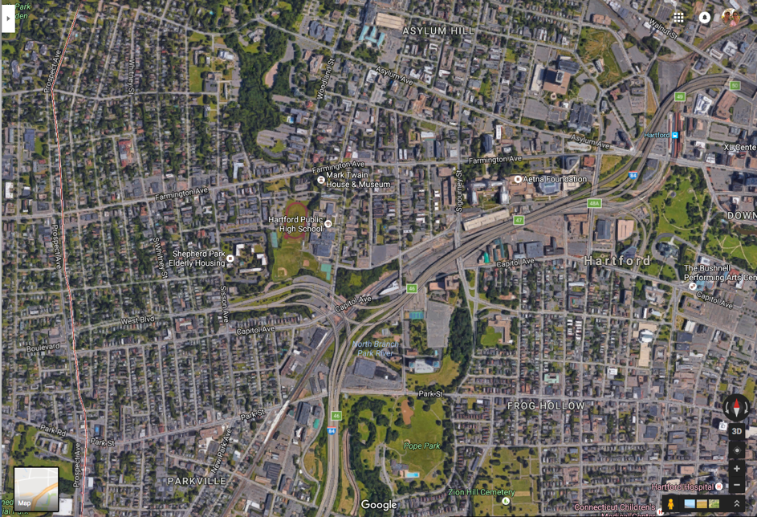
Stormwater runoff is a function of land use

Slide 7
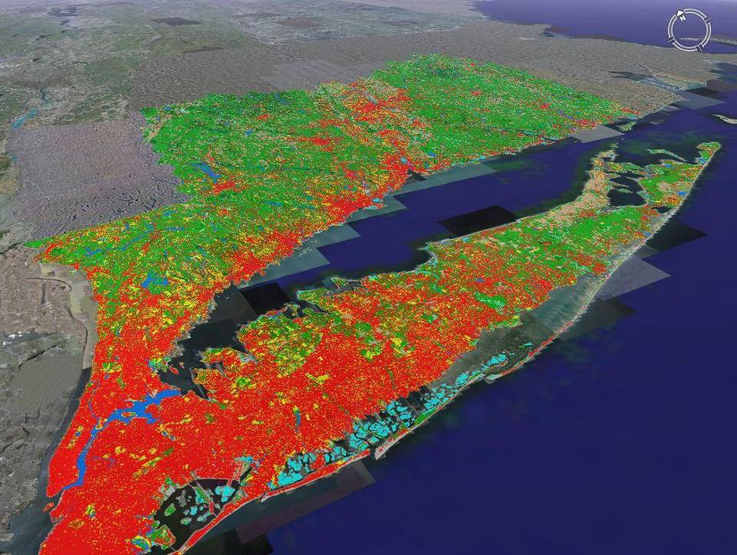
We are an urbanizing state/region/country
CT’s Changing Landscape

Slide 8
CT land cover change: 1985 - 2010

Slide 9
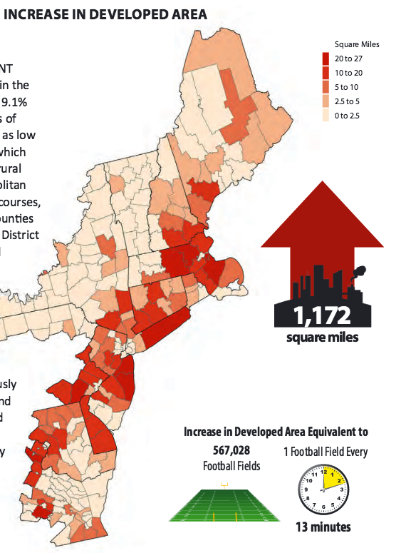
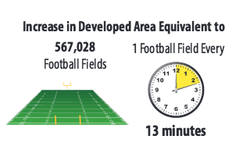
Change in Developed Area, 1996 - 2010
NOAA Office for Coastal Management
From NOAA OCM, based on National Land Cover Dataset

Slide 10
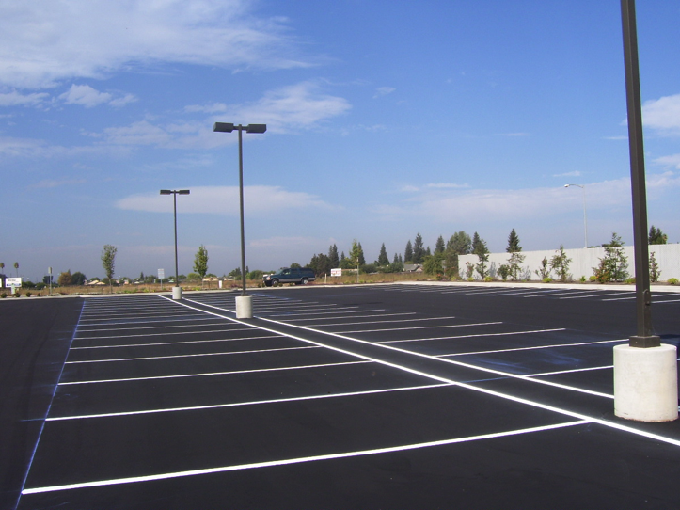
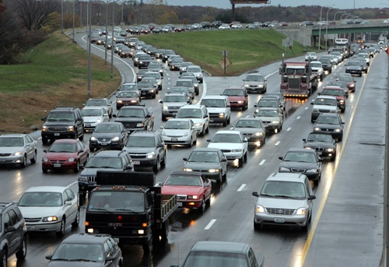
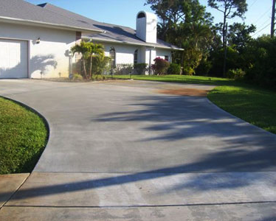

Development => Impervious Surfaces

Slide 11

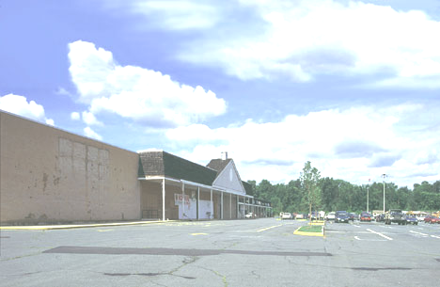
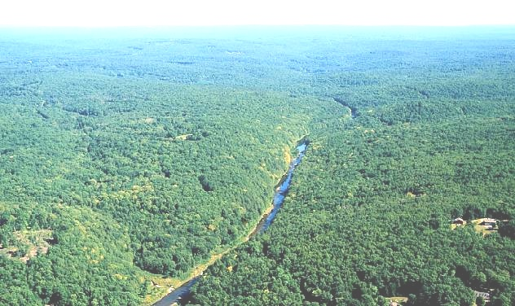
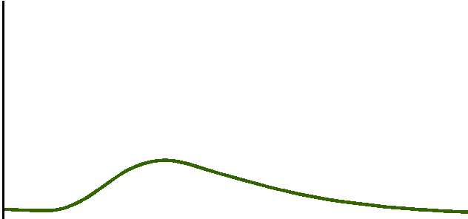
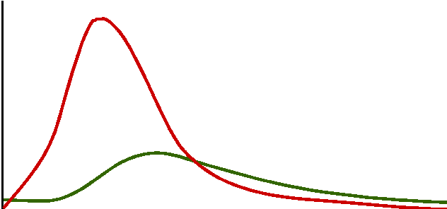
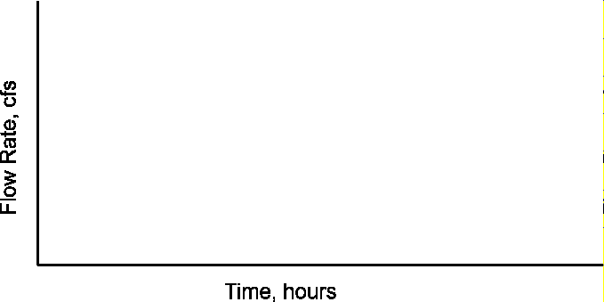
Impervious surfaces shift the land’s response to rainfall
More Runoff
Arriving Faster

Slide 12
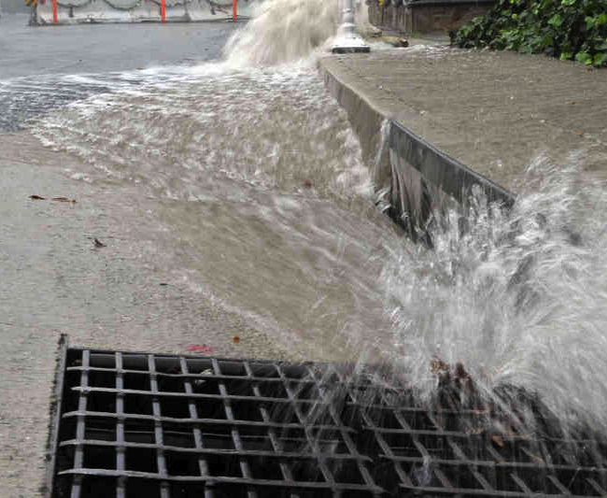
Stormwater is the/a top source of water pollution in the U.S.

Slide 13
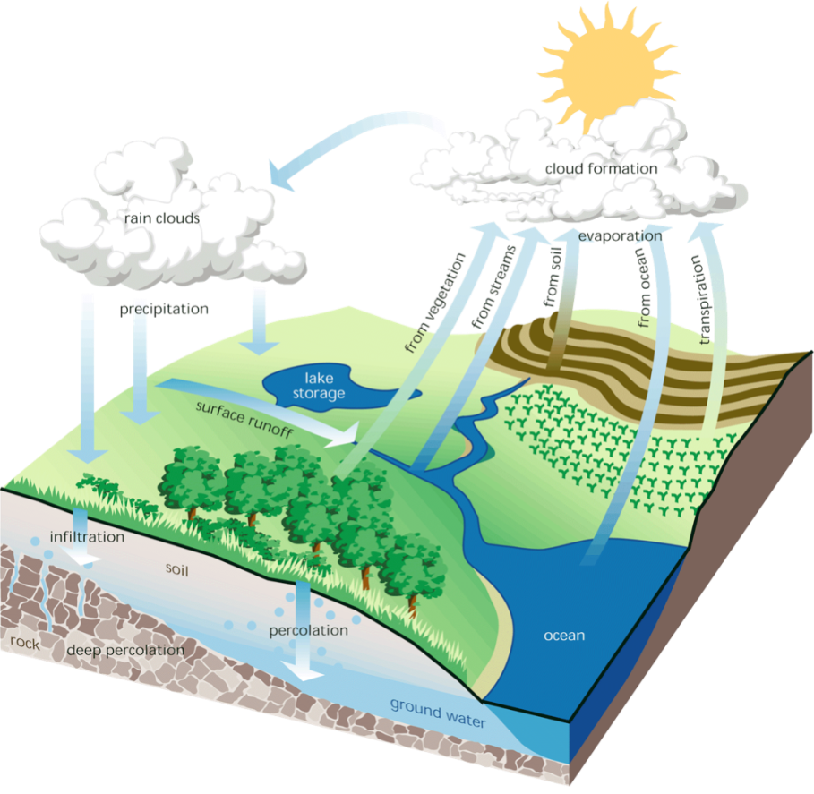
Low Impact Development (LID) Site Planning and Design Concepts
Originated in Maryland in 1990s
The goal: To preserve pre-development
hydrology
  Runoff volume and rate
  Groundwater recharge
  Stream baseflow
  Runoff water quality

Slide 14
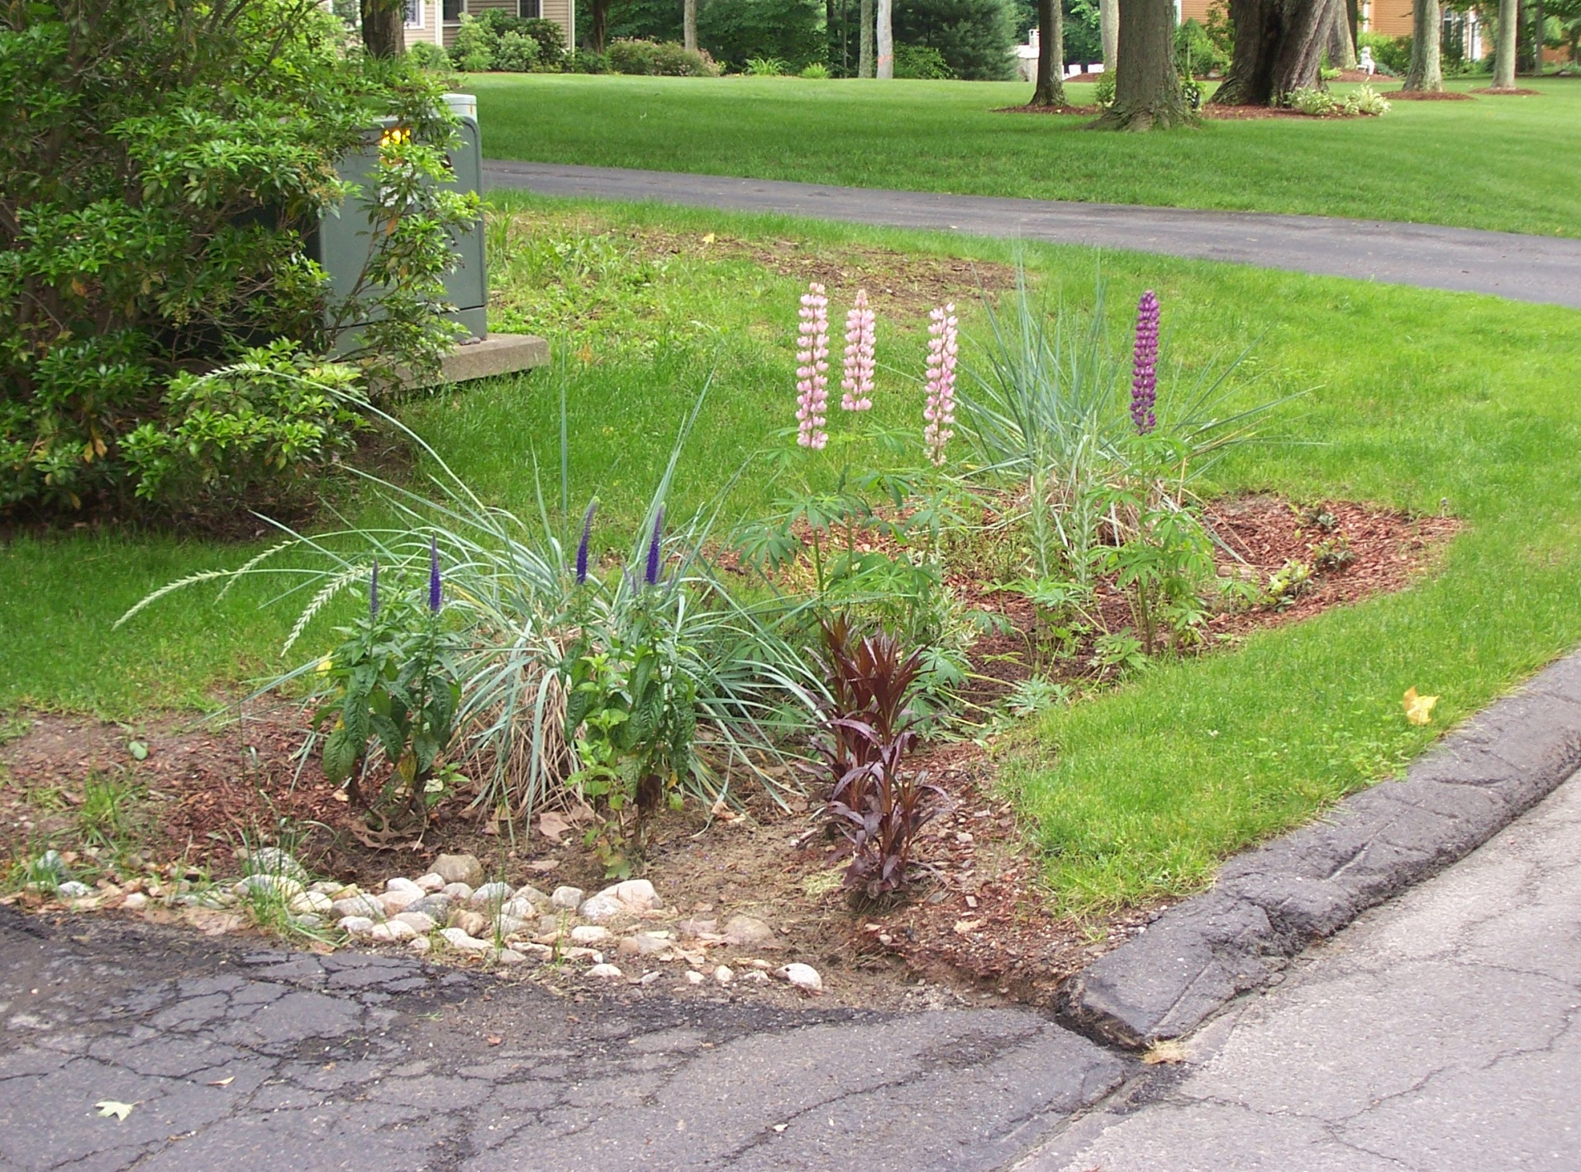
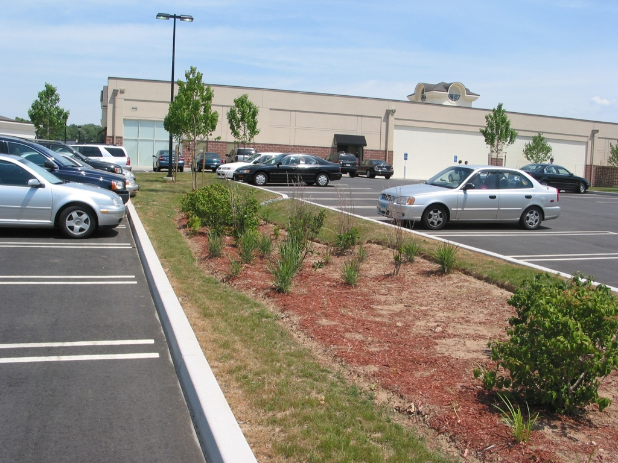
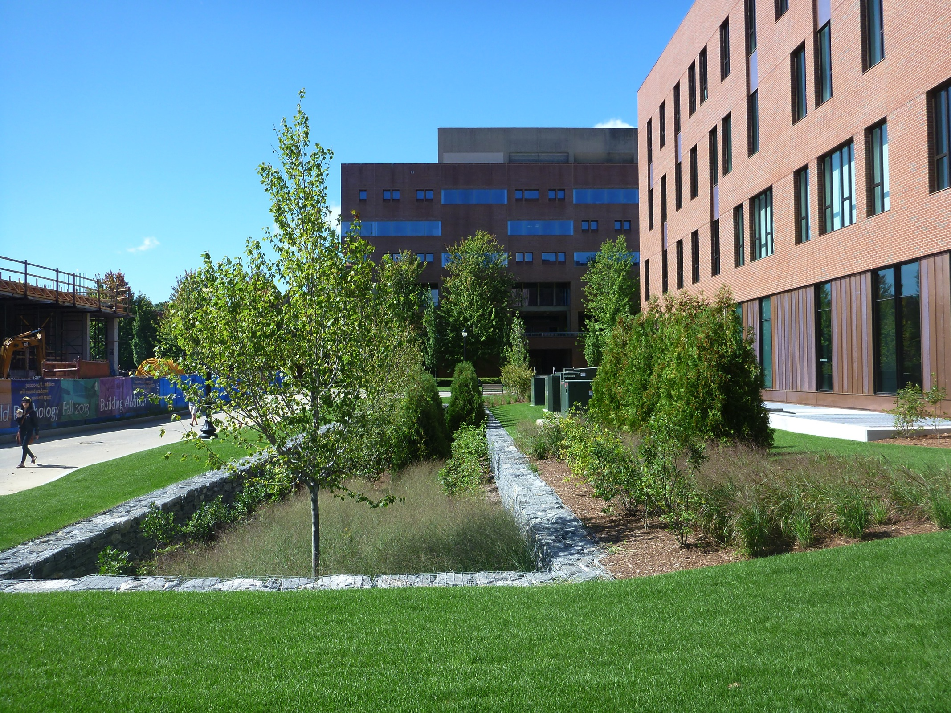
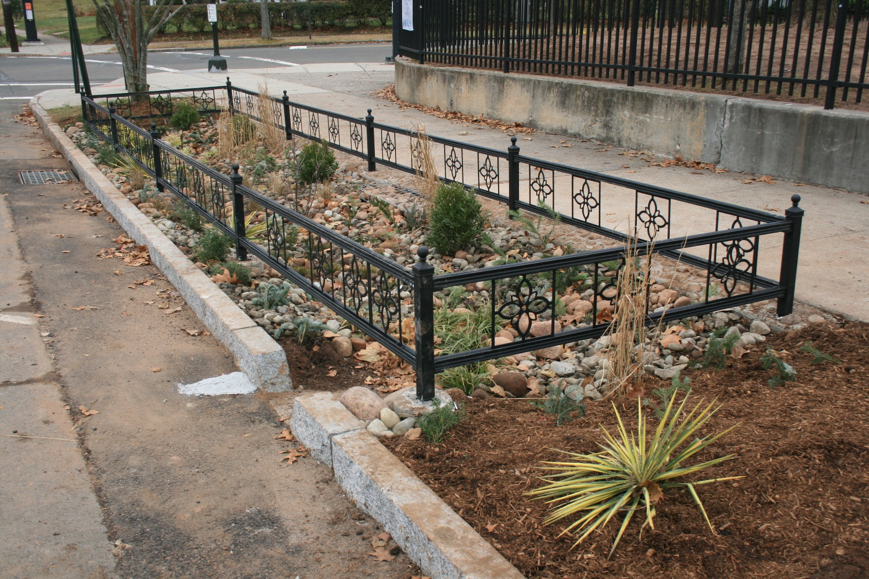
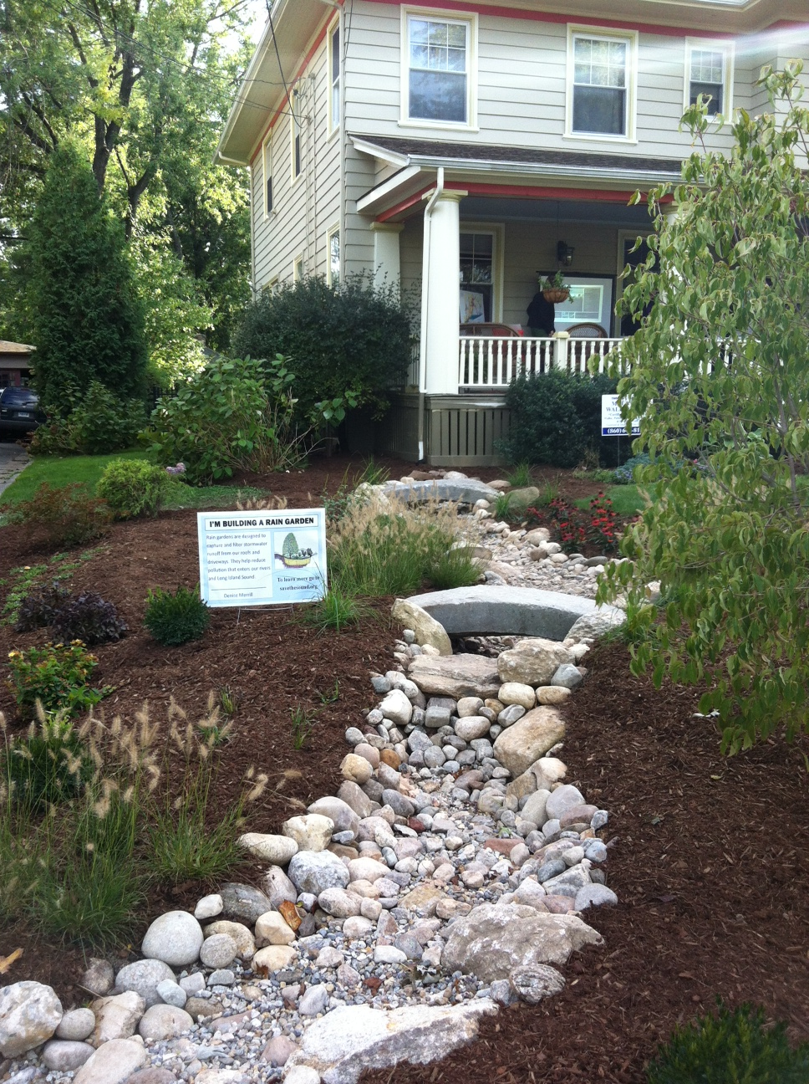
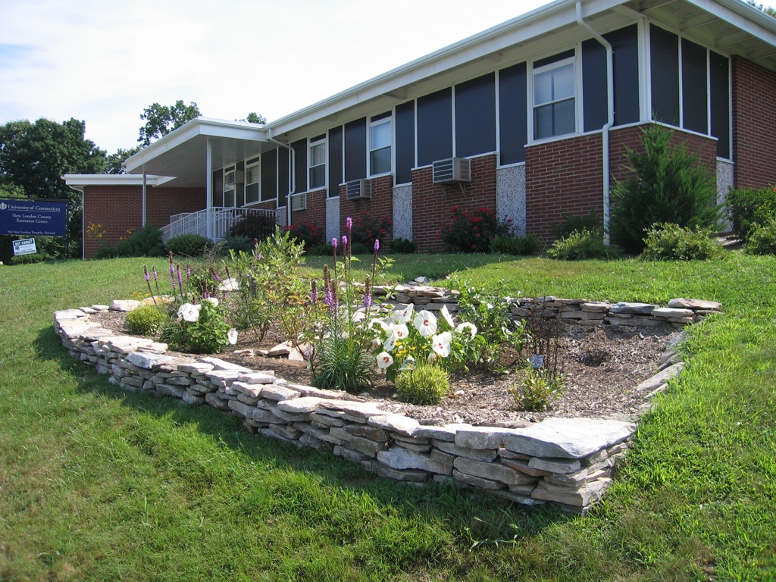
Bioretention/rain gardens
Photo courtesy of Steve Trinkaus

Slide 15
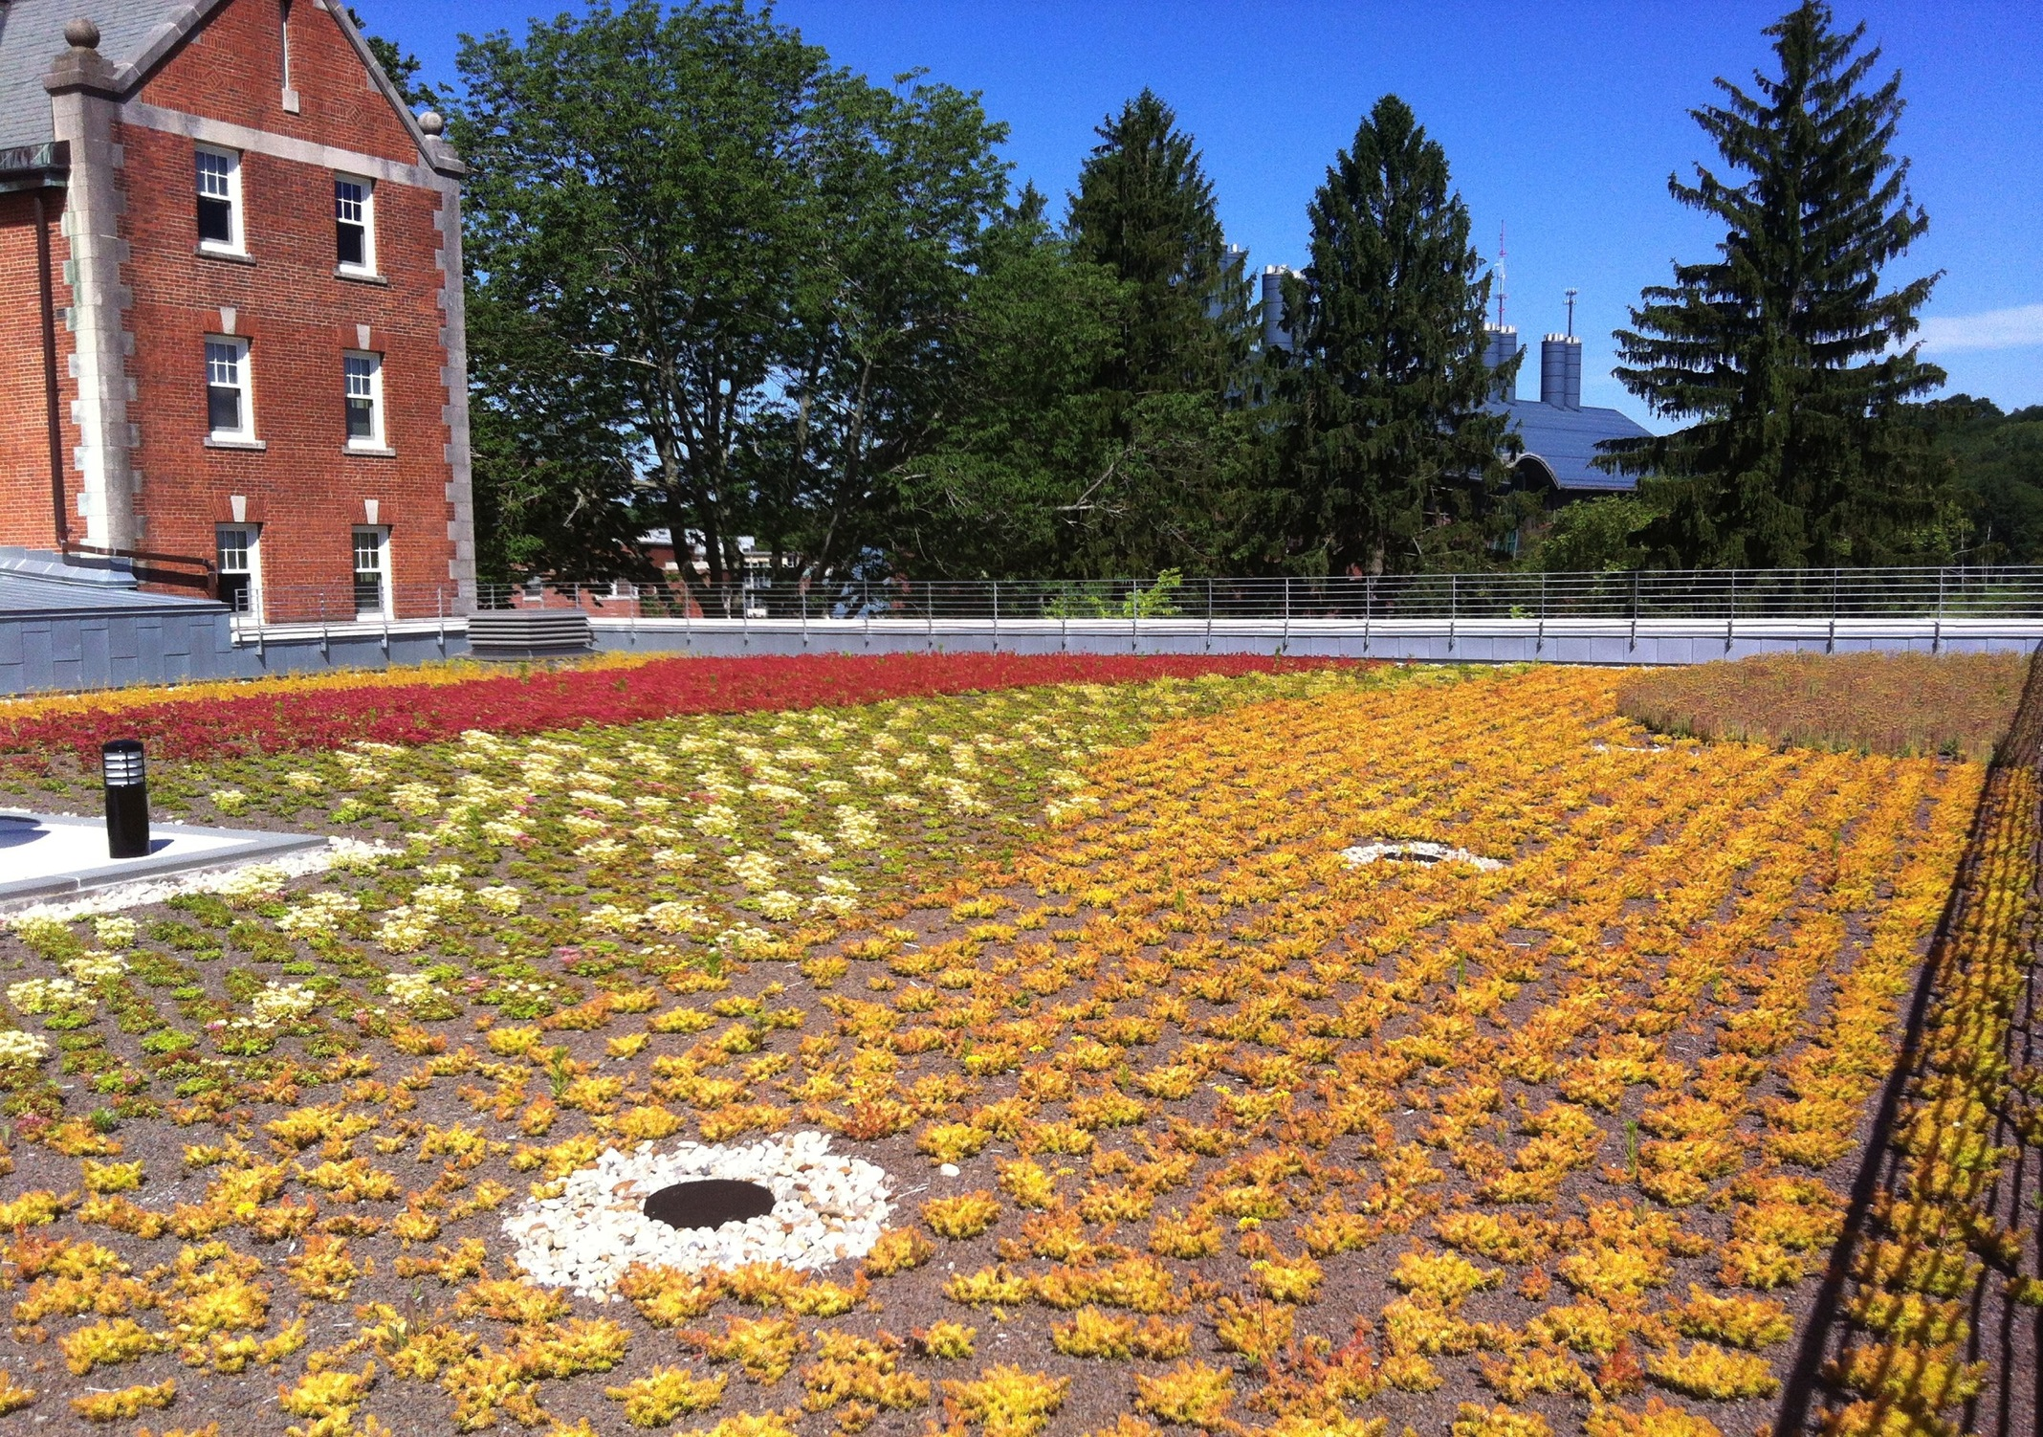
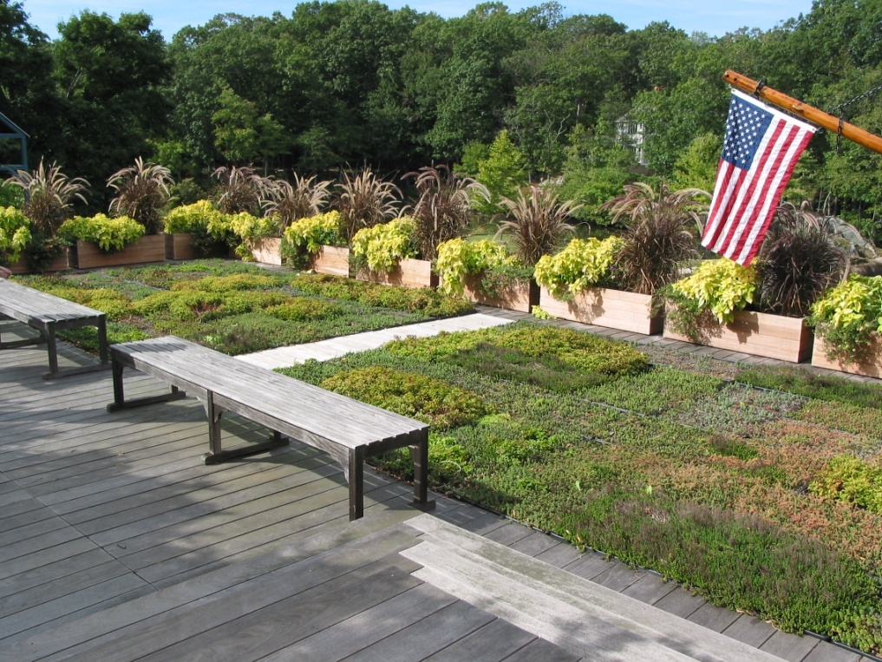
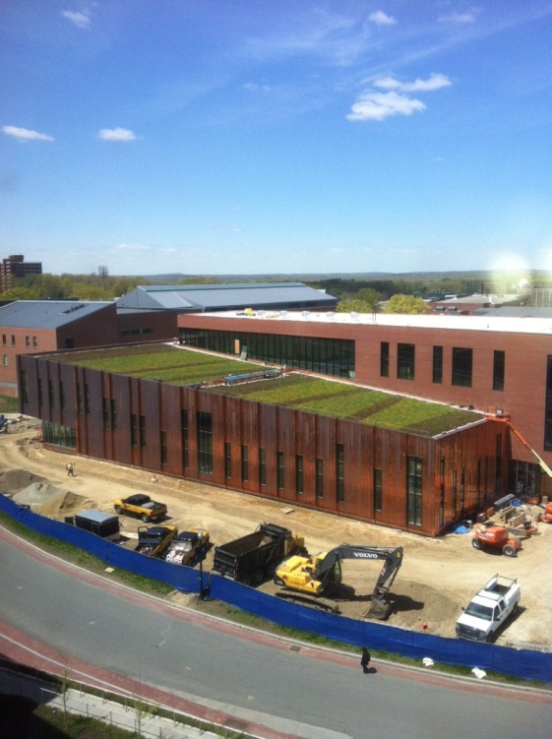
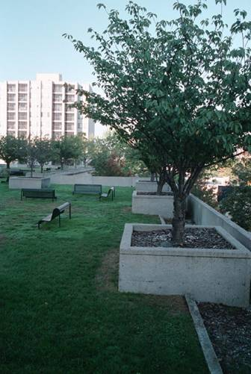
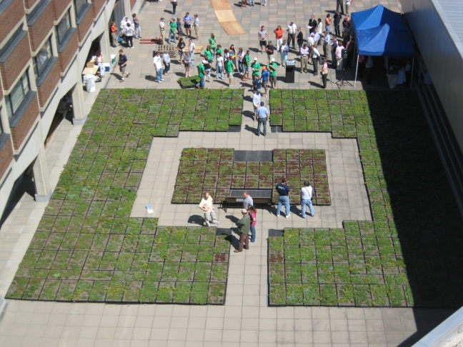
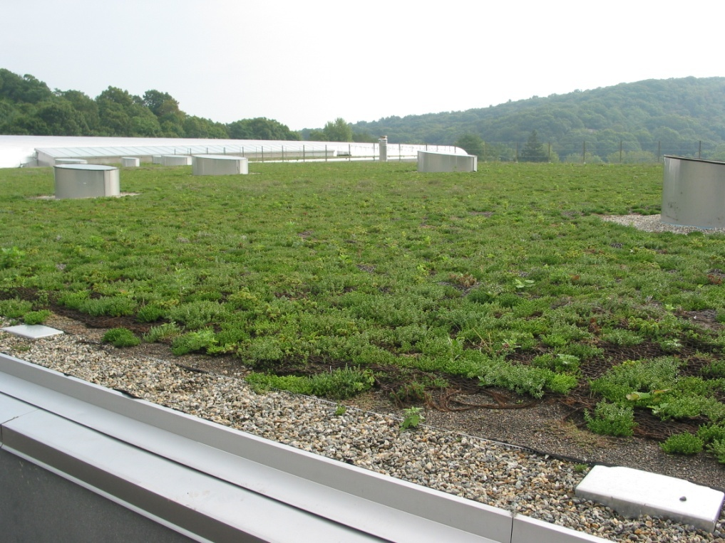
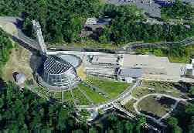
Green Roofs
Chicago City Hall
Stamford, CT
Ledyard, CT

Slide 16
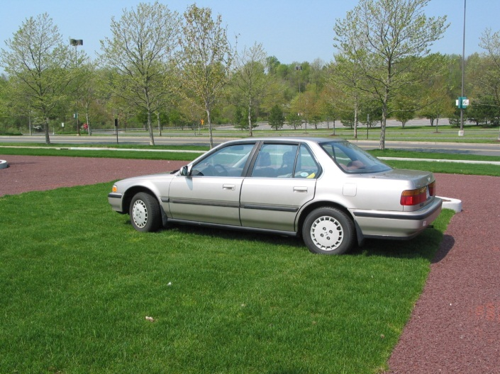
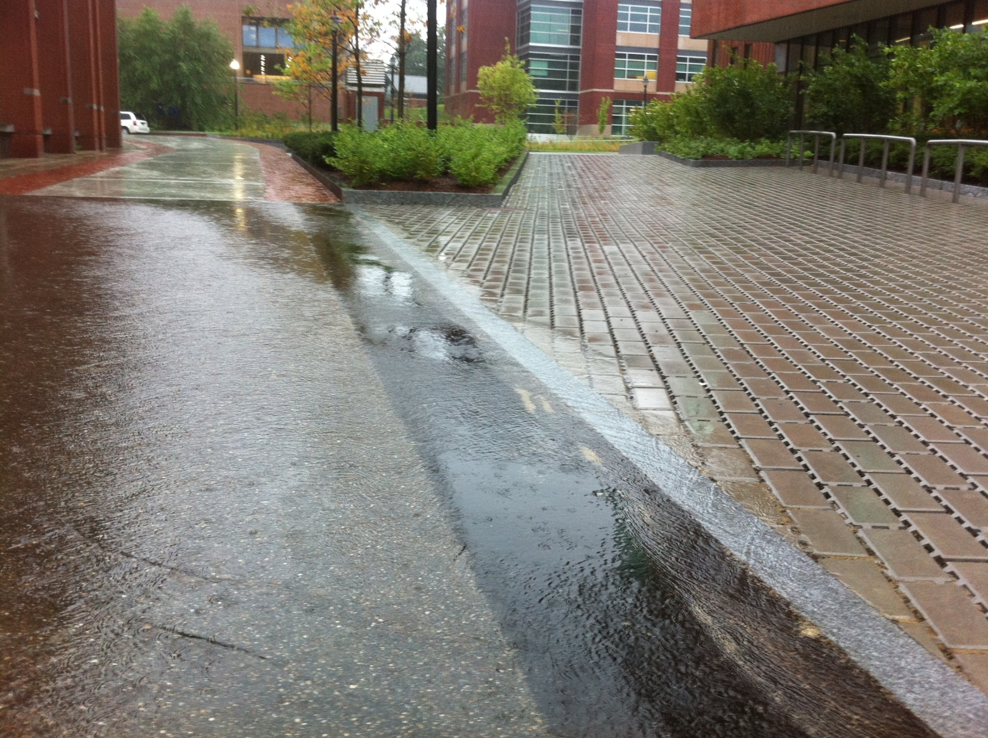
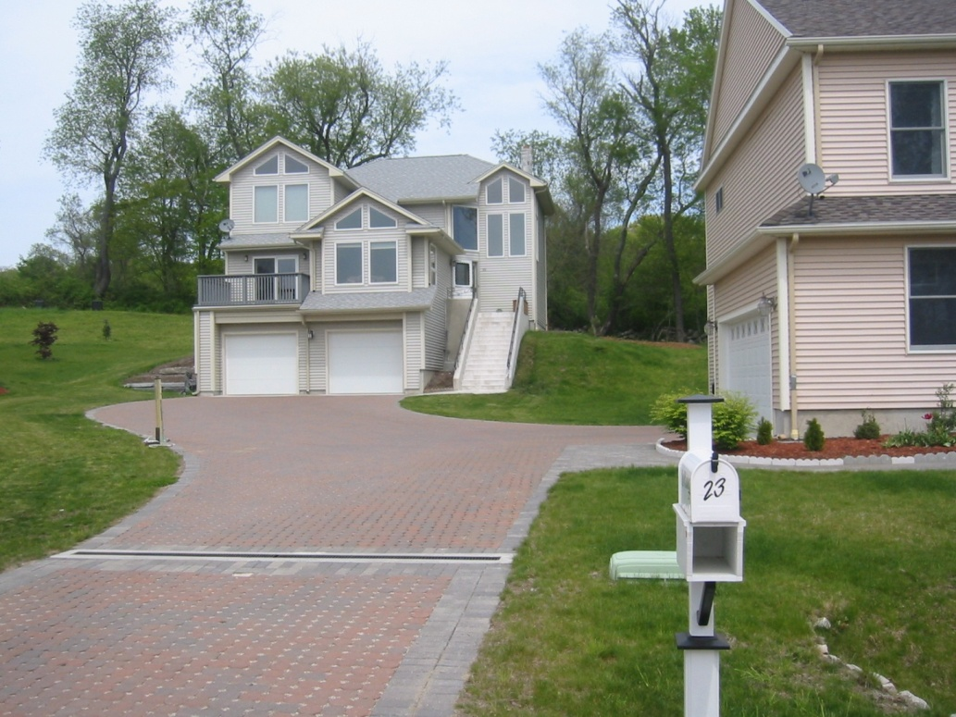
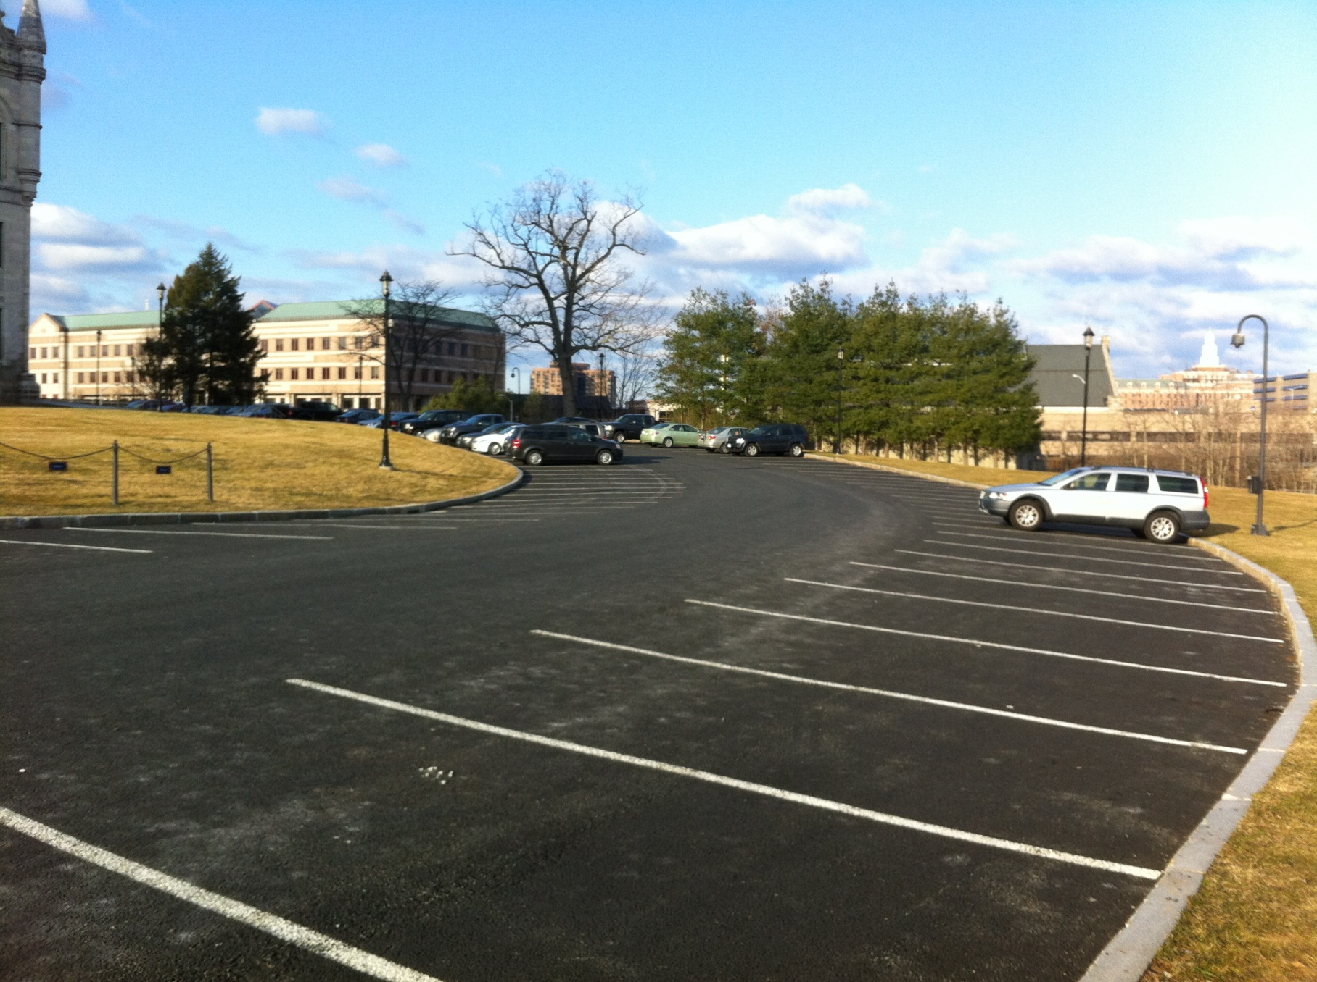
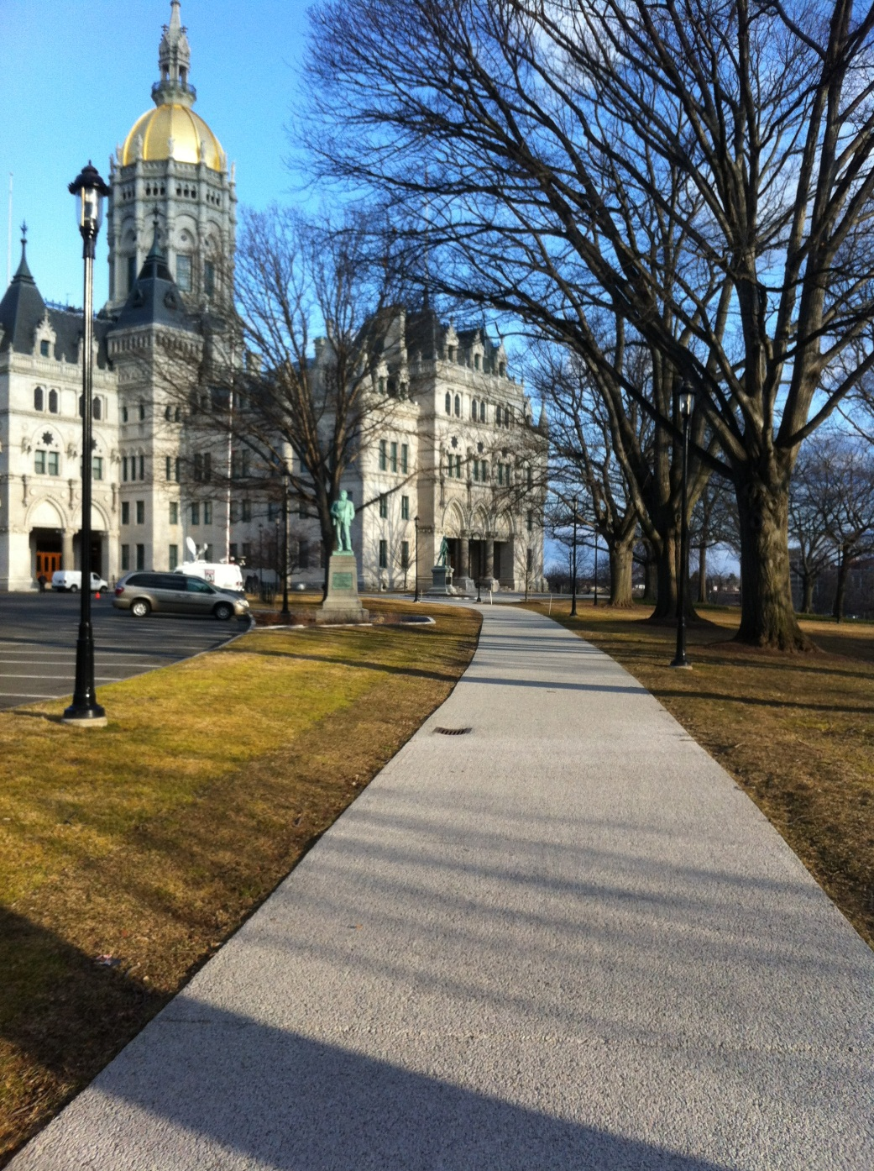
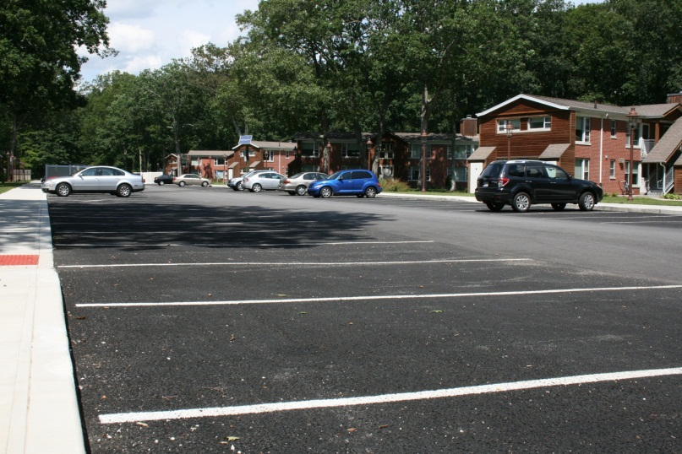
Permeable Pavements
Notes:
Villanova

Slide 17
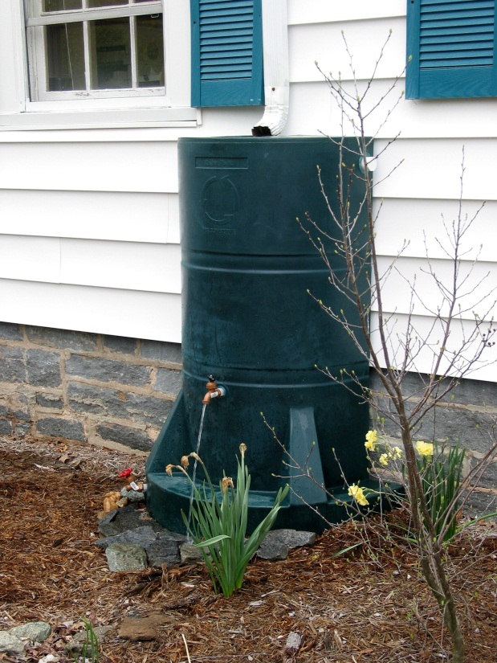
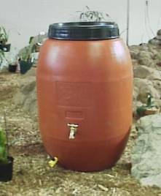
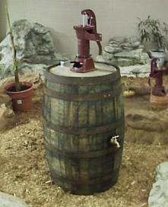
Rainwater Harvesting
Rain barrels
Cisterns
Haddam, CT

Slide 18
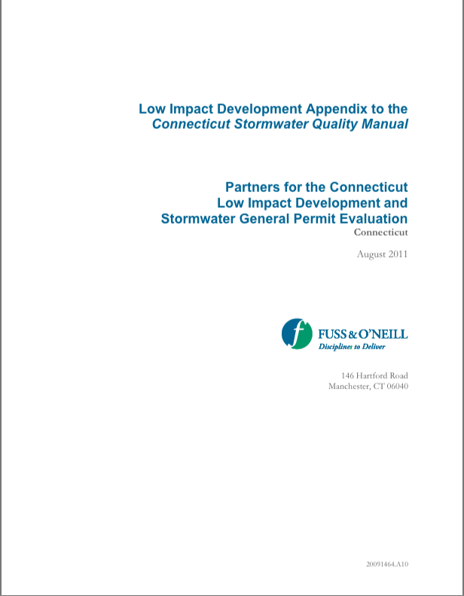
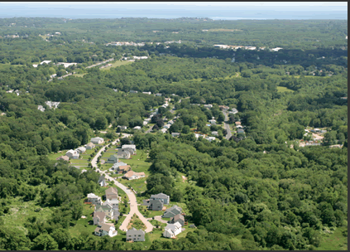
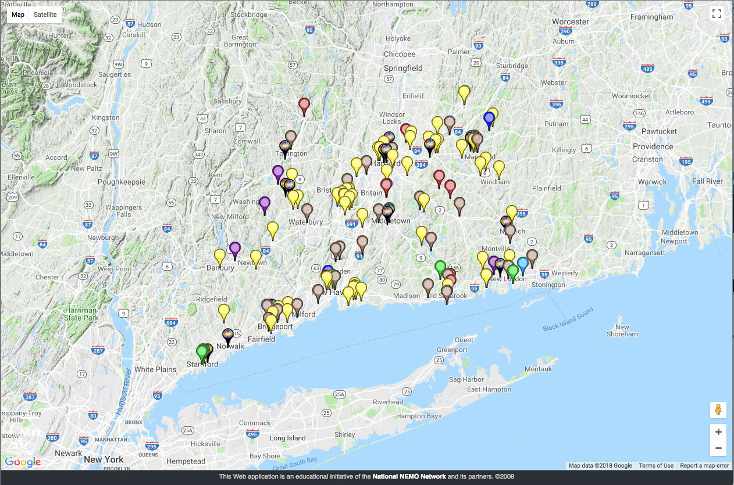
LID in CT
Encouraged since 1991
Demos: Jordan Cove (1995 – 2005)
CT Stormwater Manual (2004) & LID Appendix (2011)
Mostly carrots = modest number of practices

Slide 19
Today’s Agenda
Mercifully brief intro to LID
Where are we?
Where are we going?

Slide 20
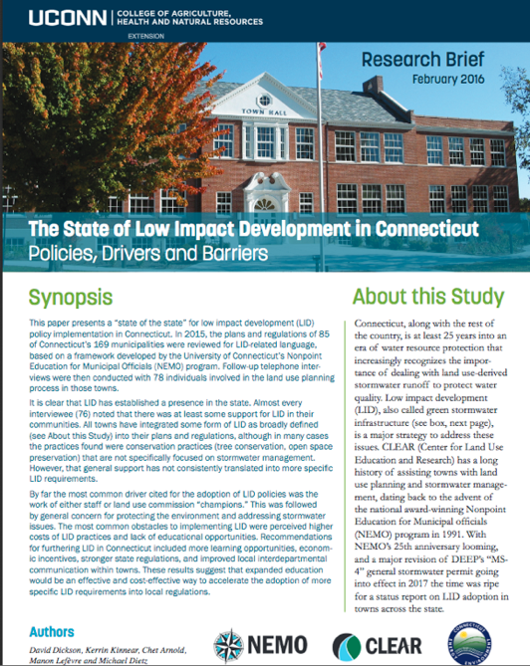

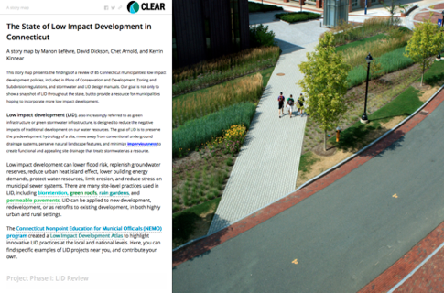
Social Research on Local LID Policy
Research Summary
“Story Map”

Slide 21

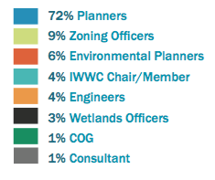
What we did
Phase 1. Web research (85 towns)
Phase 2. Phone interviews (79 towns)

Slide 22
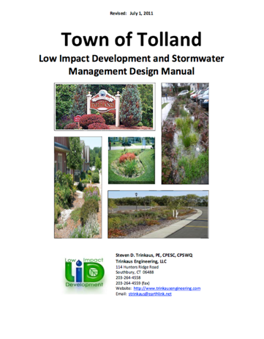

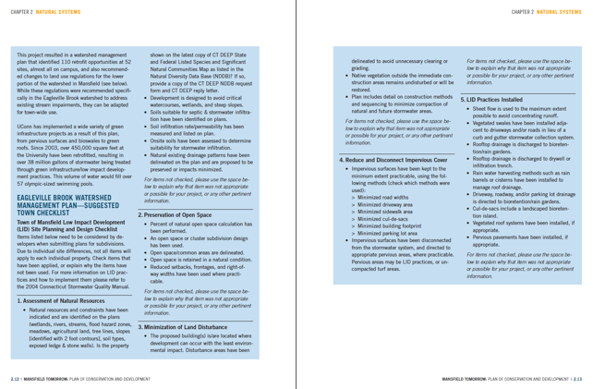
Strategies for incorporating LID
Technical manual
Reg by reg
Checklist

Slide 23


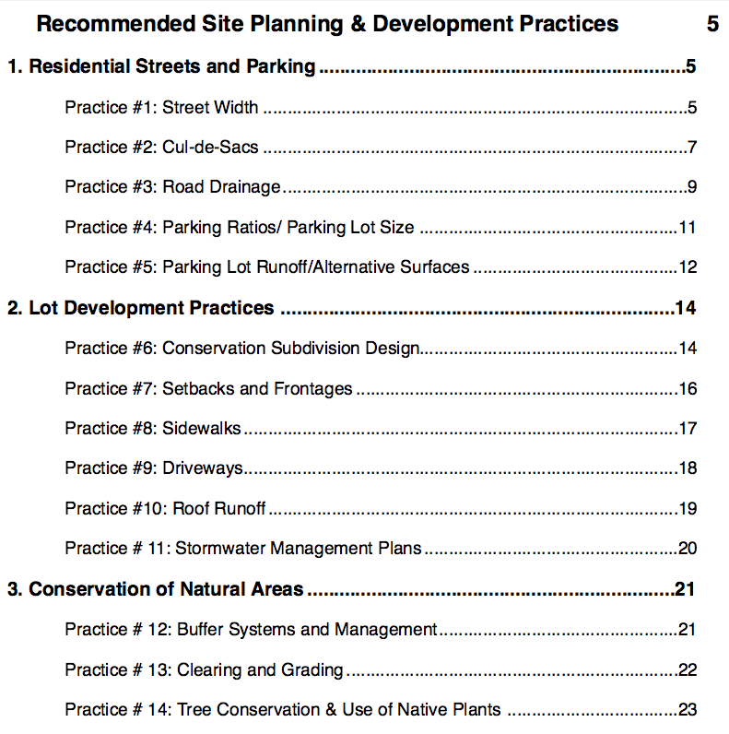
How to Quantify?

Slide 24
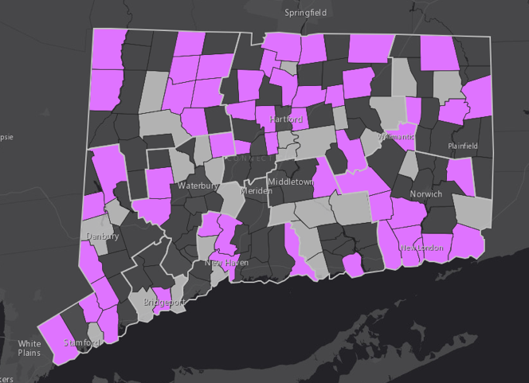
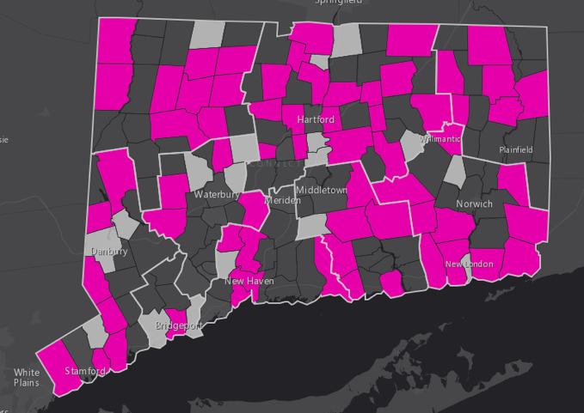
General Support for LID
54 of 85 towns mention LID
65 of 85 towns mention reducing impervious surfaces

Slide 25


Specific Regulations
GENERAL CONSERVATION POLICIES
SPECIFIC REGULATIONS RELATED TO STORMWATER

Slide 26
Top 5 LID Drivers

Slide 27
Top 5 LID Barriers

Slide 28
Today’s Agenda
Mercifully brief intro to LID
Where are we?
Where are we going?

Slide 29

Two New Drivers

Slide 30

Driver 1: A New MS4 General Permit
MS4: Municipal Separate Storm Sewer System
Part of CWA
Address Nonpoint Source Pollution
Original 2004
Updated in 2016, effective 2017

Slide 31


MS4 Basics: Who’s Included?
Willington
New Hartford
Killingly
Mansfield
Brooklyn
Plainfield
Sprague
Haddam
Stamford

Slide 32


New Permit - More “Detailed”
Old Permit – 17 pages
New Permit – 68 pages

Slide 33
Major Focus on LID/GSI
  High Directly Connected Impervious Areas – Priority
  Existing Development - DCIA Reduction Plan
  Regulatory Changes
    Remove LID Barriers
    Consider LID First
    Retention standard
Notes:
Maybe use chart & town map

Slide 34

Retrofit Program
Towns must:
reduce directly connected impervious area (DCIA) by 2% by 2022
develop a plan for meeting 2% goal
track reductions & additions
5 year look back to 2012

Slide 35


Directly Connected vs Disconnected
All impervious area is not the same
My neighbor’s house
My house

Slide 36

Retention Standard
On sites greater than 1/2 acre towns must require:
  New development
  retain 1” on site
  Redevelopment
  DCIA less than 40% - 1” on site
  DCIA greater than 40% - ½” on site

Slide 37

Land Use Regs: Removing LID barriers
Towns must:
  “identify and, where appropriate, reduce or eliminate existing local regulatory barriers to implementing LID and runoff reduction practices”

Slide 38




Land Use Regulations: Think LID 1st
Towns must require that:
  “a developer or contractor seeking the permittee’s approval shall consider the use of low impact development (“LID”) and runoff reduction site planning and development practices prior to the consideration of other practices”

Slide 39
So . . .
LID fans are like . . .
But towns are like . . .

Slide 40


CLEAR/DEEP Partnership
5 year MOA
Provide multi-faceted support to MS4 towns
High resolution IC Data

Slide 41


NEMO MS4 Support
circuit rider
Website
MS4 listserv
workshops & webinars
regulation/policy templates
Amanda
Ryan
http://nemo.uconn.edu/ms4

Slide 42




Driver 2. Climate Change

Slide 43

More rain
National Climate Assessment

Slide 44


More Intense Rainfall Events
From the National Climate Assessment

Slide 45

Will climate change help push the adoption rate of LID?
Climate what?
There is growing evidence that LID practices can be designed to handle runoff from greater than the traditional 1-2 yr storms, but….

Slide 46


Nonetheless (at least up until now)…

Slide 47
A new era for LID?

Slide 48

MS4 Map – http://s.uconn.edu/ctms4map
Urbanized Area
MS4 Impaired Waters
New HR IC Data
  By Basin
  By Town

Slide 49



Map Services & Data Download
http://cteco.uconn.edu

Slide 50

http://s.uconn.edu/stateoflid
LID Regulations Database

Slide 51

LID Atlas - http://lidmap.uconn.edu

Slide 52




Mobile LID Atlas – Add & Track LID

Slide 53


Thank you!
david.dickson@uconn.edu
http://nemo.uconn.edu
give a man a SWMP and he is in compliance for a day; teach a man how to calculate DCIA, and he is compliant for the life of the permit (arnoldian proverb)

