Slide 1
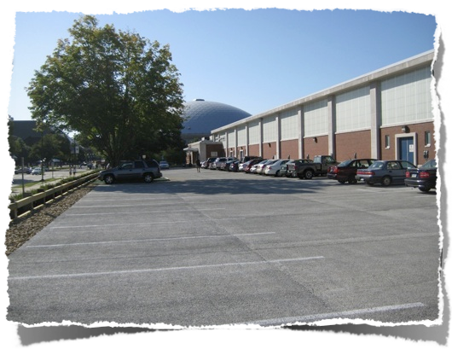
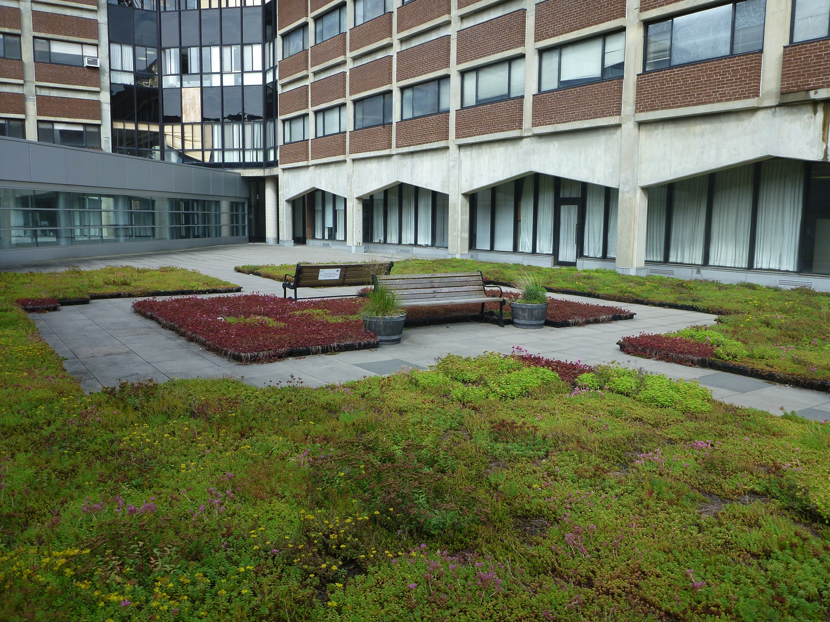
The UConn Experience: Maintenance, Issues, and Benefits
Michael Dietz, Ph.D.
University of Connecticut
Center for Land Use Education and Research (CLEAR)
Rockfall Foundation Symposium
March 22, 2018

Slide 2
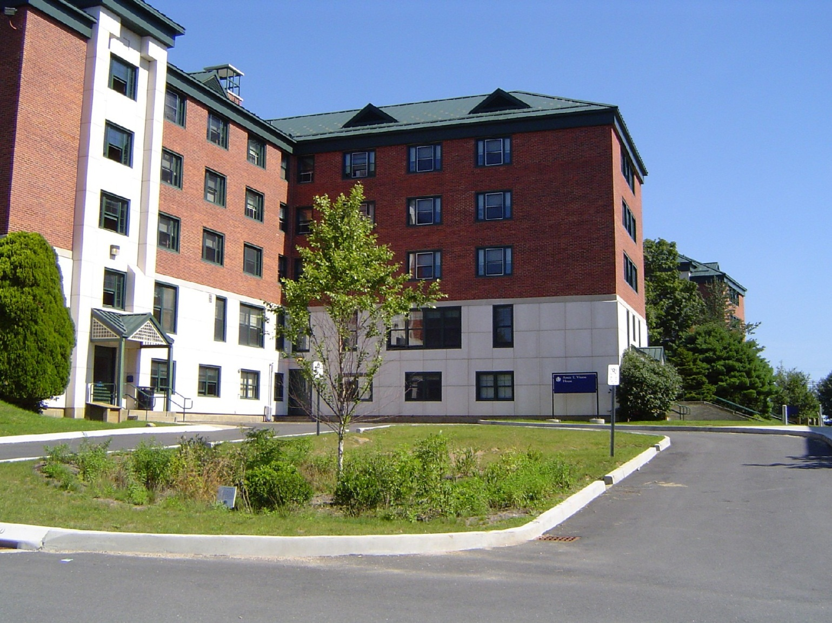
First bioretention at UConn (2003)

Slide 3
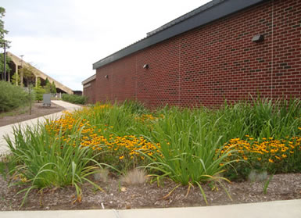
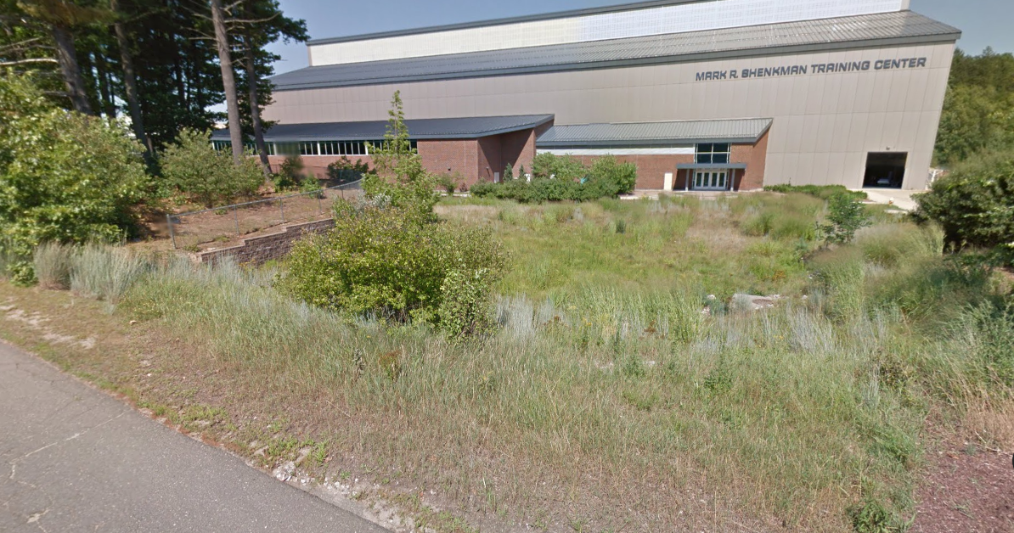
Burton-Shenkman (2005)

Slide 4
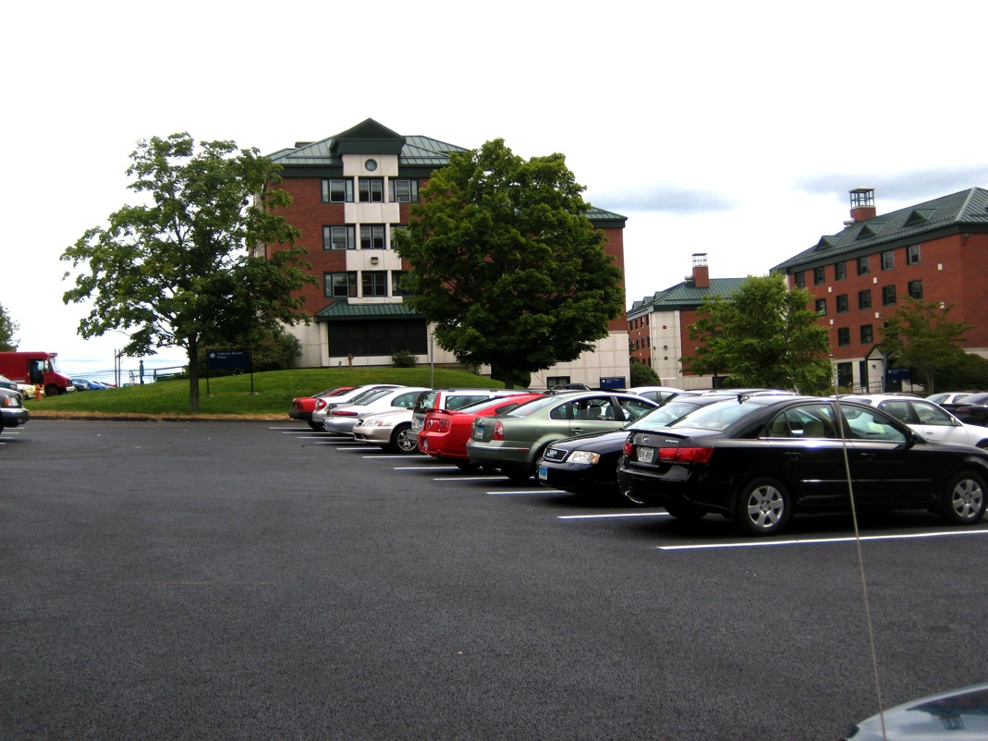
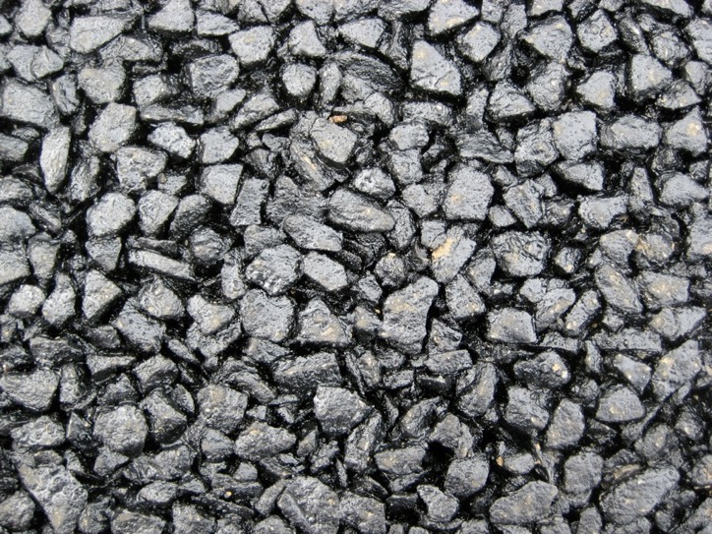
2009
Towers Pervious Asphalt Lot

Slide 5
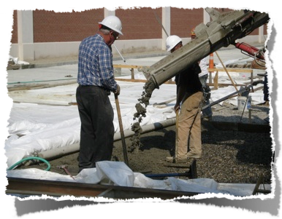
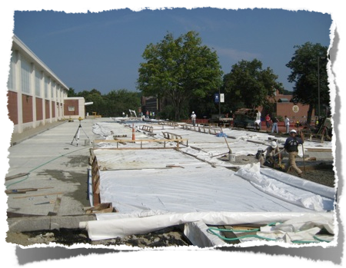
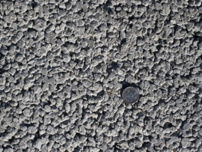
Field House Pervious Concrete (2009)

Slide 6
2009
Gant Plaza Green Roof
Retained 51% of precipitation!
Gregoire, B., and J. Clausen. 2011. Effect of a modular extensive green roof on stormwater runoff and water quality. Ecological Engineering. Vol. 37, pp. 963-969.

Slide 7
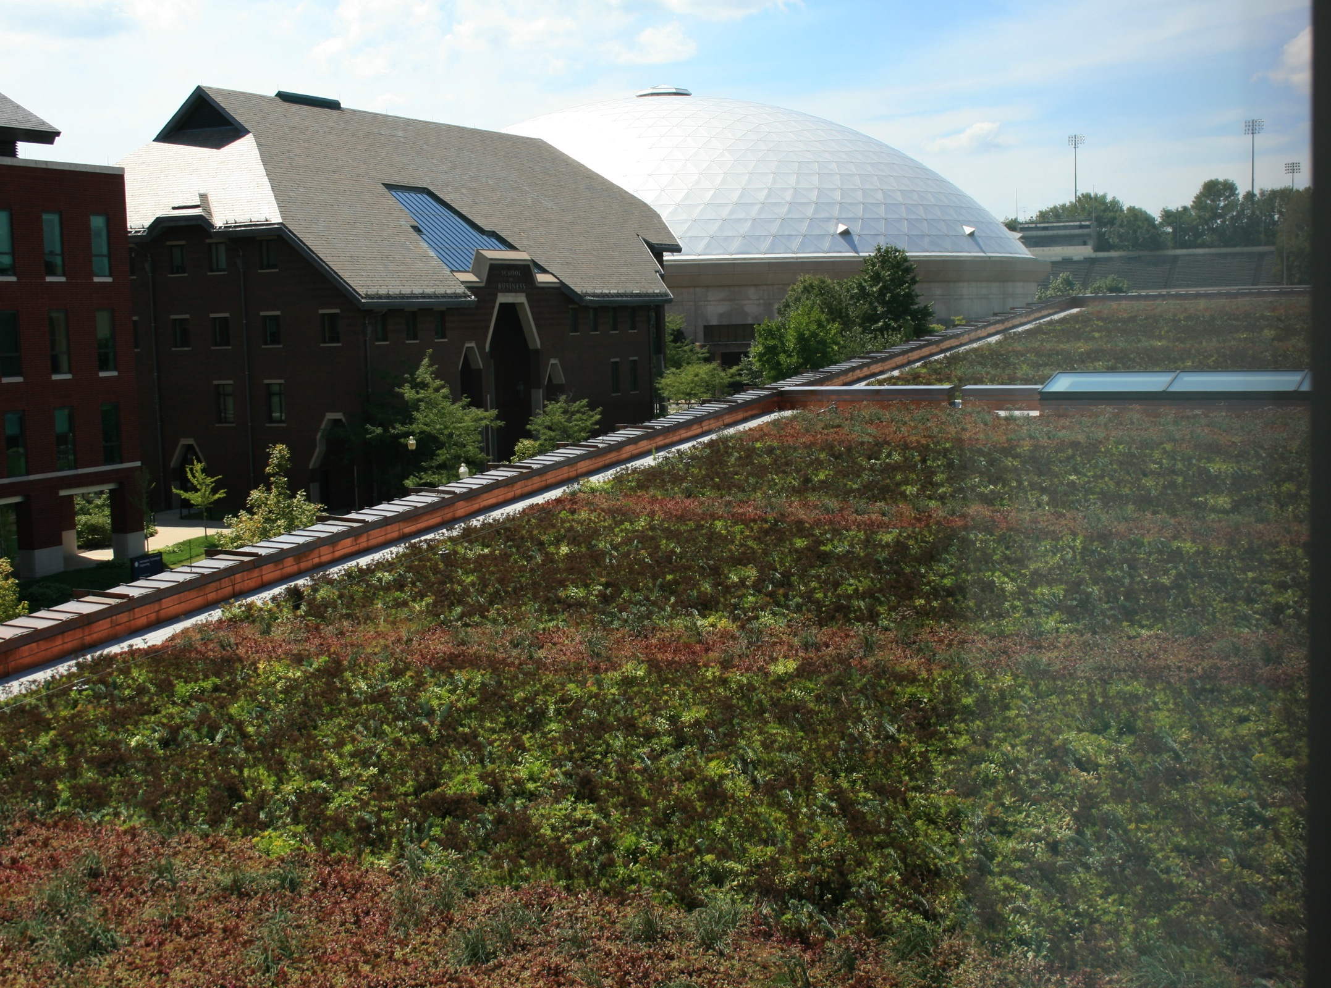
2011
Laurel Hall

Slide 8
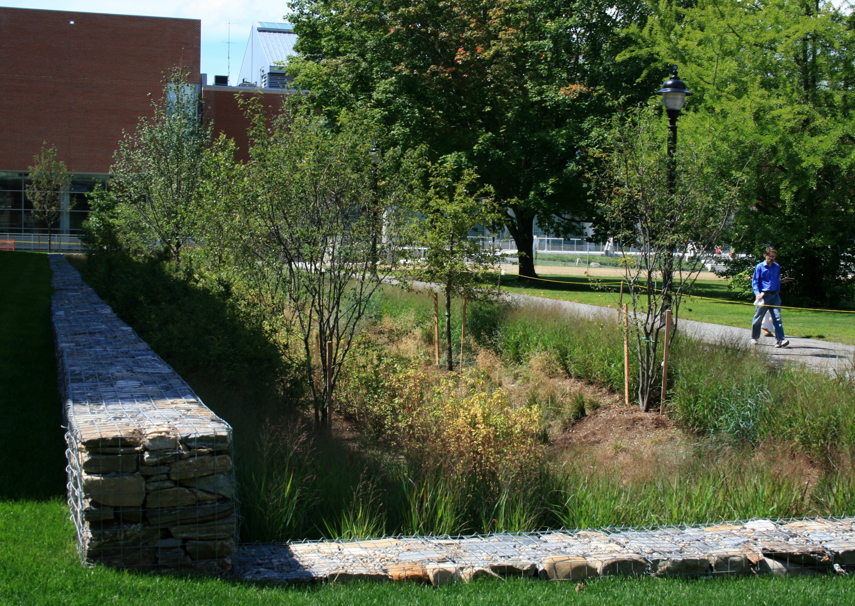
2011
Laurel Hall

Slide 9
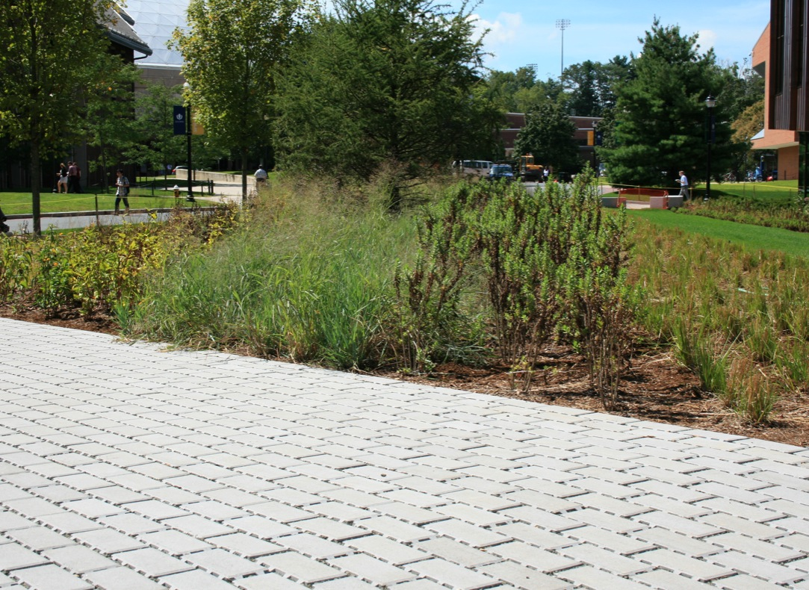
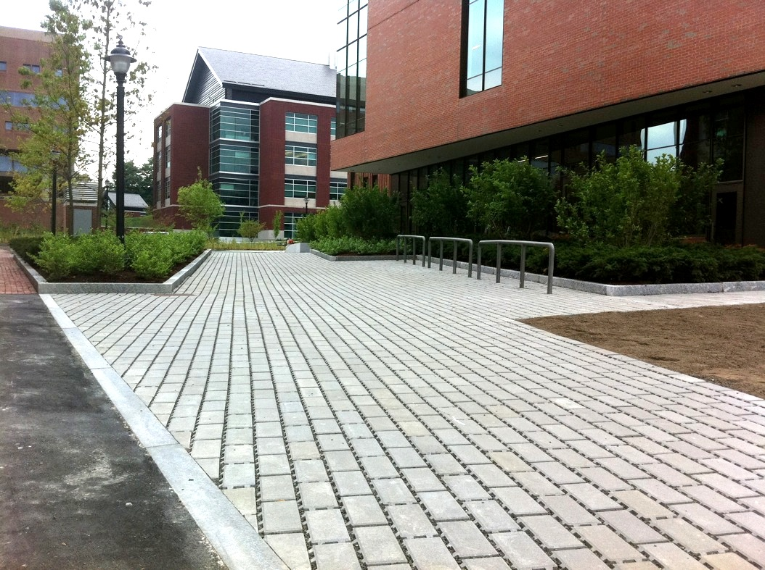
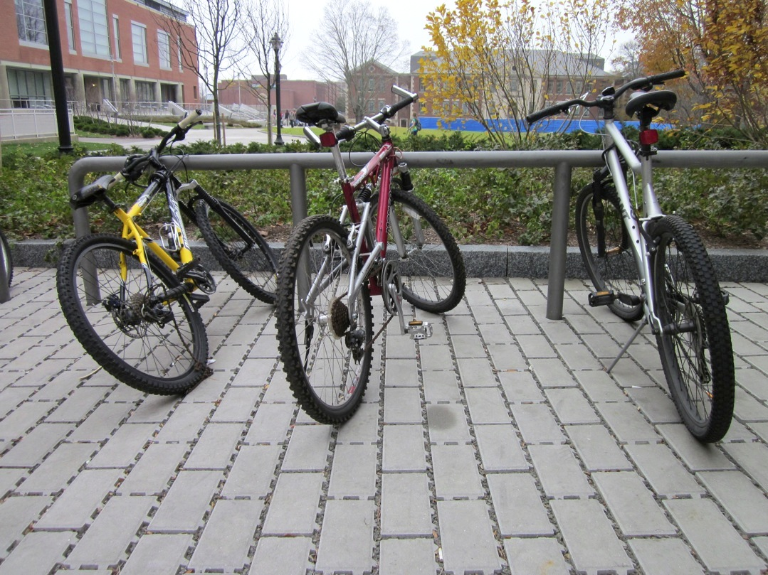
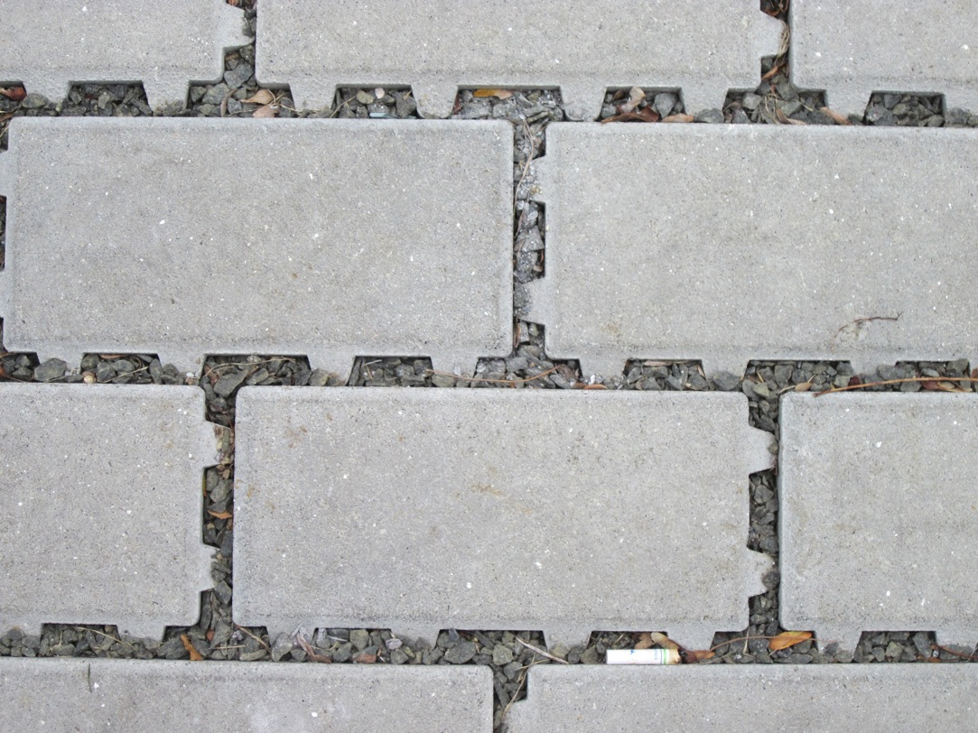
2011
Laurel Hall

Slide 10
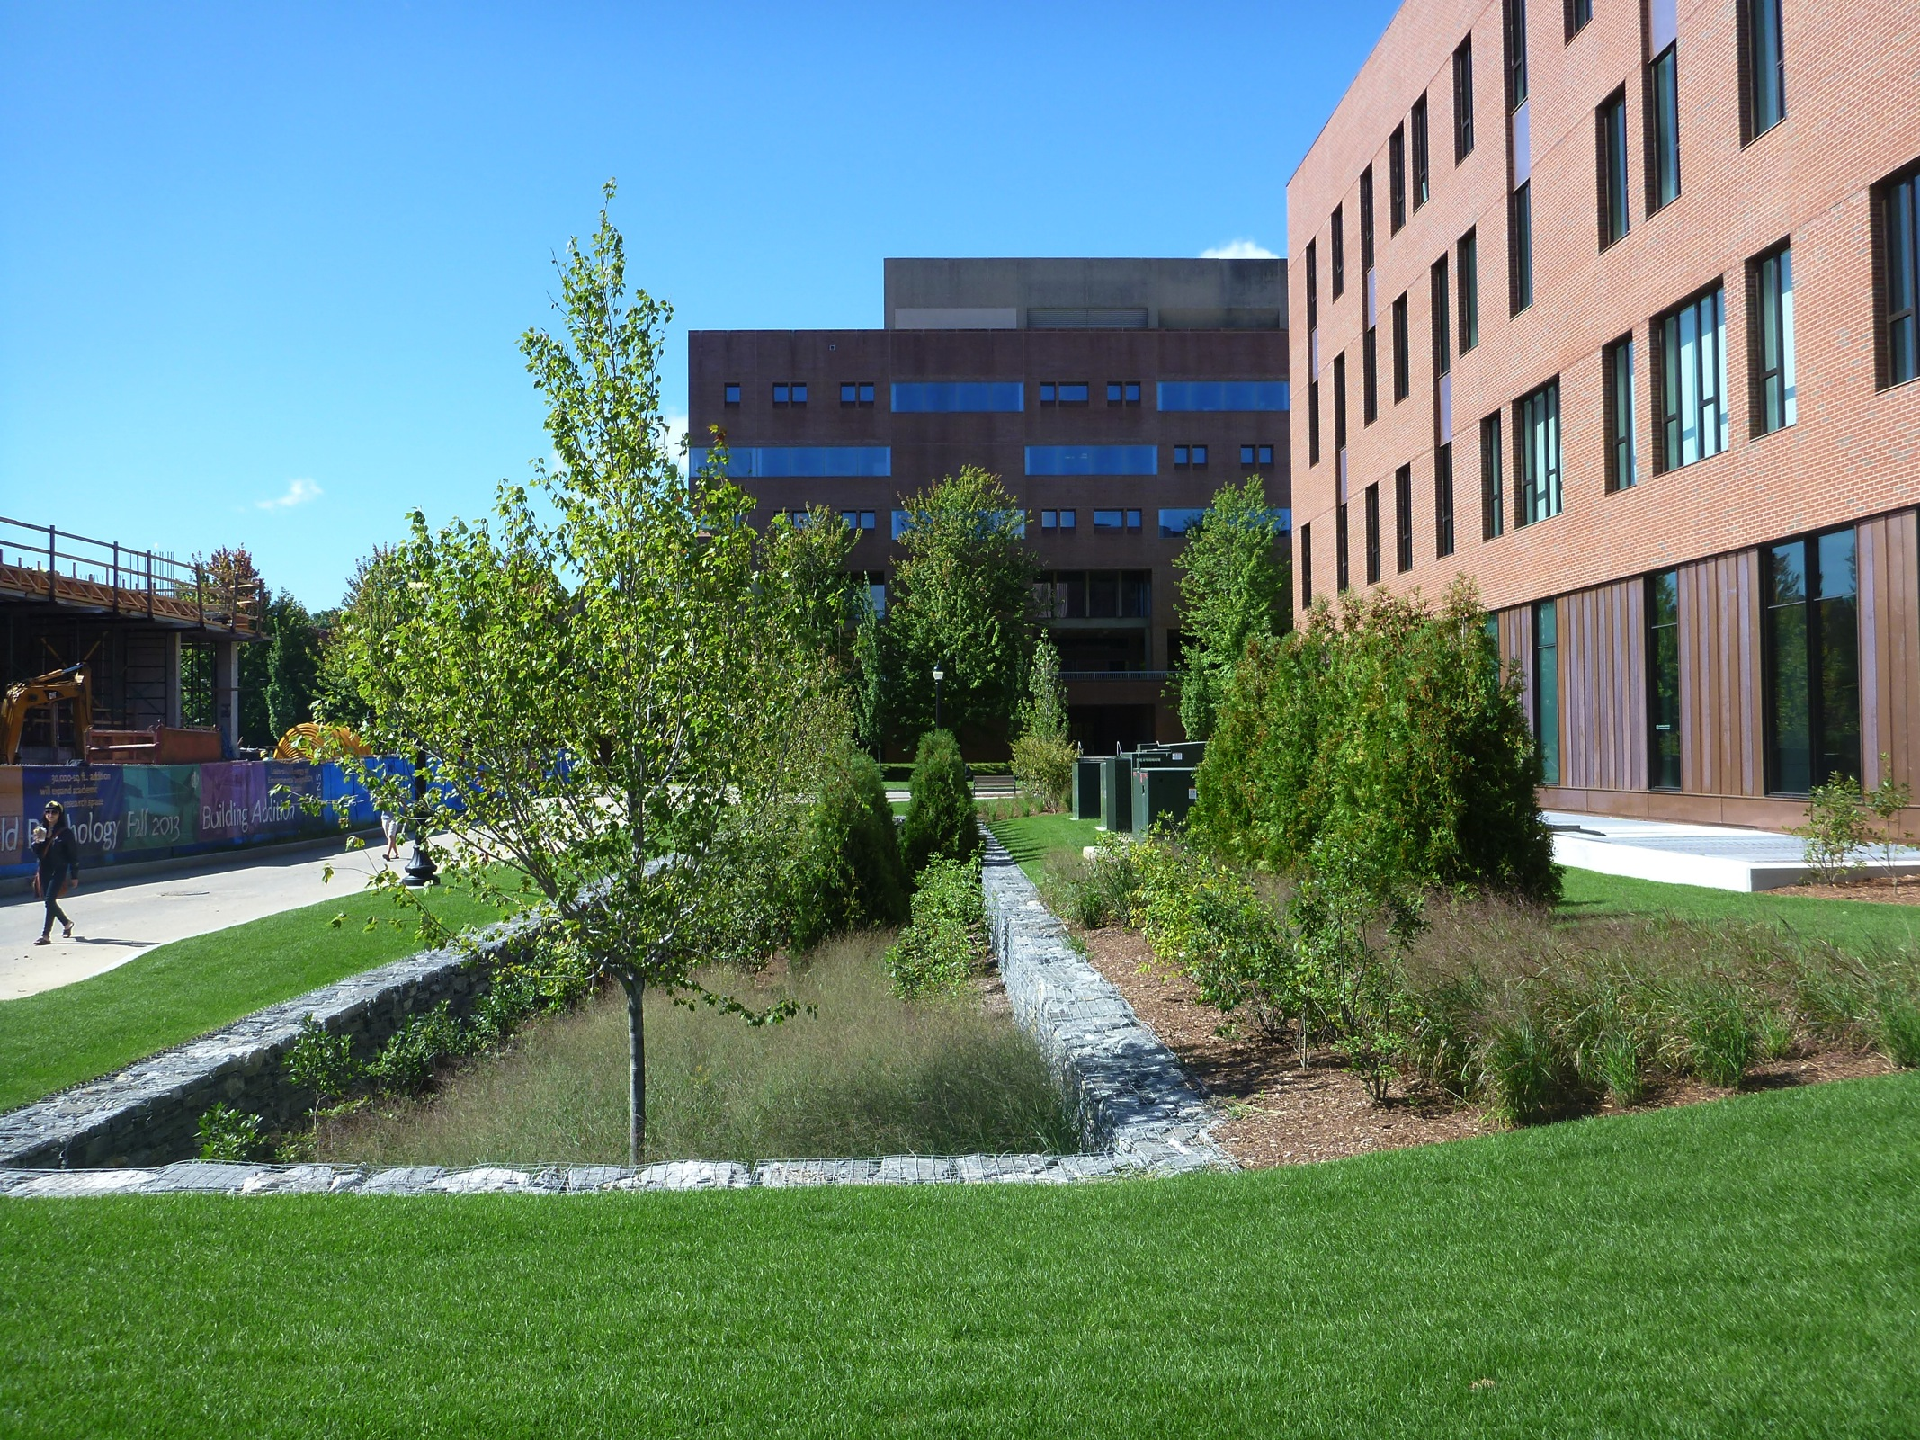
2012
Oak Hall

Slide 11
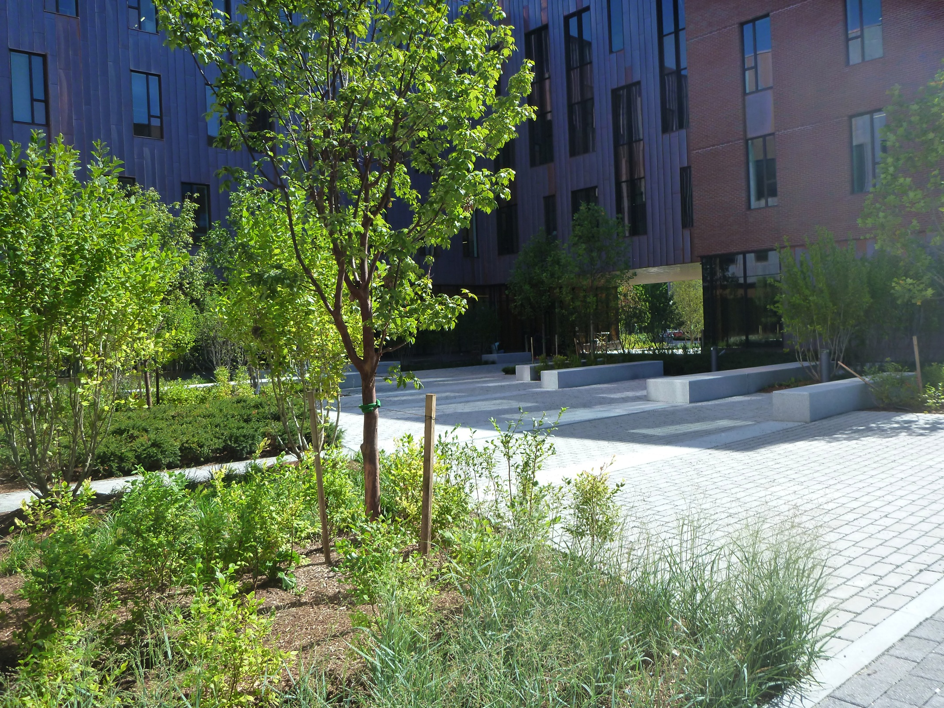
2012
Oak Hall

Slide 12
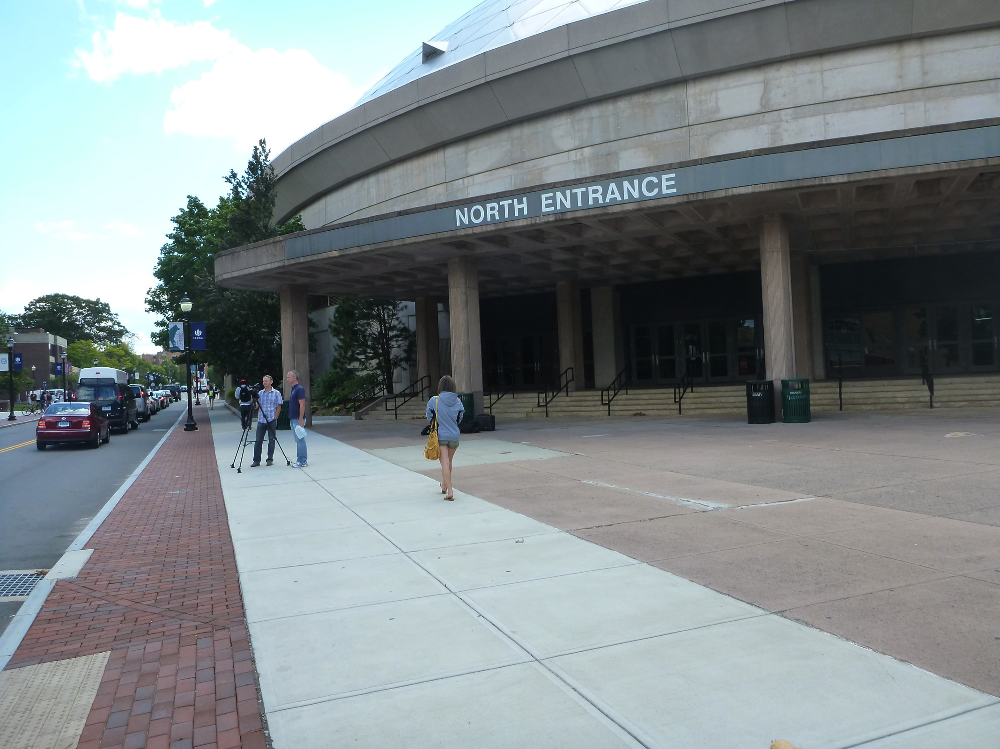
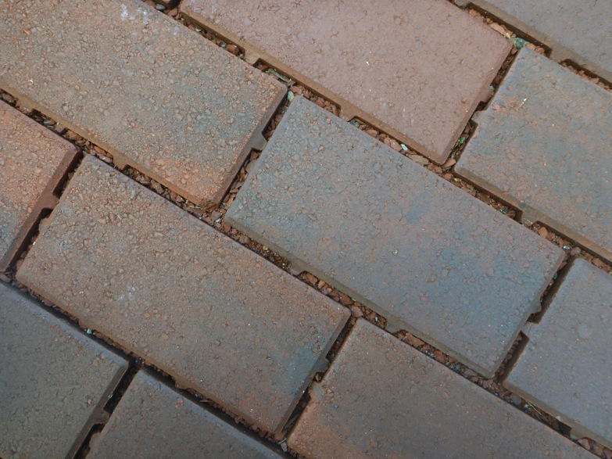
2013
Hillside Rd Snow Shelf

Slide 13
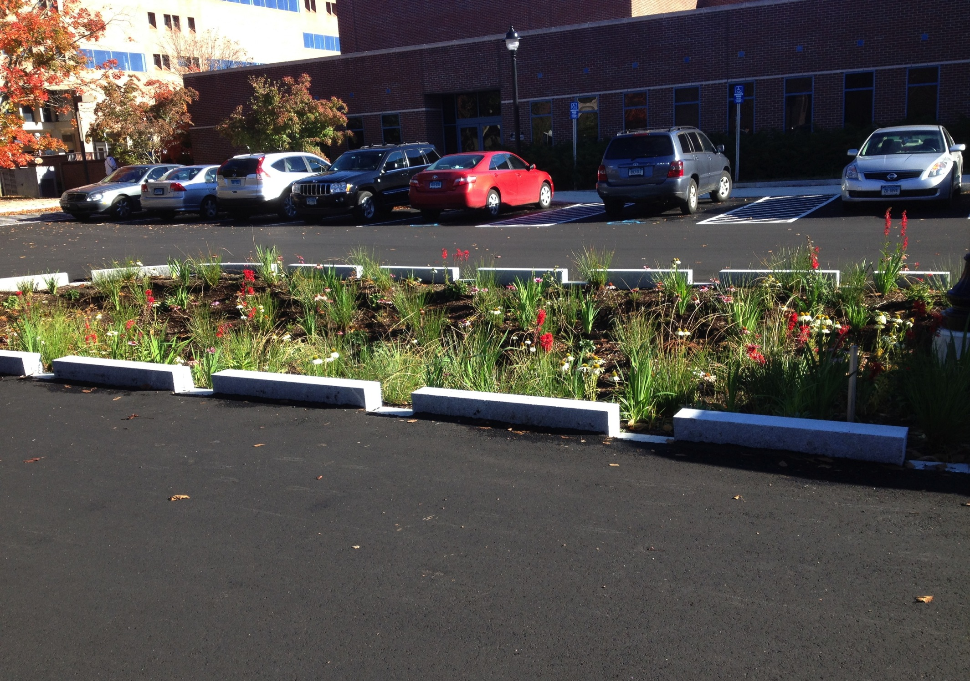
2013
Rain Gardens & pervious asphalt parking stalls near Whetten Center.

Slide 14
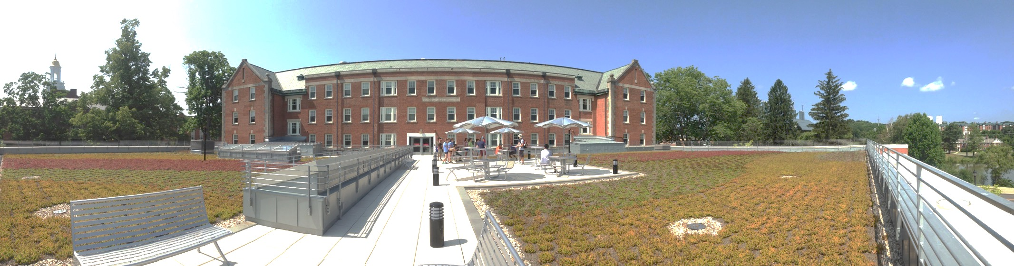
Storrs Hall 2013

Slide 15
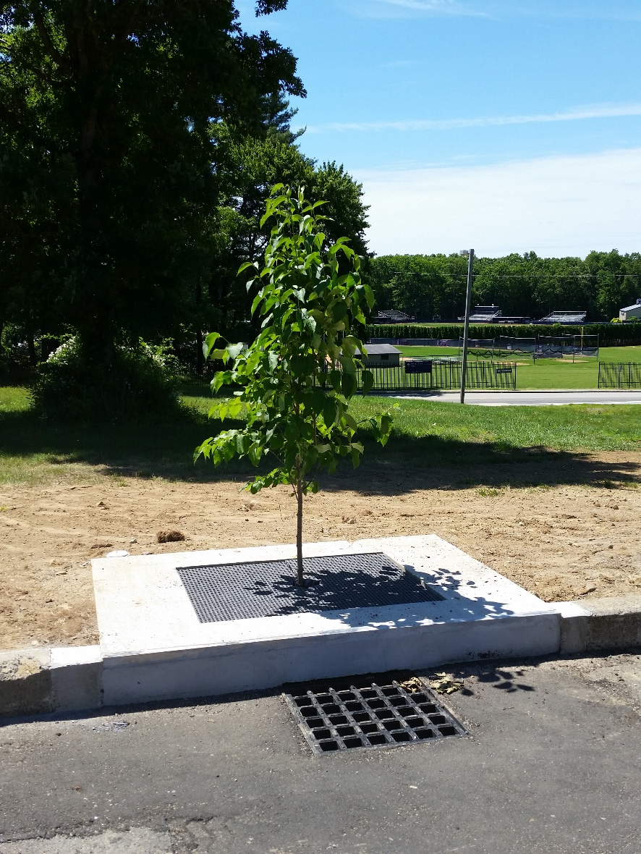
Tree Filters (2014)

Slide 16
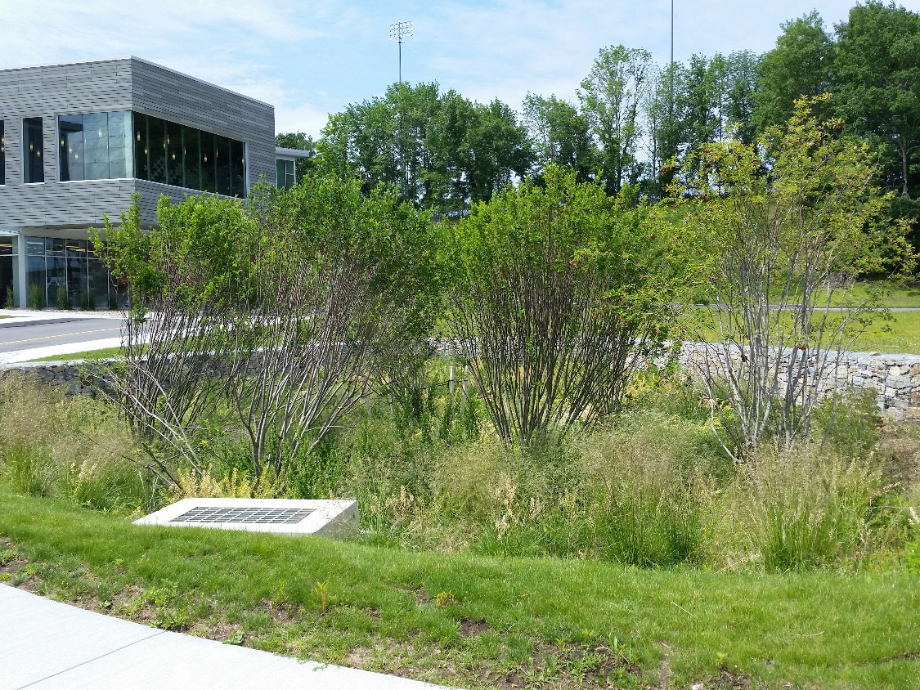
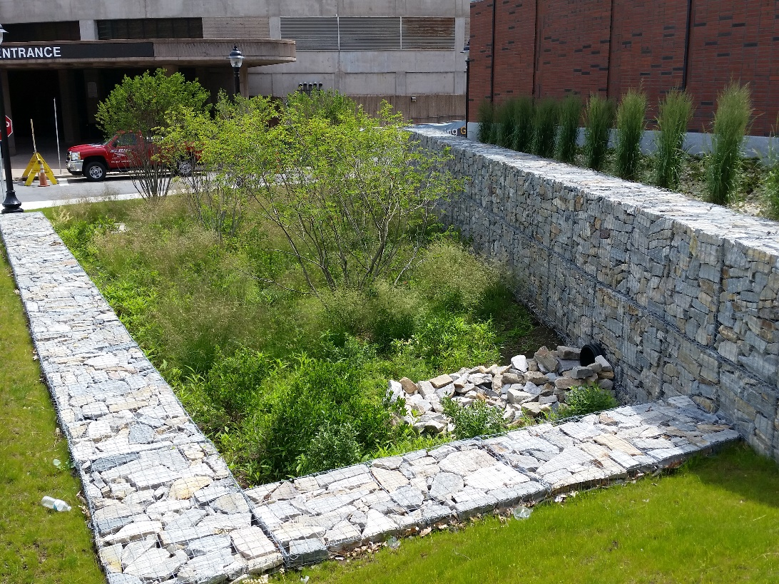
Basketball practice bioretention (2014)

Slide 17
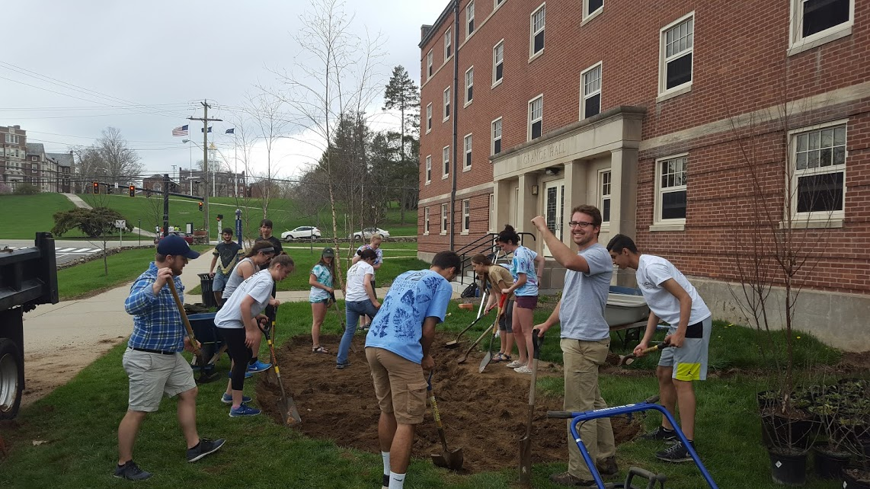
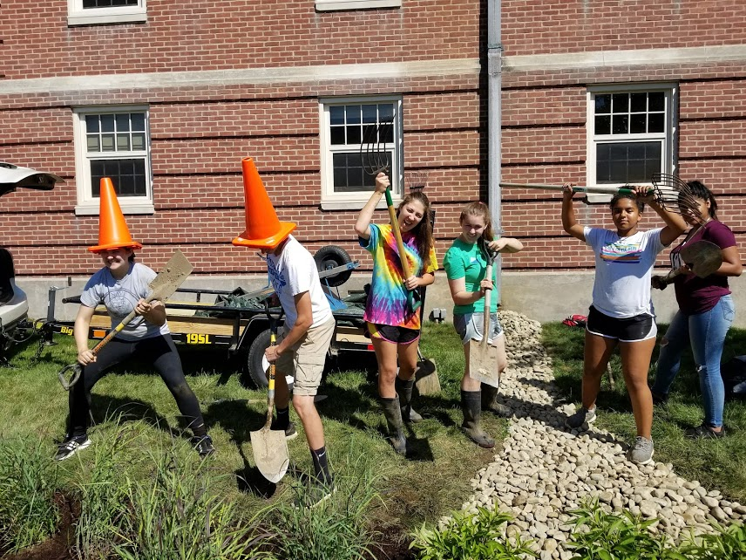
Rain gardens 2017

Slide 18
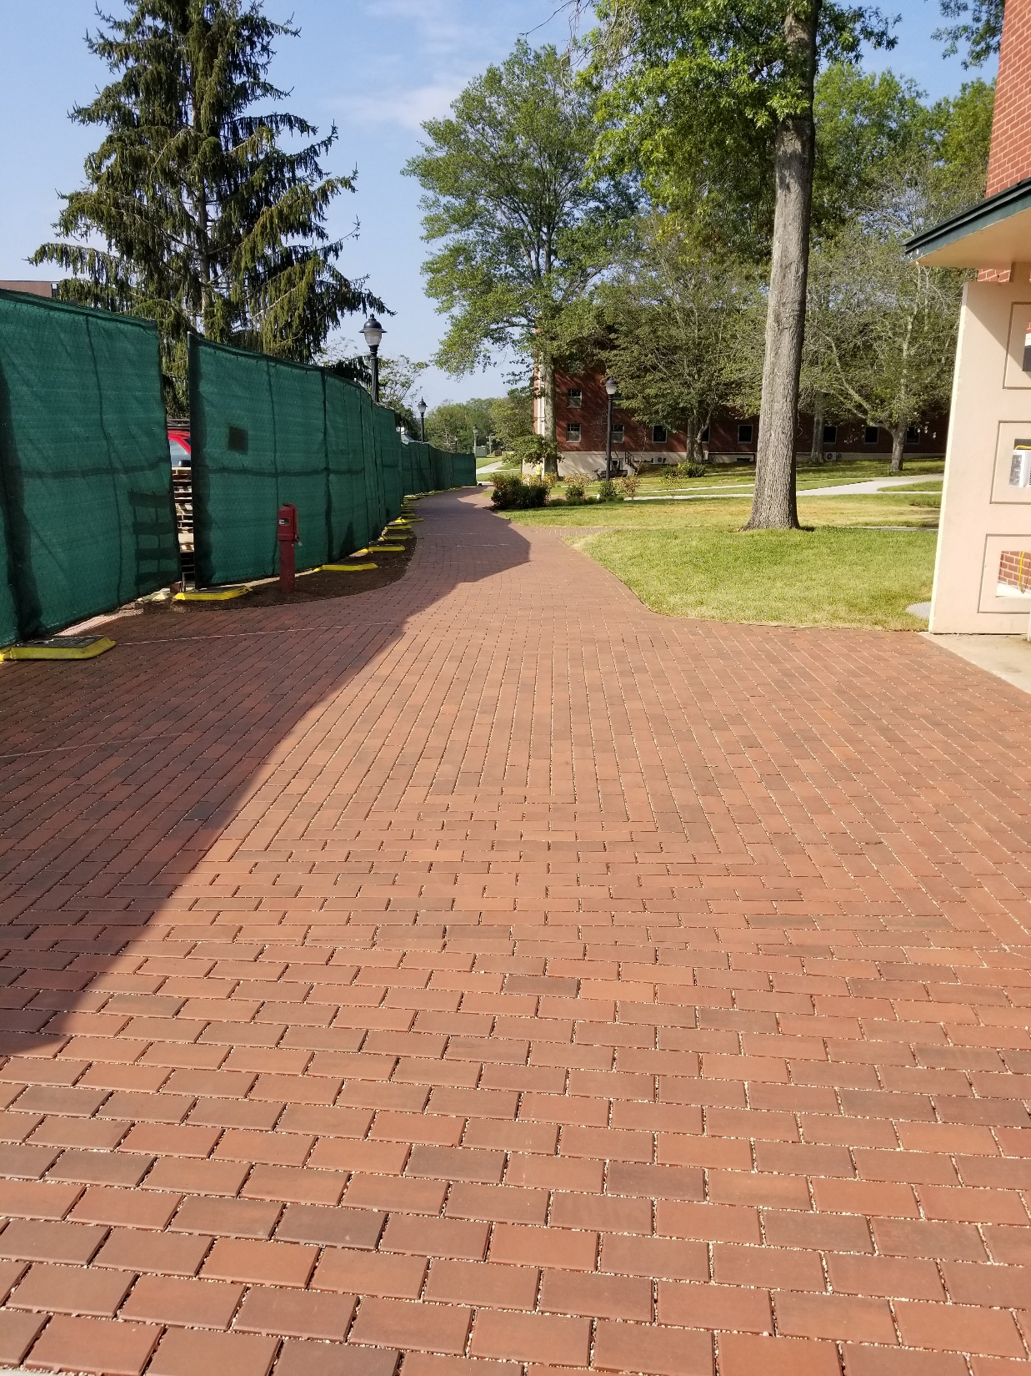
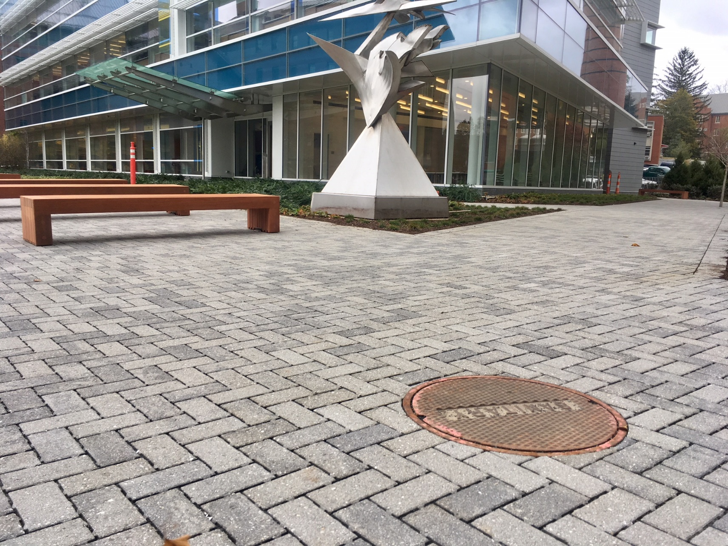
2017

Slide 20
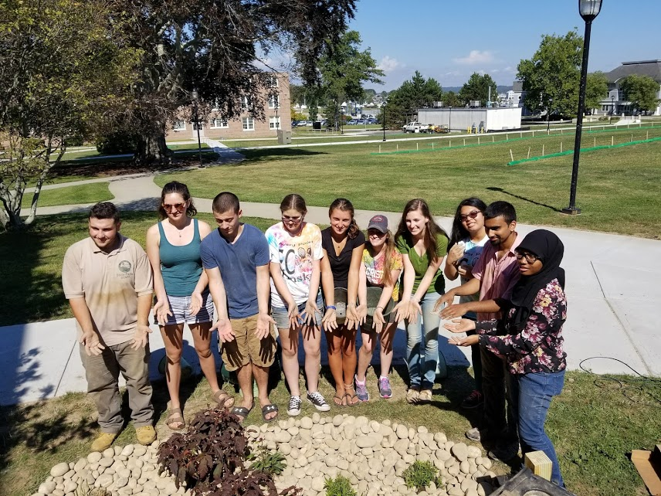
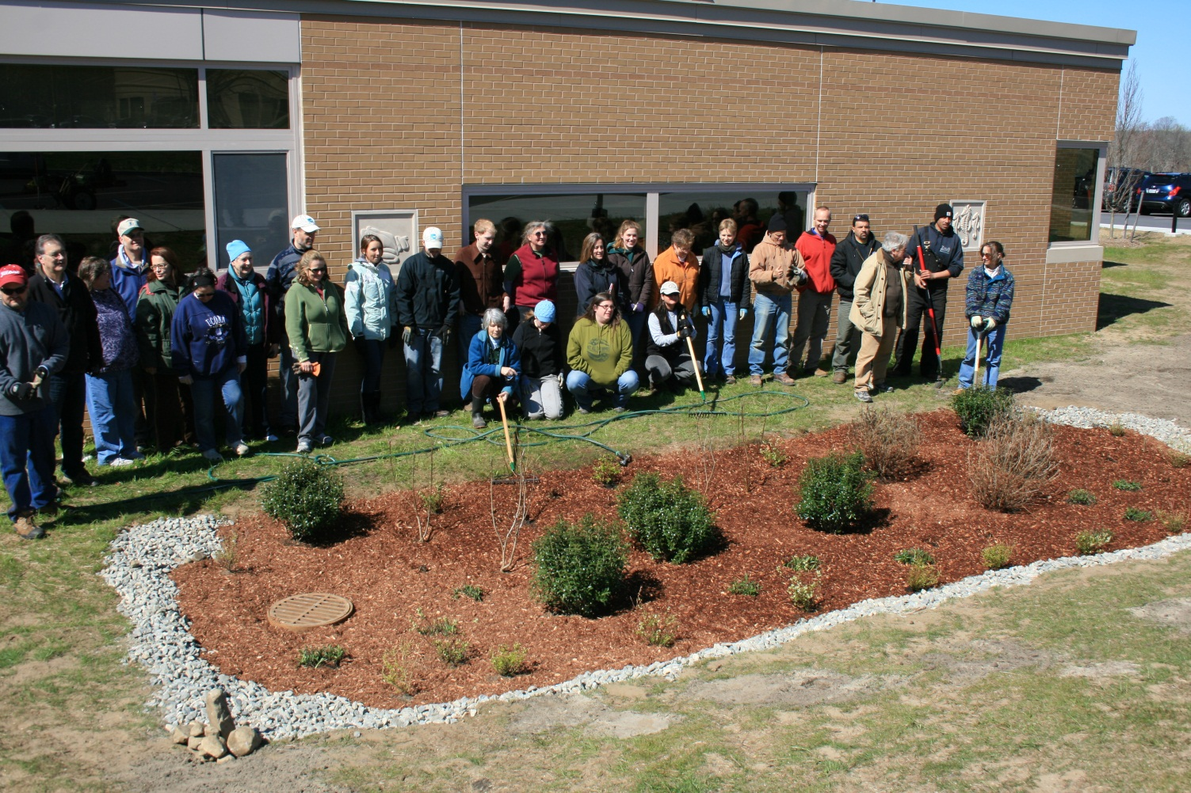
Maintenance issues

Slide 21
First rain garden/bioretention at UConn - 2004
Correctly built to specification
Curb installed after construction…but all the way around!

Slide 22
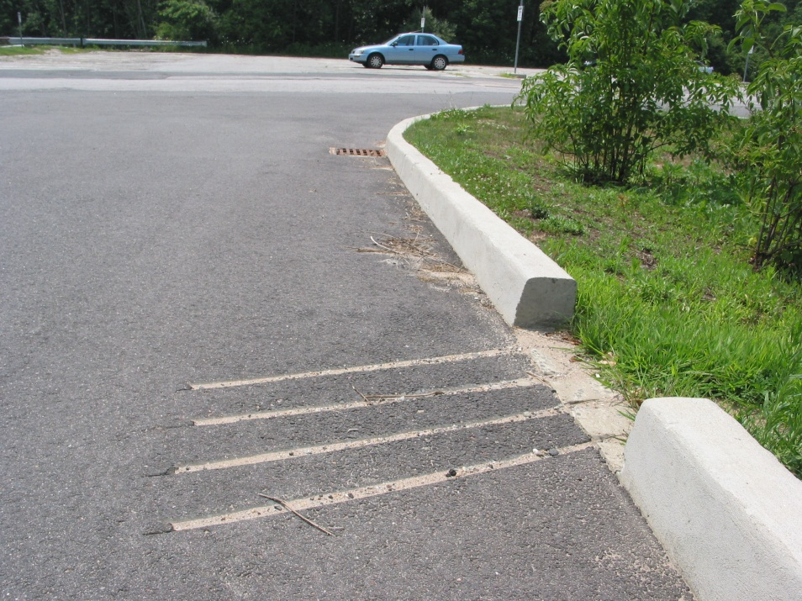
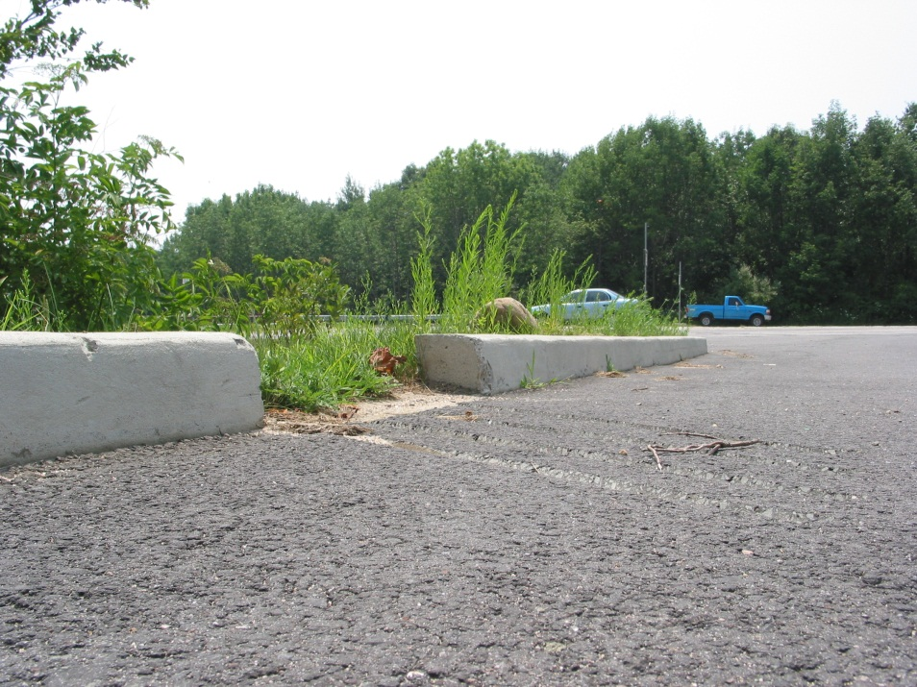
Pay attention to detail!
Curb cuts added after (not the best design here)

Slide 23
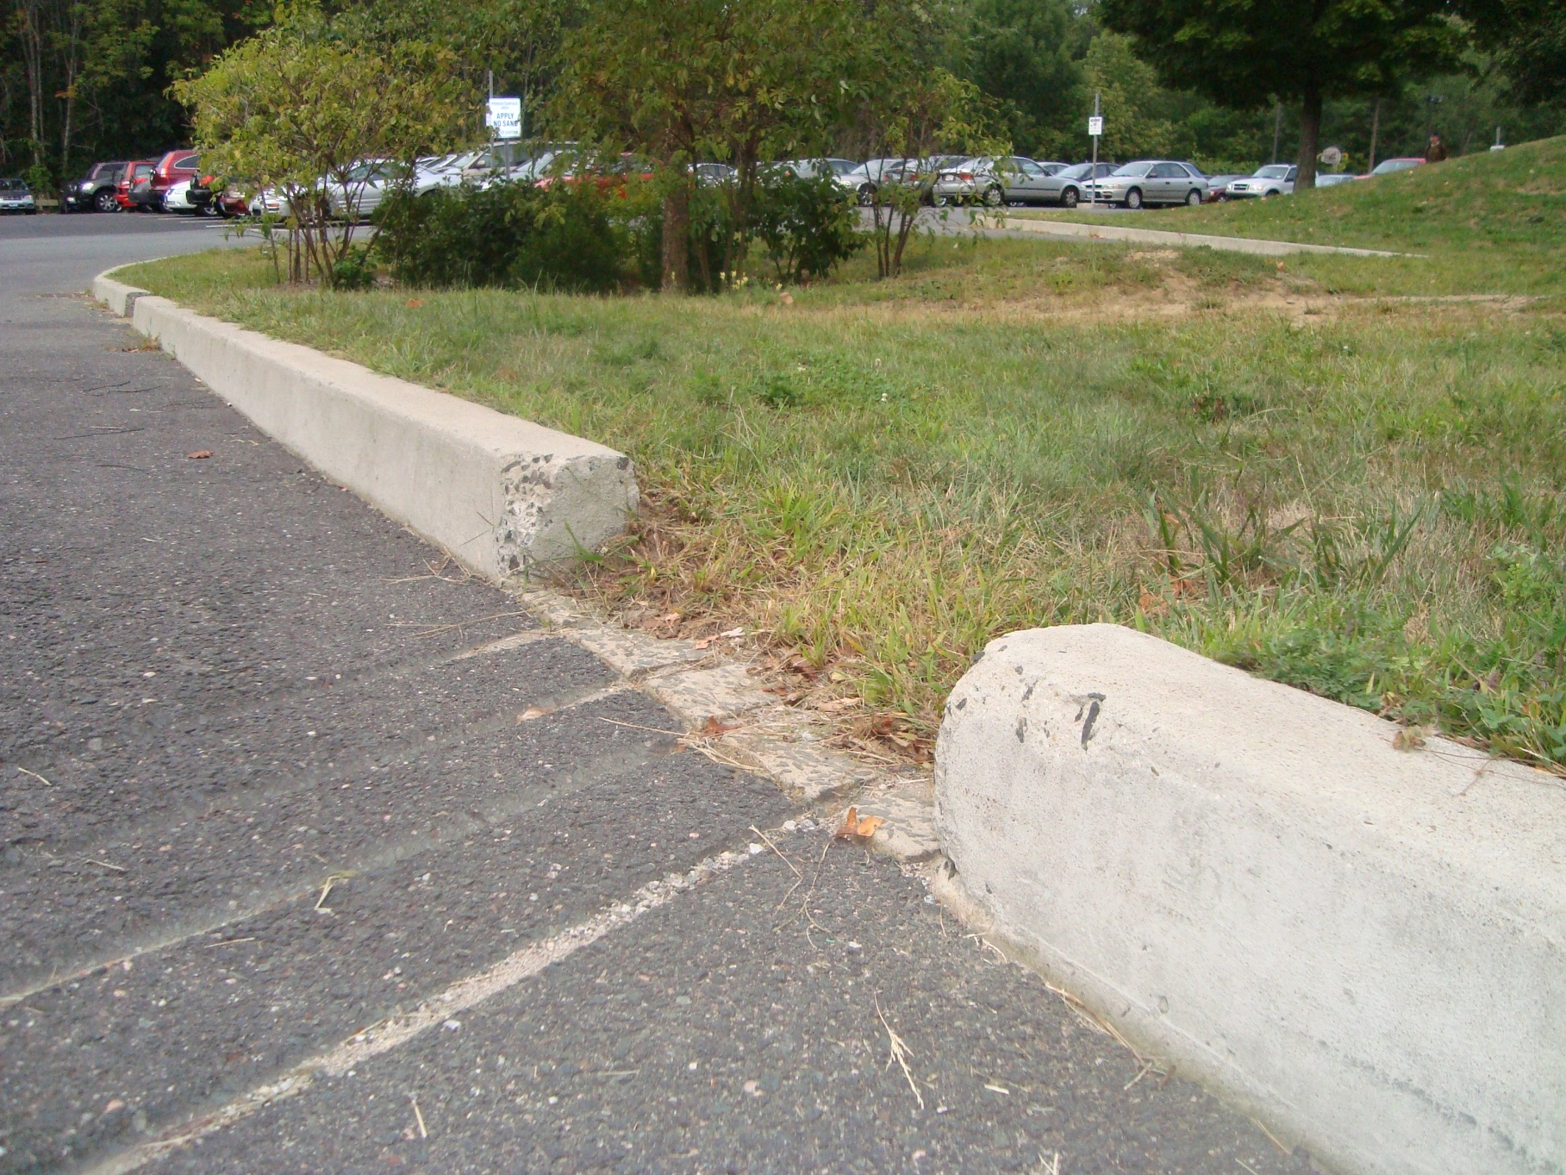
Turf dams – maintenance issue

Slide 24
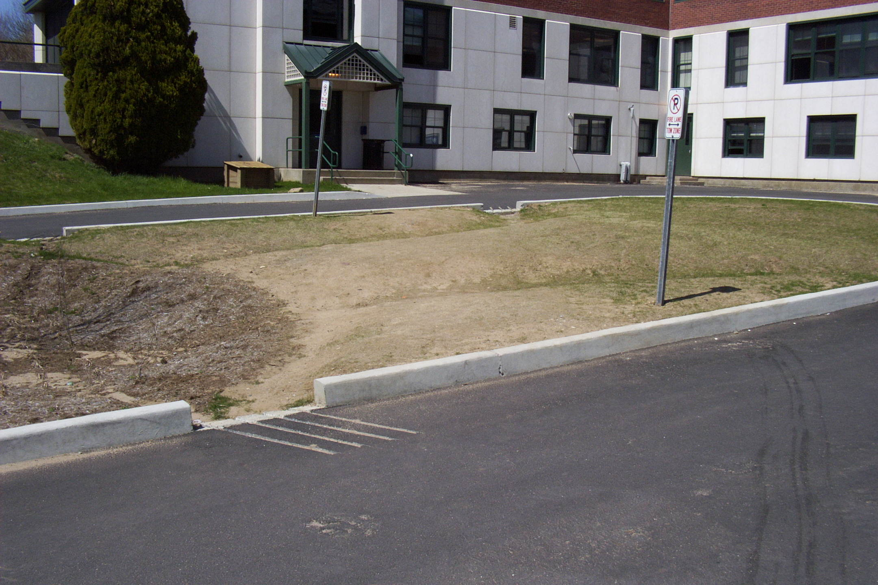
Failed to factor in people…

Slide 25
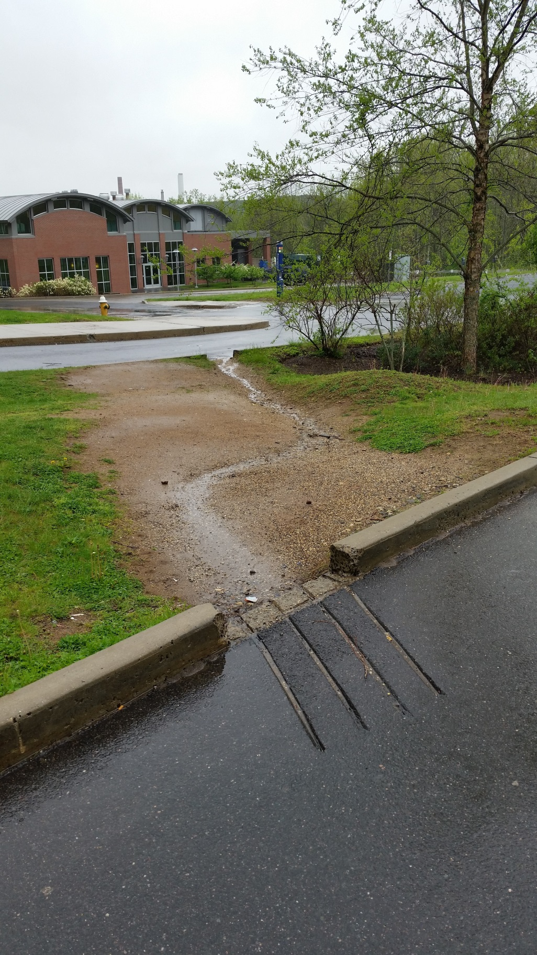
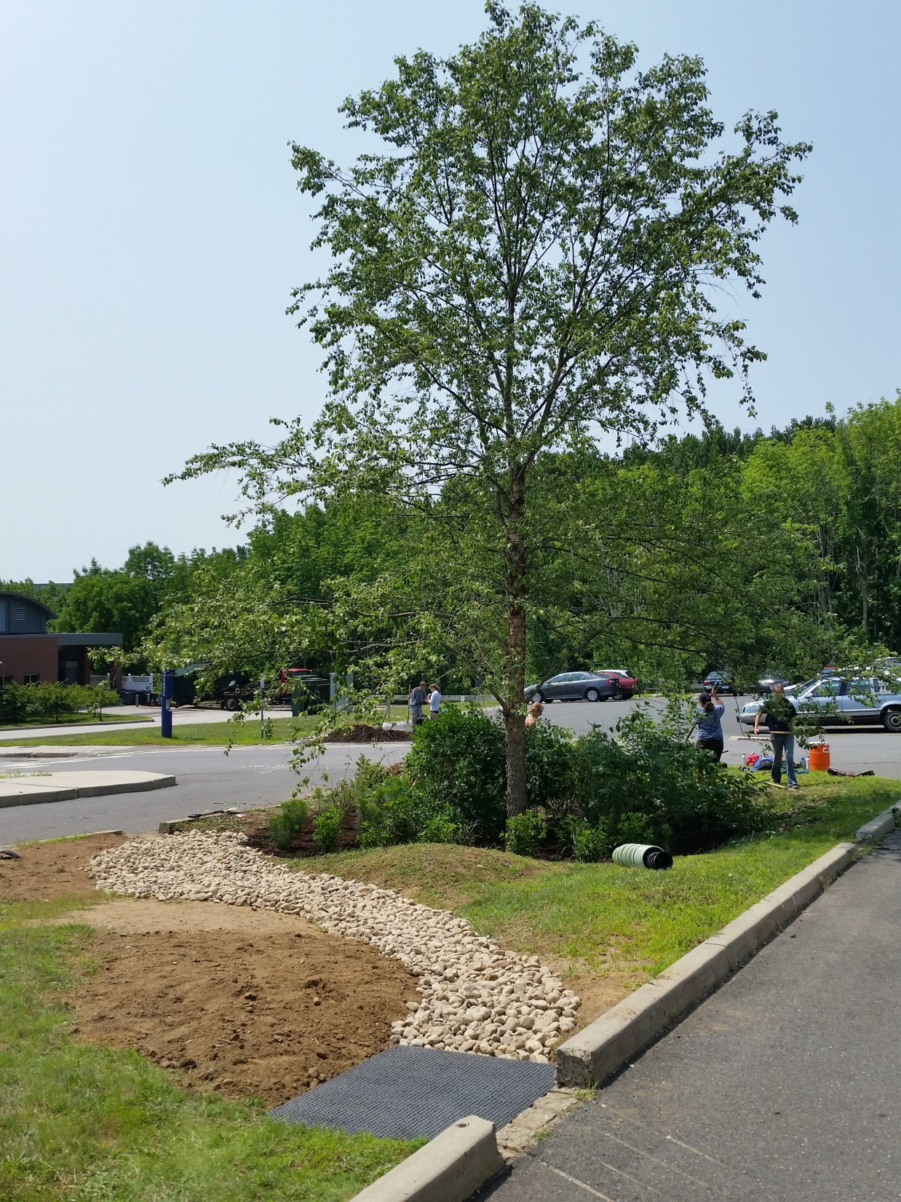
2014
2004

Slide 26
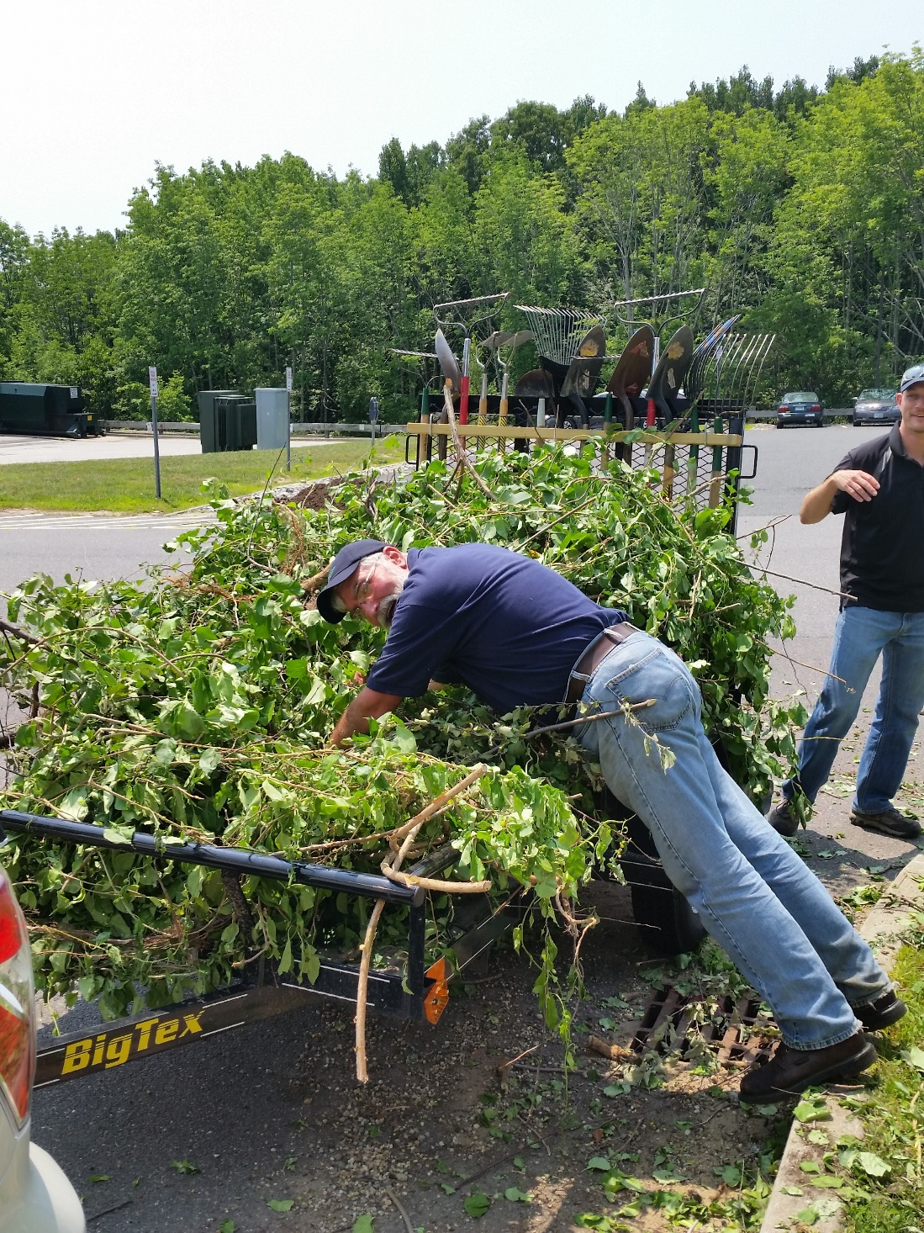
Maintenance is so bittersweet…

Slide 27
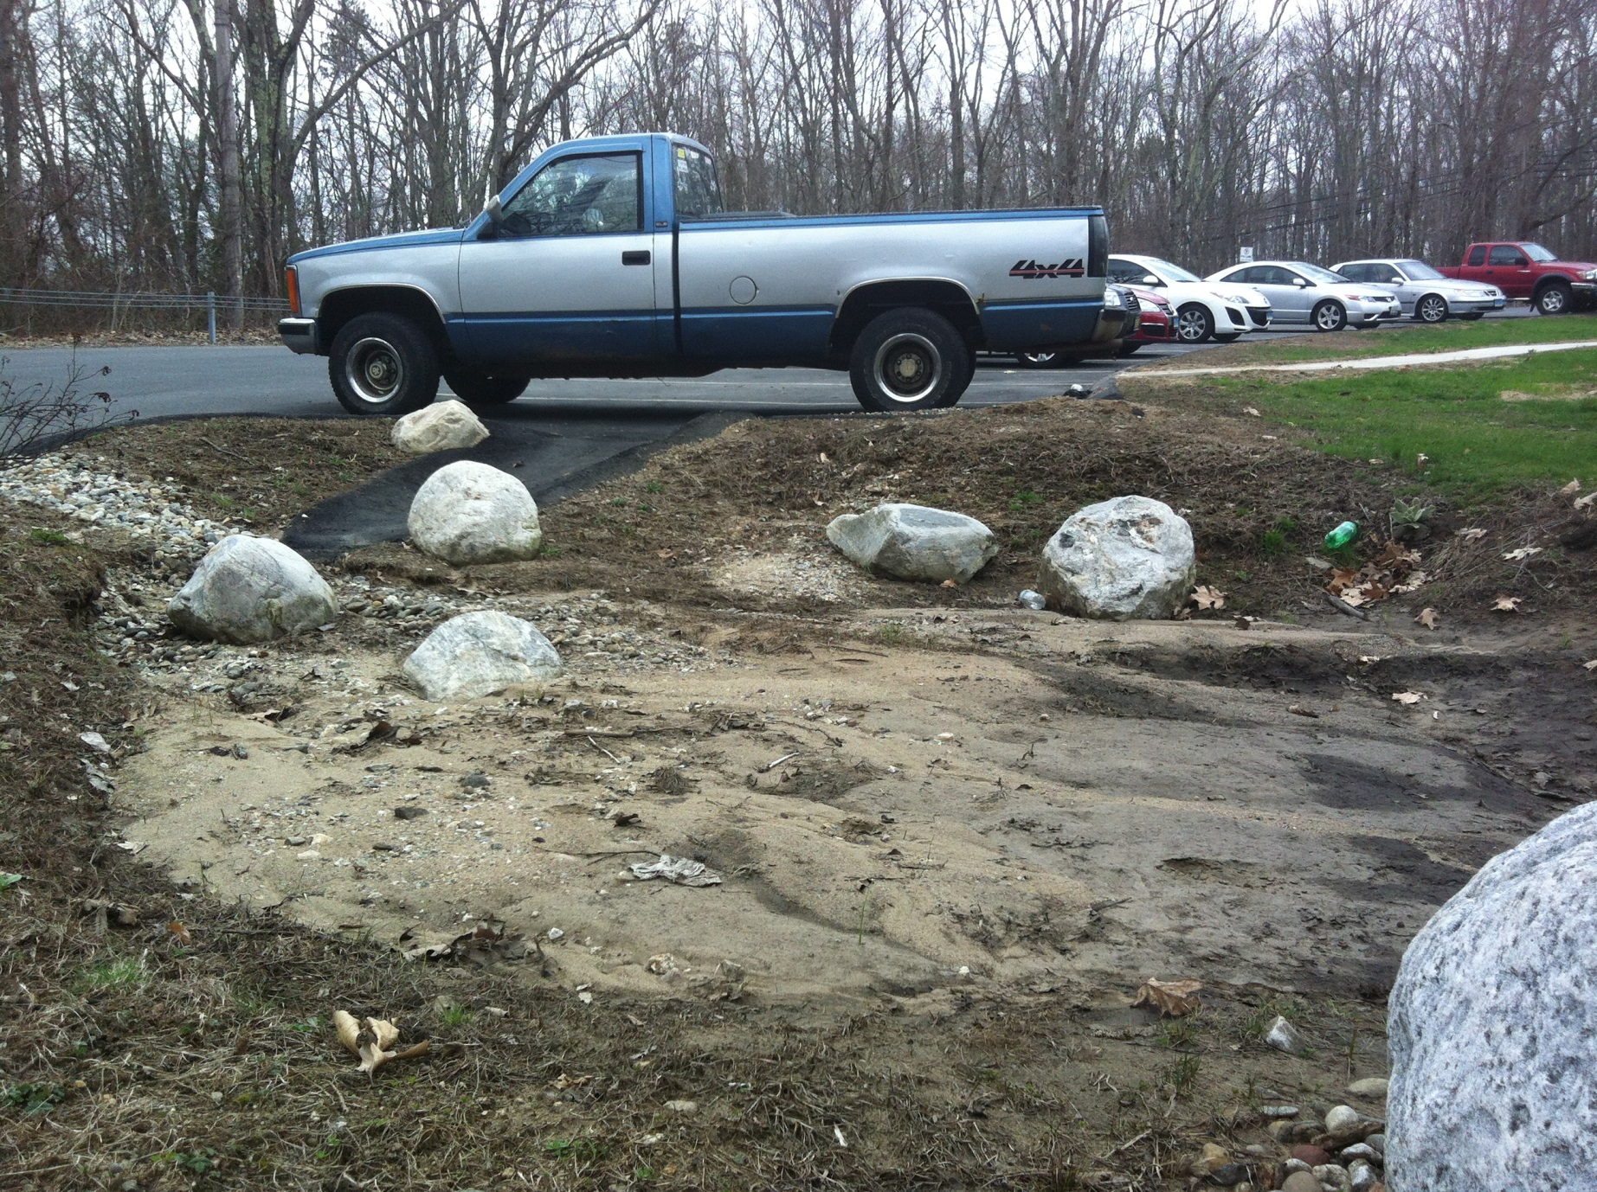
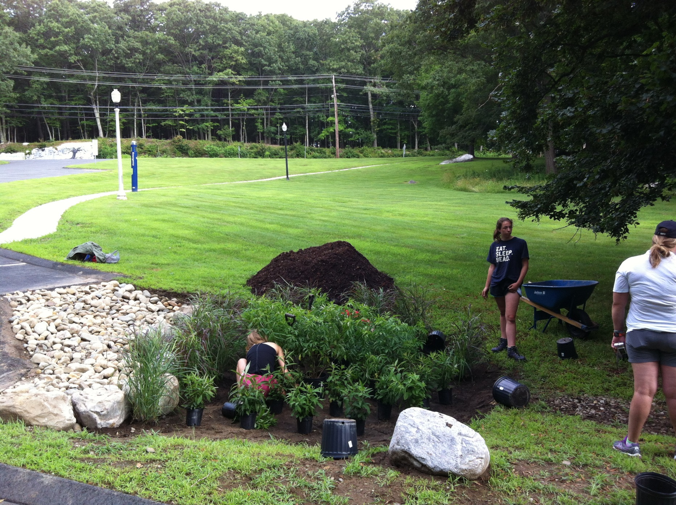

Slide 28
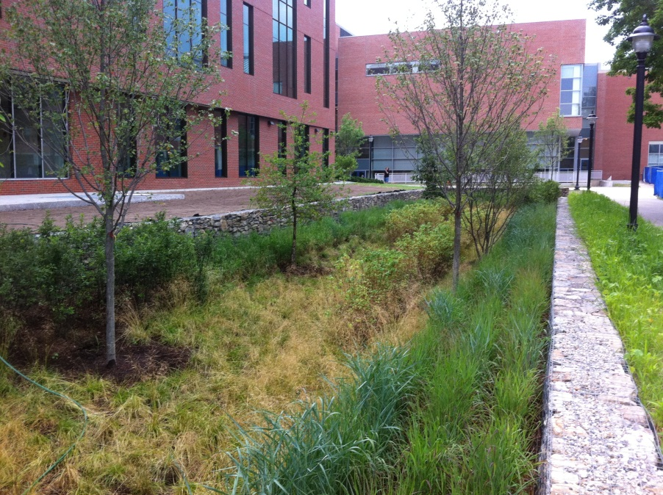
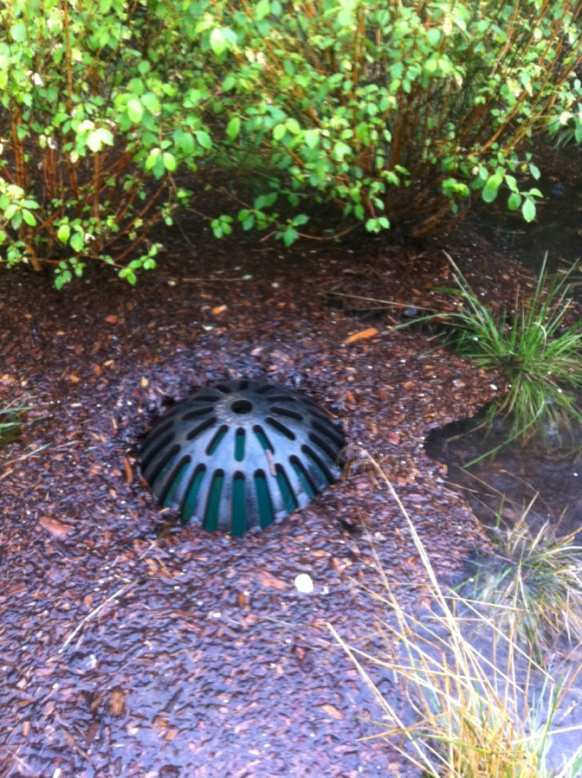
Pay attention to detail
Large bioretention installed 2011
Overflow designed to contain 10-year storm…

Slide 29
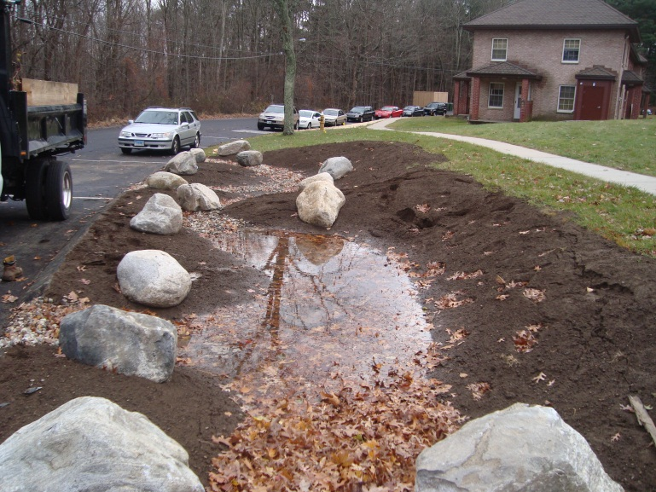
Many good examples at UConn, but…
2010
Held water for 1 week+
Compacted soils, no underdrain installed

Slide 30
Pervious concrete at UConn
Field house parking lot
Installed 2 days before classes began, 2009

Slide 31
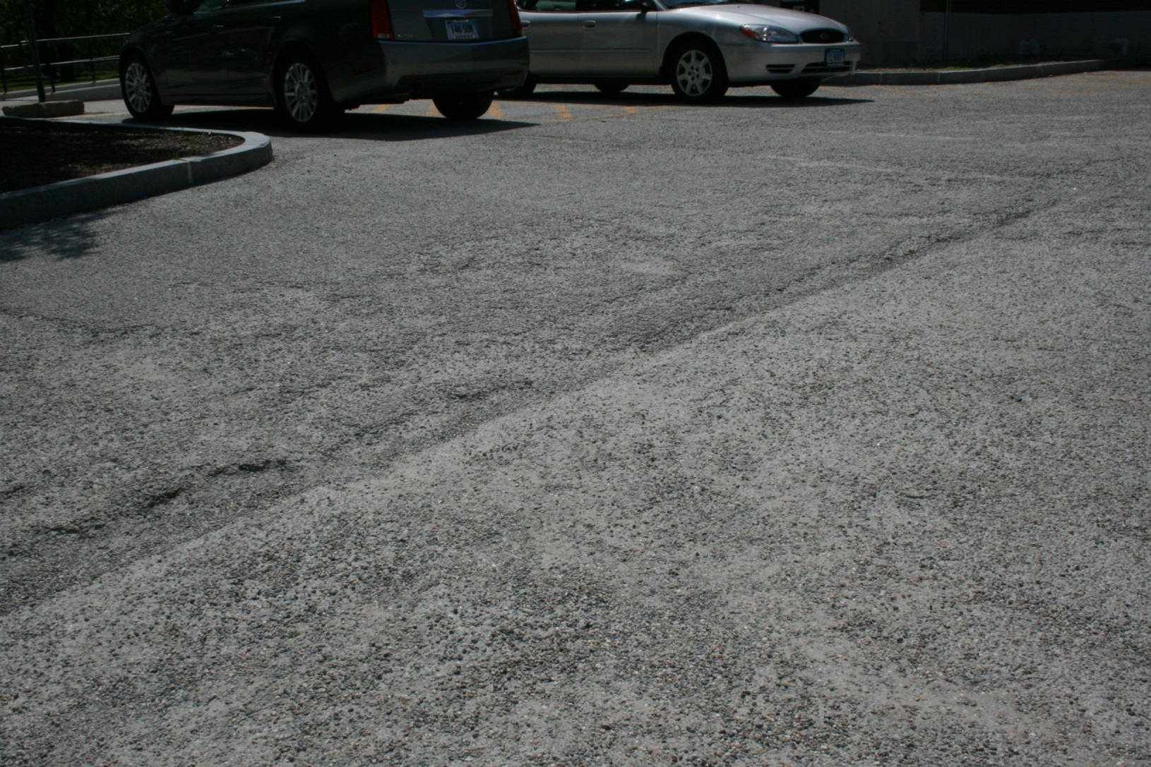
Problems with UConn pervious concrete
Lot totally failed by 2017

Slide 32
Potential reasons for failure of PC
Improper mix ratio
Improper handling (and transport time!)
Improper placement
Insufficient curing time
Improper salting

Slide 33
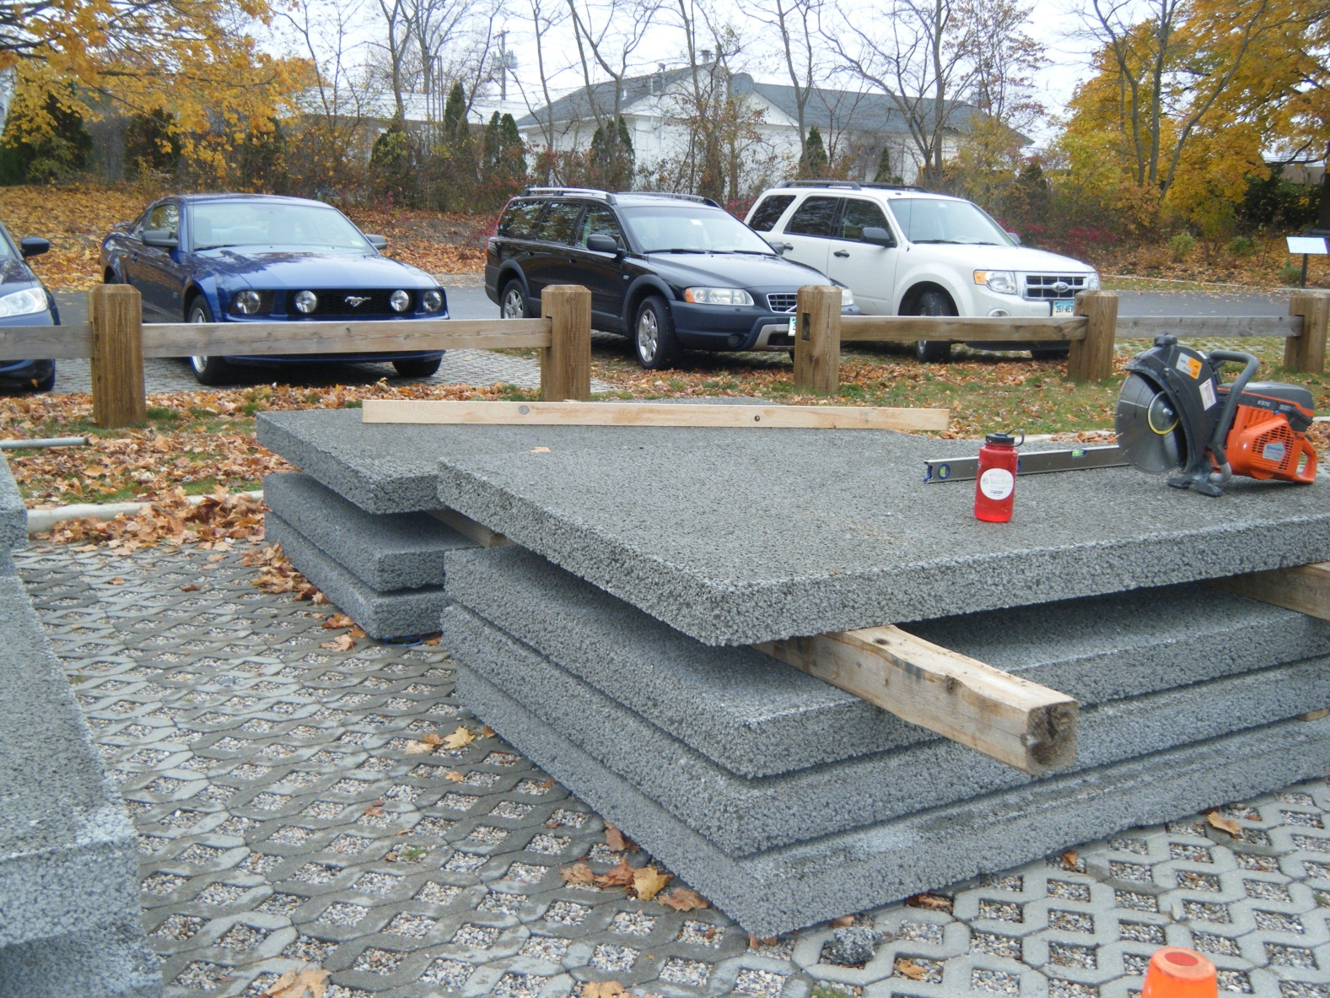
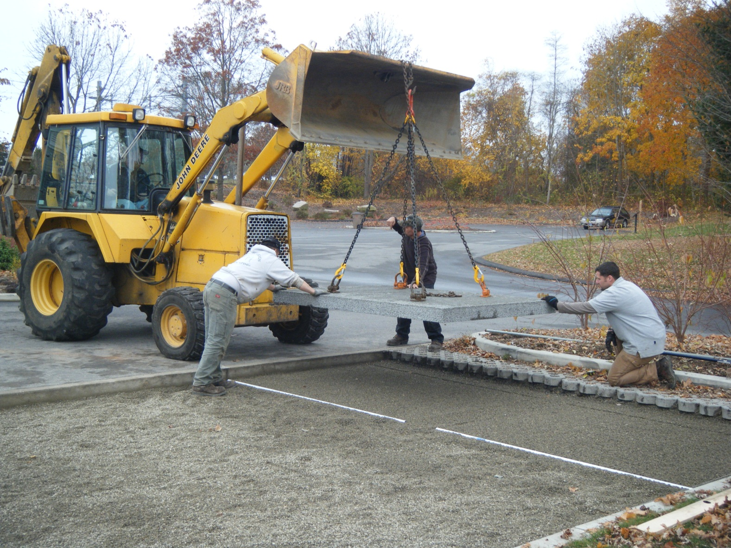
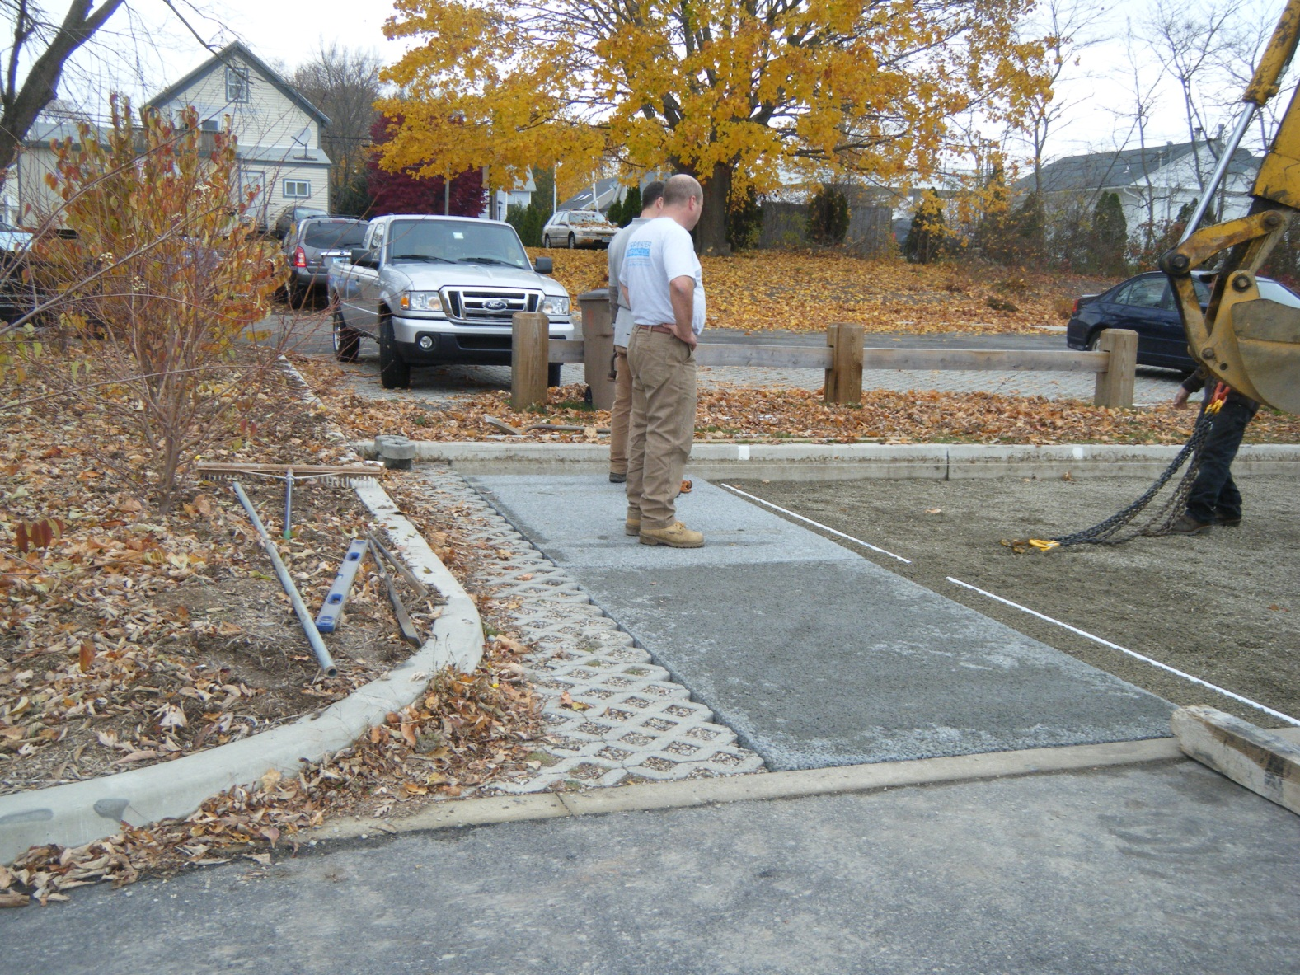
Pre-cast pervious concrete
“Stormcrete” from Porous Technologies (Yarmouth, ME)

Slide 34
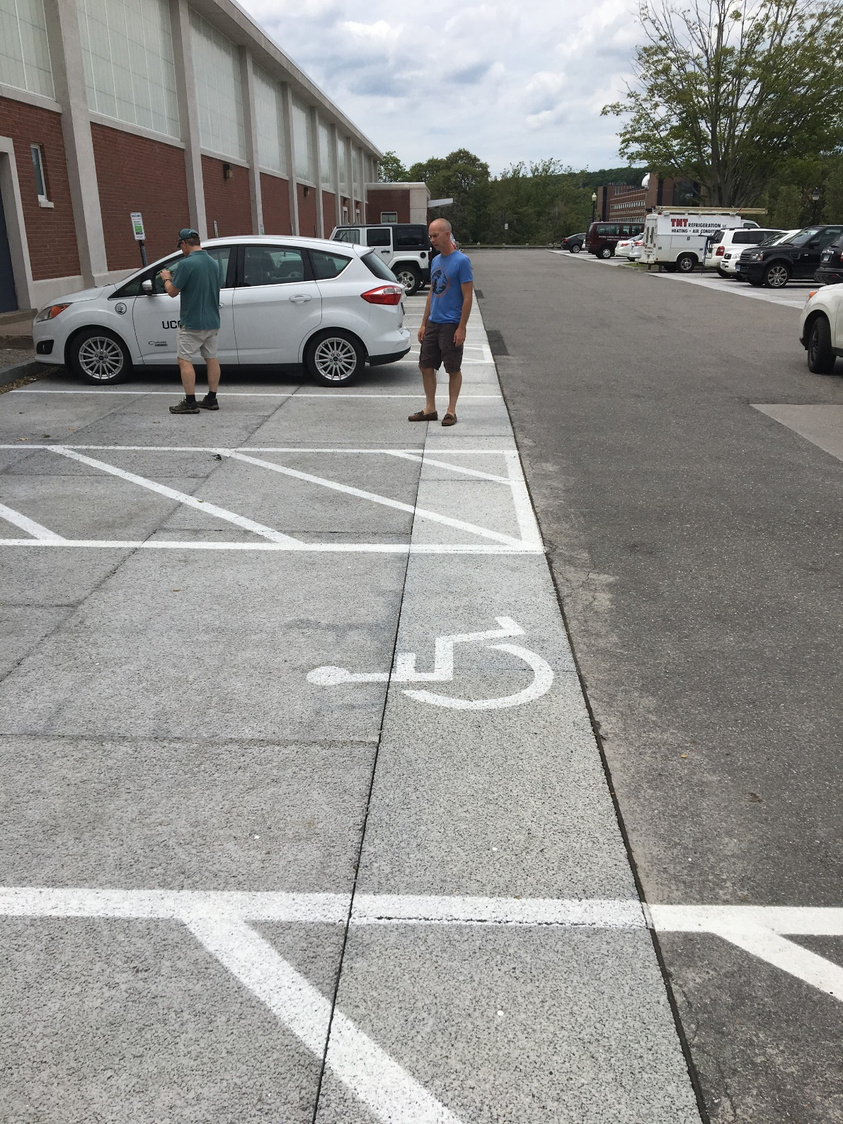

Slide 35
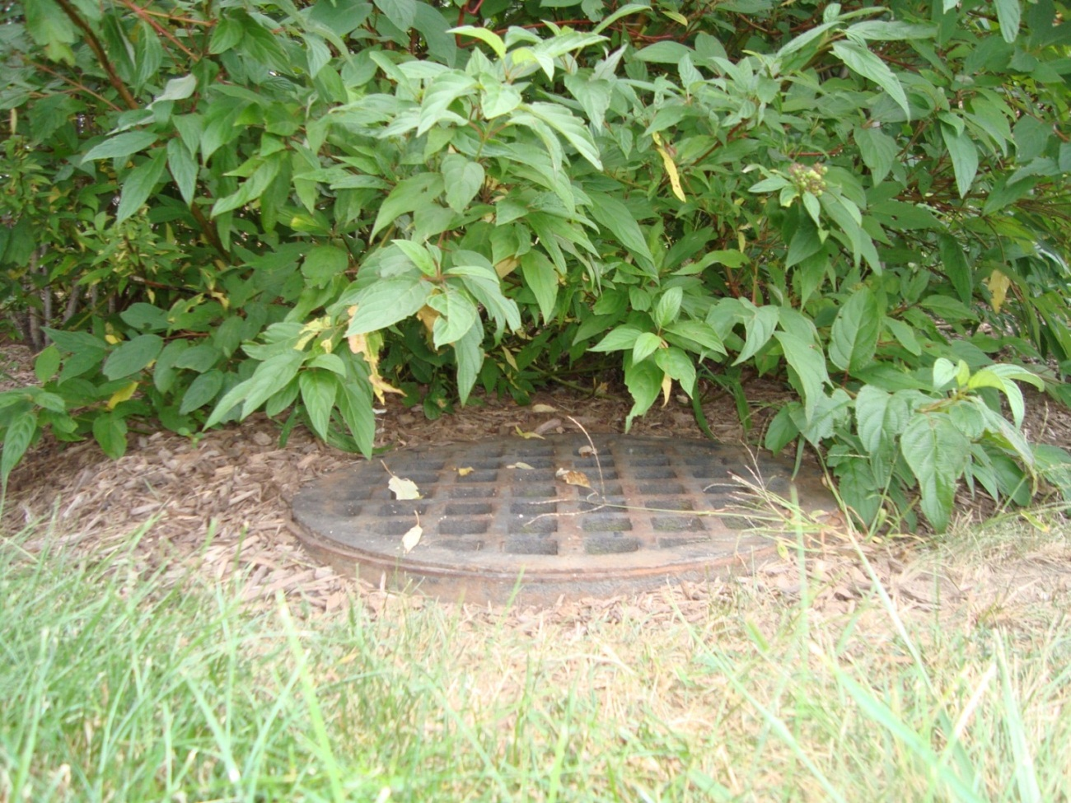
Over-mulching at UConn
Storage depth was correct at installation…but…
You need to make sure it stays that way!

Slide 36
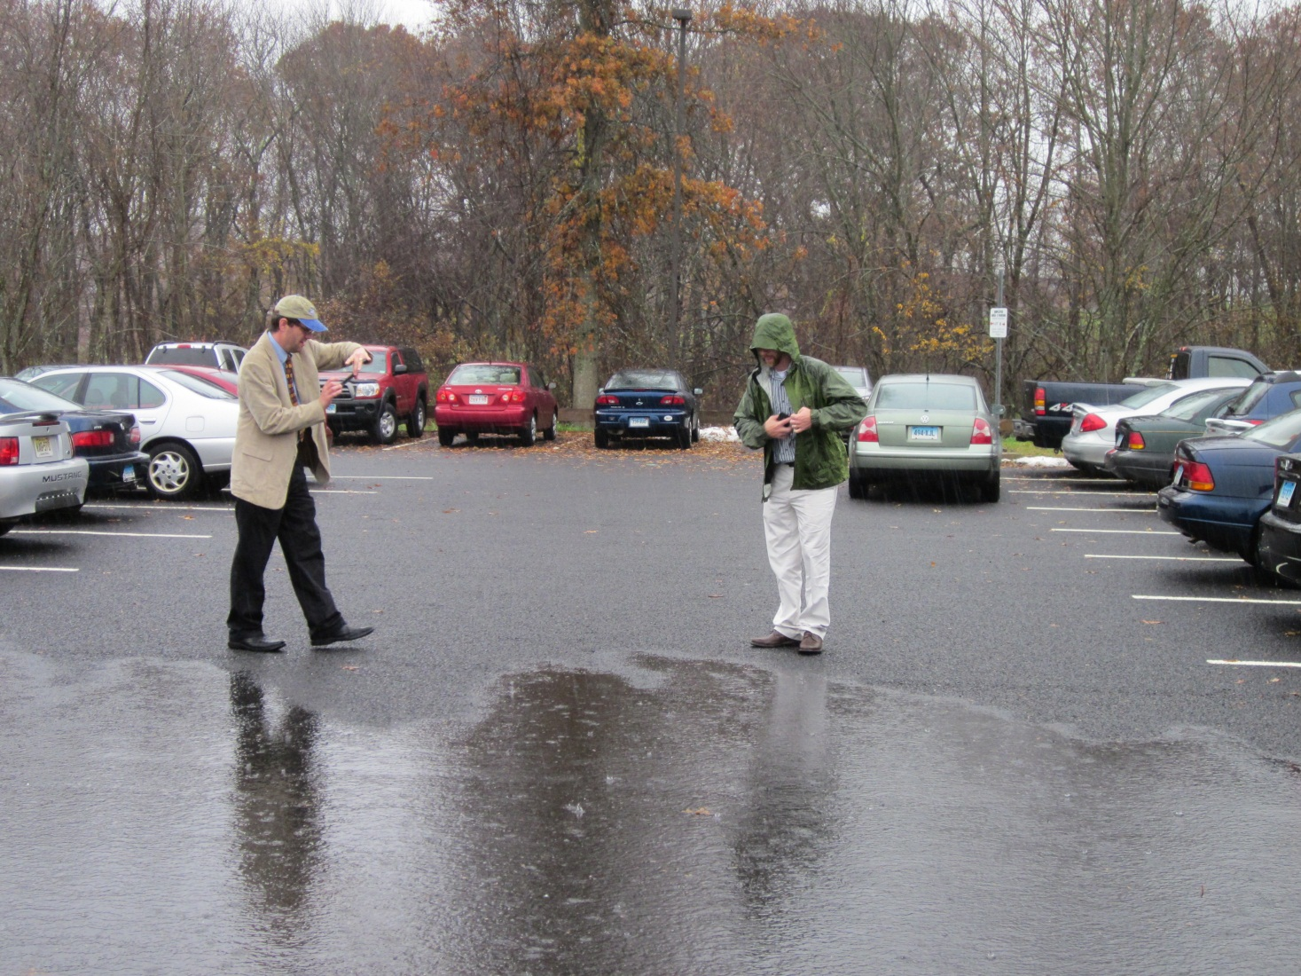

Clogging of pervious pavements
Regular maintenance keeps problems away

Slide 37

Regenerative air sweeper
Works OK with light debris loading, and performed very regularly (at least 4x per year)

Slide 38


Slide 39


Before After

Slide 40


Slide 41



Slide 42
Conclusions
All of these practices work well- IF…
  They are properly designed, installed and maintained
UConn has made a major commitment to using these practices
Coordination with facilities/DPW is critical

Slide 43
Thank You! michael.dietz@uconn.edu

