Slide 1
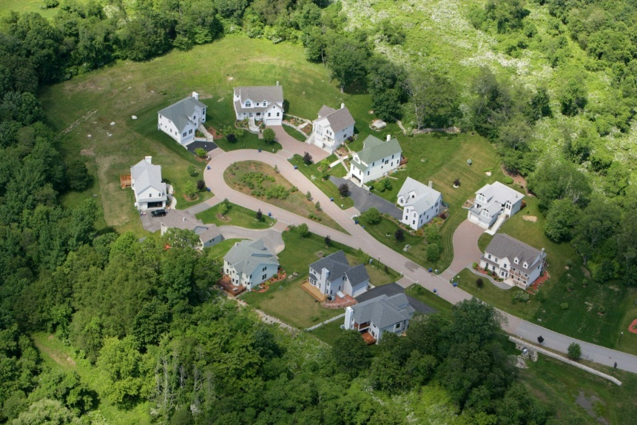
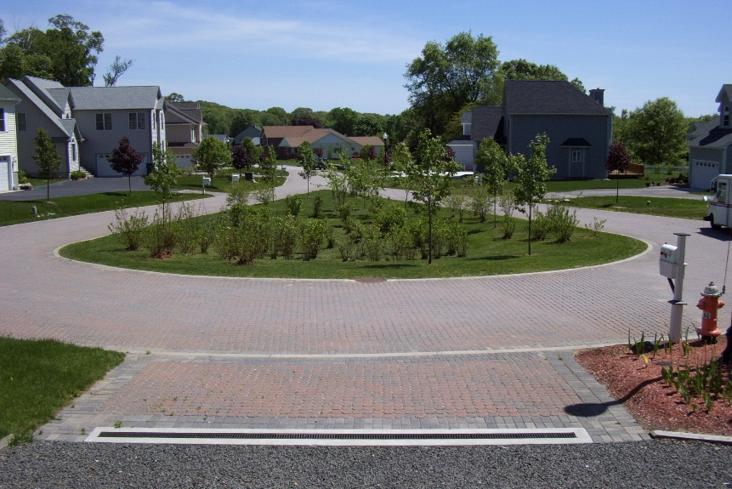
Residential Subdivision: Jordan Cove Waterford’s LID Subdivision, 15 Years later
Michael Dietz, Ph.D.
University of Connecticut
Center for Land Use Education and Research (CLEAR)
Rockfall Foundation Symposium
March 22, 2018

Slide 2



Jordan Cove project
Ten year project (1995-2005)
US EPA/CT DEEP funded
Led by Dr. Jack Clausen at UConn
Outreach by CLEAR
http://jordancove.uconn.edu
Funded in part by the Connecticut Department of Energy and Environmental Protection through a United States Environmental Protection Agency Clean Water Act Section 319 Nonpoint Source Grant

Slide 3
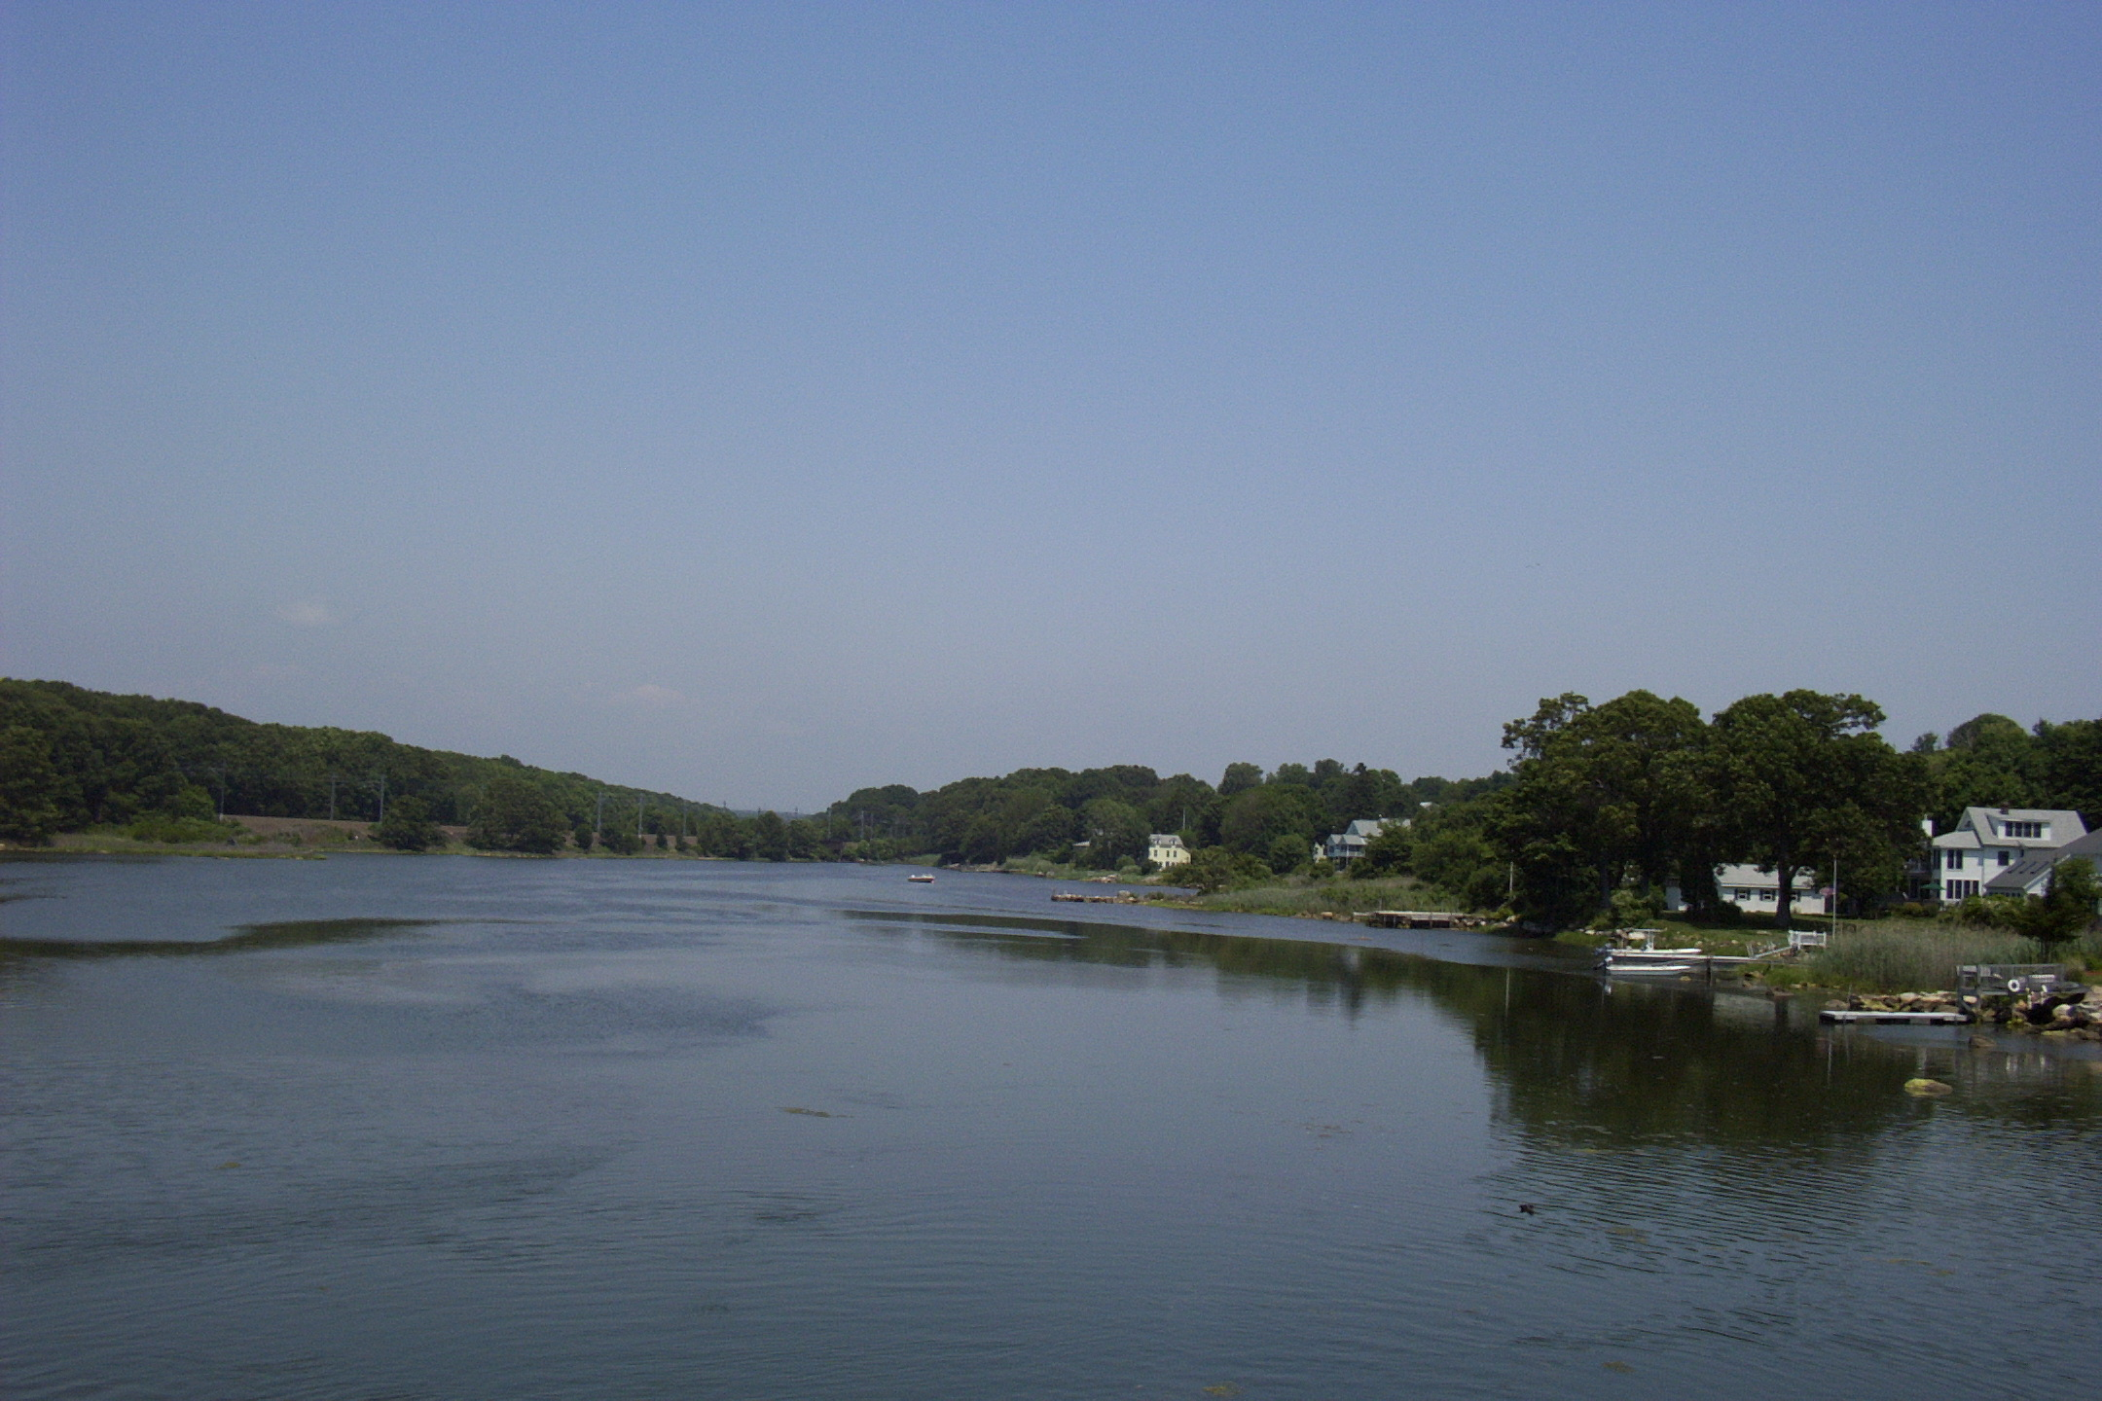
Jordan Cove Urban Watershed Project
Objective was to investigate:
  -Impacts of residential construction
  -Efficiency of a group of selected BMPs
  -Effectiveness of a community educational program

Slide 4
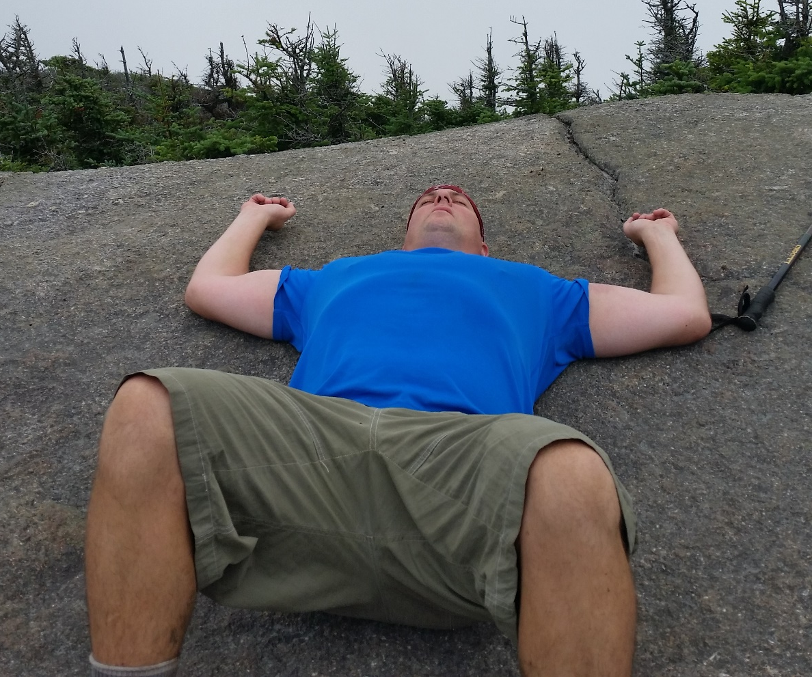
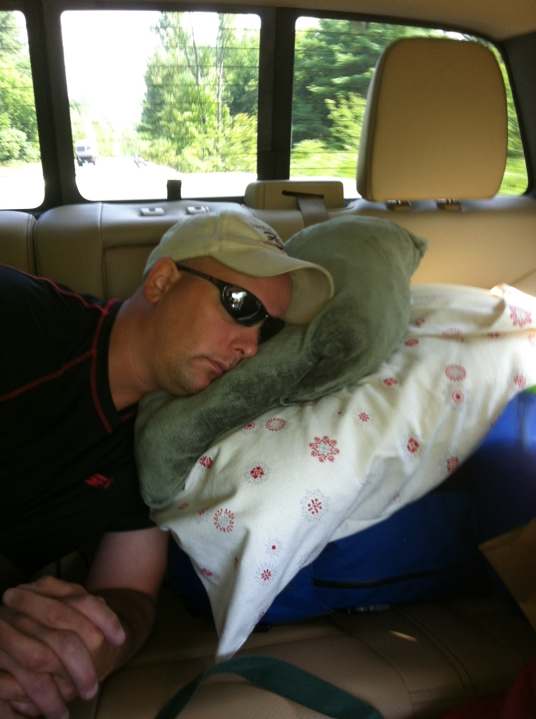
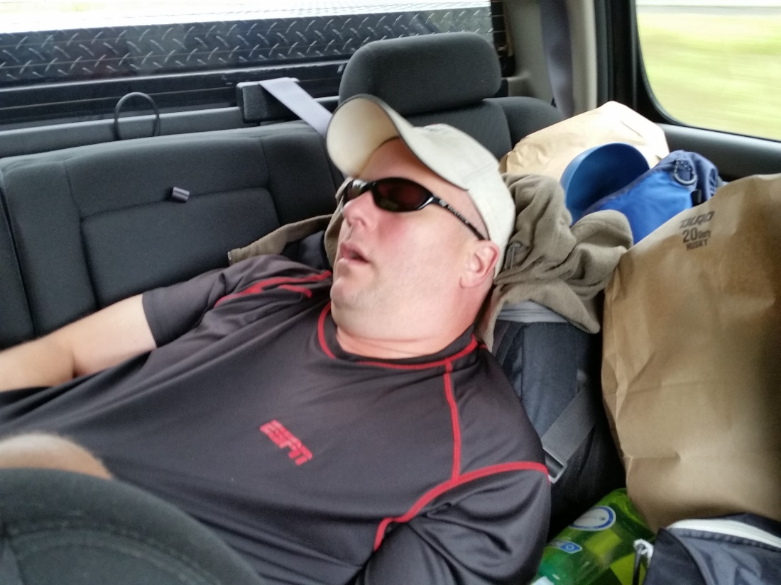

Slide 5
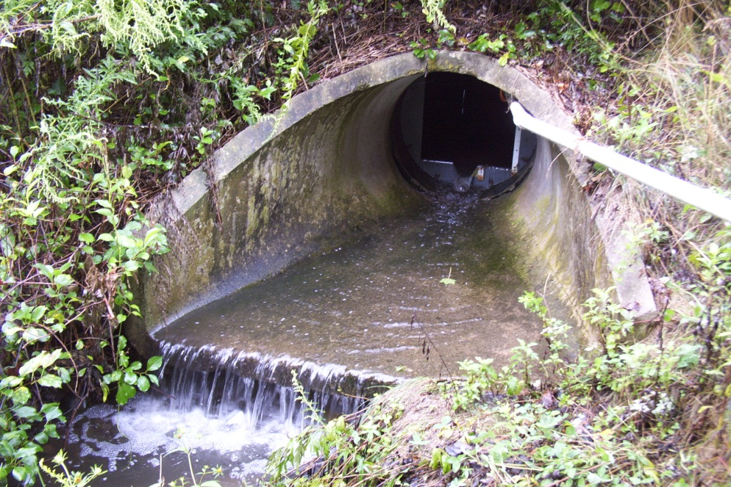
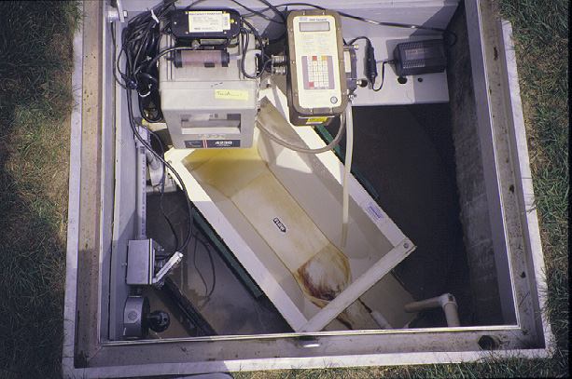
  Water quantity and quality measured downstream of 3 different subdivisions

Slide 6
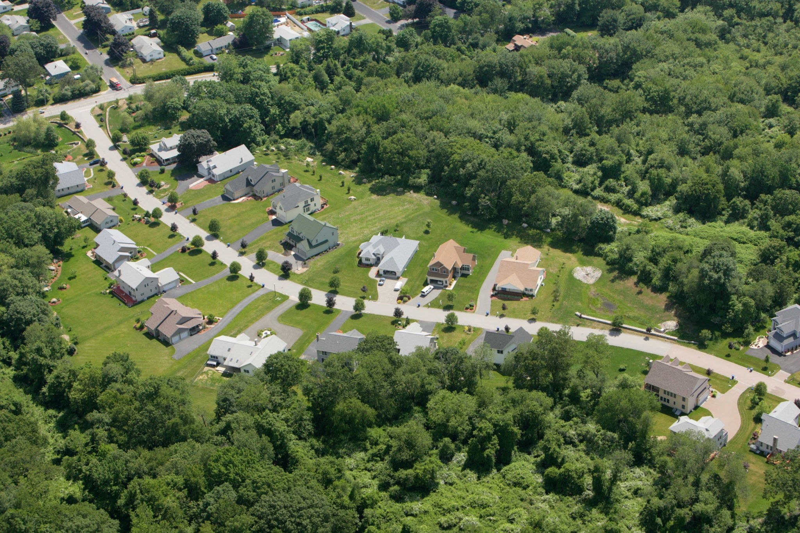
Traditional subdivision

Slide 7
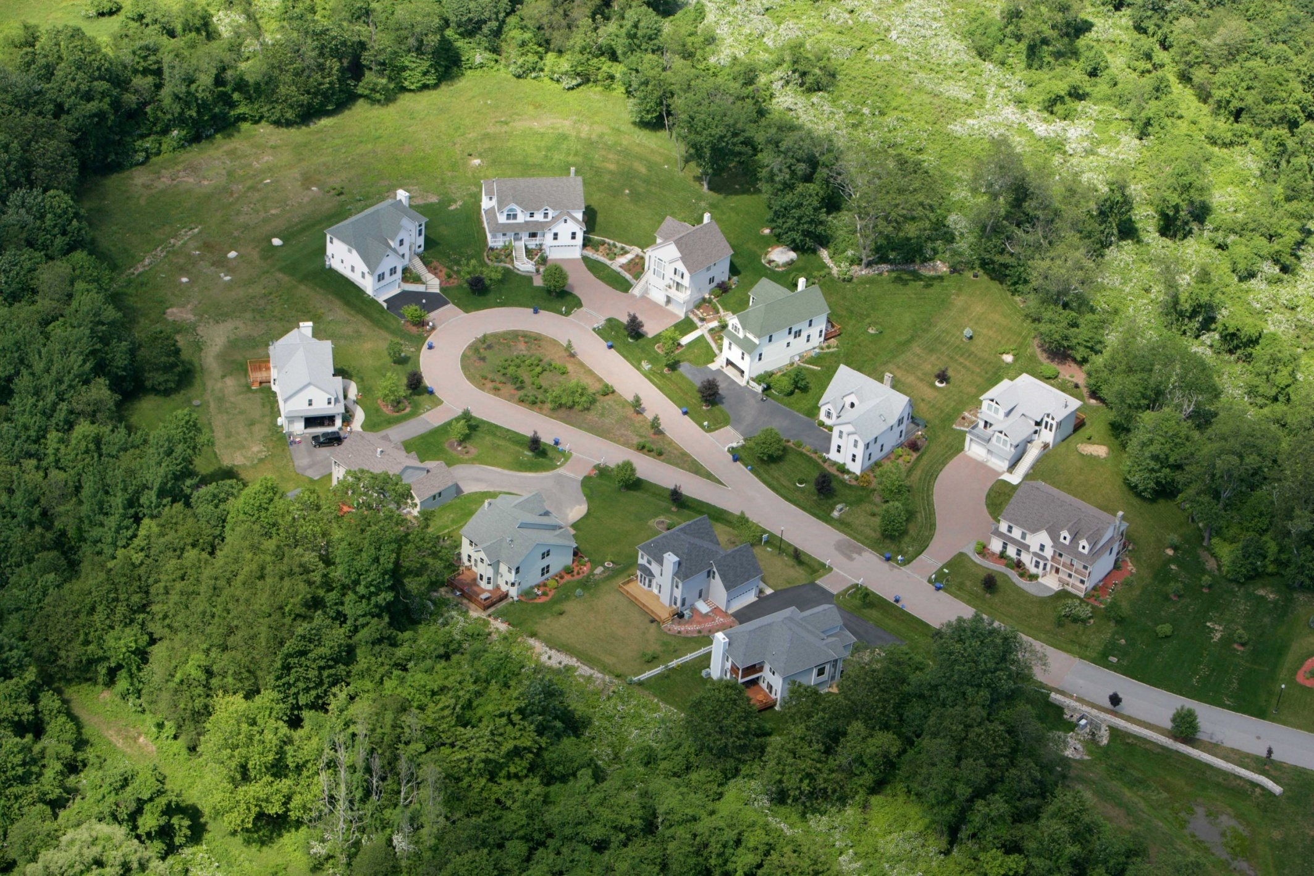
LID Subdivision
Bioretention cul-de-sac
Grassed swales
Rain gardens
Open space and low-mow area
Cluster layout with shared driveways
Pervious roadway

Slide 8
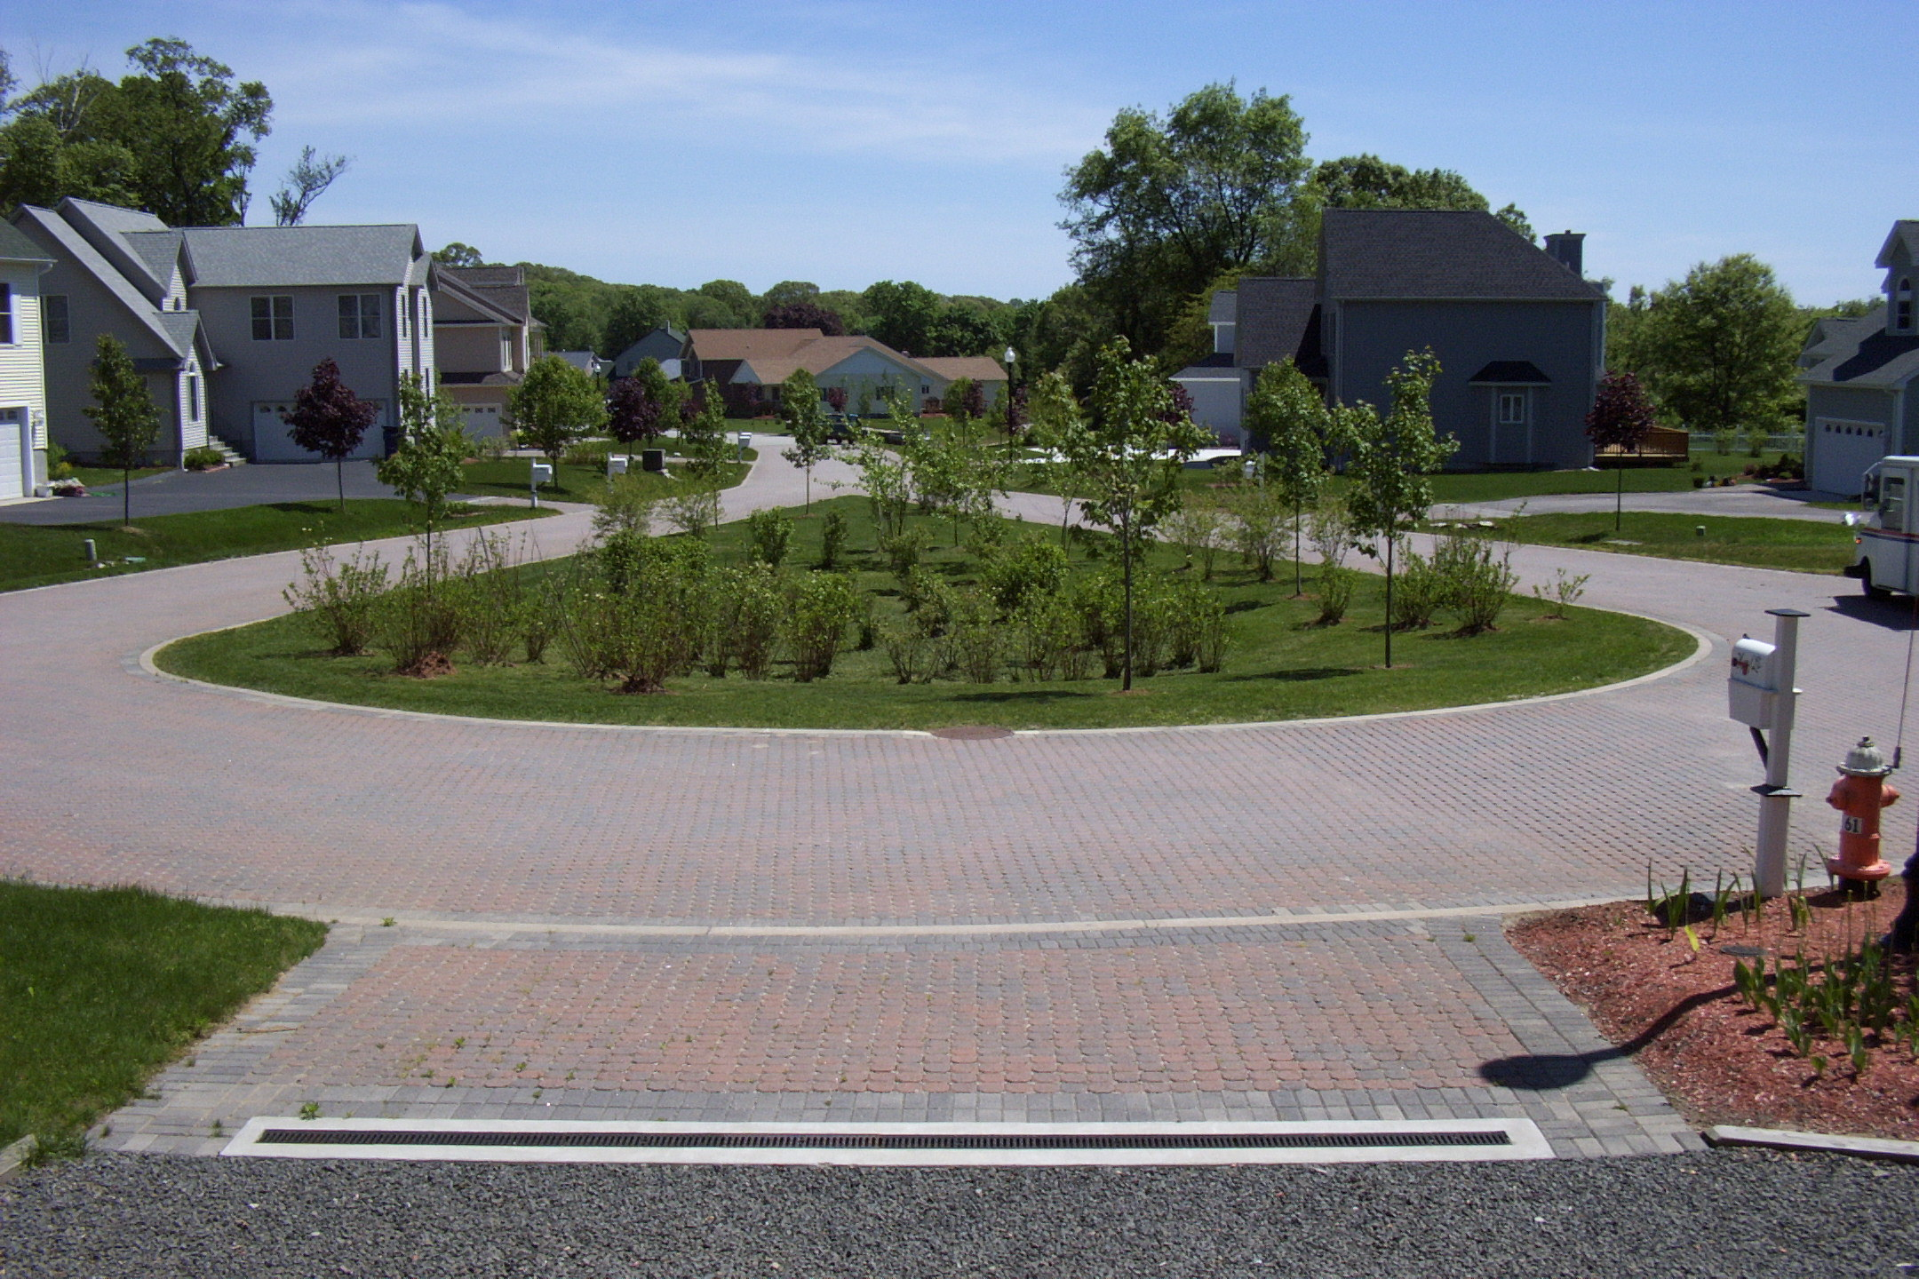

Bioretention cul-de-sac

Slide 9
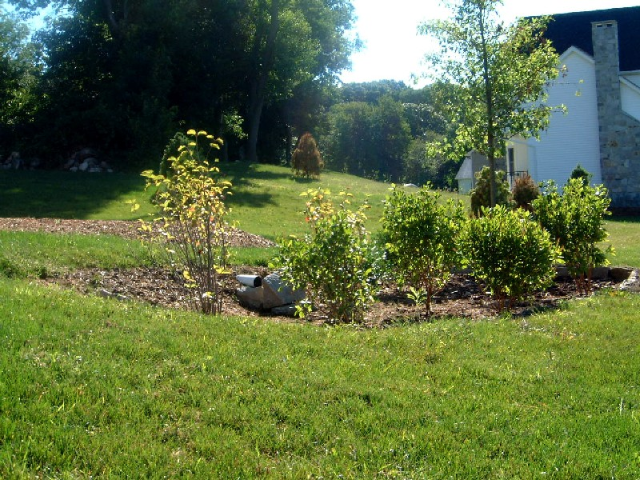
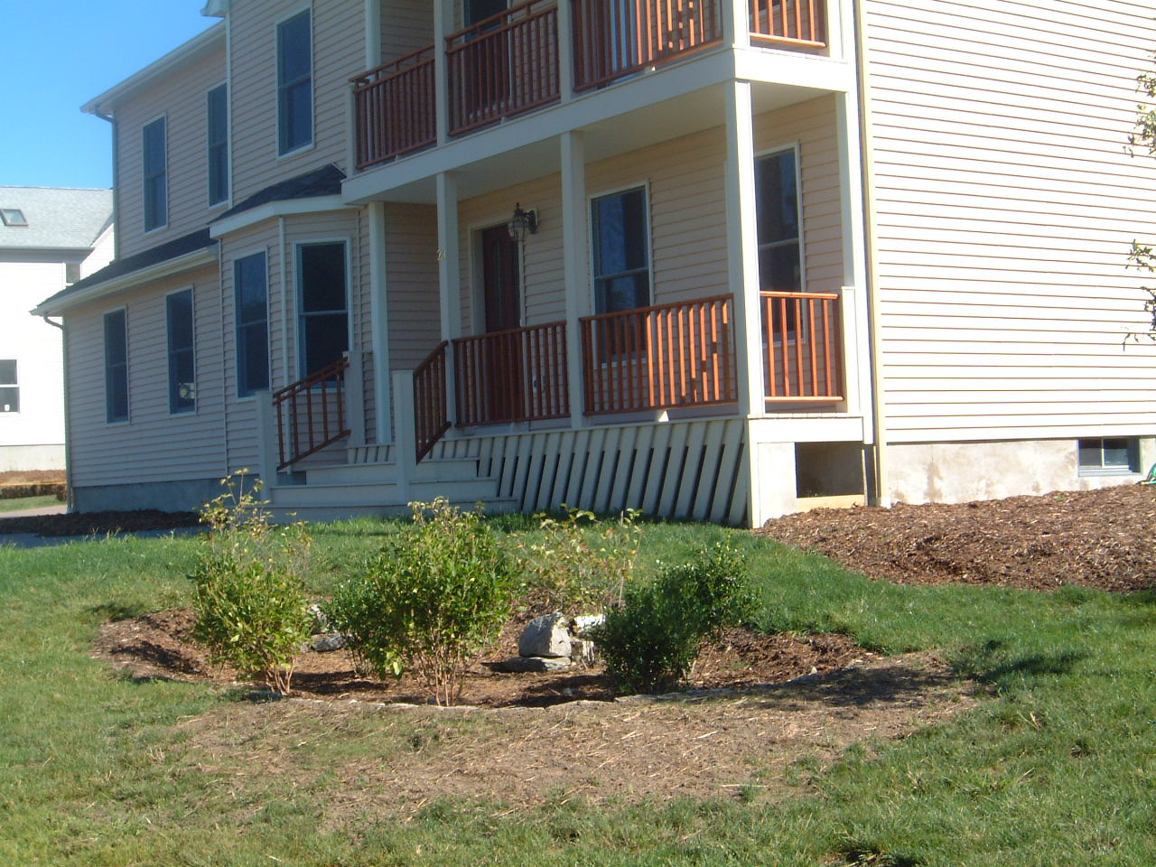
Rain gardens

Slide 10
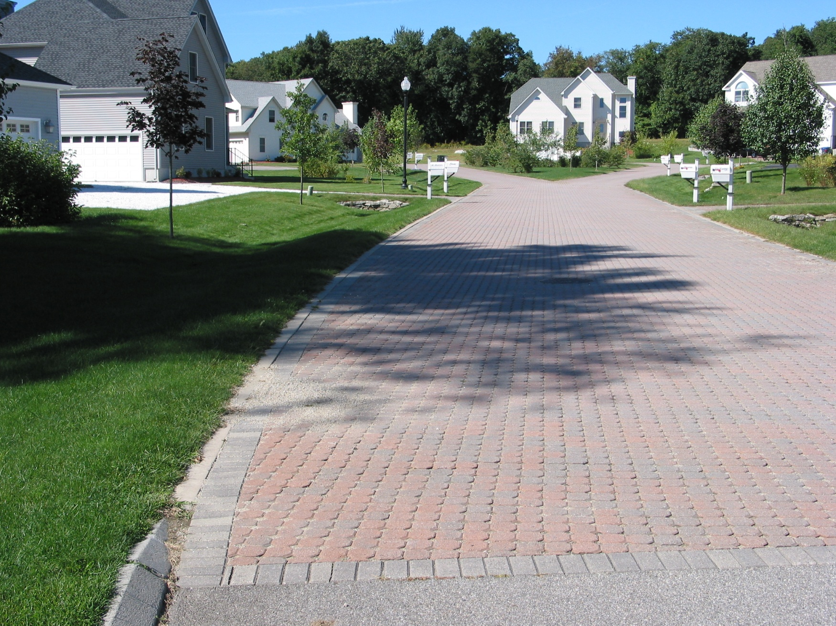
Pervious road and grassed swales

Slide 12
Runoff depth

Slide 13
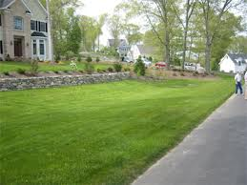

Side note on swales
Swales in right-of-way and managed by homeowners are subject to the way homeowners manage their lawns!

Slide 14
Behavior Surveys
Pets, lawn care (targeting fertilization practices), leaves, gutters
Given to all residents (control, traditional, LID)
LID residents received one-on-one education from university personnel, free soil testing, demonstrations

Slide 15

Initial surveys: ALL RESIDENTS said that they did not fertilize their lawn…but the evidence showed otherwise

Slide 16
Jordan Cove survey results
NO SIGNIFICANT DIFFERENCES IN BEHAVIOR AMONG WATERSHEDS or ACROSS YEARS
High intensity education methods DID NOT WORK here
Fortunately, stormwater and pollutant export and were much lower from the LID watershed

Slide 17
Social factor - lesson learned
People end up acting like their neighbors
Social norms theory

Slide 18

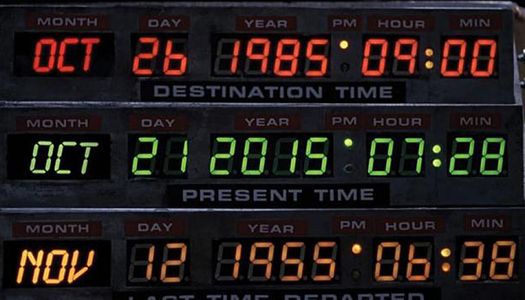


MAR

Slide 19
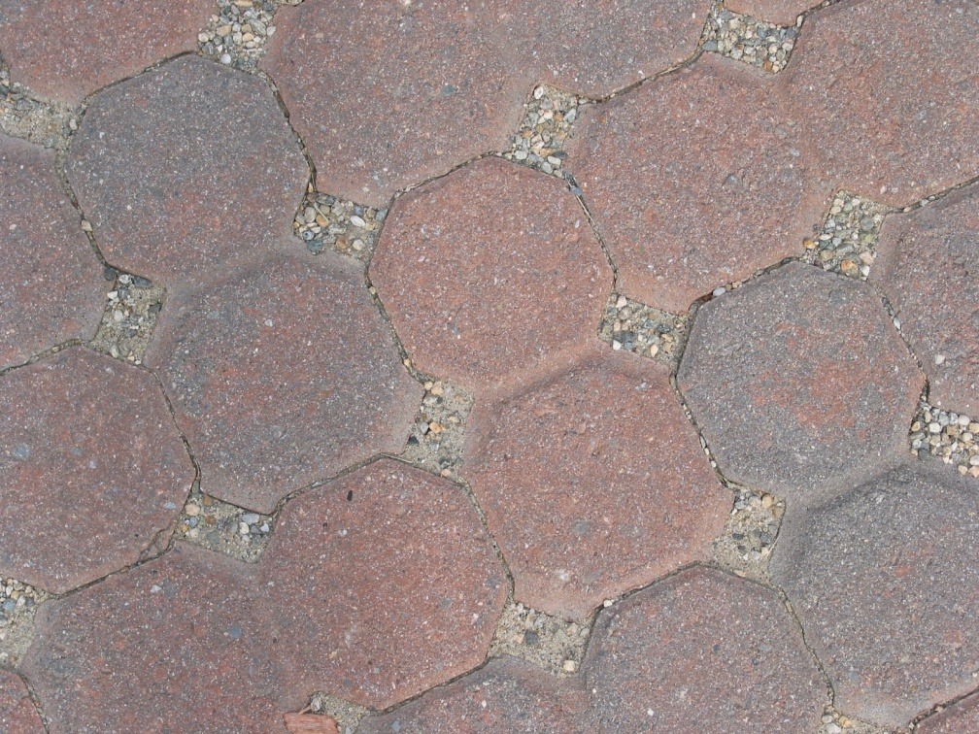
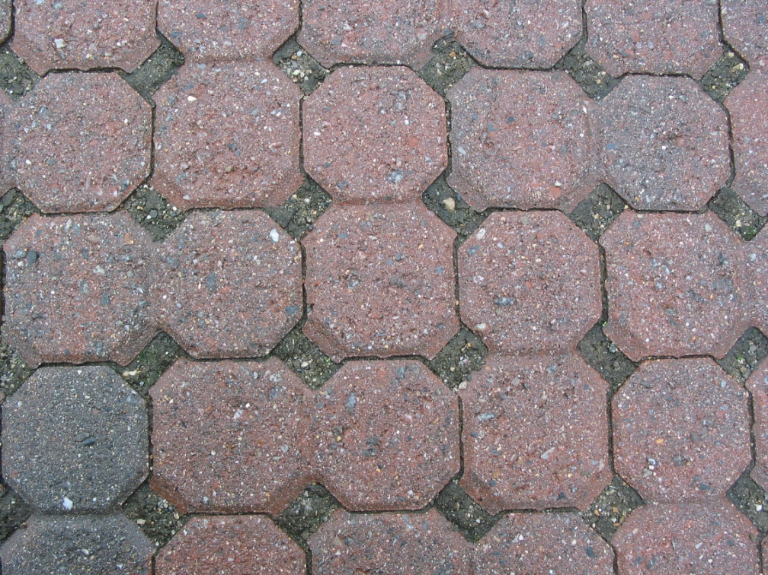
Jordan Cove
Uni-EcoStone® paver road and driveways
2002
2005

Slide 20
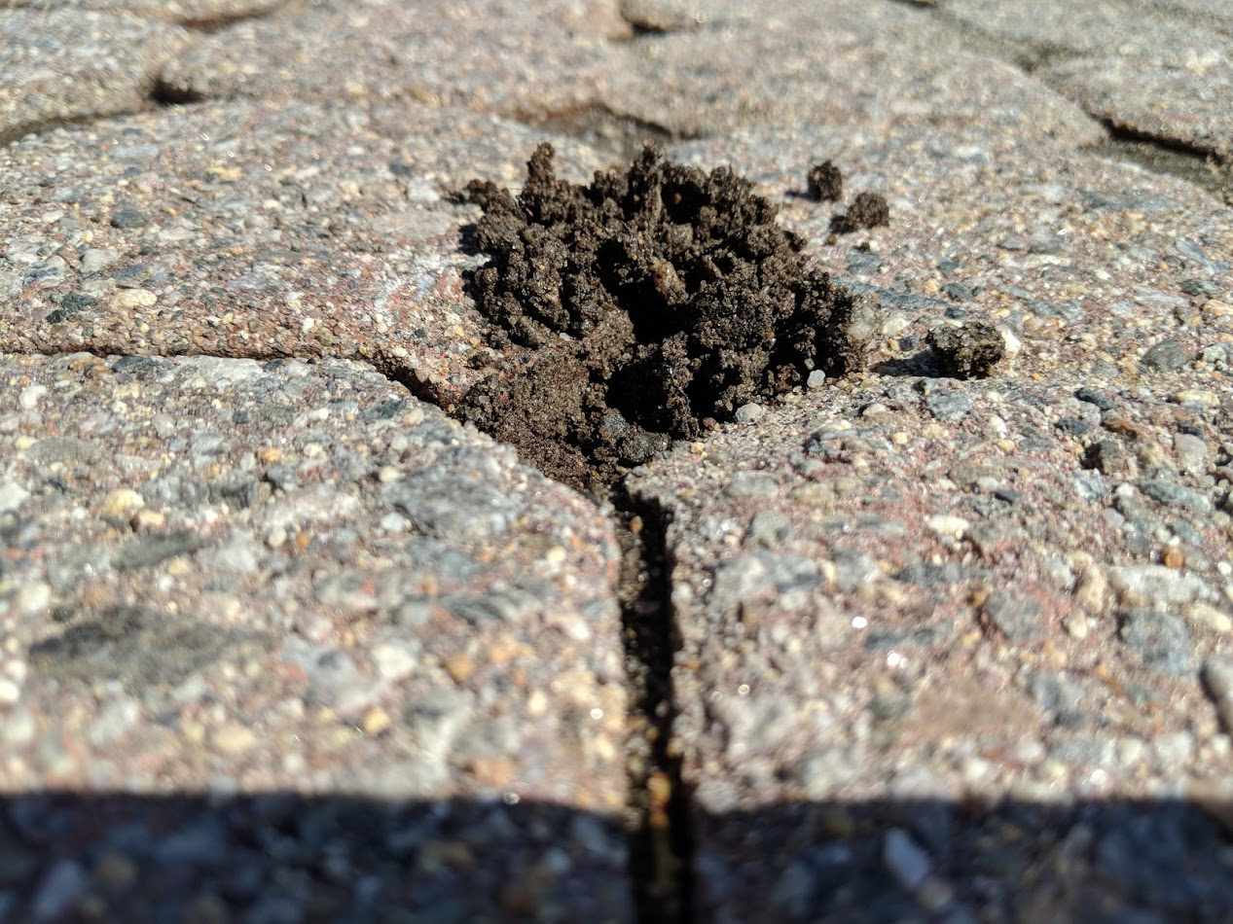
2018

Slide 21
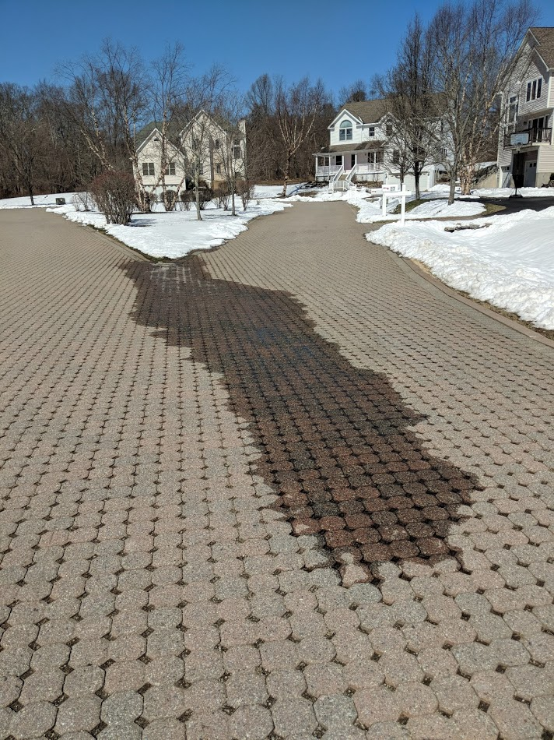
Paver road
Clogged, but still functions (1 inch per hour)
Integrity of road surface (almost 20 years old!) is amazing

Slide 22
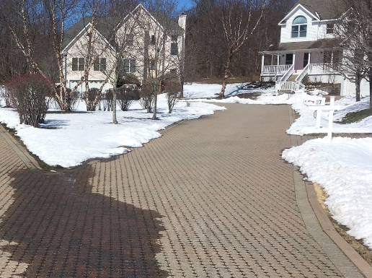
Some settling and turf dams along flush curb edge

Slide 23
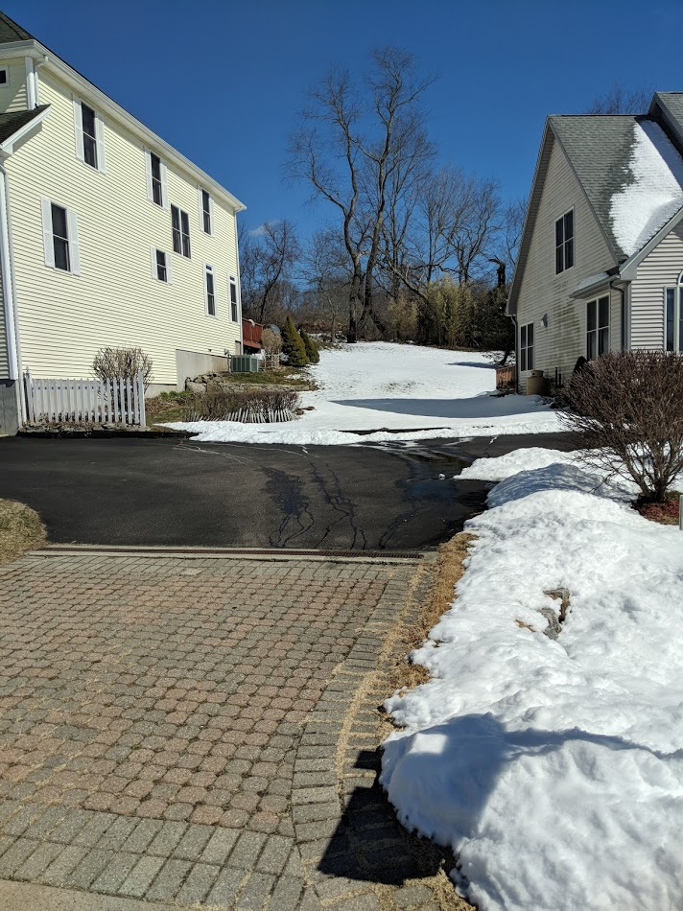
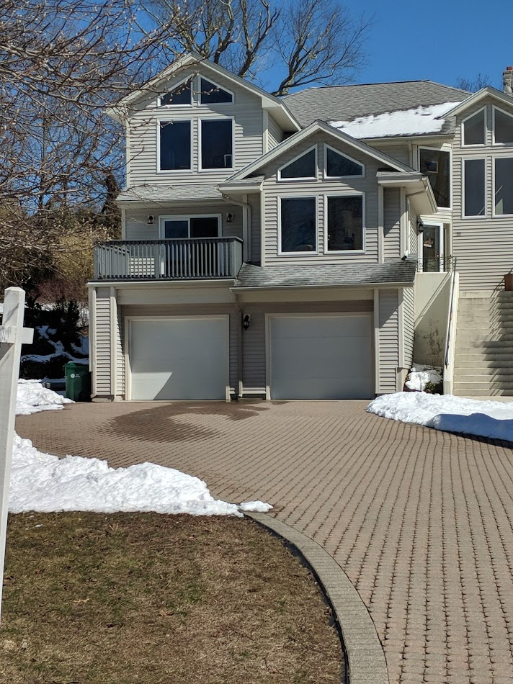
Driveway pavers still infiltrating

Slide 24
Rain gardens
8 originally installed – 6 still exist and are functional
Social norms theory??

Slide 25
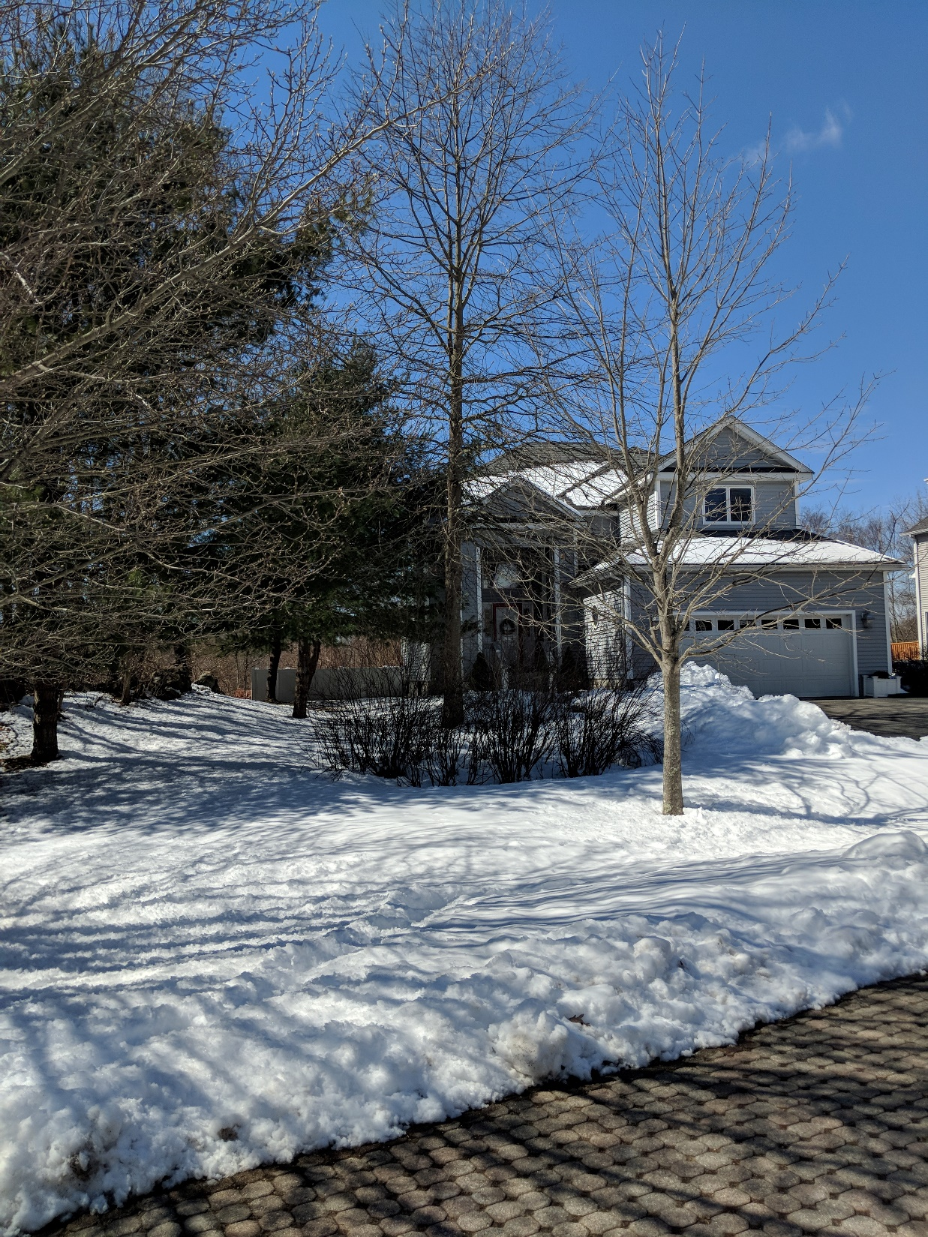
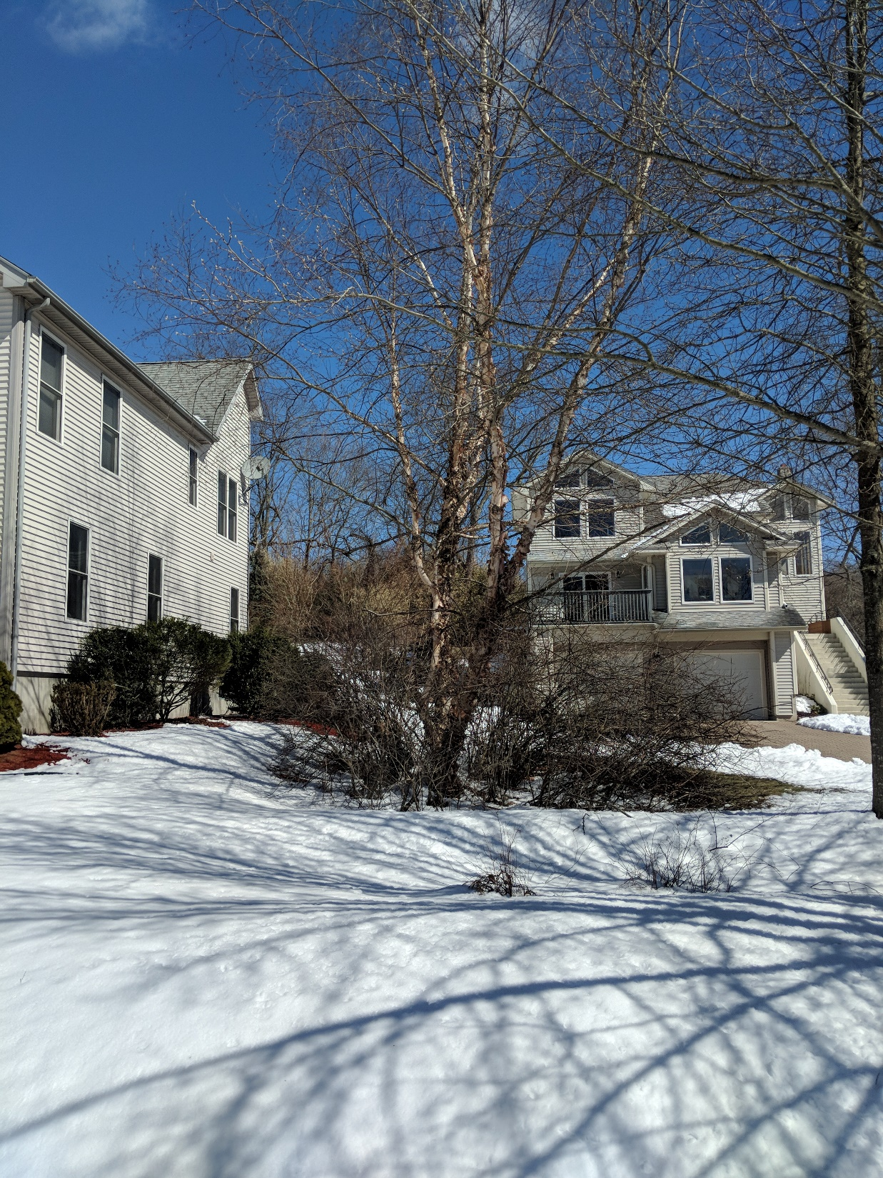
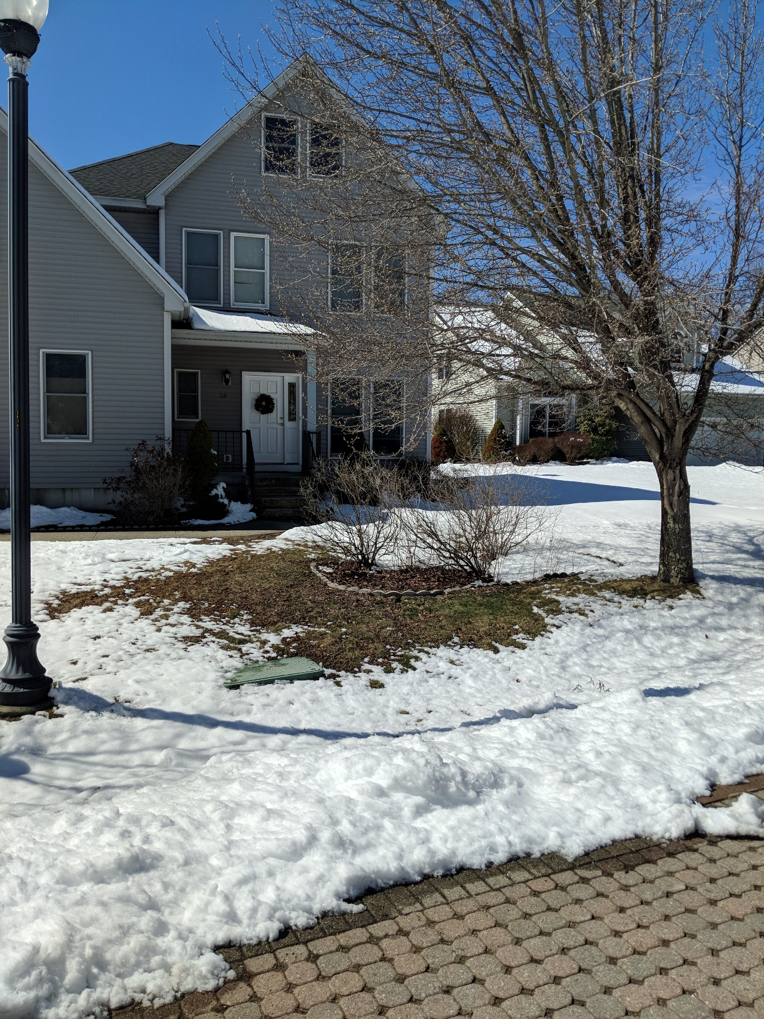
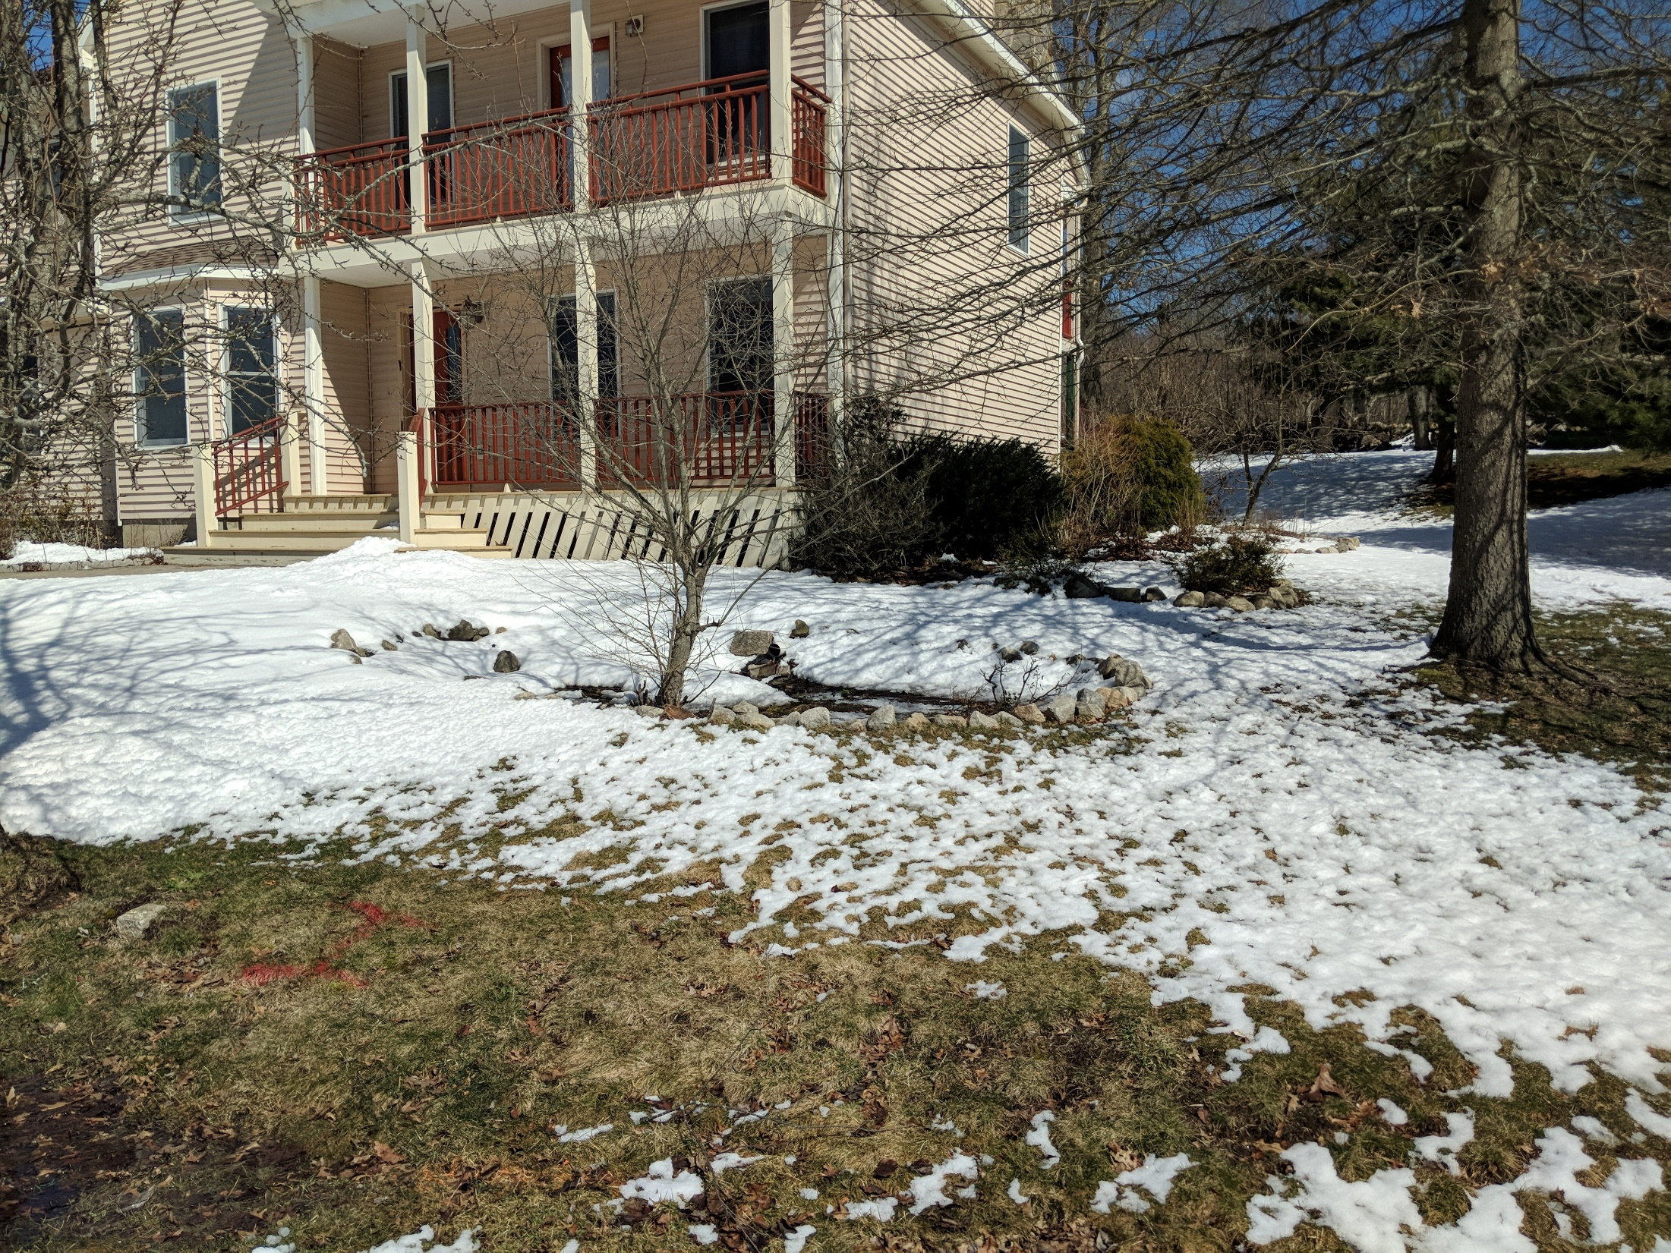

Slide 26

Cul-de-sac bioretention

Slide 27
Cul-de-sac bioretention
Either make all grass, or plant a small number of large trees
Makes maintenance easier

Slide 28
Summary
Social factors are still important
Most rain gardens still in place
No maintenance done on paver road, but it is still functioning
Some settling of road prevents water from getting into swales

Slide 29
2005 take home message:
(in spite of what people do…) http://jordancove.uconn.edu
LID works!

Slide 30
2018 take home message:
(in spite of what people do…) http://jordancove.uconn.edu
LID (mostly) STILL works!

Slide 31
Thank You! michael.dietz@uconn.edu

Slide 32
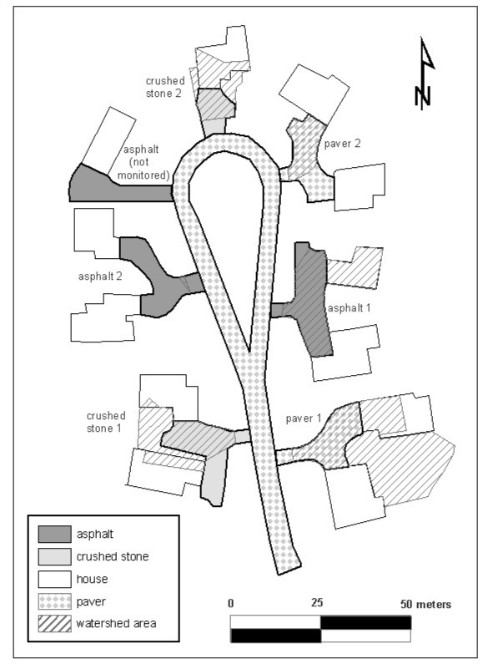
Site preparation
If soil is highly compacted, you need to remove, or loosen and aerate
  Compacted soil will cause a rain garden or bioretention area to fail
Someone “in the know” needs to be on site for installation

